Slide 1
NSWRC Operational Scenarios
October 18, 2012
Mark Weadon
AvMet Applications

Slide 2
Purpose of Operational Scenarios
Legacy requirements provide specifications of what terminal weather and airport surveillance radars do independently
The key to multi-functionality is a phased array radar engineered to meet the demands of surveillance and weather simultaneously
Use case scenarios describe actual weather and surveillance target loading on a multi-function phased array radar under stressful conditions
Sternest test for a multi-function radar is heavy air traffic coupled with complex weather in the terminal airspace

Slide 3
Methodology
Two scenarios: O’Hare International Airport (ORD) on 23-24 June 2010; Atlanta Hartsfield (ATL) on 29-30 June 2008
Both days represent peak operations at large hubs during significant weather; weather is bad, yet not so bad as to shut down airport operations
  These scenarios represent the sternest challenge for multifunction radar resource allocation: many aircraft and convective targets in the same airspace
Once a candidate day/time selected, the Weather Analysis and Visualization Environment (WAVE) tool used to develop graphics analyze actual traffic counts and weather loading within the airspace
  WAVE uses data feeds from Enhanced Traffic Management System (ETMS) for airborne targets
  Airborne targets temporally and spatially correlated with the National Convective Weather Diagnostic (NCWD)
  Aircraft counts at 5 min intervals within 110km (60nm) radius of terminals

Slide 4
Scenario #1 – O’Hare International Airport (ORD) 23-24 June 2010
Wednesday afternoon/night at an extremely busy hub
Mid-afternoon line of convection developed quickly to west, swept across airport in late afternoon at time of peak scheduled in air traffic, causing numerous delays and reroutes for inbound flights
Solid line convection with echo tops>45K ft; VIP >60dBz; numerous microbursts within the Chicago TRACON area; hail and tornados reported to south of ORD

Slide 5
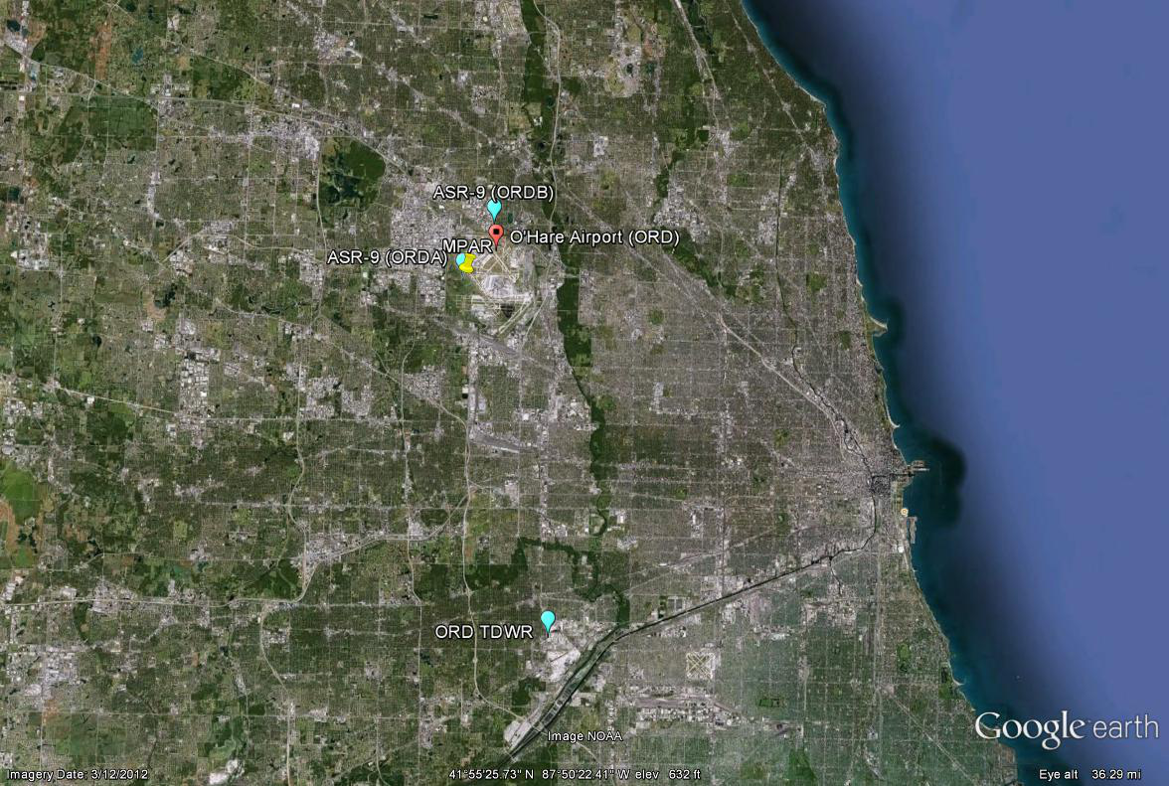
21 km

Slide 6
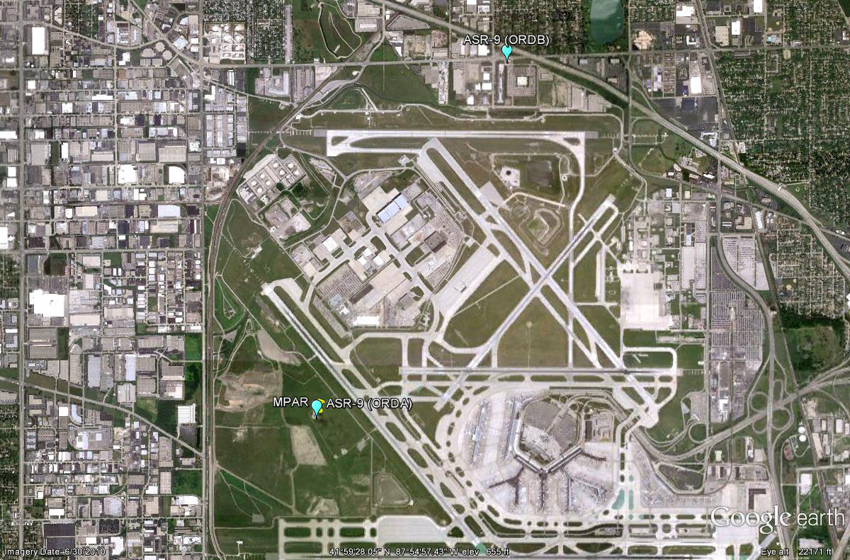

Slide 7
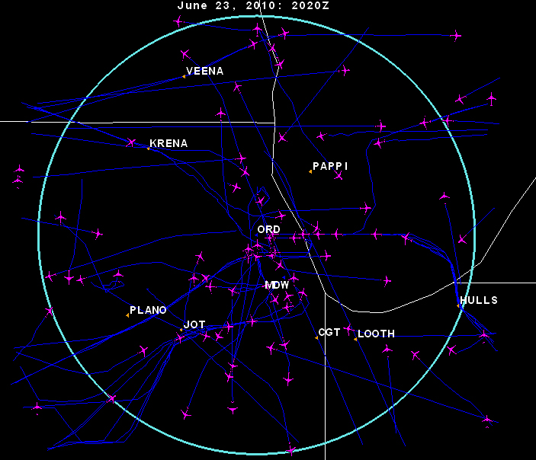
Pre-impact – 6/23/10 2020Z

Slide 8
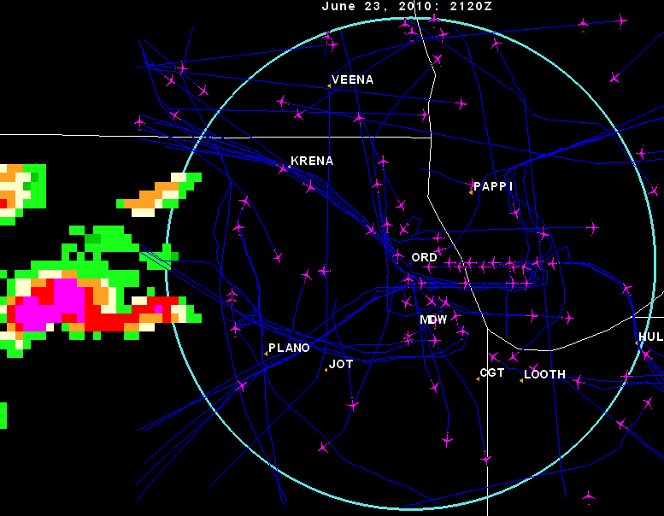
Convection Building – 6/23/10 2120Z

Slide 9
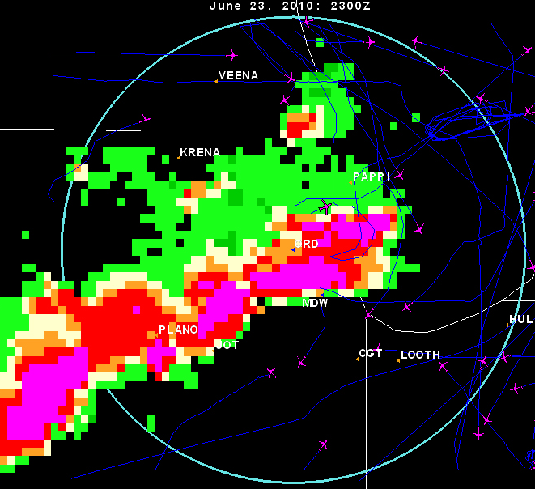
Maximum Impact – 6/23/10 2300Z

Slide 10
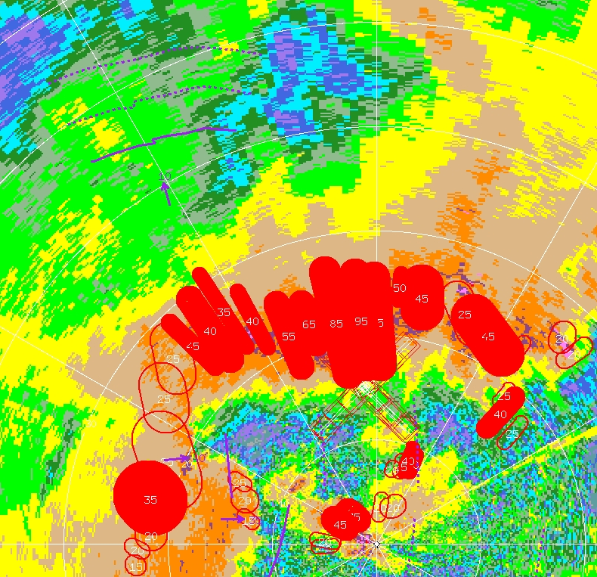
Microbursts
23 June, 2300Z,
O’Hare Airport

Slide 11
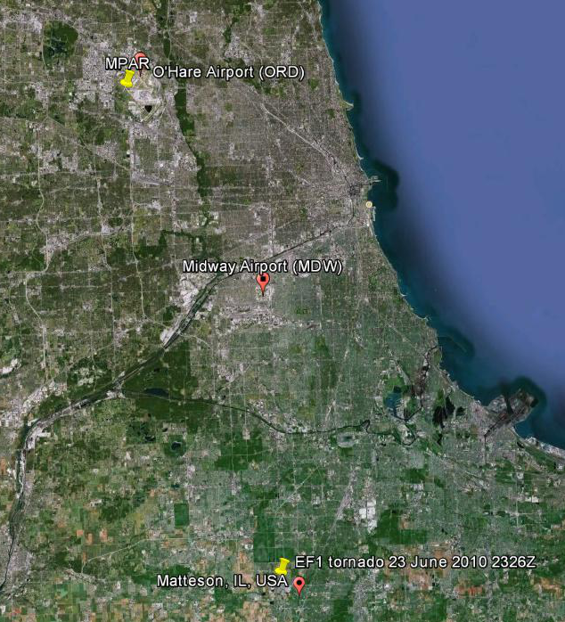
Severe Weather
23 June, 2326Z
53 km

Slide 12
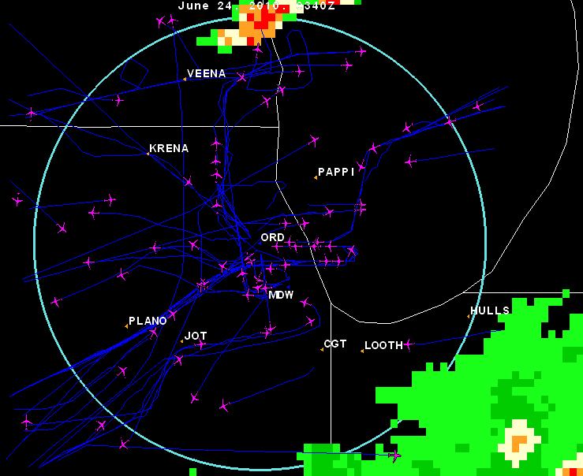
Post-impact – 6/24/10 0340Z

Slide 13
Animation
Animation shown here

Slide 14
Start of Animation
End of Animation

Slide 19
Scenario #2 – Atlanta Hartsfield Airport (ATL) 29-30 June 2008
Sunday afternoon/night into Monday morning at extremely busy hub
Mid-afternoon line of convection developed quickly, swept across airport in late afternoon at time of peak scheduled in air traffic, causing numerous delays and reroutes for inbound flights

Slide 20
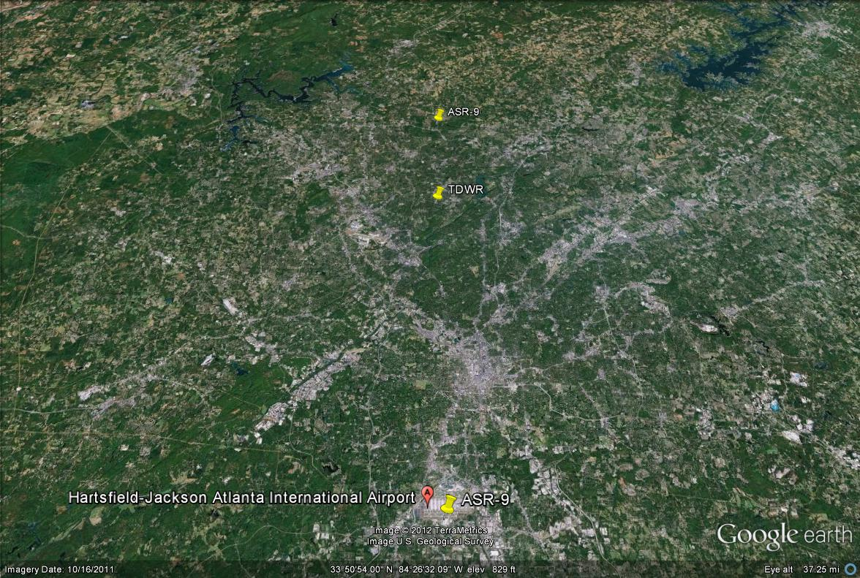
35 km

Slide 21
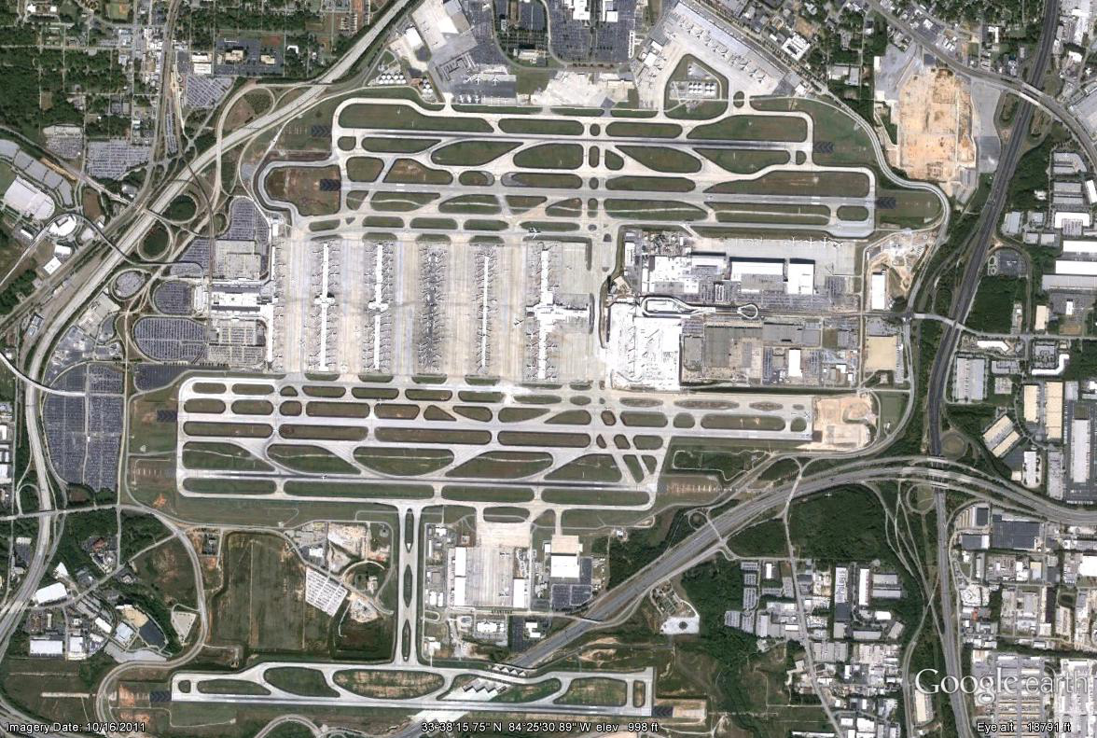
x MPAR

Slide 22
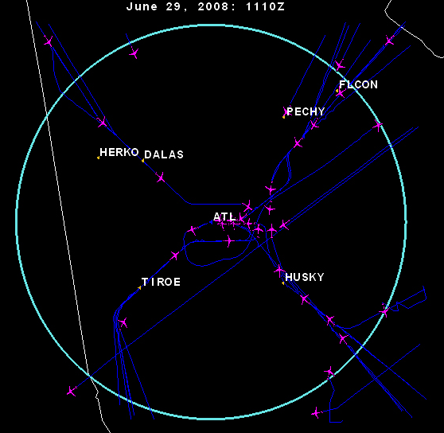
Pre-impact – 6/29/08 1110Z

Slide 23
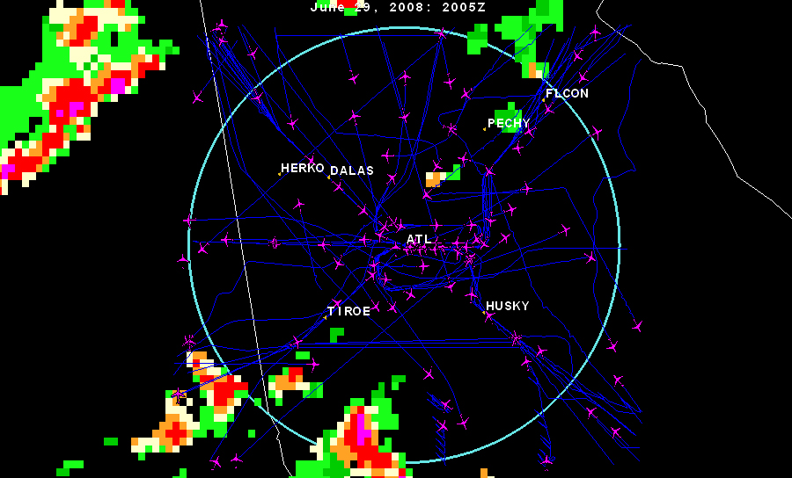
Convection Building – 6/29/08 2005Z

Slide 24
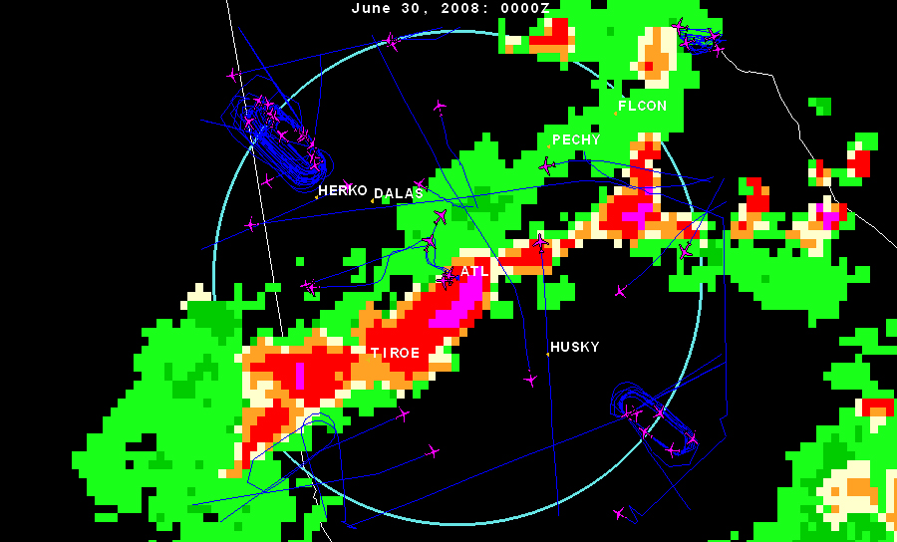
Maximum Impact – 6/30/08 0000Z

Slide 25
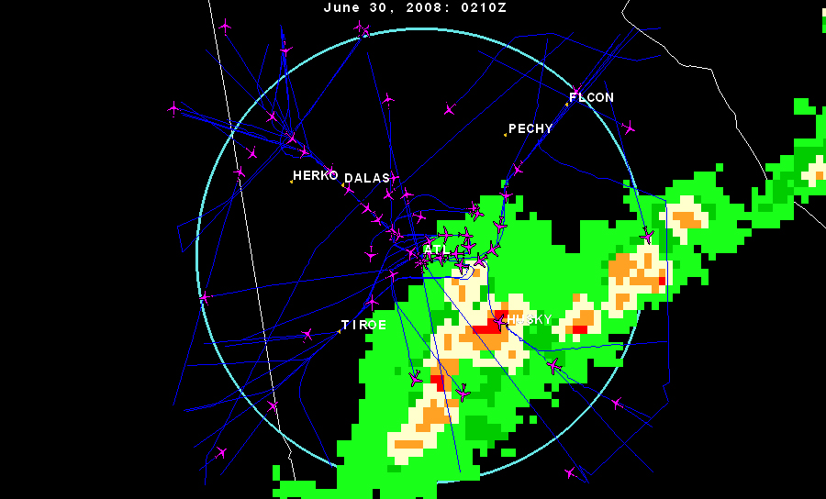
Post-impact – 6/30/08 0201Z

Slide 26
Animation
Animation shown here

Slide 27
Start of Animation
End of Animation

Slide 32
Conclusions
Each multi-function radar face is assumed to operate independently-- most stressful scenario for the MPAR is, by definition, the one that appears within the field of view of any one of its faces.
Convective activity and aircraft counts are, roughly speaking, inversely related.
The multi-function radar must be agile and have sufficient radar resources to track aircraft and weather (including severe weather and microbursts) simultaneously in the same sector.
Other, unforeseen factors may drive radar resource use even higher: i.e., non-cooperative aircraft requiring intensive tracking

Slide 33
THANK YOU

Slide 34


