Slide 1
A Future Watch/Warning Concept: Forecasting a Continuum of Environmental Threats (FACETs)
Lans P. Rothfusz¹, Paul T. Schlatter², Elliott Jacks³ and Travis M. Smith^{1,4}
¹NOAA/OAR/NSSL Norman, OK
²NOAA/NWS/AA, Silver Spring, MD
³NOAA/NWS/OCWWS, Silver Spring, MD
⁴CIMMS/University of Oklahoma Norman, OK

Slide 2
Special Thanks to…
Greg Stumpf (OU CIMMS/NWS MDL)
Russ Schneider (NWS SPC)
Chris Karstens (OU CIMMS)
John Ferree (NWS)

Slide 3
DISCLAIMER!!!!!
The concepts presented herein are under development and exploration by the National Severe Storms Laboratory.
They are NOT the accepted and adopted plans of the National Weather Service
…although NWS is partnering in the exploration.

Slide 4
FACETs Is…
a new, all-hazard watch/warning paradigm;
a framework intended to organize and guide paradigm reinvention efforts;
a vehicle for achieving several WRN goals.

Slide 5
Informing a Paradigm Shift
Refine, revise and/or reinvent.
Future Watch/Warning Paradigm
Good things we do now.
Challenges we have now.
Trajectories of science, tools and society.
First, do no harm!
Where we’re headed.

Slide 6
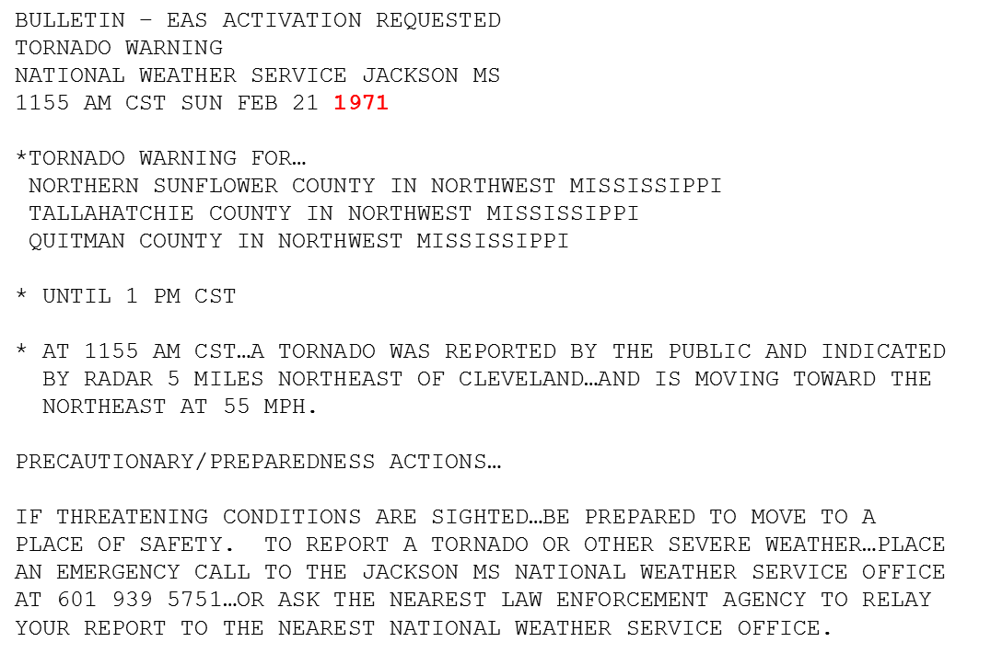
Current Watch/Warning System “Challenges”
Warning methodologies have changed little in over 40 years.
Except for “bullet format” and “storm-based” issuance.
Still deterministic (binary) and text-based.
Society has changed….
Technology
Science
Social diversity
Lifestyles
Vulnerability

Slide 7
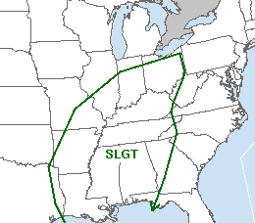
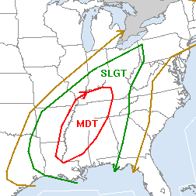
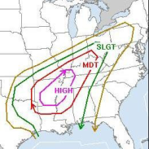
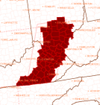
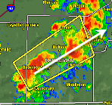
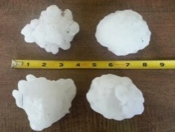
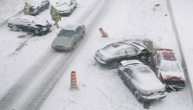
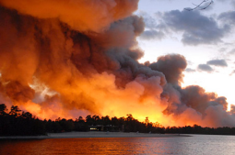
Current Watch/Warning System “Challenges”
Information Void(s)
Outlooks
Watches
Warnings
Time
Days
Hours
Minutes
Event
Needed: A Comprehensive Information Continuum for Time & Space
Space
Regional
State
Local
Product-centric, deterministic and presumptuous
More information wanted by recipients.
More information available from forecasters.
Adapted from Dr. Heather Lazrus (NCAR)
Notes:
7

Slide 8
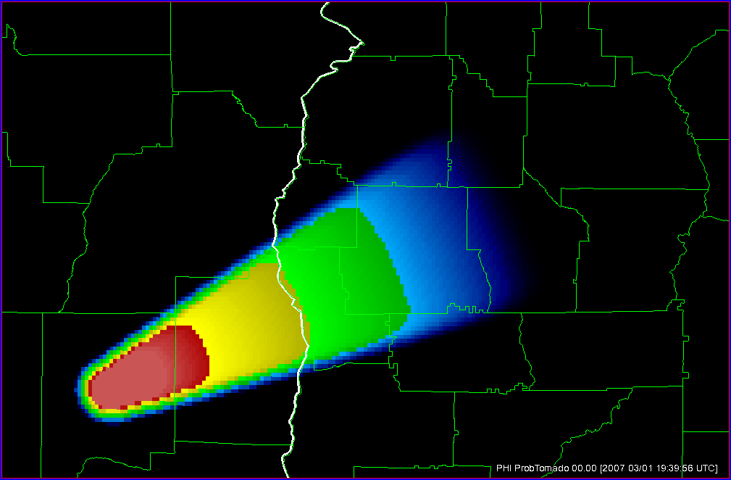
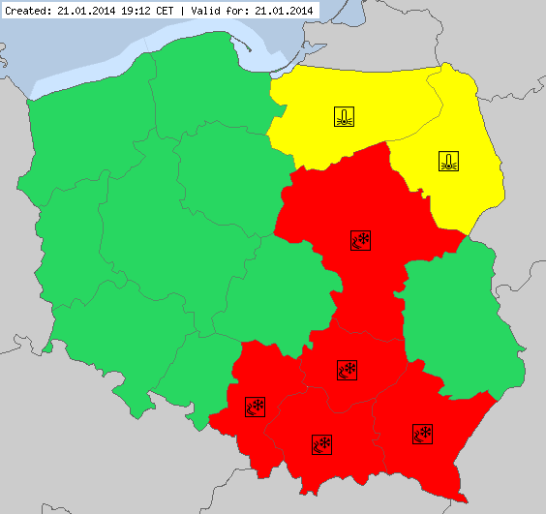
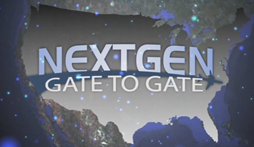
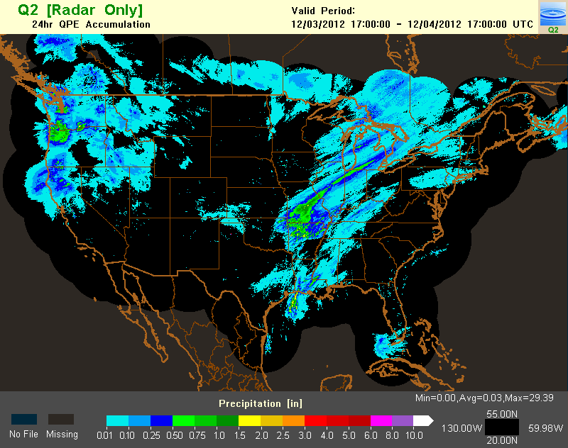
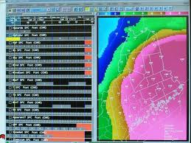
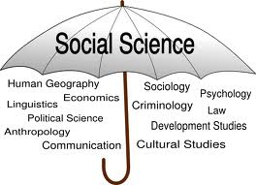
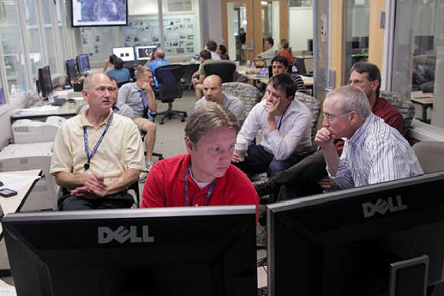
Society, Science & Tech Trajectories
Storm-scale NWP
The Grid!
NWS already on it.
But not severe ops.
Social/Behavioral sciences.
HazSimp alternatives to “Watch/Warning?”
Exploration-friendly environment.
WRN Pilot Projects
Testbeds/Proving Ground
PHI
WoF
MRMS

Slide 9
Seminal Question (inspired by WRN)
Should we continue addressing watch/warning system challenges in an ad-hoc, piecemeal manner (i.e., tinker) …
…or develop a new watch/warning paradigm that addresses the challenges comprehensively (i.e., reinvent)?
Or, perhaps a little of both?

Slide 10
Grid-Based Probabilistic Threats
Obs & Guidance
The Forecaster
Threat Grid Tools
Useful Output
Effective Response
Verification
Integrated Social Sciences
1
2
3
4
5
6
7

Slide 11
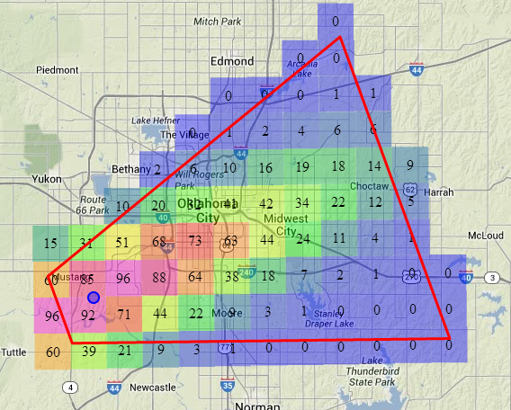
Facet #1: Grid-Based Probabilistic Threats
Grid-Based Probabilistic Threats
30-Minute Threat: Tornado Probability
Valid 10:00 p.m. - 10:30 p.m. CDT
Last updated: 2 minutes ago
1
Probabilistic Hazard Information (PHI)
Forecasters convey threat probability on grids.
NOT (explicitly) watches or warnings, but…

Slide 12
Facet #1: Grid-Based Probabilistic Threats
Grid-Based Probabilistic Threats
30-Minute Threat: Tornado Probability
Valid 10:00 p.m. - 10:30 p.m. CDT
Last updated: 2 minutes ago
1
Legacy products (warnings/watches) result from pre-determined thresholds.
Opens the door for new products and services.
For ALL weather hazards (not just tornadoes)!!
Proximity (Yellow)
Alert??
“Byproduct”
Tornado Warning

Slide 13
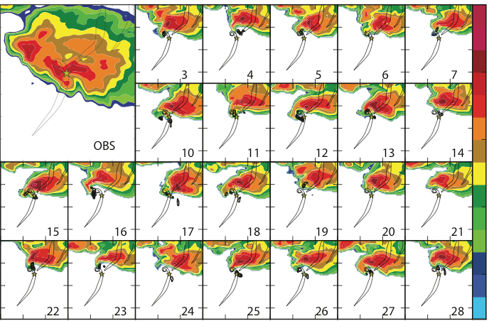
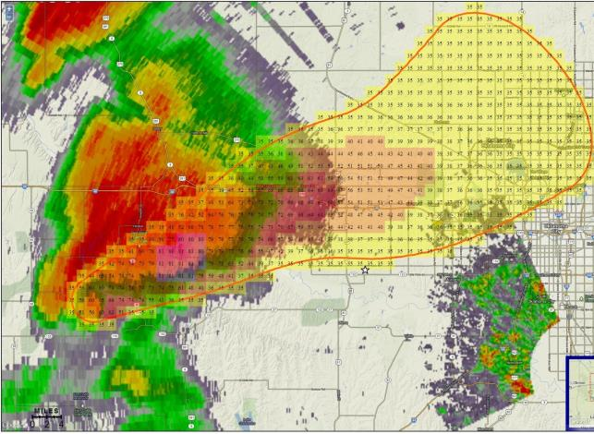
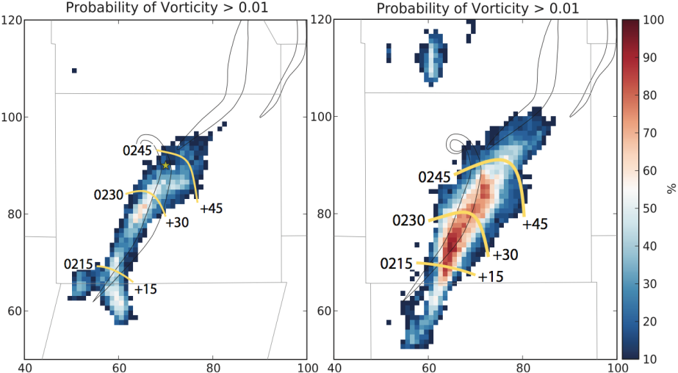
Facet #2: Obs & Guidance
Obs & Guidance
What forecasters use to make decisions.
Radars, satellites, observations, models, etc.
Warn on Forecast
Output from storm-scale NWP… then what?!
FACETs is the “delivery mechanism” for WoF-generated probabilistic output.
2

Slide 14
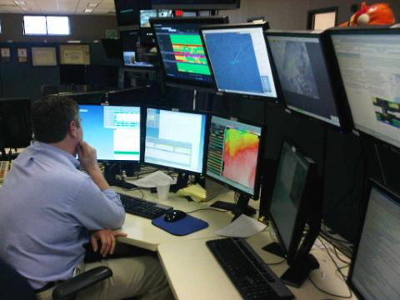
Facet #3: The Forecaster
The Forecaster
3
New paradigm = New (extensive) training.
Involved in EVERY facet, especially…
Interpreting and decision making (Obs & Guidance; Facet #2)
Decision supporting (Useful Output Facet; Facet #5).
As essential as ever to the entire warning process.

Slide 15
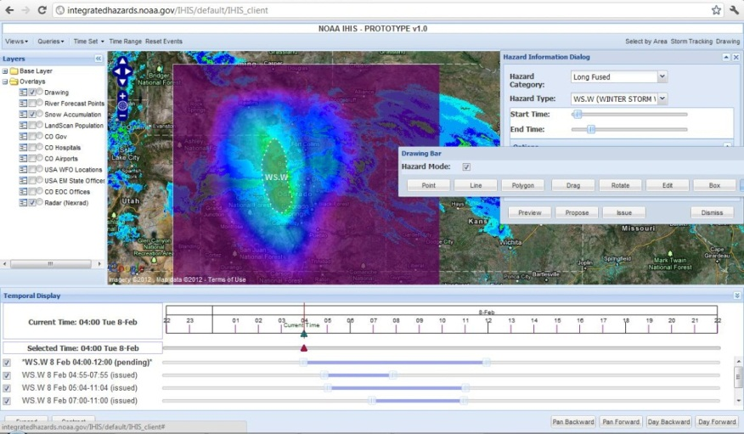
Facet #4: Forecast Tools
Threat Grid Tools
4
Global Systems Division (GSD)’s “Hazard Services” AWIPS-II tool.
Multi-phenomenon threats.
Working with NSSL on science-based “Recommenders.”
More than just grid editing for severe ops!!

Slide 16
Facet #5: Useful Output
Useful Output
5
30-Minute Threat: Tornado Probability
Valid 10:00 p.m. - 10:30 p.m. CDT
Last updated: 2 minutes ago
Watches and warnings, yes!
But more precise, with a continuous stream of threat information.
Copious private sector opportunities.
Examples follow…
“Byproduct”
Tornado Warning

Slide 17
Facet #5: Useful Output
Tornado Probability

Slide 18
Facet #5: Useful Output
Useful Output
Tornado
Threat
Meter
5

Slide 19
Facet #5: Useful Output
Useful Output
5
Until
6:45 p.m.
Last Update
6:15 p.m.
Until
5:30 p.m.
Last Update
5:00 p.m.
High
Act Now!
Act Now!
Med
Low
Example (Private Sector) Phone App

Slide 20
Facet #5: Useful Output
Useful Output
5

Slide 21
Facet #6: Effective Response
Effective Response
6
Employ social/behavioral science insights into ensuring the most effective response.
“Learn how people respond to weather information & threats, accept that reality, and then build the system to work within that reality and still achieve the desired outcomes.” – Jeff Lazo
Today’s Town Hall Meeting…
Social Science and a New Watch/Warning Paradigm: What Can We Apply and What Is Still Unknown?
12:15 PM-1:15 PM in Room C205.

Slide 22
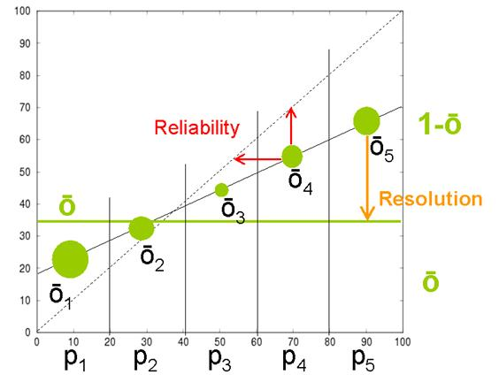
Facet #7: Verification
Verification
7
Forecasts and observations on the same coordinate system: A geospatial grid.
Statistically-valid and scientifically-robust results suitable for system improvement & research.
Not just forecast verification!
Verify “Effectiveness of Response,” too.
From ECMWF and Allan Murphy

Slide 23
& :The Connections
 |  | Applicable Facet
 | Category of Challenge | #1 Method | #2 Obs/Guid | #3 Fcstr | #4 Tools | #5 Output | #6 Response | #7 Verif
Norman Meeting | 1. Soc/Phys Sci Integration | ✓ | ✓ | ✓ | ✓ | ✓ | ✓ | ✓
 | 2. FAR Reduction | ✓ | ✓ | ✓ |  |  | ✓ | ✓
 | 3. Dissemination | ✓ | ✓ |  | ✓ | ✓ | ✓ | ✓
 | 4. Modeling |  | ✓ | ✓ | ✓ |  | ✓ | ✓
 | 5. Outreach & Education | ✓ |  |  | ✓ | ✓ | ✓
 | 6. Service Assessments |  |  |  |  |  | ✓ | ✓
 | 7. Resilience Coalition |  |  |  |  | ✓ | ✓ | ✓
 | 8. Warning Process | ✓ | ✓ | ✓ | ✓ | ✓ | ✓ | ✓
Birmingham Meeting | 1. Physical Understanding |  |  | ✓ |  |  | ✓ | ✓
 | 2. Warning Process | ✓ | ✓ | ✓ | ✓ | ✓ | ✓ | ✓
 | 3. Response |  |  |  |  | ✓ | ✓ | ✓
 | 4. Population Differences |  |  |  |  |  | ✓
 | 5. Household Preparedness |  |  |  |  |  | ✓
 | 6. Planning |  |  |  |  |  | ✓
 | 7. Warning Economics | ✓ | ✓ | ✓ | ✓ | ✓ | ✓ | ✓
 | 8. Safe Rooms |  |  |  |  |  | ✓
 | 9. Organizational | ✓ | ✓ | ✓ | ✓ | ✓ | ✓ | ✓
WRN-Identified Projects | A. Physical Understanding |  | ✓ | ✓
 | B. Wind & Buildings
 | C. Polygonology | ✓ | ✓ | ✓ | ✓
 | D. False Alarms | ✓ | ✓ | ✓ |  | ✓ | ✓ | ✓
 | E. Warning Channel & Response | ✓ | ✓ | ✓ | ✓ | ✓ | ✓ | ✓
 | F. Warning Message Experiments | ✓ | ✓ | ✓ | ✓ | ✓ | ✓ | ✓
 | G. Preparedness |  |  |  |  | ✓ | ✓
 | H. Vulnerable Population |  |  |  |  | ✓ | ✓
 | I. Planning & Recovery |  |  |  |  |  | ✓
 | J. Mitigation |  |  |  |  |  | ✓
 | K. Warning Valuation |  |  |  |  | ✓ | ✓ | ✓
 | L. SocSci Course |  |  | ✓

Slide 24
In Summary…
FACETs is…
a new, all-hazard watch/warning paradigm (grid-based, probabilistic threats) redesigned with social/behavioral science infused;
a framework intended to organize and guide reinvention efforts;
a vehicle for achieving several WRN goals;
under development and awaiting your input, suggestions, concerns and collaboration (e.g., HWT)!

Slide 25
Lans P. Rothfusz
National Severe Storms Laboratory
lans.rothfusz@noaa.gov
678-665-7049
Grid-Based Probabilistic Threats
Obs & Guidance
The Forecaster
Threat Grid Tools
Useful Output
Effective Response
Verification
Integrated Social Sciences
1
2
3
4
5
6
7

