Slide 1
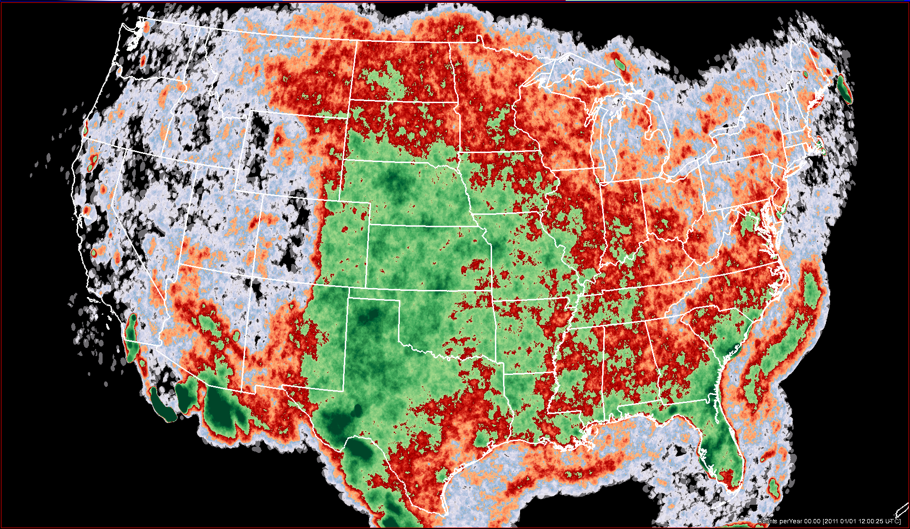
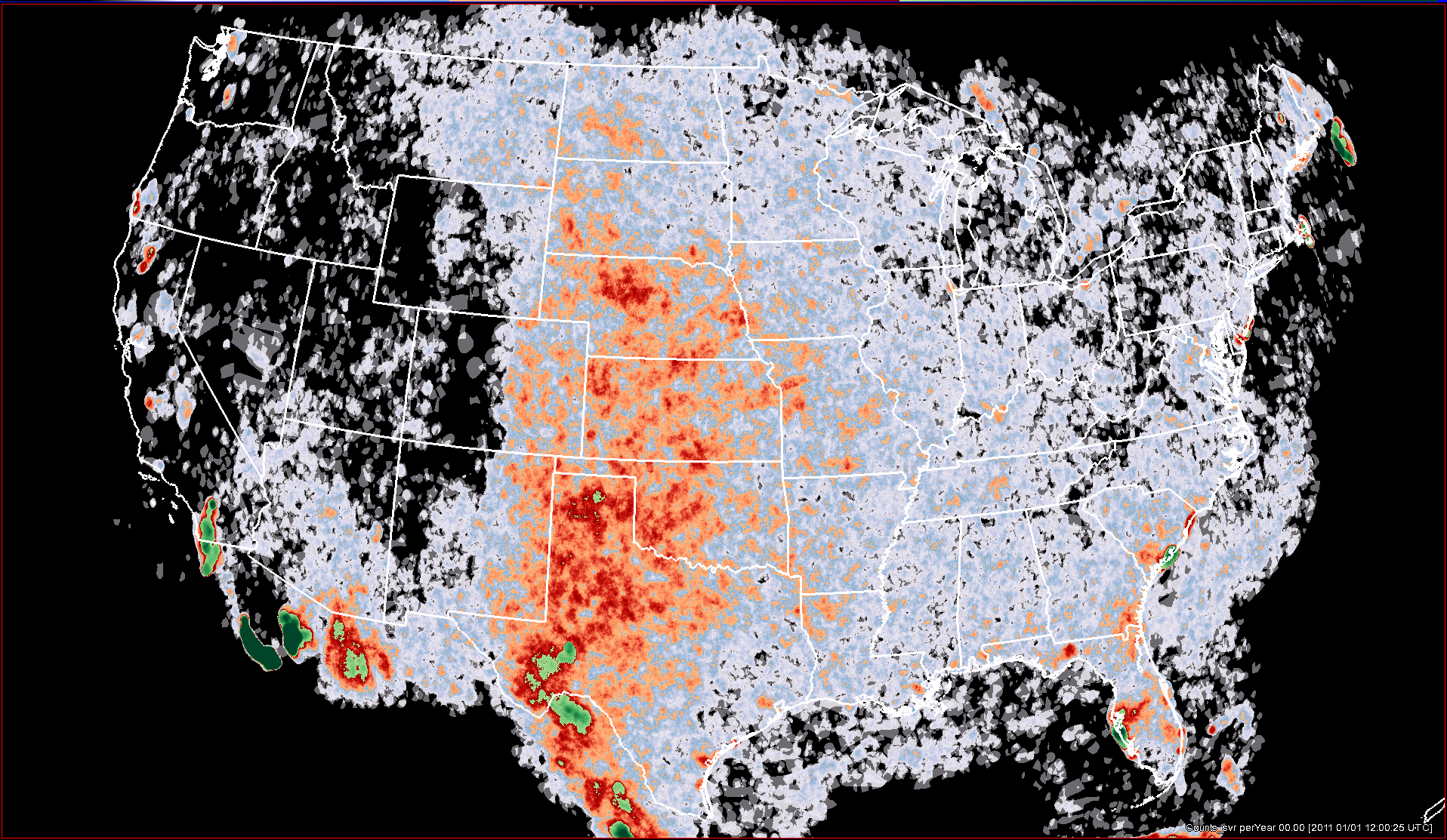
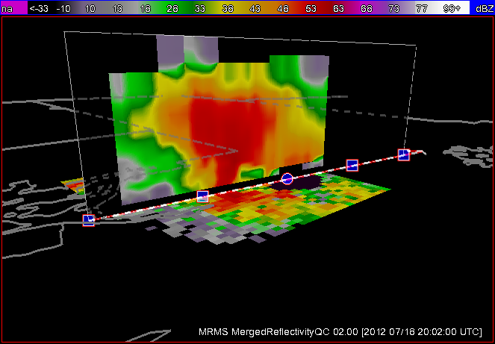
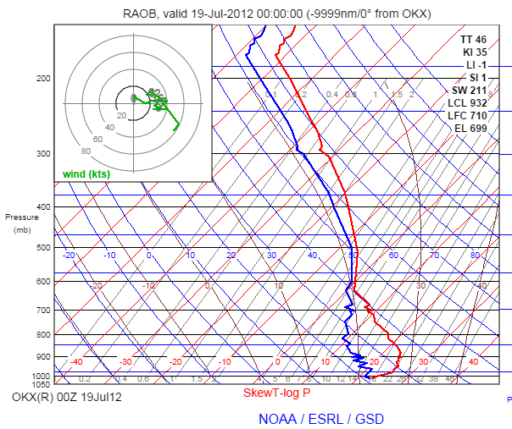
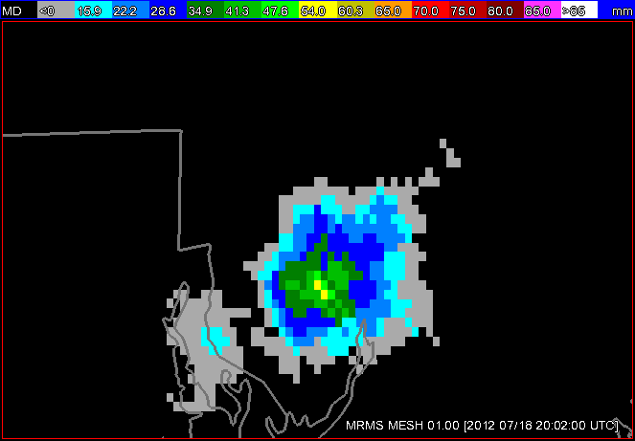
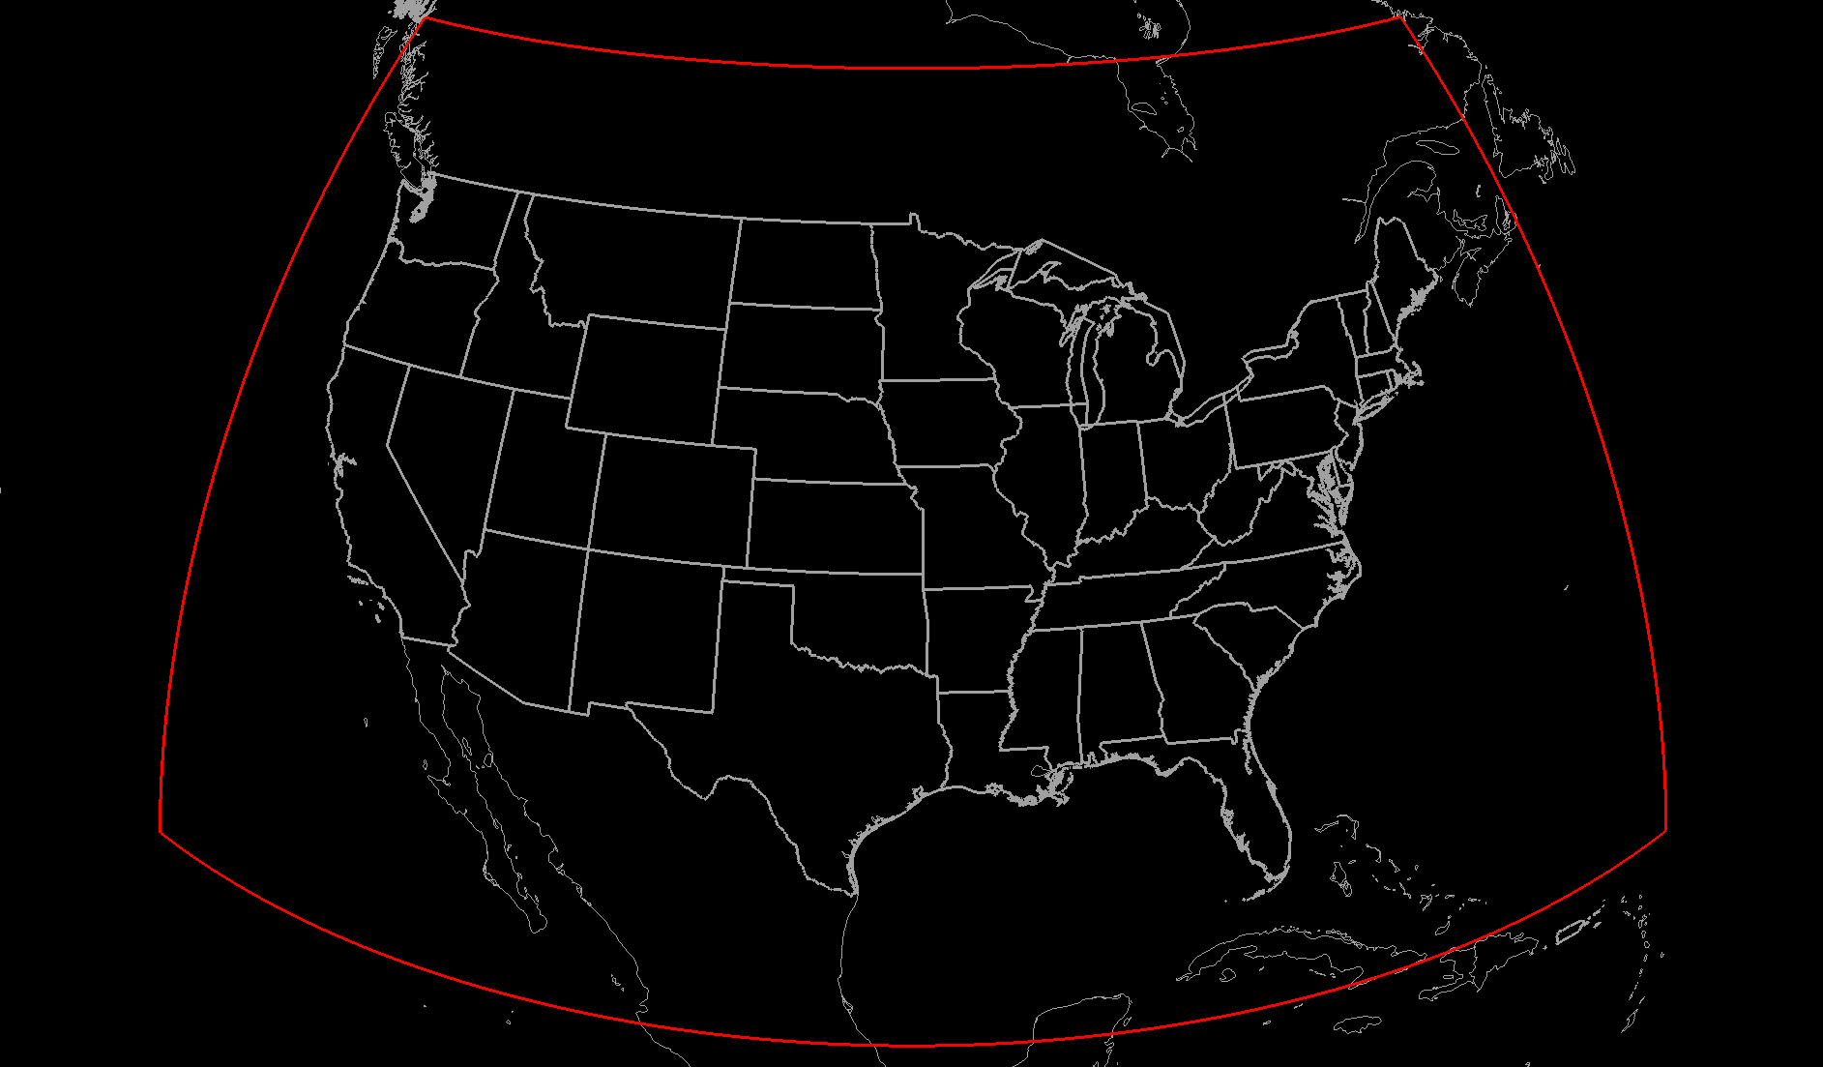
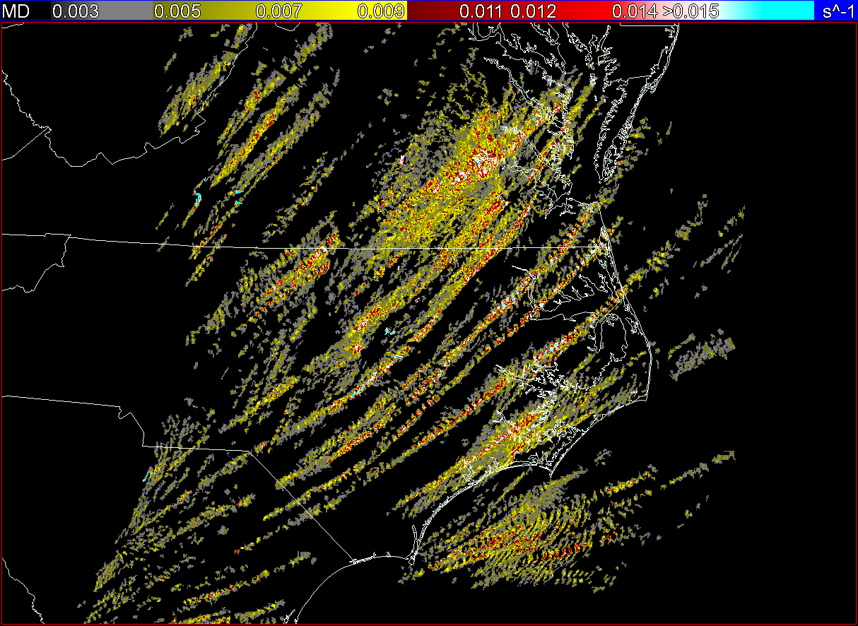
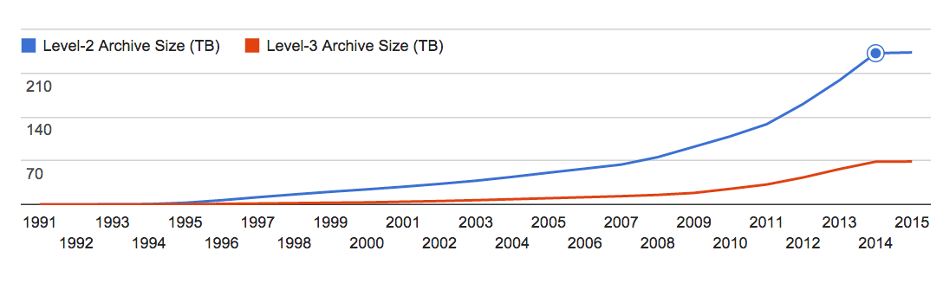
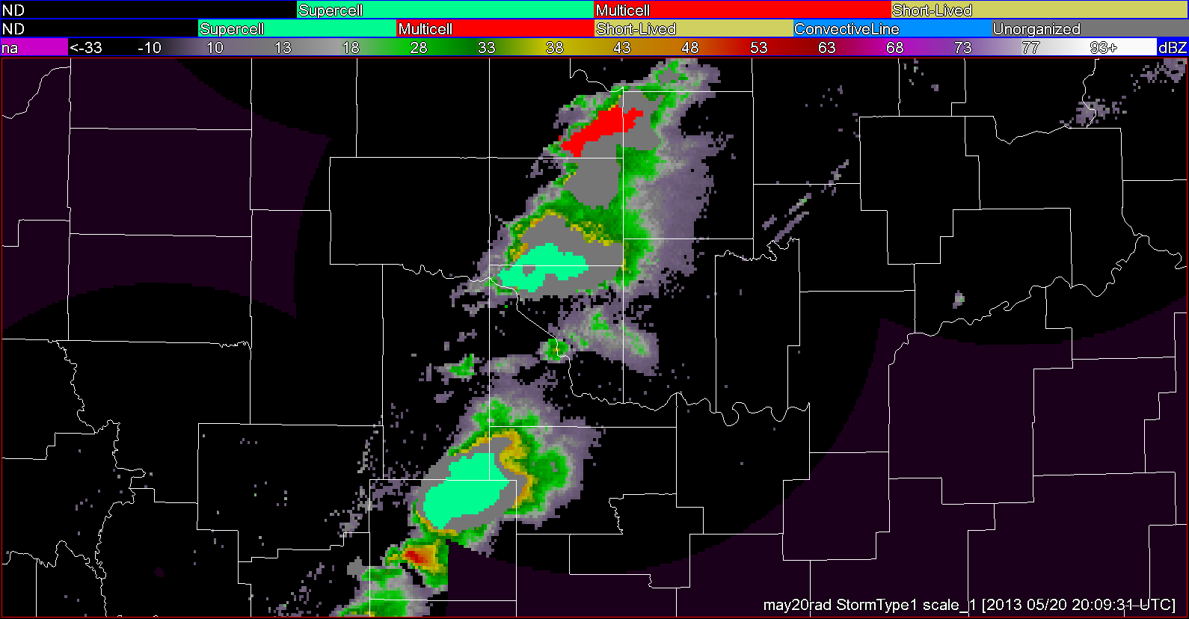
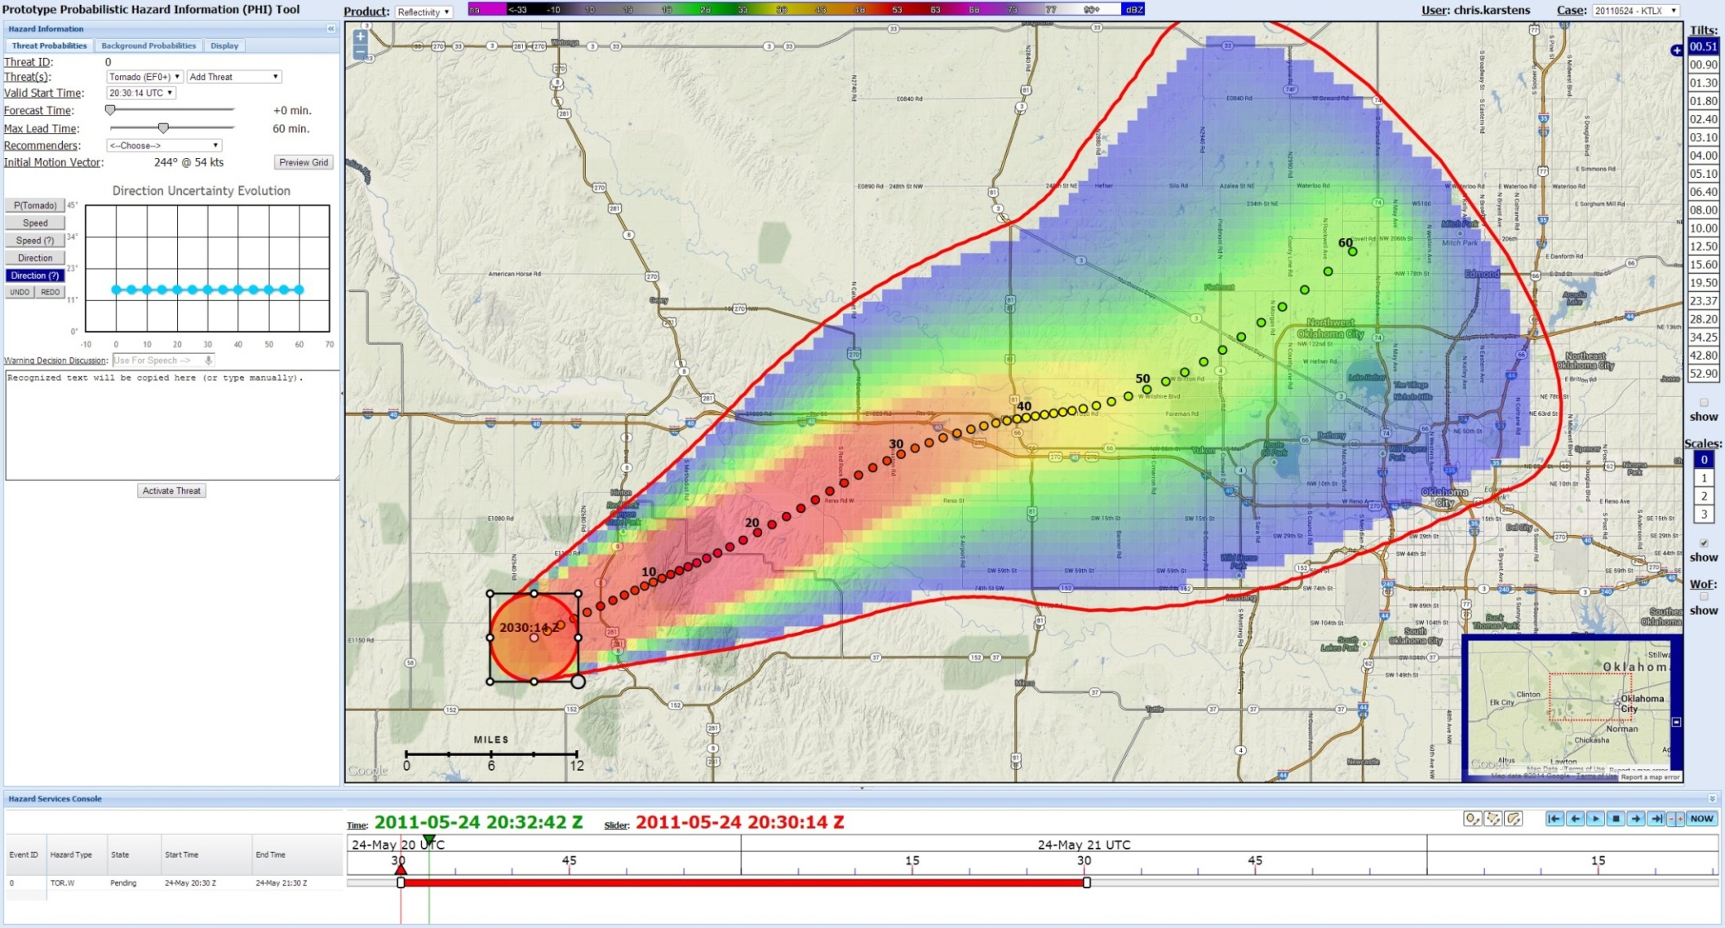
Multi-Year Reanalysis of Remotely Sensed Storms (MYRORSS)
Travis Smith and Kiel Ortega – OU/CIMMS
MYRORSS is reprocessed Multi Radar / Multi Sensor (MRMS) data for the NEXRAD era (1996-present).
Warning Improvement Goals:
Automated storm type classification / characteristics (trained by SPC forecasters)
Probabilities of:
  Severe weather (tornado / hail / wind)
  Convection Initiation, Lightning, Etc.
Probabilistic nowcast of storm motion / longevity / intensity.
Blend with Warn-on-Forecast for the best available Probabilistic Hazard Information for severe weather guidance.
MRMS hail size
MRMS 3D reflectivity
Hail days
per year
Severe Hail days
per year
5 minute
0.01 deg. Res.
35 vertical levels
MRMS mesocyclone tracks
Goals:
Provide a seamless, temporally and spatially consistent data set across the CONUS.
Support research in the development of probabilistic information for severe weather threats.
Develop collaboration across multiple disciples that can take advantage of the data for the benefit of society (climate, agriculture, economics, etc.)
Data mining of storm properties (radar, environment, satellite) to generate probabilities is the core of the FACETs project.
Statistical guidance
Process:
Single-radar processing and automated quality control (QC)
Multi-radar blending
Human QC (reprocess when needed)
Multi-radar algorithms
Data mining, statistics generation
Data to be hosted at NCDC for NOAA use and licensed to the private sector by OU.
NCDC NEXRAD radar data archive
242 TB
(compressed)
MRMS Maximum Hail Size

