Slide 1
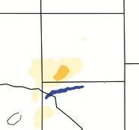
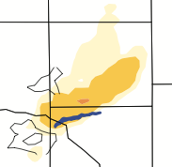
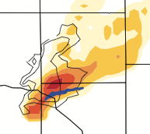
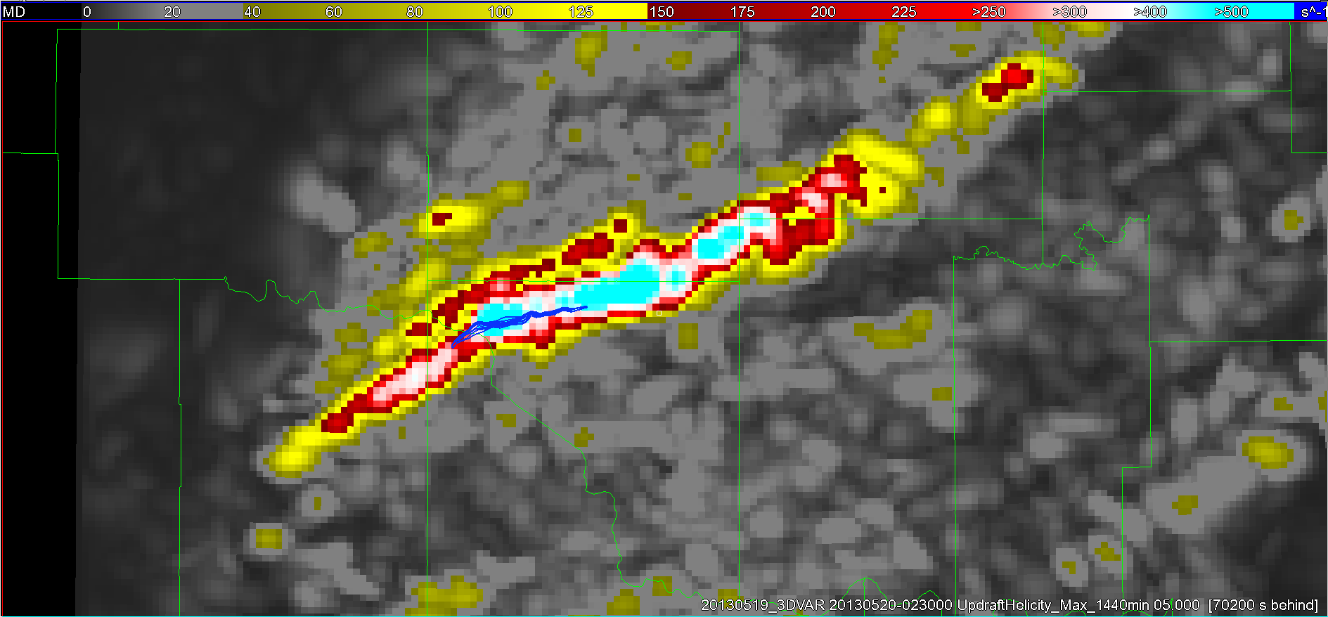
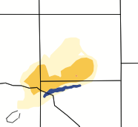
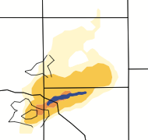
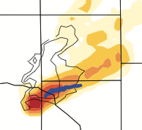

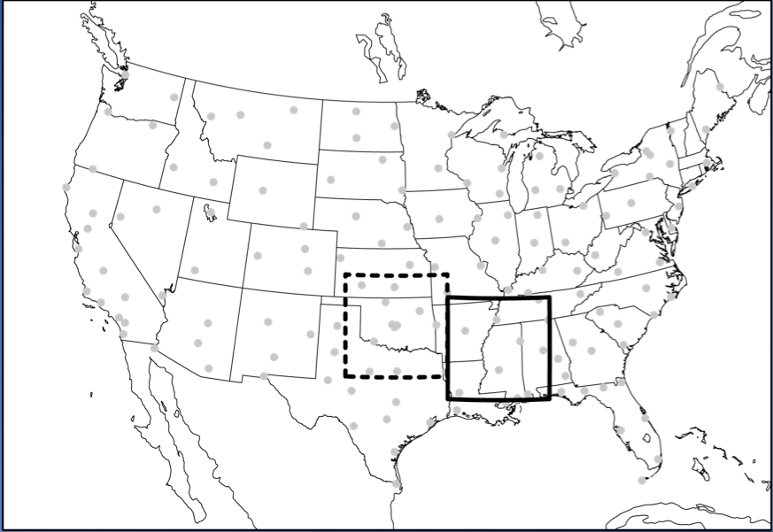
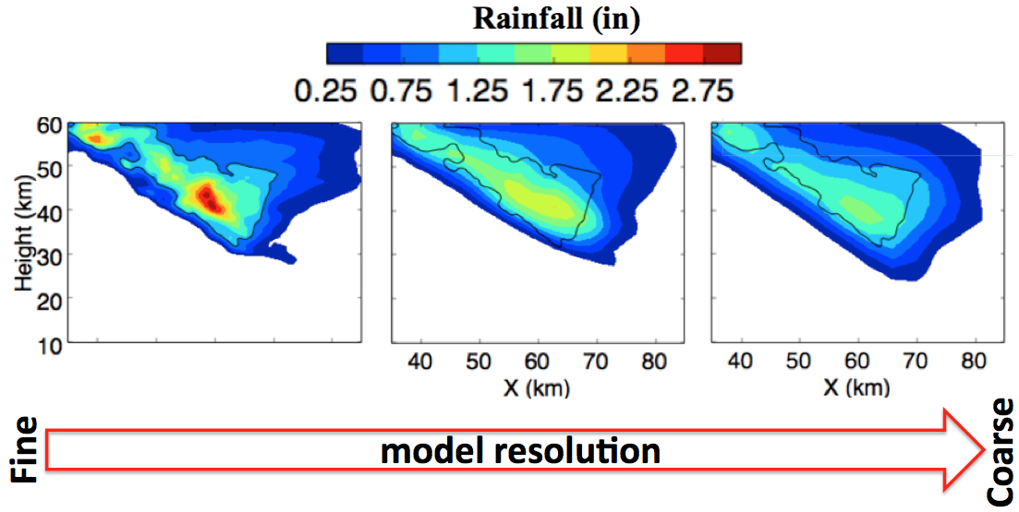
Latest Results of Warn-on-Forecast Research
Corey Potvin, Jidong Gao, Thomas Jones, Kent Knopfmeier, Dustan Wheatley, Louis Wicker, and Nusrat Yussouf
NSSL Experimental WoF System - Ensemble (NEWS-e)
Given current technologies, how skillfully can severe storm hazards be predicted 0-2 hours in advance?
Coarse grid covering US provides initial/boundary conditions to a regional, weather-adaptive, storm-scale-prediction grid
Assimilates conventional, surface, radar, satellite obs
New storm-scale ensemble forecast generated every 15 min
Probabilistic guidance generated from ensemble forecasts
  A dozen retrospective case studies demonstrate potential value
  May 2015, HWT: First time an hourly-updated, storm-scale ensemble prediction system will be run in real-time and evaluated by forecasters
NEWS-e Case Studies
Weather-adaptive, real-time analysis system
Blends multi-radar obs with operational model forecasts
1-km 3-D wind, rotation, reflectivity analyses every 5 min
HWT forecasters report that system highlights storms of interest, adds confidence to decision process, and should therefore increase warning lead times
20 May 2013 Moore, OK EF-5 Tornado
Radar only
T-56 min
T-41 min
T-26 min
NWS tornado warning
issued T-16 min
Ensemble forecast has tornado signal by T-41 min: 25 min before NWS warning!
tor path
Radar + satellite
20 May 2013:
Real-time rotation analysis matches well with tornado (blue line) and mesocyclone tracks
T-56 min
T-41 min
T-26 min
Adding satellite data improves forecasts
0-1 hr forecast probability of intense low-level rotation
Model resolution requirements
How much resolution needed to predict storm hazards?
Explore using idealized (below) and real case studies
Provide vital guidance for WoF system design
Mesoscale & storm-scale domains
Significant Scientific Discoveries
Idealized studies suggest thunderstorms are predictable for up to 2+ hours despite model/observational/computational limitations
Real-data case studies from variety of storm environments are consistent with idealized experiments
New observation types (satellite, phased array radar) improve analyses and forecasts
Using high-resolution ensembles to improve forecasts of convective storm hazards appears viable
Δx = 15 km
Δx = 3 km
Δx = 333 m
Δx = 2 km
Δx = 4 km

Slide 2
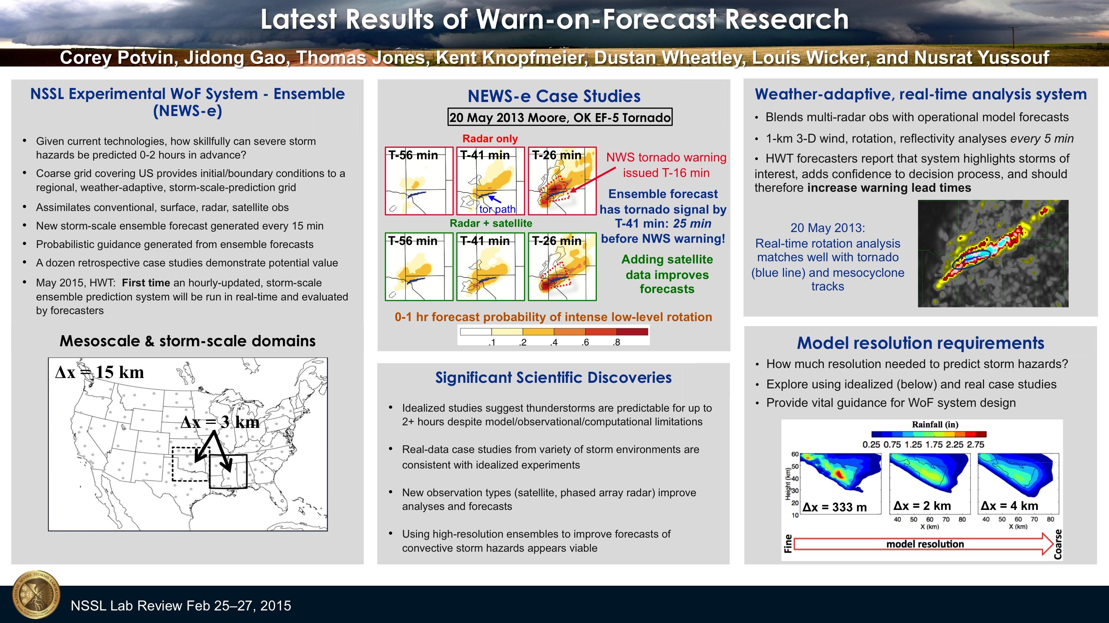
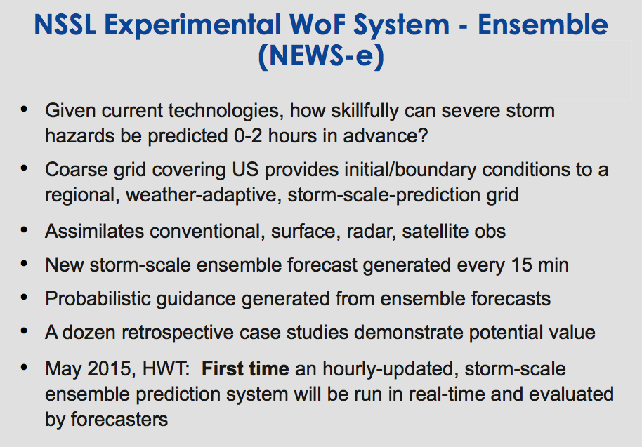
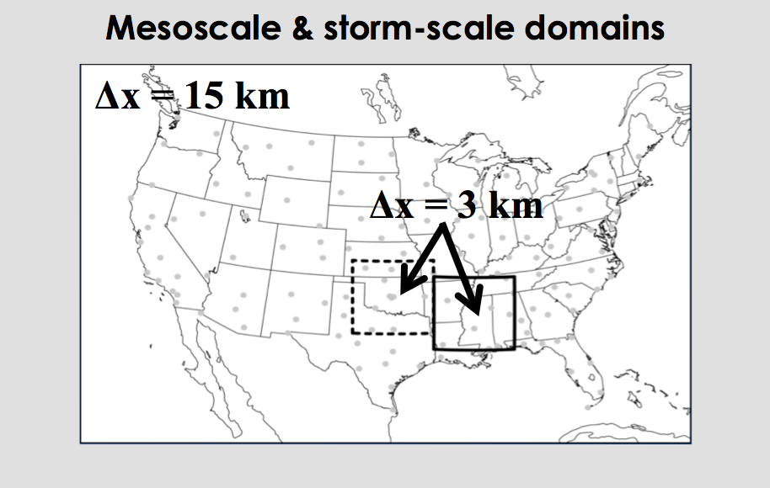
Notes:
Knopfmeier, K. H., and D. M. Wheatley, G. J. Creager, M. Coniglio, D. Dowell, J. Correia Jr., and A.J. Clark, 2014: Evaluation of the NSSL Mesoscale Ensemble during the High-Impact Severe
Weather Events of May 2013. Annual AMS Meeting, Atlanta, GA.

Slide 3
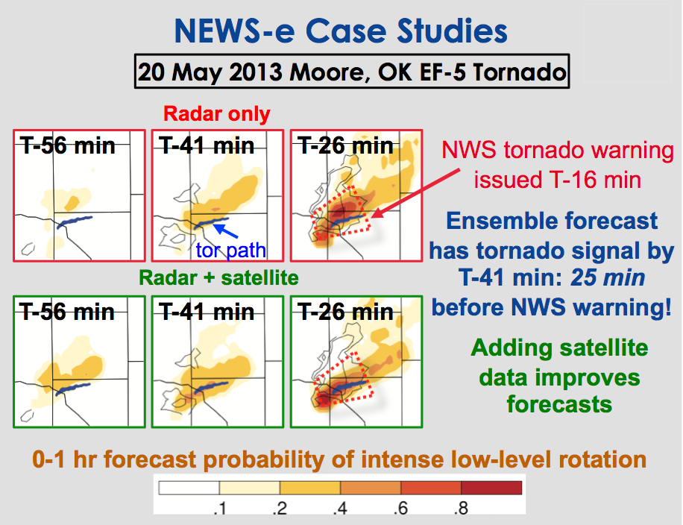
Notes:
Wheatley, D. M., T. A. Jones, K. Knopfmeier, and G. Creager, 2015: The NSSL Experimental Warn-on-Forecast System – Ensemble (NEWS-e). Part I: System design and radar data assimilation experiments. In preparation for submission to Mon. Wea. Rev.
Jones, T. A., K. Knopfmeier, D. M. Wheatley, G. Creager, P. Minnis, and R. Palikonda, 2015: The NSSL Experimental Warn-on-Forecast System – Ensemble (NEWS-e). Part II: Combined radar and satellite data assimilation. In preparation for submission to Mon. Wea. Rev.

Slide 4
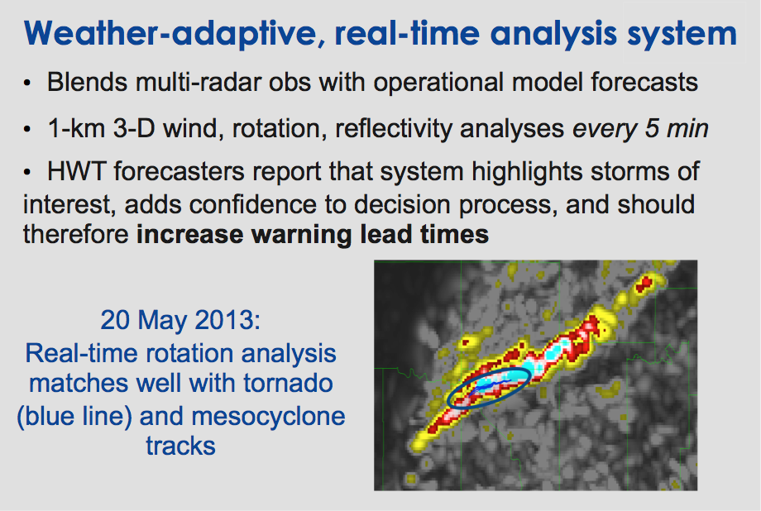
Notes:
Calhoun, K., T. M. Smith, D. M. Kingfield, J. Gao, and D. J. Stensrud, 2014: Forecaster use and evaluation of realtime 3DVAR analyses during severe thunderstorm
And tornado warning operations in the Hazardous Weather Testbed. Wea. Forecasting, 29, 601-613.
Gao, J., T. M. Smith, D. J. Stensrud, C. Fu, K. Calhoun, K. L. Manross, J. Brogden, V. Lakshmanan, Y. Wang, K. W. Thomas, K. Brewster, and M. Xue, 2013:
A real-time weather-adaptive 3DVAR analysis system for severe weather detections and warnings. Wea. Forecasting, 28, 727–745.

Slide 5
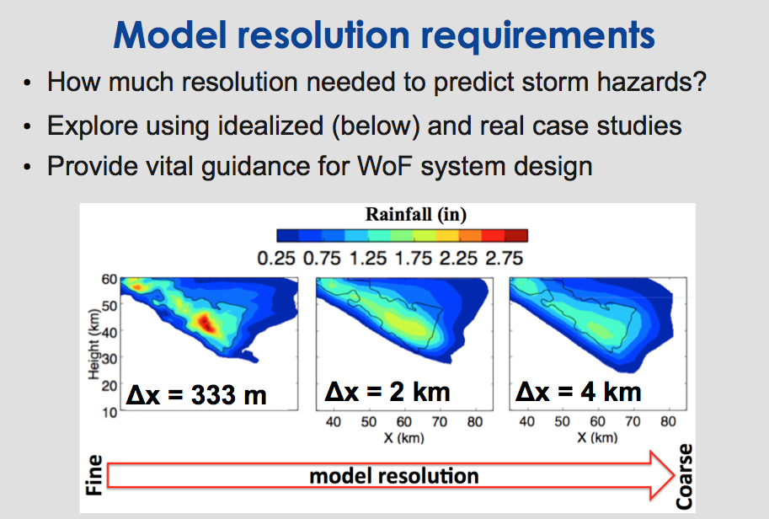
Notes:
Potvin, C. K., and M. L. Flora, 2015: Sensitivity of idealized supercell simulations to horizontal grid spacing: Implications for Warn-on-Forecast. Conditionally accepted, Mon. Wea. Rev.

Slide 6
