Slide 1
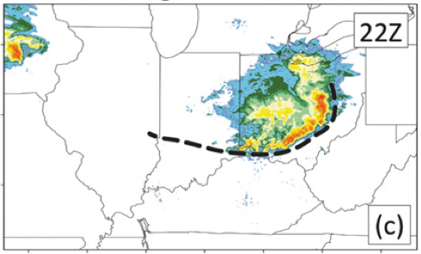
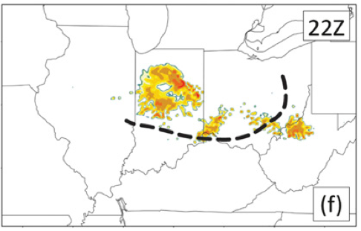
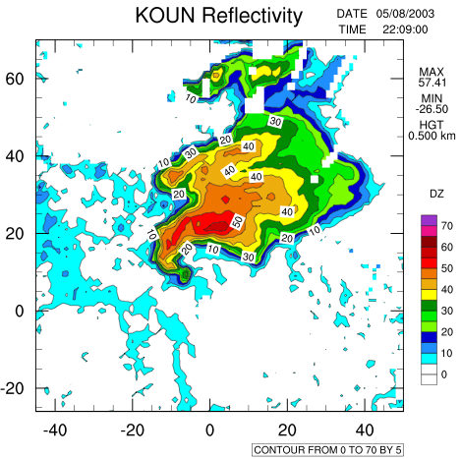
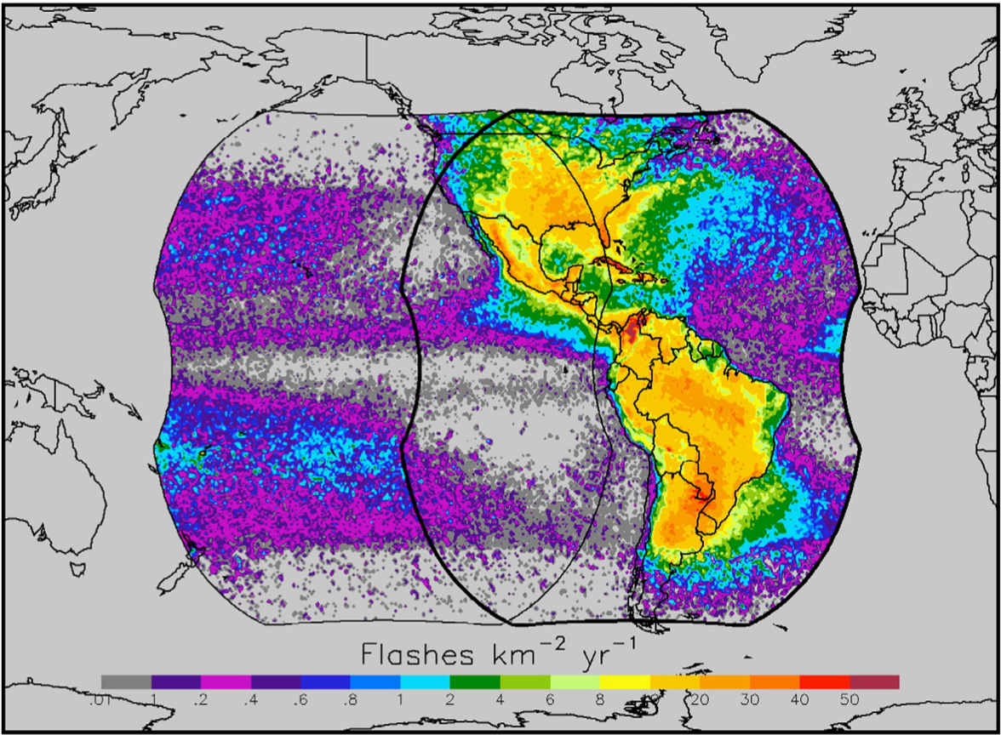
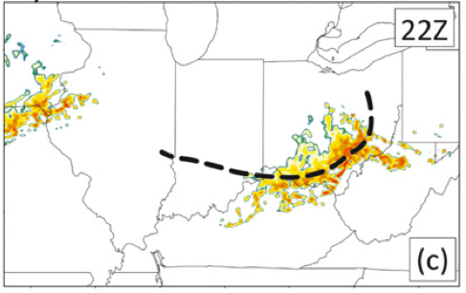
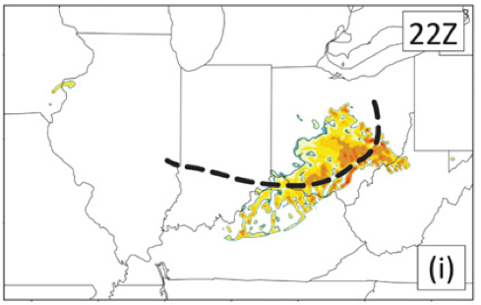
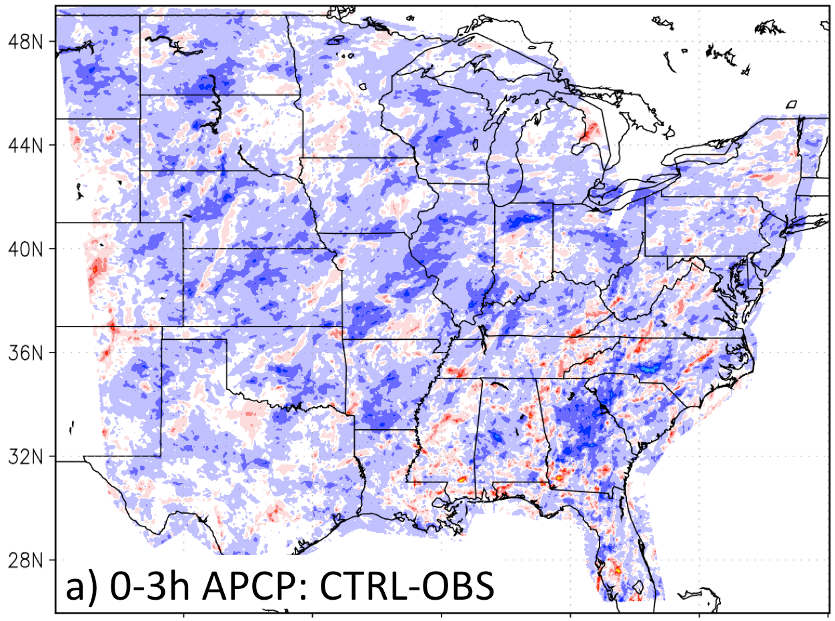
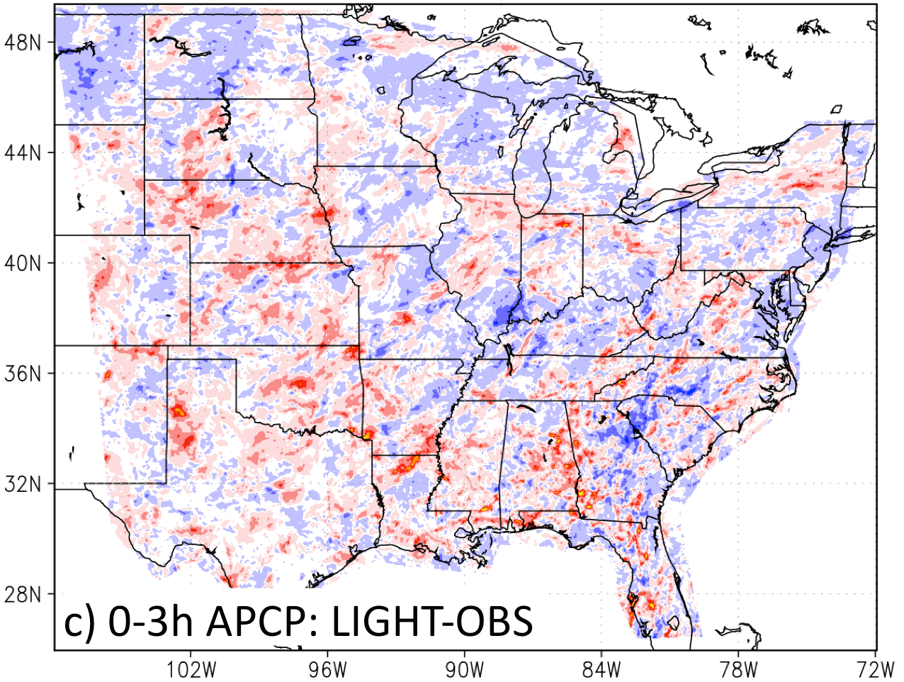
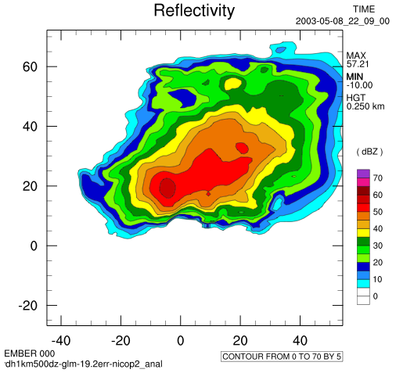
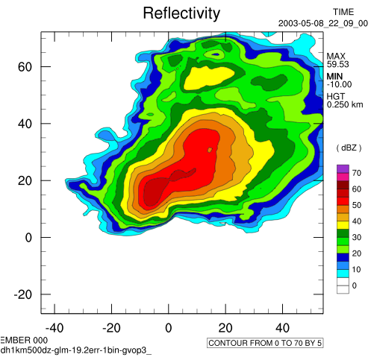
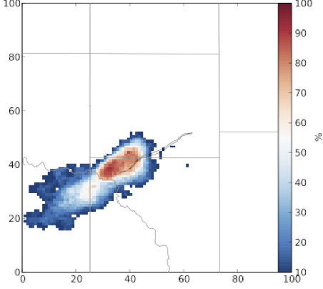
Storm-scale lightning data assimilation at NSSL
Edward Mansell, Alexandre Fierro, Blake Allen
What can total lightning data provide for forecasts and analyses, in lieu of or in addition to radar?
Nudging (water vapor and/or temperature) where lightning is
observed but convection is absent in the model. (Fierro et al. 2012,2014)
2. Ensemble Kalman Filter: Ensemble relationships provide adjustments to all state variables. (Mansell 2014, Allen 2014)
Observation
Control Forecast
6-hr forecasts of radar reflectivity of a severe wind storm (derecho) with lightning nudging (ENTLN) or cycled radar 3DVAR methods.
May 8, 2003 tornadic supercell storm
GOES-R Lightning Density derived from Mapping Array data
29 June 2012
a
Latitude
1 min⁻¹
b
80 min⁻¹
Radar assimilation (3DVar)
Lightning nudging
22:09Z
GOES-R field of view
Longitude
Observed Reflectivity
Good preliminary results were found with a simple linear
flash density operator: LD = (0.017)*(graupel volume)
[Will try to use with 3DVAR, as well.]
c
d
Nudging tested on 67 daily NSSL real-time forecasts during spring 2013. Generally improved low biases in accumulated rainfall. Needs further tuning to avoid increasing high biases. (Fierro, Clark, Mansell et al. 2015)
Probability of rotation
at 1.75 km model height
Rainfall Equitable
Threat Scores (ETS)
(bias-corrected)
22:09Z
22:09Z
Lightning assimilation (ensemble mean)
Radar velocity assimilation
(ensemble mean)
Better scores with assimilation
Lightning assimilation
Total Rainfall bias
(mm) 0– 3 hours
Analyses produce a supercell storm with low-level rotation. Less detailed than is possible with radar data, but shows promise in radar data-poor areas (e.g., mountains, off-shore)
This work supported in part by the GOES-R program

