Slide 1
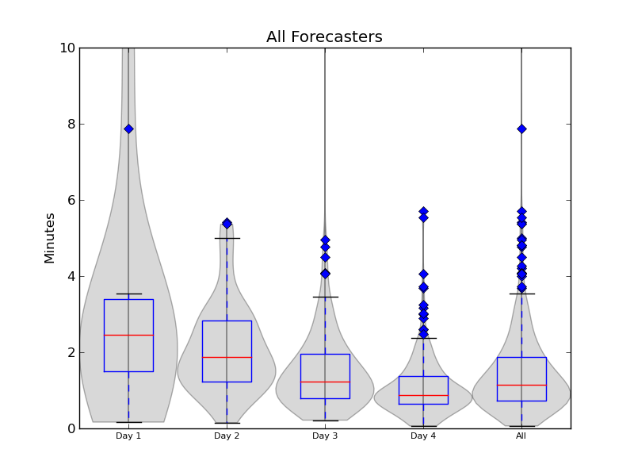
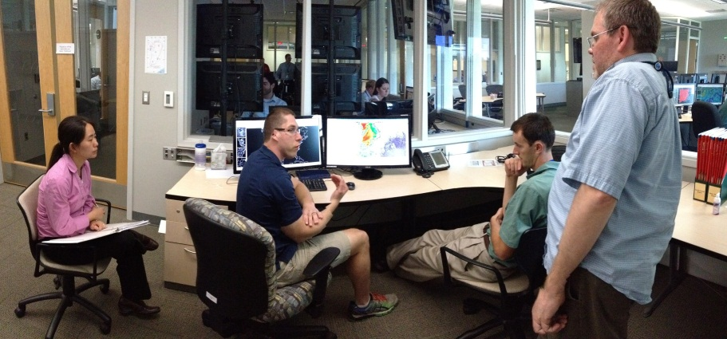
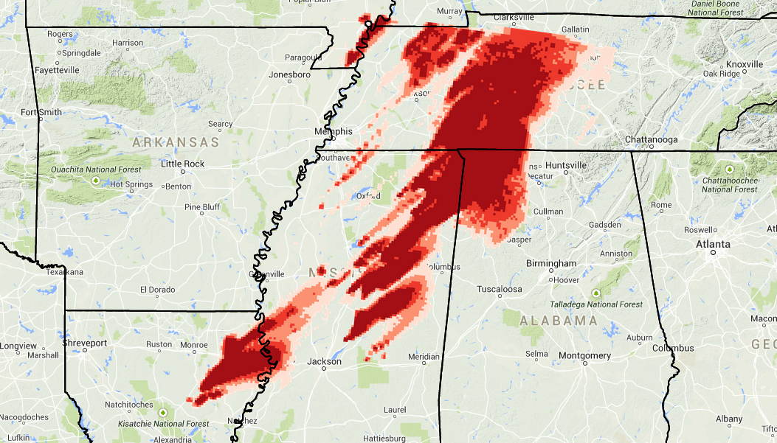
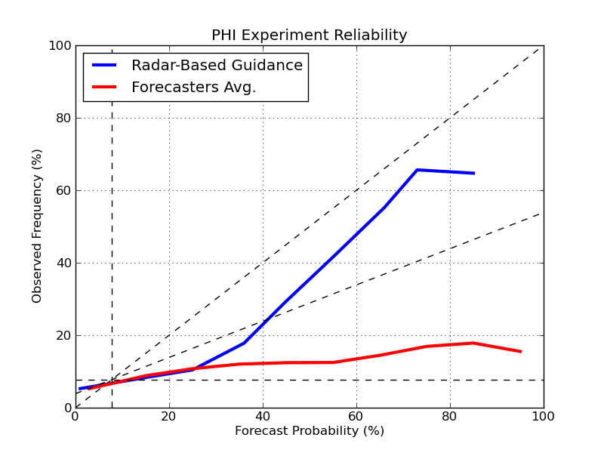
Prototype Development for Creating Probabilistic Hazard Information (PHI) for Severe Convective Weather
Christopher Karstens, Lans Rothfusz, Greg Stumpf, Travis Smith
Probabilistic Hazard Information (PHI)
Information describing the probability for a given hazardous weather phenomenon within a defined spatial and temporal range
2014 HWT Experiment Findings (EWP)
Future Plans
HWT Experiments
Infusion of radar- and satellite-based algorithms
Simultaneous experiment with Emergency Managers
Warn-on-Forecast
Research To Operations (R2O)
Collaboration with NOAA/GSD Hazard Services development group
Operational forecasting support for the PECAN field project (Summer 2015)
Forecast Creation Times
Forecasters found the prototype concepts intuitive
Decreasing amount of time to generate forecasts throughout the week
Quickly grasped new abilities (e.g., low probability forecasts with extended lead-time)
HWT
Tornado
Guidance
Human
Factors
Scientists
Atmospheric
Scientists
Forecasters
Forecast Reliability
ProbSevere
Need for incorporating reliable 1st guess guidance in forecast decision-making
WoF
Under-Forecast
Region
Perfect Reliability
Skill / No Skill
Over-Forecast
Region
Climatology

