Slide 1
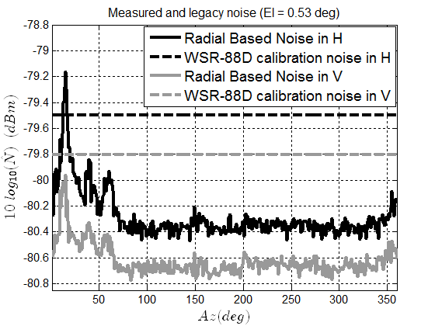
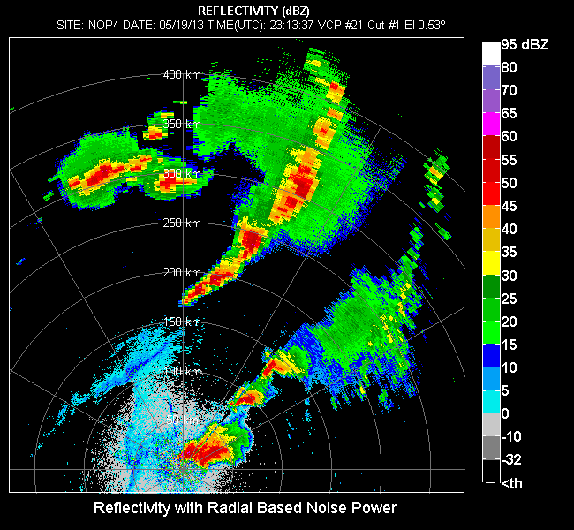
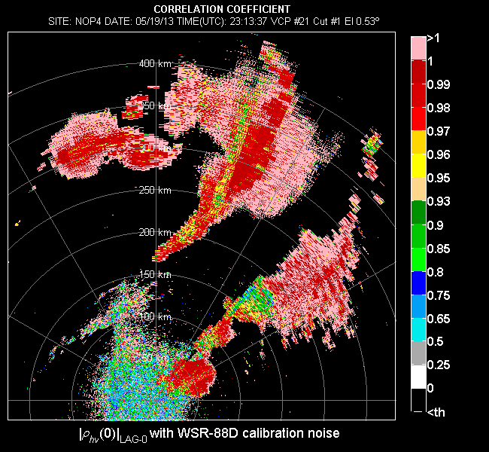
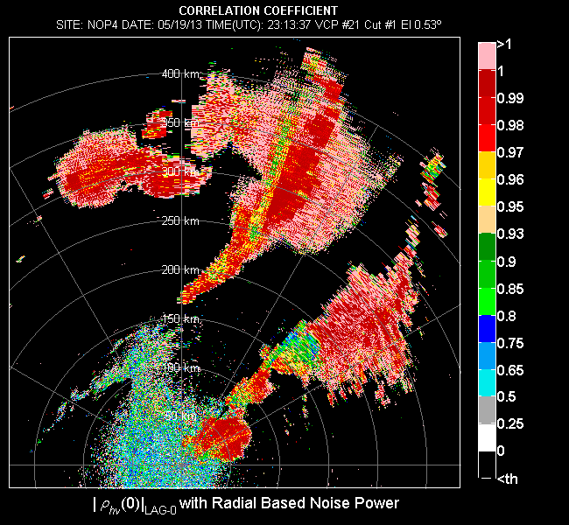
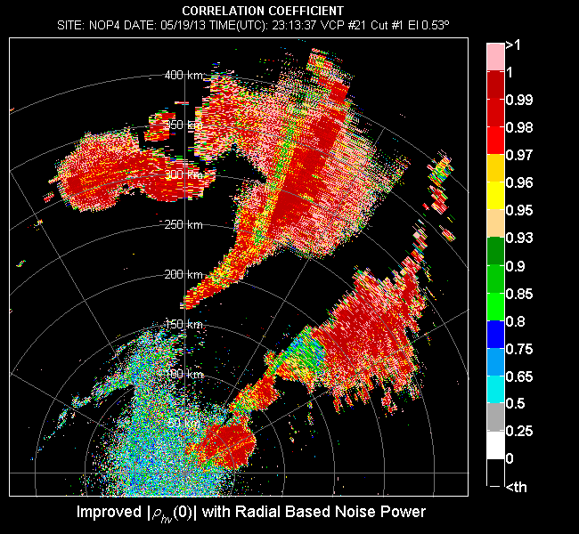
Increasing the value of NEXRAD's dual-polarization upgrade by improving the quality of correlation coefficient
The correlation coefficient (|ρ_{hv}(0)|) is used for classification of radar returns.
The correlation coefficient estimates are unusable when larger than one (i.e., invalid).
There are three causes to this
Mismeasurement of noise powers in the horizontal and vertical channels.
Can be mitigated using the more accurate radial based noise power estimator (RBNE) (developed at NSSL and implemented in operations).
Statistical errors inherent in the legacy correlation coefficient estimator (i.e., |ρ_{hv}(0)|_{LAG-0}).
Can be mitigated using the improved estimator (developed at NSSL and tasked to be implemented in operations).
Standard deviation (larger when the number of samples per dwell is small and/or SNR is low).
Can be mitigated by Increasing the number of samples (M) used to produce estimates at locations with invalid values.
LEGACY PROCESSING
(LEGACY WSR-88D NOISE CALIBRATION +
LEGACY ESTIMATOR)
RADIAL BASED NOISE POWER (RBNE) +
LEGACY ESTIMATOR
RADIAL BASED NOISE POWER (RBNE) +
IMPROVED ESTIMATOR+
ENHANCE SAMPLE SIZE (M)
RADIAL BASED NOISE POWER (RBNE) +
IMPROVED ESTIMATOR
Igor Ivić (CIMMS/NSSL)
Notes:
PEER REVIEWED PUBLICATIONS 2013-2014
Ivić I. R., C. Curtis, and S. M. Torres, 2013: Radial-based Noise Power Estimation for Weather Radars, J. Atmos. Oceanic Technol., 30, 2737-2753.
[Available online at http://journals.ametsoc.org/doi/abs/10.1175/JTECH-D-13-00008.1]
Ivić I. R., 2014: On the Use of a Radial-Based Noise Power Estimation Technique to Improve Estimates of the Correlation Coefficient on Dual-Polarization Weather Radars. J. Atmos. Oceanic Technol., 31, 1867–1880.
[Available online at http://journals.ametsoc.org/doi/abs/10.1175/JTECH-D-14-00052.1]
Ivić I. R. , Jane C. Krause, Olen E. Boydstun, Amy E. Daniel, Alan D. Free, and Walter D. Zittel, 2014: Effects of Radial-Based Noise Power Estimation on Spectral Moment Estimates. J. Atmos. Oceanic Technol., 31, 2671–2691.
[Available online at http://journals.ametsoc.org/doi/abs/10.1175/JTECH-D-14-00048.1?journalCode=atot]
CONFERENCE PAPERS
Ivić, I. R., 2014: Improved Correlation Coefficient Estimator, The Eigth European Conference On Radar In Meteorology And Hydrology (ERAD), Garmich-Partenkirchen, Germany.
[Available online at http://www.researchgate.net/publication/264975547_Improved_Correlation_Coefficient_Estimator]
Ivić, I. R., and B. Isom, 2014: Methods to Improve Fields of Correlation Coefficient Estimates, The Eigth European Conference On Radar In Meteorology And Hydrology (ERAD), Garmich-Partenkirchen, Germany.
[Available online at http://www.researchgate.net/publication/264975442_Methods_to_Improve_Fields_of_Correlation_Coefficient_Estimates]

Slide 2
Increasing the value of NEXRAD's dual-polarization upgrade by improving the quality of correlation coefficient
The correlation coefficient (|ρ_{hv}(0)|) is used for hydrometeor classification (HCA) and tornado debris recognition.
The bias level should not exceed ±0.01.
The correlation coefficient estimates are unusable when larger than one (i.e., invalid).
There are three causes to this
Mismeasurement of noise powers in the horizontal and vertical channels.
Can be mitigated using the more accurate radial based noise power estimator (RBNE) developed at NSSL. This technique has been implemented in operations.
Inherent positive bias in the legacy correlation coefficient estimator.
Can be mitigated using the improved estimator developed at NSSL. This technique is tasked to be implemented in operations.
Standard deviation (larger when the number of samples per dwell is small).
Can be mitigated by Increasing the number of samples (M) used to produce estimates at bins with invalid values.
PROCESS USING LEGACY ESTIMATOR AND RADIAL BASED NOISE POWER ESTIMATION (RBNE) DEVELOPED AT NSSL.
LEGACY PROCESSING
LEGACY PROCESSING
(LEGACY WSR-88D NOISE CALIBRATION
+
LEGACY ESTIMATOR)
PROCESS USING THE IMPROVED ESTIMATOR AND RBNE DEVELOPED AT NSSL.
ENHANCE SAMPLE SIZE (M) AT BINS WHERE ESTIMATES ARE INVALID BY APPENDING SAMPLES FROM ADJACENT AZIMUTH.
PEER REVIEWED PUBLICATIONS 2013-2014
Ivić I. R., C. Curtis, and S. M. Torres, 2013: Radial-based Noise Power Estimation for Weather Radars, J. Atmos. Oceanic Technol., 30, 2737-2753.
Ivić I. R. , 2014: On the Use of a Radial-Based Noise Power Estimation Technique to Improve Estimates of the Correlation Coefficient on Dual-Polarization Weather Radars. J. Atmos. Oceanic Technol., 31, 1867–1880.
Ivić I. R, Jane C. Krause, Olen E. Boydstun, Amy E. Daniel, Alan D. Free, and Walter D. Zittel, 2014: Effects of Radial-Based Noise Power Estimation on Spectral Moment Estimates. J. Atmos. Oceanic Technol., 31, 2671–2691.
Igor Ivić

Slide 3
Increasing the value of NEXRAD's dual-polarization upgrade by improving the quality of correlation coefficient
The correlation coefficient (|ρ_{hv}(0)|) is used for hydrometeor classification (HCA) and tornado debris recognition.
The bias level should not exceed ±0.01.
The correlation coefficient estimates are unusable when larger than one (i.e., invalid).
There are three causes to this
Mismeasurement of noise powers in the horizontal and vertical channels.
Can be mitigated using the more accurate radial based noise power estimator (RBNE) developed at NSSL. This technique has been implemented in operations.
Inherent positive bias in the legacy correlation coefficient estimator.
Can be mitigated using the improved estimator developed at NSSL. This technique is tasked to be implemented in operations.
Standard deviation (larger when the number of samples per dwell is small).
Can be mitigated by Increasing the number of samples (M) used to produce estimates at bins with invalid values.
PROCESS USING LEGACY ESTIMATOR AND RADIAL BASED NOISE POWER ESTIMATION (RBNE) DEVELOPED AT NSSL.
LEGACY PROCESSING
RADIAL BASED NOISE POWER (RBNE)
+
LEGACY ESTIMATOR
PROCESS USING THE IMPROVED ESTIMATOR AND RBNE DEVELOPED AT NSSL.
ENHANCE SAMPLE SIZE (M) AT BINS WHERE ESTIMATES ARE INVALID BY APPENDING SAMPLES FROM ADJACENT AZIMUTH.
PEER REVIEWED PUBLICATIONS 2013-2014
Ivić I. R., C. Curtis, and S. M. Torres, 2013: Radial-based Noise Power Estimation for Weather Radars, J. Atmos. Oceanic Technol., 30, 2737-2753.
Ivić I. R. , 2014: On the Use of a Radial-Based Noise Power Estimation Technique to Improve Estimates of the Correlation Coefficient on Dual-Polarization Weather Radars. J. Atmos. Oceanic Technol., 31, 1867–1880.
Ivić I. R, Jane C. Krause, Olen E. Boydstun, Amy E. Daniel, Alan D. Free, and Walter D. Zittel, 2014: Effects of Radial-Based Noise Power Estimation on Spectral Moment Estimates. J. Atmos. Oceanic Technol., 31, 2671–2691.
Igor Ivić

Slide 4
Increasing the value of NEXRAD's dual-polarization upgrade by improving the quality of correlation coefficient
The correlation coefficient (|ρ_{hv}(0)|) is used for hydrometeor classification (HCA) and tornado debris recognition.
The bias level should not exceed ±0.01.
The correlation coefficient estimates are unusable when larger than one (i.e., invalid).
There are three causes to this
Mismeasurement of noise powers in the horizontal and vertical channels.
Can be mitigated using the more accurate radial based noise power estimator (RBNE) developed at NSSL. This technique has been implemented in operations.
Inherent positive bias in the legacy correlation coefficient estimator.
Can be mitigated using the improved estimator developed at NSSL. This technique is tasked to be implemented in operations.
Standard deviation (larger when the number of samples per dwell is small).
Can be mitigated by Increasing the number of samples (M) used to produce estimates at bins with invalid values.
PROCESS USING LEGACY ESTIMATOR AND RADIAL BASED NOISE POWER ESTIMATION (RBNE) DEVELOPED AT NSSL.
LEGACY PROCESSING
RADIAL BASED NOISE POWER (RBNE)
+
IMPROVED ESTIMATOR
PROCESS USING THE IMPROVED ESTIMATOR AND RBNE DEVELOPED AT NSSL.
ENHANCE SAMPLE SIZE (M) AT BINS WHERE ESTIMATES ARE INVALID BY APPENDING SAMPLES FROM ADJACENT AZIMUTH.
PEER REVIEWED PUBLICATIONS 2013-2014
Ivić I. R., C. Curtis, and S. M. Torres, 2013: Radial-based Noise Power Estimation for Weather Radars, J. Atmos. Oceanic Technol., 30, 2737-2753.
Ivić I. R. , 2014: On the Use of a Radial-Based Noise Power Estimation Technique to Improve Estimates of the Correlation Coefficient on Dual-Polarization Weather Radars. J. Atmos. Oceanic Technol., 31, 1867–1880.
Ivić I. R, Jane C. Krause, Olen E. Boydstun, Amy E. Daniel, Alan D. Free, and Walter D. Zittel, 2014: Effects of Radial-Based Noise Power Estimation on Spectral Moment Estimates. J. Atmos. Oceanic Technol., 31, 2671–2691.
Igor Ivić

Slide 5
Increasing the value of NEXRAD's dual-polarization upgrade by improving the quality of correlation coefficient
The correlation coefficient (|ρ_{hv}(0)|) is used for hydrometeor classification (HCA) and tornado debris recognition.
The bias level should not exceed ±0.01.
The correlation coefficient estimates are unusable when larger than one (i.e., invalid).
There are three causes to this
Mismeasurement of noise powers in the horizontal and vertical channels.
Can be mitigated using the more accurate radial based noise power estimator (RBNE) developed at NSSL. This technique has been implemented in operations.
Inherent positive bias in the legacy correlation coefficient estimator.
Can be mitigated using the improved estimator developed at NSSL. This technique is tasked to be implemented in operations.
Standard deviation (larger when the number of samples per dwell is small).
Can be mitigated by Increasing the number of samples (M) used to produce estimates at bins with invalid values.
PROCESS USING LEGACY ESTIMATOR AND RADIAL BASED NOISE POWER ESTIMATION (RBNE) DEVELOPED AT NSSL.
RADIAL BASED NOISE POWER (RBNE)
+
IMPROVED ESTIMATOR
+
ENHANCE SAMPLE SIZE (M)
LEGACY PROCESSING
PROCESS USING THE IMPROVED ESTIMATOR AND RBNE DEVELOPED AT NSSL.
ENHANCE SAMPLE SIZE (M) AT BINS WHERE ESTIMATES ARE INVALID BY APPENDING SAMPLES FROM ADJACENT AZIMUTH.
PEER REVIEWED PUBLICATIONS 2013-2014
Ivić I. R., C. Curtis, and S. M. Torres, 2013: Radial-based Noise Power Estimation for Weather Radars, J. Atmos. Oceanic Technol., 30, 2737-2753.
Ivić I. R. , 2014: On the Use of a Radial-Based Noise Power Estimation Technique to Improve Estimates of the Correlation Coefficient on Dual-Polarization Weather Radars. J. Atmos. Oceanic Technol., 31, 1867–1880.
Ivić I. R, Jane C. Krause, Olen E. Boydstun, Amy E. Daniel, Alan D. Free, and Walter D. Zittel, 2014: Effects of Radial-Based Noise Power Estimation on Spectral Moment Estimates. J. Atmos. Oceanic Technol., 31, 2671–2691.
Igor Ivić

Slide 6
Increasing the value of NEXRAD's dual-polarization upgrade by improving the quality of correlation coefficient
The correlation coefficient (|ρ_{hv}(0)|) is used for hydrometeor classification (HCA) and tornado debris recognition.
The bias level should not exceed ±0.01.
The correlation coefficient estimates are unusable when larger than one (i.e., invalid).
There are three causes to this
Mismeasurement of noise powers in the horizontal and vertical channels.
Can be mitigated using the more accurate radial based noise power estimator (RBNE) developed at NSSL. This technique has been implemented in operations.
Inherent positive bias in the legacy correlation coefficient estimator.
Can be mitigated using the improved estimator developed at NSSL. This technique is tasked to be implemented in operations.
Standard deviation (larger when the number of samples per dwell is small).
Can be mitigated by Increasing the number of samples (M) used to produce estimates at bins with invalid values.
PROCESS USING LEGACY ESTIMATOR AND RADIAL BASED NOISE POWER ESTIMATION (RBNE) DEVELOPED AT NSSL.
LEGACY PROCESSING
LEGACY PROCESSING
(LEGACY WSR-88D NOISE CALIBRATION
+
LEGACY ESTIMATOR)
PROCESS USING THE IMPROVED ESTIMATOR AND RBNE DEVELOPED AT NSSL.
ENHANCE SAMPLE SIZE (M) AT BINS WHERE ESTIMATES ARE INVALID BY APPENDING SAMPLES FROM ADJACENT AZIMUTH.
PEER REVIEWED PUBLICATIONS 2013-2014
Ivić I. R., C. Curtis, and S. M. Torres, 2013: Radial-based Noise Power Estimation for Weather Radars, J. Atmos. Oceanic Technol., 30, 2737-2753.
Ivić I. R. , 2014: On the Use of a Radial-Based Noise Power Estimation Technique to Improve Estimates of the Correlation Coefficient on Dual-Polarization Weather Radars. J. Atmos. Oceanic Technol., 31, 1867–1880.
Ivić I. R, Jane C. Krause, Olen E. Boydstun, Amy E. Daniel, Alan D. Free, and Walter D. Zittel, 2014: Effects of Radial-Based Noise Power Estimation on Spectral Moment Estimates. J. Atmos. Oceanic Technol., 31, 2671–2691.
Igor Ivić

