Slide 1
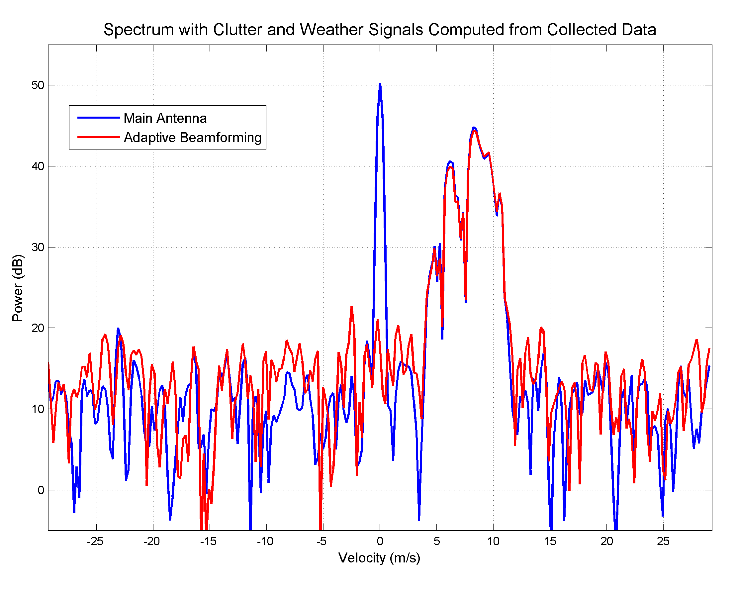
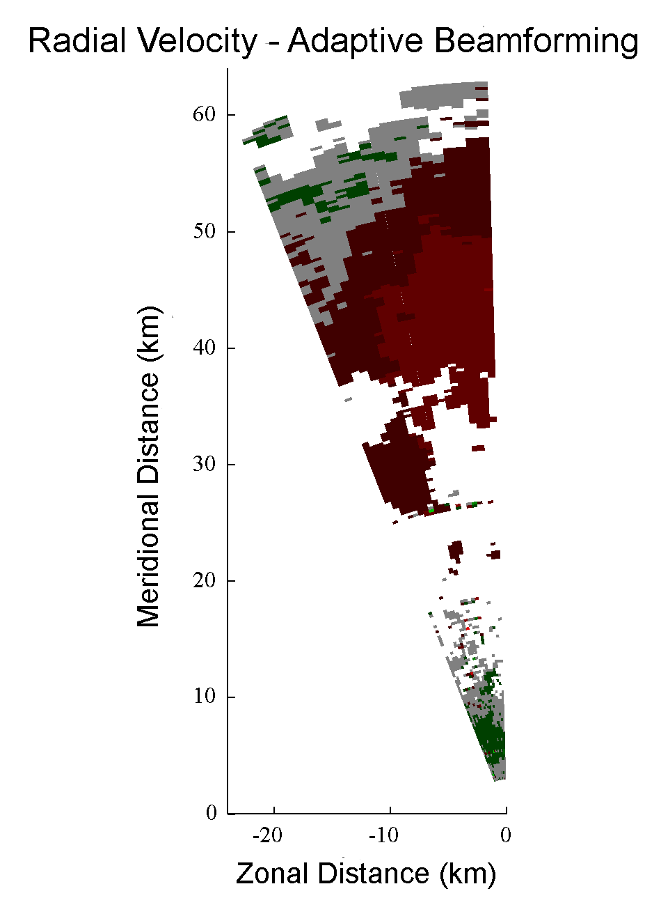
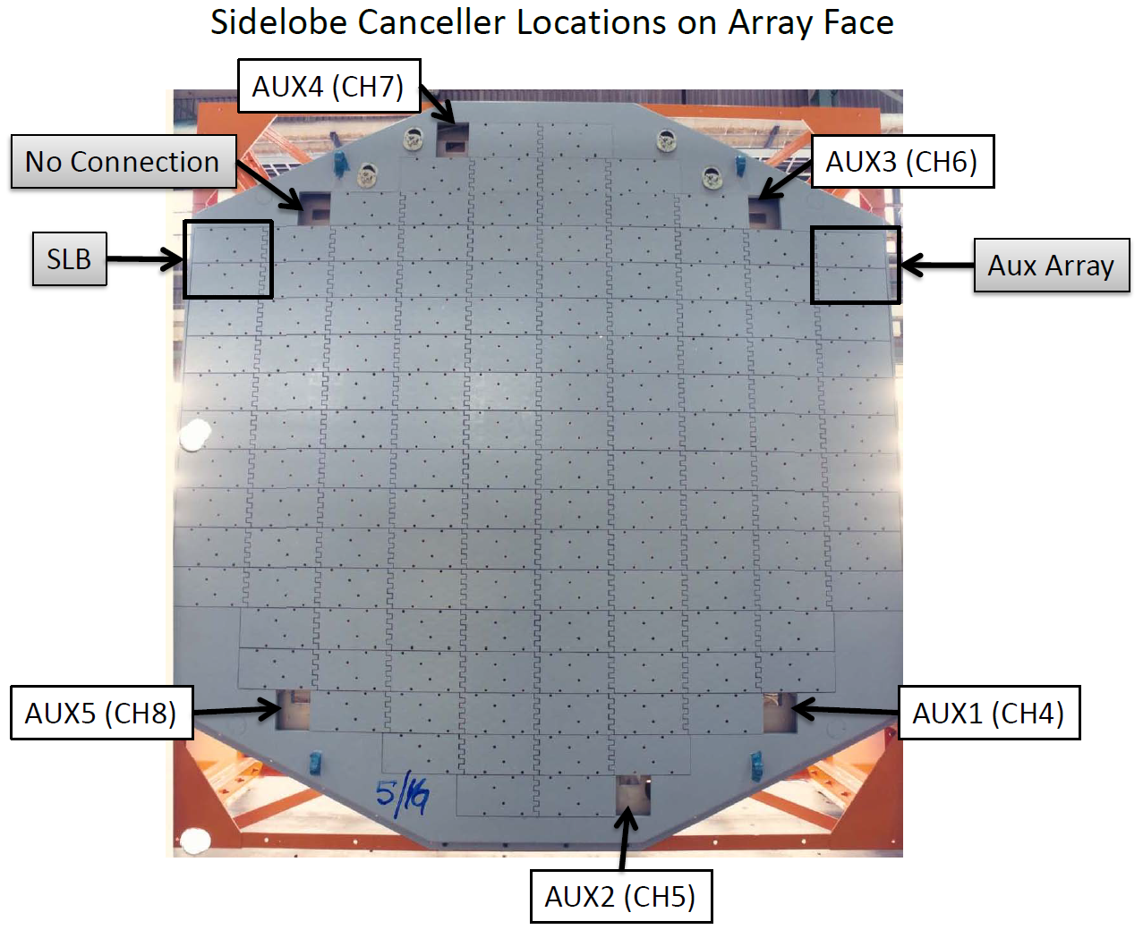
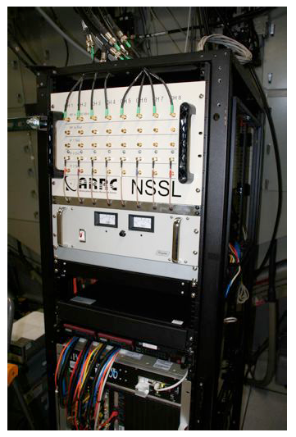
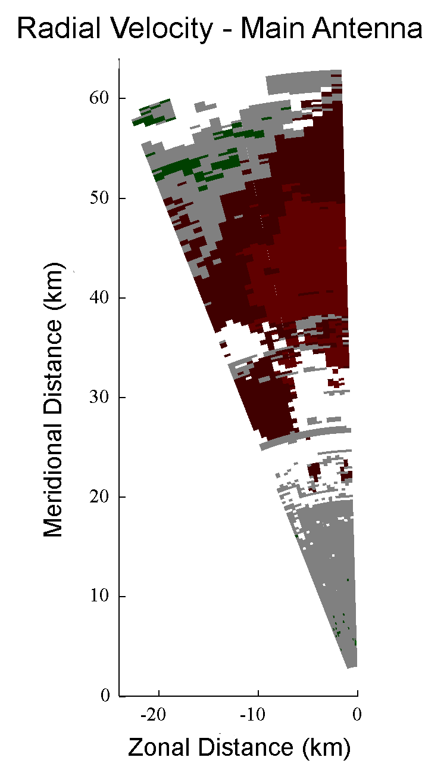
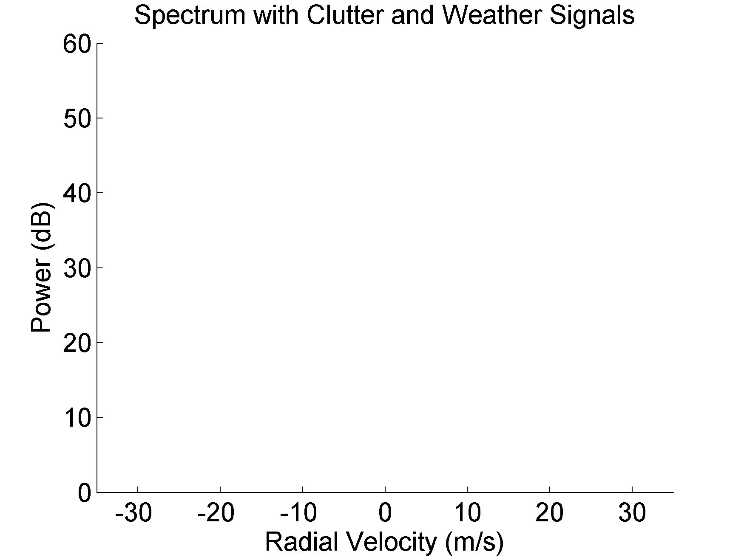
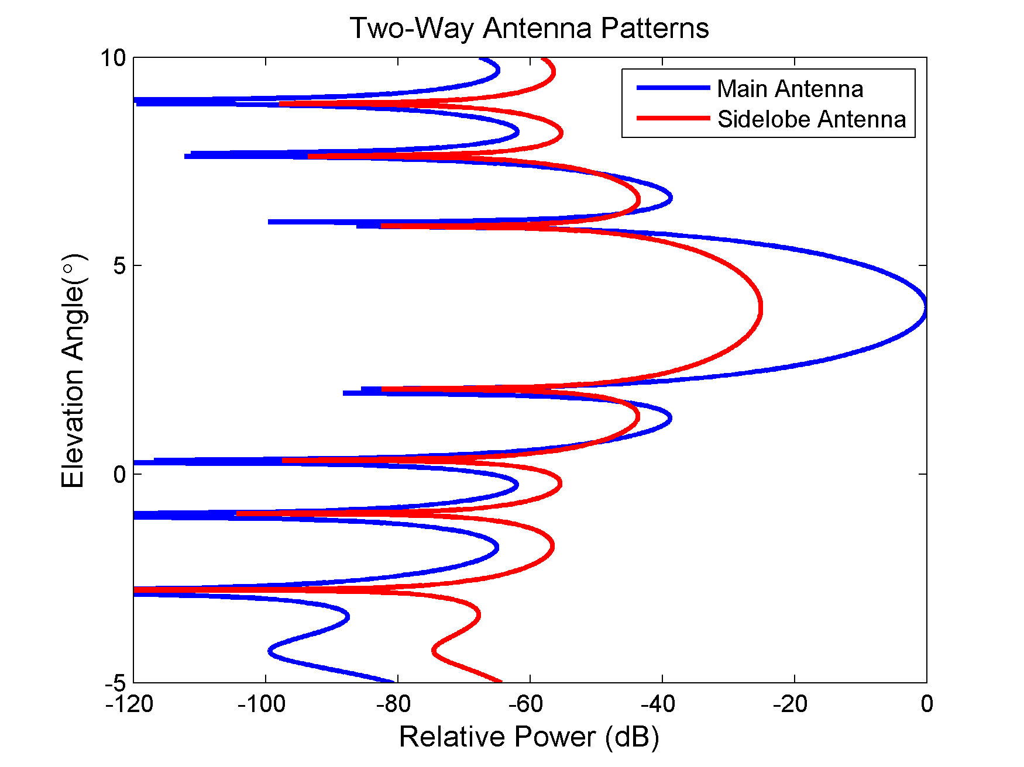
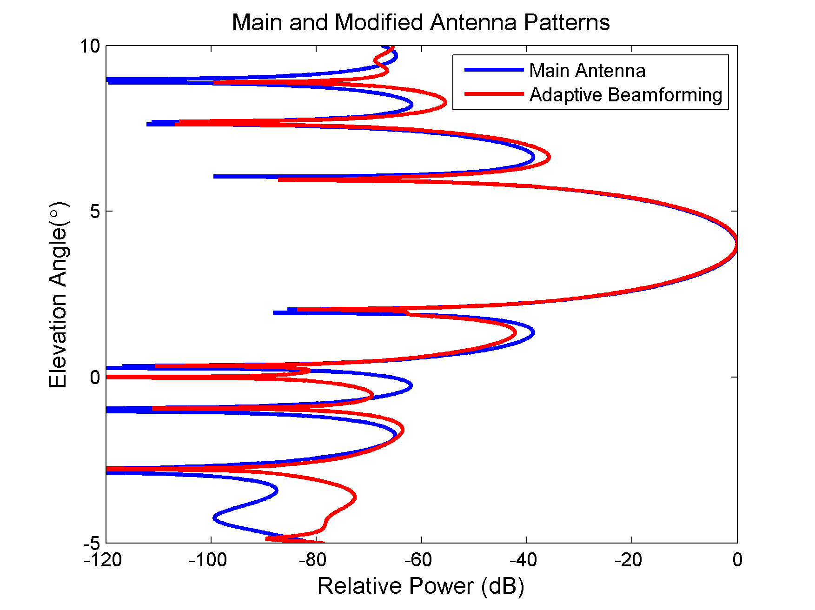
PAR to the Rescue: Improving Clutter Mitigation with Adaptive Beamforming
Christopher Curtis
Clutter Filtering Challenges
Conventional ground clutter filters discriminate between clutter and weather based on radial velocity.
When clutter and weather have sufficiently different velocities, they work very well.
When the weather velocity is near zero, clutter filtering can affect the estimates of meteorological variables.
Clutter filtering is also difficult when collecting a small number of pulses (e.g., detection scans, beam multiplexing), techniques that could be useful on a phased array
NWRT as a Proof-of-Concept
Is there another way to discriminate between clutter and weather signals?
Combining multiple channels from antennas at different positions allows spatial filtering.
Spatial filtering is a method of adaptive beamforming that discriminates based on position in space.
Antenna pattern can be changed to reduce sensitivity in certain directions (nulling).
NWRT Multi-Channel Results
By properly combining the channels, ground clutter can be removed using spatial filtering.
Modern Active Arrays
Modern active arrays such as the Advanced Technology Demonstrator provide more channels and a different array geometry, leading to new research opportunities.

Slide 2
PAR to the Rescue: Improving Clutter Mitigation with Adaptive Beamforming
Christopher Curtis
Clutter Filtering Challenges
Conventional ground clutter filters discriminate between clutter and weather based on radial velocity.
When clutter and weather have sufficiently different velocities, they work very well.
When the weather velocity is near zero, clutter filtering can affect the estimates of meteorological variables.
Clutter filtering is also difficult when collecting a small number of pulses (e.g., detection scans, beam multiplexing), techniques that could be useful on a phased array
NWRT as a Proof-of-Concept
Is there another way to discriminate between clutter and weather signals?
Combining multiple channels from antennas at different positions allows spatial filtering.
Spatial filtering is a method of adaptive beamforming that discriminates based on position in space.
Antenna pattern can be changed to reduce sensitivity in certain directions (nulling).
NWRT Multi-Channel Results
By properly combining the channels, ground clutter can be removed using spatial filtering.
Modern Active Arrays
Modern active arrays such as the Advanced Technology Demonstrator provide more channels and a different array geometry, leading to new research opportunities.

Slide 3
PAR to the Rescue: Improving Clutter Mitigation with Adaptive Beamforming
Christopher Curtis
Clutter Filtering Challenges
Conventional ground clutter filters discriminate between clutter and weather based on radial velocity.
When clutter and weather have sufficiently different velocities, they work very well.
When the weather velocity is near zero, clutter filtering can affect the estimates of meteorological variables.
Clutter filtering is also difficult when collecting a small number of pulses (e.g., detection scans, beam multiplexing), techniques that could be useful on a phased array
NWRT as a Proof-of-Concept
Is there another way to discriminate between clutter and weather signals?
Combining multiple channels from antennas at different positions allows spatial filtering.
Spatial filtering is a method of adaptive beamforming that discriminates based on position in space.
Antenna pattern can be changed to reduce sensitivity in certain directions (nulling).
NWRT Multi-Channel Results
By properly combining the channels, ground clutter can be removed using spatial filtering.
Modern Active Arrays
Modern active arrays such as the Advanced Technology Demonstrator provide more channels and a different array geometry, leading to new research opportunities.

Slide 4
PAR to the Rescue: Improving Clutter Mitigation with Adaptive Beamforming
Christopher Curtis
Clutter Filtering Challenges
Conventional ground clutter filters discriminate between clutter and weather based on radial velocity.
When clutter and weather have sufficiently different velocities, they work very well.
When the weather velocity is near zero, clutter filtering can affect the estimates of meteorological variables.
Clutter filtering is also difficult when collecting a small number of pulses (e.g., detection scans, beam multiplexing), techniques that could be useful on a phased array
NWRT as a Proof-of-Concept
Is there another way to discriminate between clutter and weather signals?
Combining multiple channels from antennas at different positions allows spatial filtering.
Spatial filtering is a method of adaptive beamforming that discriminates based on position in space.
Antenna pattern can be changed to reduce sensitivity in certain directions (nulling).
NWRT Multi-Channel Results
By properly combining the channels, ground clutter can be removed using spatial filtering.
Modern Active Arrays
Modern active arrays such as the Advanced Technology Demonstrator provide more channels and a different array geometry, leading to new research opportunities.

Slide 5
PAR to the Rescue: Improving Clutter Mitigation with Adaptive Beamforming
Christopher Curtis
Clutter Filtering Challenges
Conventional ground clutter filters discriminate between clutter and weather based on radial velocity.
When clutter and weather have sufficiently different velocities, they work very well.
When the weather velocity is near zero, clutter filtering can affect the estimates of meteorological variables.
Clutter filtering is also difficult when collecting a small number of pulses (e.g., detection scans, beam multiplexing), techniques that could be useful on a phased array
NWRT as a Proof-of-Concept
Is there another way to discriminate between clutter and weather signals?
Combining multiple channels from antennas at different positions allows spatial filtering.
Spatial filtering is a method of adaptive beamforming that discriminates based on position in space.
Antenna pattern can be changed to reduce sensitivity in certain directions (nulling).
NWRT Multi-Channel Results
By properly combining the channels, ground clutter can be removed using spatial filtering.
Modern Active Arrays
Modern active arrays such as the Advanced Technology Demonstrator provide more channels and a different array geometry, leading to new research opportunities.

Slide 6
PAR to the Rescue: Improving Clutter Mitigation with Adaptive Beamforming
Christopher Curtis
Clutter Filtering Challenges
Conventional ground clutter filters discriminate between clutter and weather based on radial velocity.
When clutter and weather have sufficiently different velocities, they work very well.
When the weather velocity is near zero, clutter filtering can affect the estimates of meteorological variables.
Clutter filtering is also difficult when collecting a small number of pulses (e.g., detection scans, beam multiplexing), techniques that could be useful on a phased array
NWRT as a Proof-of-Concept
Is there another way to discriminate between clutter and weather signals?
Combining multiple channels from antennas at different positions allows spatial filtering.
Spatial filtering is a method of adaptive beamforming that discriminates based on position in space.
Antenna pattern can be changed to reduce sensitivity in certain directions (nulling).
NWRT Multi-Channel Results
By properly combining the channels, ground clutter can be removed using spatial filtering.
Modern Active Arrays
Modern active arrays such as the Advanced Technology Demonstrator provide more channels and a different array geometry, leading to new research opportunities.
Mainlobe
Null
Sidelobes

Slide 7
PAR to the Rescue: Improving Clutter Mitigation with Adaptive Beamforming
Christopher Curtis
Clutter Filtering Challenges
Conventional ground clutter filters discriminate between clutter and weather based on radial velocity.
When clutter and weather have sufficiently different velocities, they work very well.
When the weather velocity is near zero, clutter filtering can affect the estimates of meteorological variables.
Clutter filtering is also difficult when collecting a small number of pulses (e.g., detection scans, beam multiplexing), techniques that could be useful on a phased array
NWRT as a Proof-of-Concept
Is there another way to discriminate between clutter and weather signals?
Combining multiple channels from antennas at different positions allows spatial filtering.
Spatial filtering is a method of adaptive beamforming that discriminates based on position in space.
Antenna pattern can be changed to reduce sensitivity in certain directions (nulling).
NWRT Multi-Channel Results
By properly combining the channels, ground clutter can be removed using spatial filtering.
Modern Active Arrays
Modern active arrays such as the Advanced Technology Demonstrator provide more channels and a different array geometry, leading to new research opportunities.

Slide 8
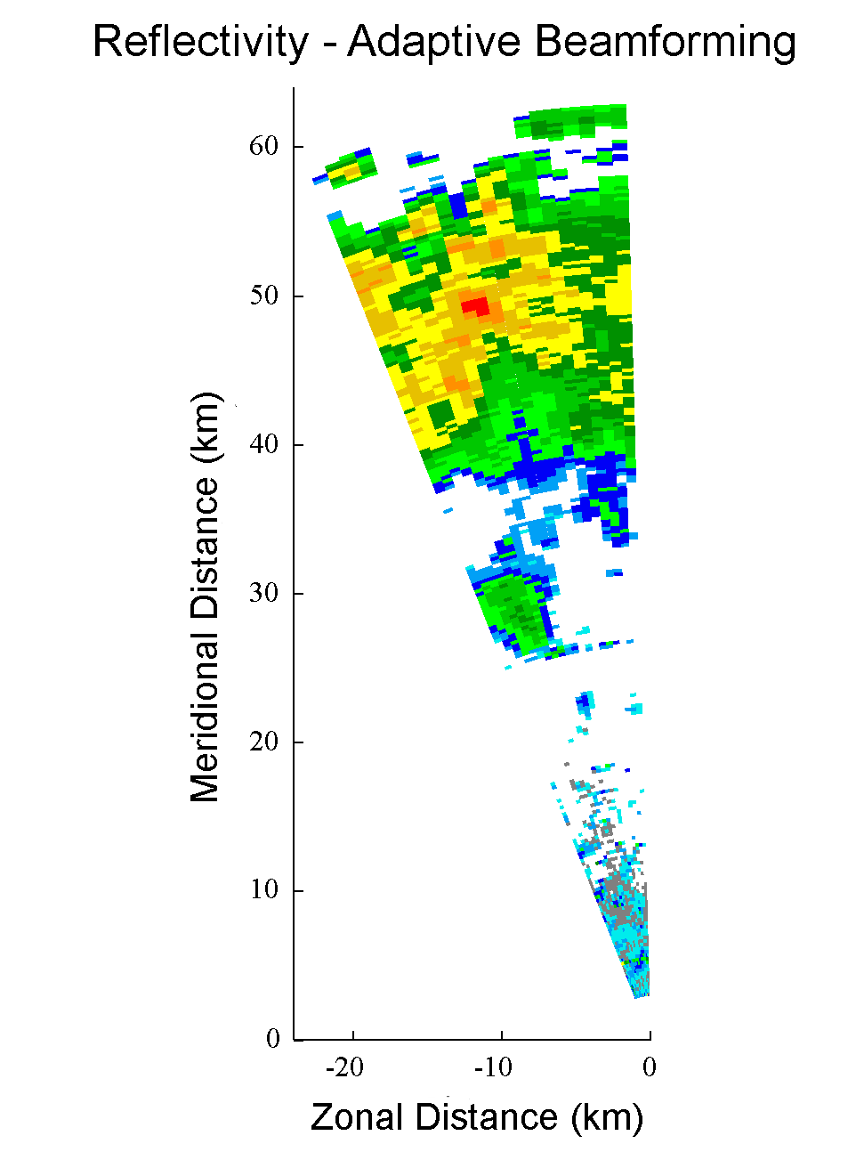
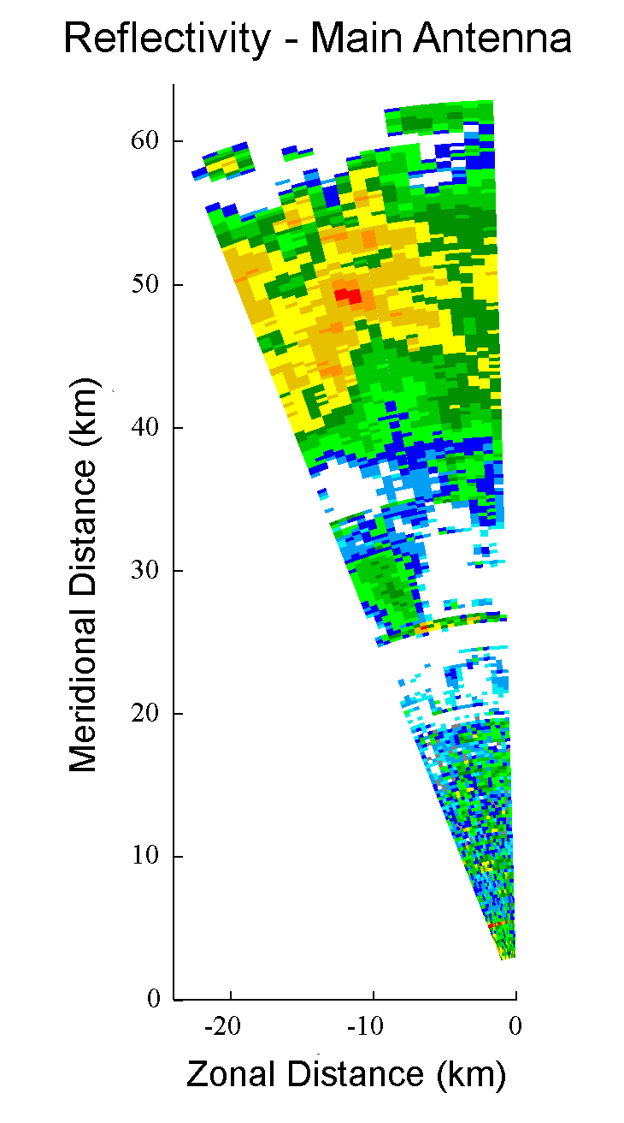
PAR to the Rescue: Improving Clutter Mitigation with Adaptive Beamforming
Christopher Curtis
Clutter Filtering Challenges
Conventional ground clutter filters discriminate between clutter and weather based on radial velocity.
When clutter and weather have sufficiently different velocities, they work very well.
When the weather velocity is near zero, clutter filtering can affect the estimates of meteorological variables.
Clutter filtering is also difficult when collecting a small number of pulses (e.g., detection scans, beam multiplexing), techniques that could be useful on a phased array
NWRT as a Proof-of-Concept
Is there another way to discriminate between clutter and weather signals?
Combining multiple channels from antennas at different positions allows spatial filtering.
Spatial filtering is a method of adaptive beamforming that discriminates based on position in space.
Antenna pattern can be changed to reduce sensitivity in certain directions (nulling).
NWRT Multi-Channel Results
By properly combining the channels, ground clutter can be removed using spatial filtering.
Modern Active Arrays
Modern active arrays such as the Advanced Technology Demonstrator provide more channels and a different array geometry, leading to new research opportunities.

Slide 9
PAR to the Rescue: Improving Clutter Mitigation with Adaptive Beamforming
Christopher Curtis
Clutter Filtering Challenges
Conventional ground clutter filters discriminate between clutter and weather based on radial velocity.
When clutter and weather have sufficiently different velocities, they work very well.
When the weather velocity is near zero, clutter filtering can affect the estimates of meteorological variables.
Clutter filtering is also difficult when collecting a small number of pulses (e.g., detection scans, beam multiplexing), techniques that could be useful on a phased array
NWRT as a Proof-of-Concept
Is there another way to discriminate between clutter and weather signals?
Combining multiple channels from antennas at different positions allows spatial filtering.
Spatial filtering is a method of adaptive beamforming that discriminates based on position in space.
Antenna pattern can be changed to reduce sensitivity in certain directions (nulling).
NWRT Multi-Channel Results
By properly combining the channels, ground clutter can be removed using spatial filtering.
Modern Active Arrays
Modern active arrays such as the Advanced Technology Demonstrator provide more channels and a different array geometry, leading to new research opportunities.

Slide 10
PAR to the Rescue: Improving Clutter Mitigation with Adaptive Beamforming
Christopher Curtis
Clutter Filtering Challenges
Conventional ground clutter filters discriminate between clutter and weather based on radial velocity.
When clutter and weather have sufficiently different velocities, they work very well.
When the weather velocity is near zero, clutter filtering can affect the estimates of meteorological variables.
Clutter filtering is also difficult when collecting a small number of pulses (e.g., detection scans, beam multiplexing), techniques that could be useful on a phased array
NWRT as a Proof-of-Concept
Is there another way to discriminate between clutter and weather signals?
Combining multiple channels from antennas at different positions allows spatial filtering.
Spatial filtering is a method of adaptive beamforming that discriminates based on position in space.
Antenna pattern can be changed to reduce sensitivity in certain directions (nulling).
NWRT Multi-Channel Results
By properly combining the channels, ground clutter can be removed using spatial filtering.
Modern Active Arrays
Modern active arrays such as the Advanced Technology Demonstrator provide more channels and a different array geometry, leading to new research opportunities.
76 Panels, 24 Subarrays
Subarray
Phase Center
4x2 Subarray

Slide 11
PAR to the Rescue: Improving Clutter Mitigation with Adaptive Beamforming
Christopher Curtis
Clutter Filtering Challenges
Conventional ground clutter filters discriminate between clutter and weather based on radial velocity.
When clutter and weather have sufficiently different velocities, they work very well.
When the weather velocity is near zero, clutter filtering can affect the estimates of meteorological variables.
Clutter filtering is also difficult when collecting a small number of pulses (e.g., detection scans, beam multiplexing), techniques that could be useful on a phased array
NWRT as a Proof-of-Concept
Is there another way to discriminate between clutter and weather signals?
Combining multiple channels from antennas at different positions allows spatial filtering.
Spatial filtering is a method of adaptive beamforming that discriminates based on position in space.
Antenna pattern can be changed to reduce sensitivity in certain directions (nulling).
NWRT Multi-Channel Results
By properly combining the channels, ground clutter can be removed using spatial filtering.
Modern Active Arrays
Modern active arrays such as the Advanced Technology Demonstrator provide more channels and a different array geometry, leading to new research opportunities.

