Slide 1
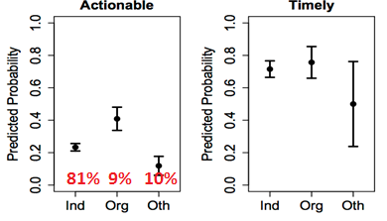
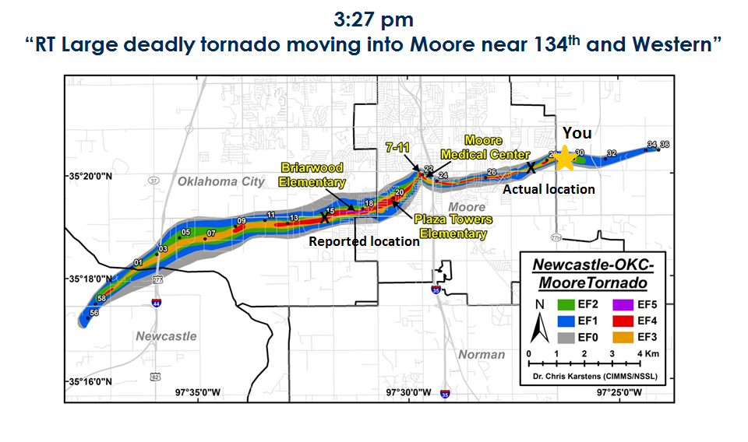
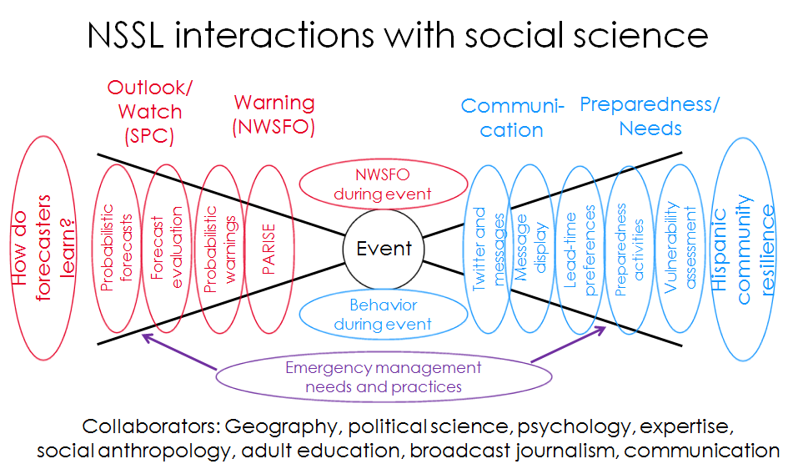
Social Science and Severe Weather Research
Harold Brooks (NOAA/NSSL), Makenzie Krocak (Hollings Scholar, Iowa State Univ.), Joseph Ripberger (Univ. of Oklahoma)
Example-Twitter and Tornadoes
Imagine you’re in 20 May’s path
Strategy
What question do we want to answer?
What data are needed?
What disciplines are needed?
Collaborate with right people
What we learned and will do
Weather organizations such as NWS
provide more timely and actionable
information on twitter
Want to test impact of message
“grammar” on twitter flow (e.g., what,
where, when)
Sampled 5000 tweets for event
Determined if verifiable, accurate,
actionable, timely
Looked at source (individual, orgs)
and weather “enthusiasts”

