Slide 1
Multi-Radar Multi-Sensor (MRMS) Quantitative Precipitation Estimation (QPE)
Jian Zhang (NSSL)
February 25–27, 2015
National Weather Center
Norman, Oklahoma

Slide 2
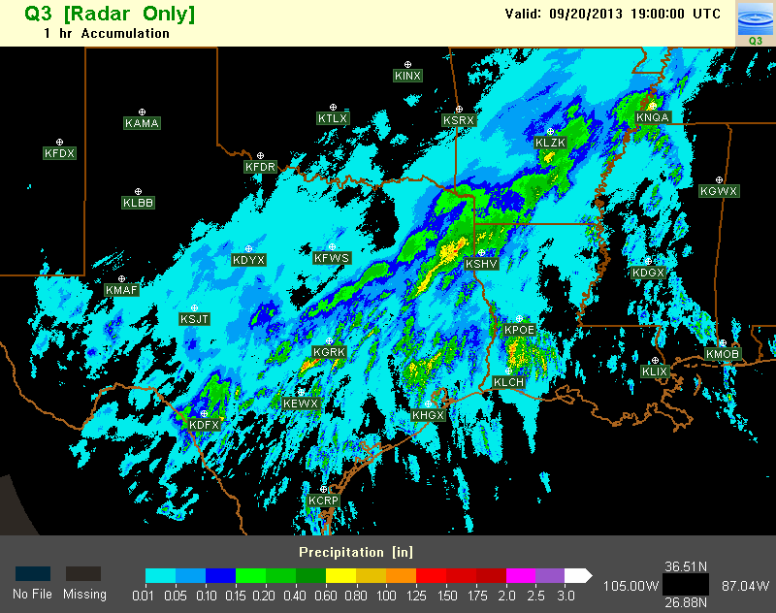
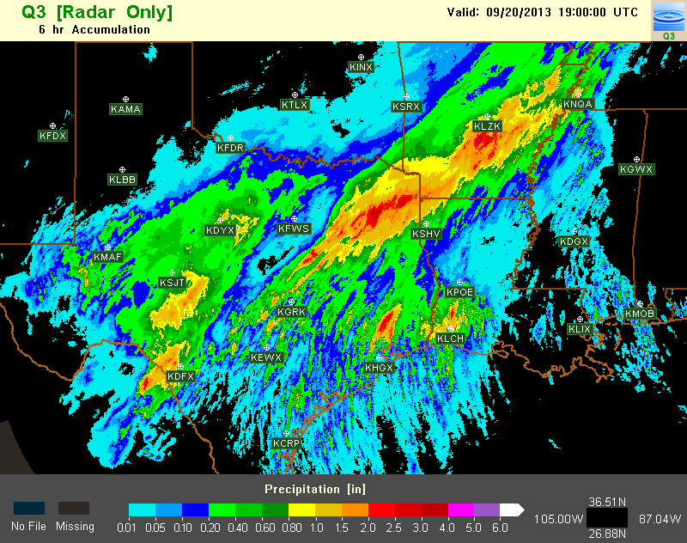
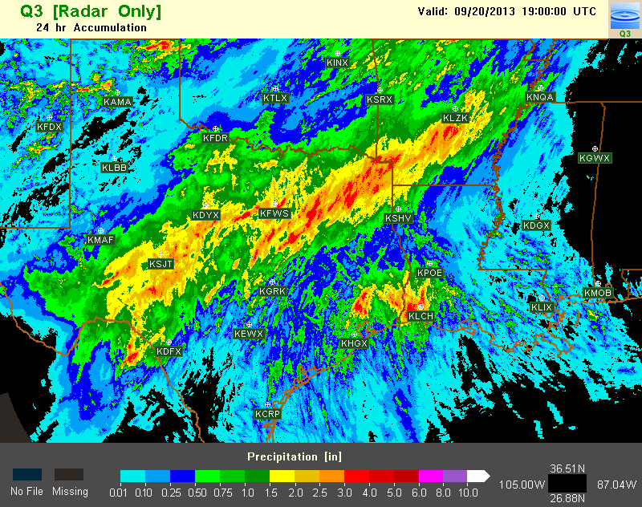
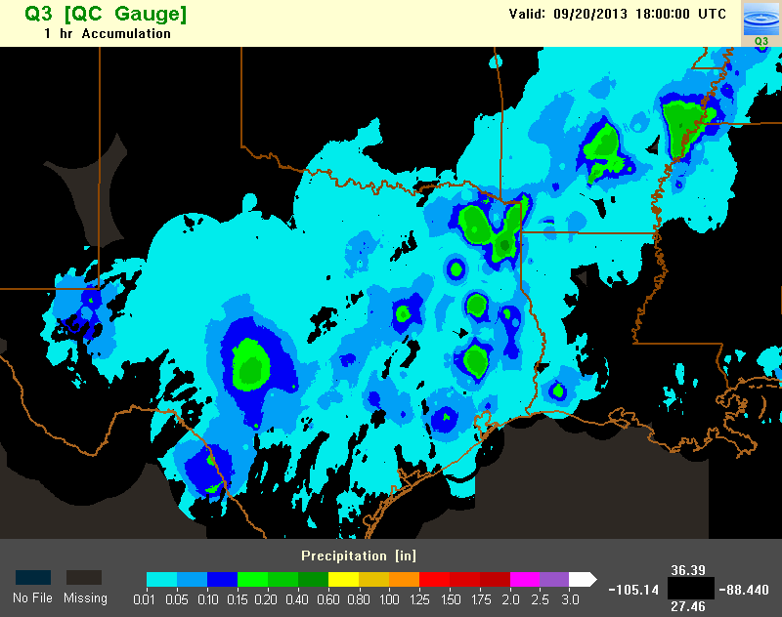
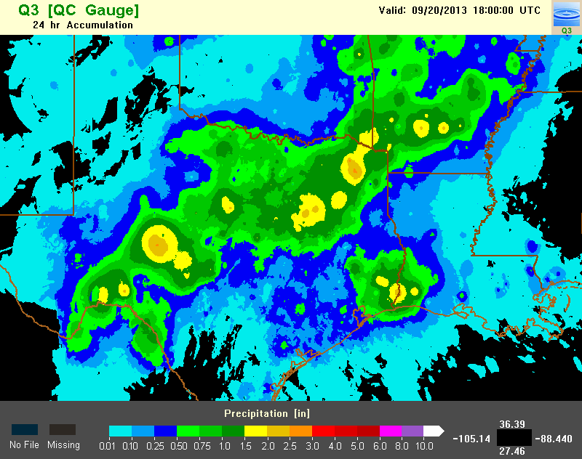
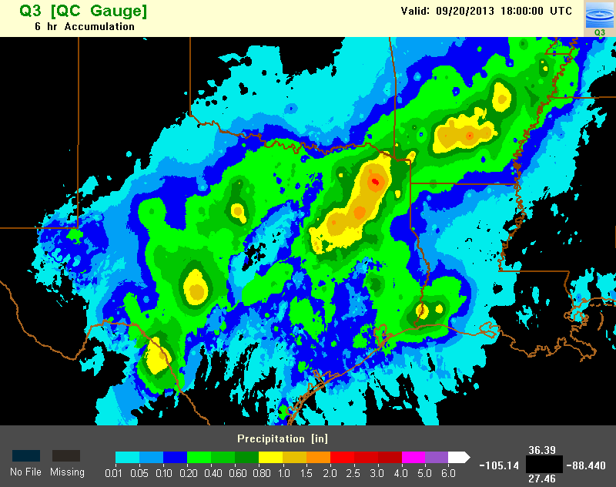
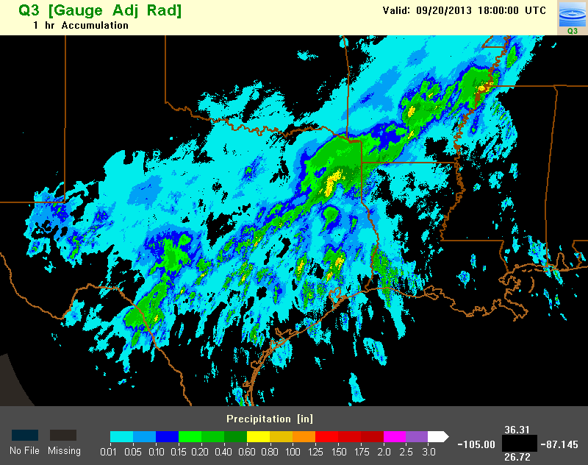
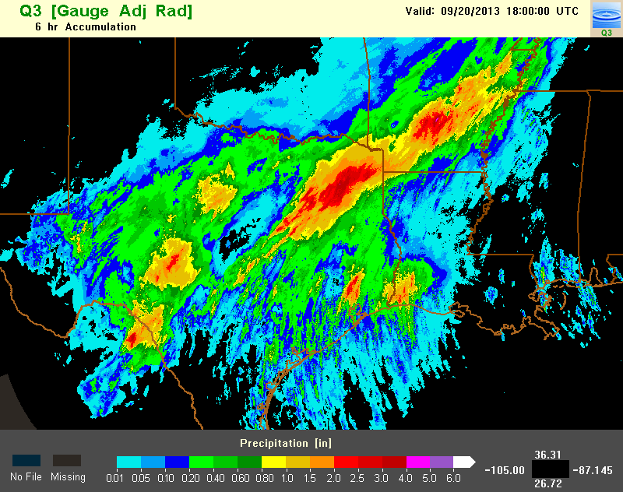
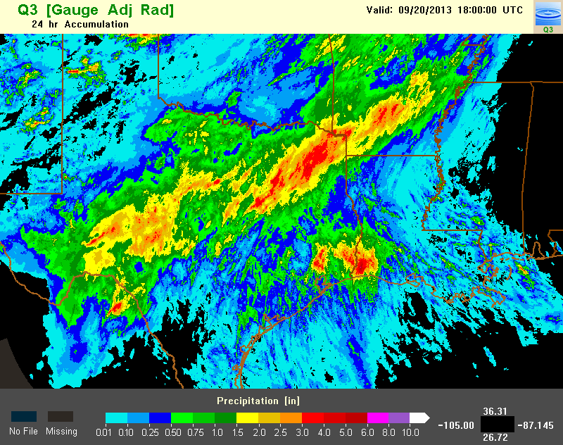
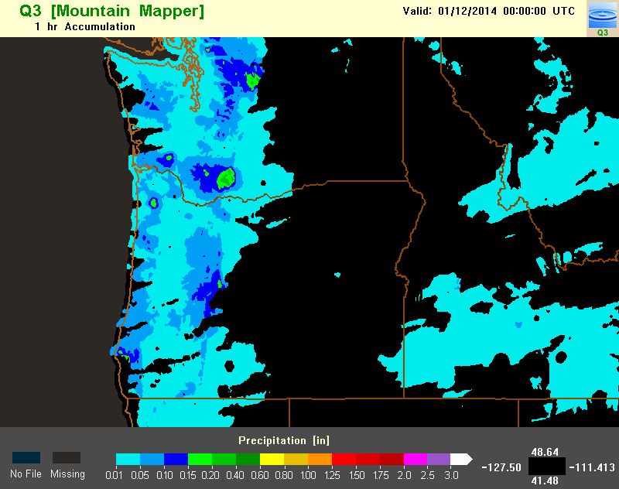
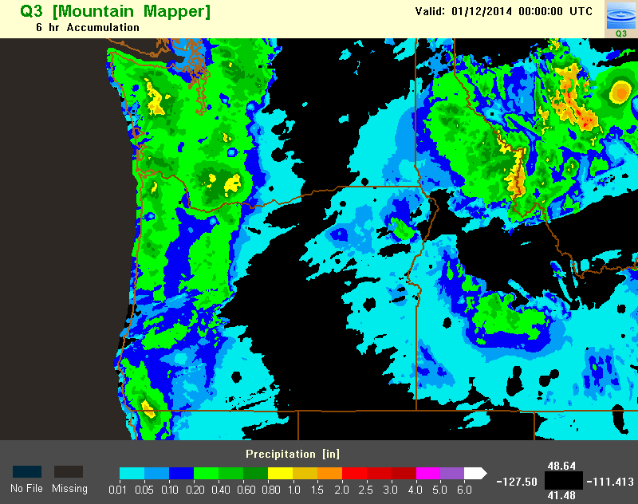
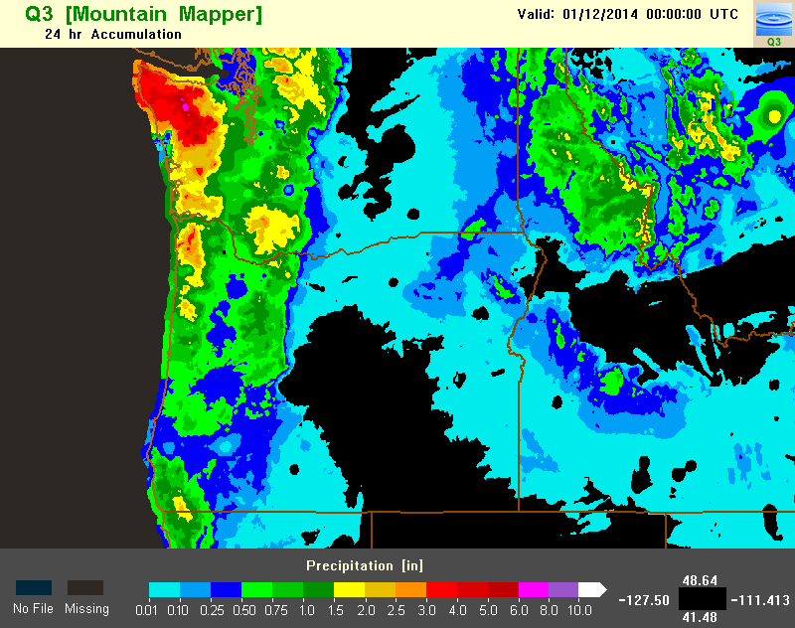
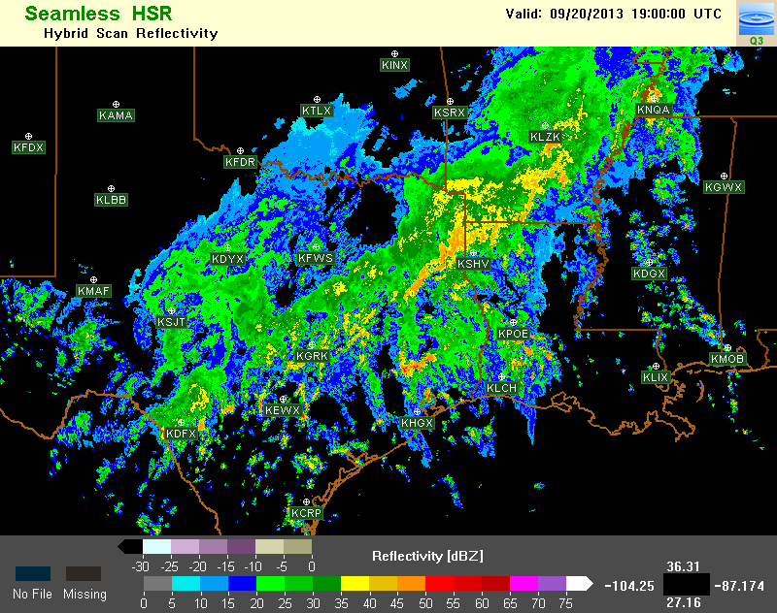
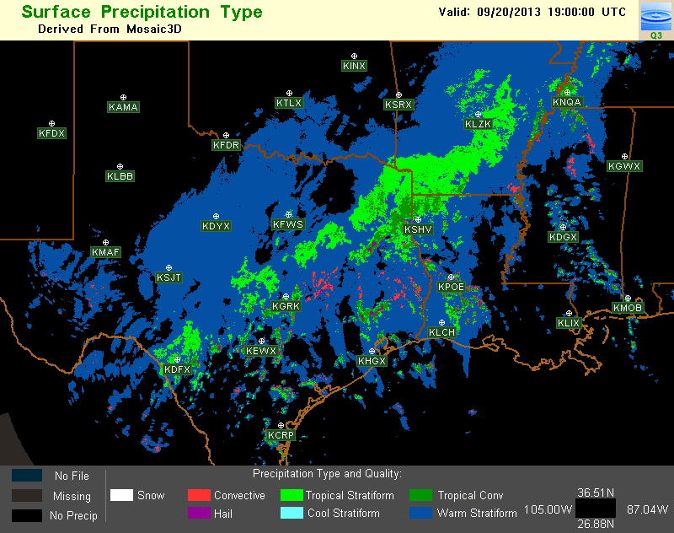
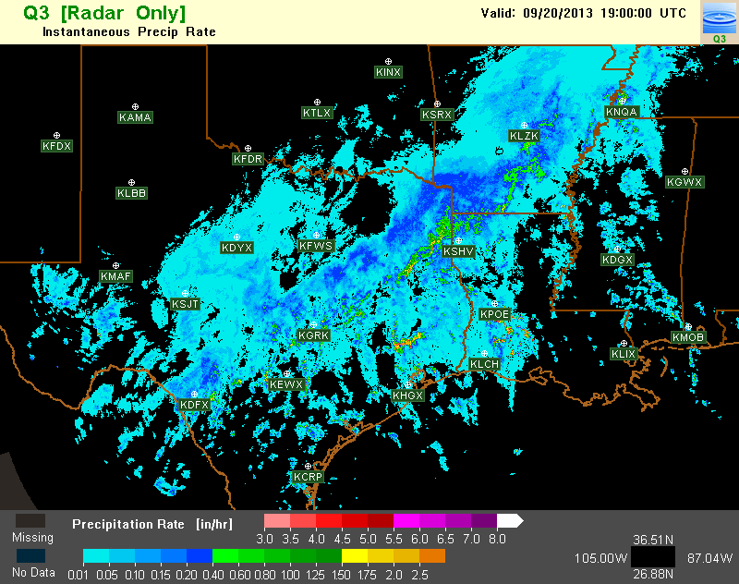
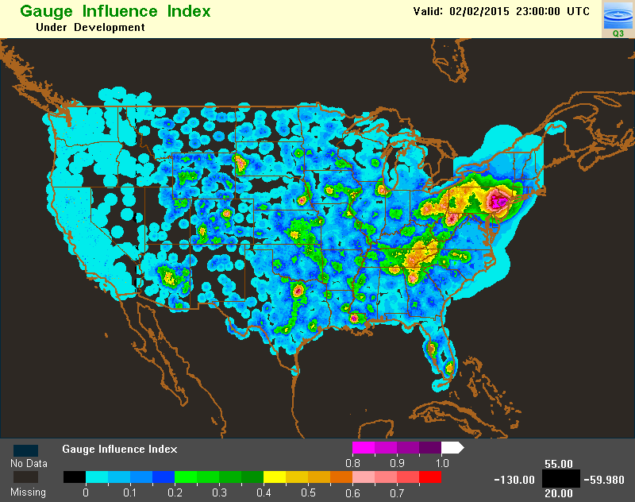
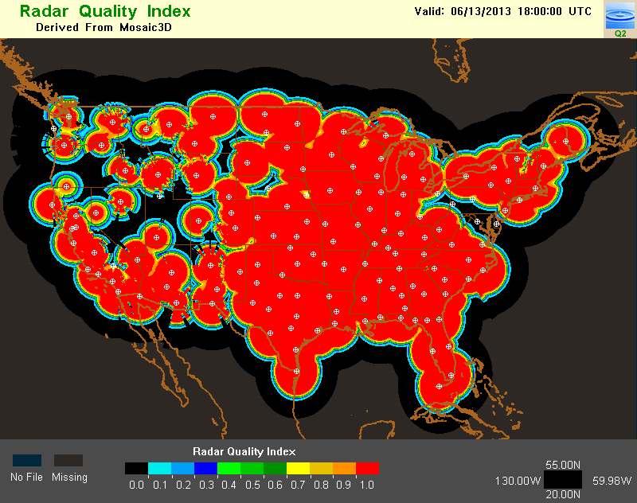
What is MRMS QPE?
1, 3, 6, 12, 24, 48 and 72 hr accumulations
Radar QPE
Gauge QPE
Local gauge bias corrected radar QPE
Gauge + orographic pcp climatology QPE
Associated with Radar QPE [1km x 1km, 2 min]:
Surface Precipitation Type
Surface Precipitation Rate
Radar QPE Quality Index (RQI)
other…
Associated with Gauge QPE [1km x 1km, 1 hr]:
GII 23Z 2/2/2015
RQI 18Z 6/13/2013
Gauge Influence Index (GII)
Notes:
The MRMS QPE consists of an ensemble of four QPE products. Each product group has a suite of accumulations ranging from 1 to 72hr.
Associated with radar QPE, there are several high-resolution products such as surface precipitation type and rate. These high-resolution products are very useful for flash flood and urban hydrology applications.
A radar QPE quality index product was developed to show the spatial variation of radar QPE uncertainties. This is an example of the RQI valid at 18Z on Jun 13th, 2013. The color red represents high quality and black low quality. This RQI image shows that the radar QPE is generally more accurate in the eastern US than in the west. And in this upper-Atlantic coastal area, the radar QPE quality may be poor due to an radar outage.
Associated with the gauge based QPEs, there is a gauge influence index product, which shows the spatial distribution of gauge contributions.

Slide 3
Relevance
MRMS | NOAA’s mission
Uses most advanced polarimetric radar technologies and provides high-resolution information of precipitation types and amounts for the nation
Use cutting-edge research and high-tech instrumentation to provide citizens, planners, emergency managers and other decision makers with reliable information they need.
Products are used by WFOs, RFCs and private companies for flash flood and river flood warnings and water resources management
Protect life and property and conserve and protect natural resources
~70 users from government agencies, universities, and private companies
Notes:
So how does MRMS relates to NOAA’s mission?
MRMS uses polarimetric radar technologies to produce high-res precipitation products for the nation, which contributes to NOAA’s mission of using cutting edge technologies to provide people with useful information.
MRMS provided products for flood warnings and water resource managements, which contributed to NOAA’s mission of protecting life and property.
Currently we have ~70 users from government agencies, universities, and privates companies who get real-time data from our research system at NSSL.

Slide 4
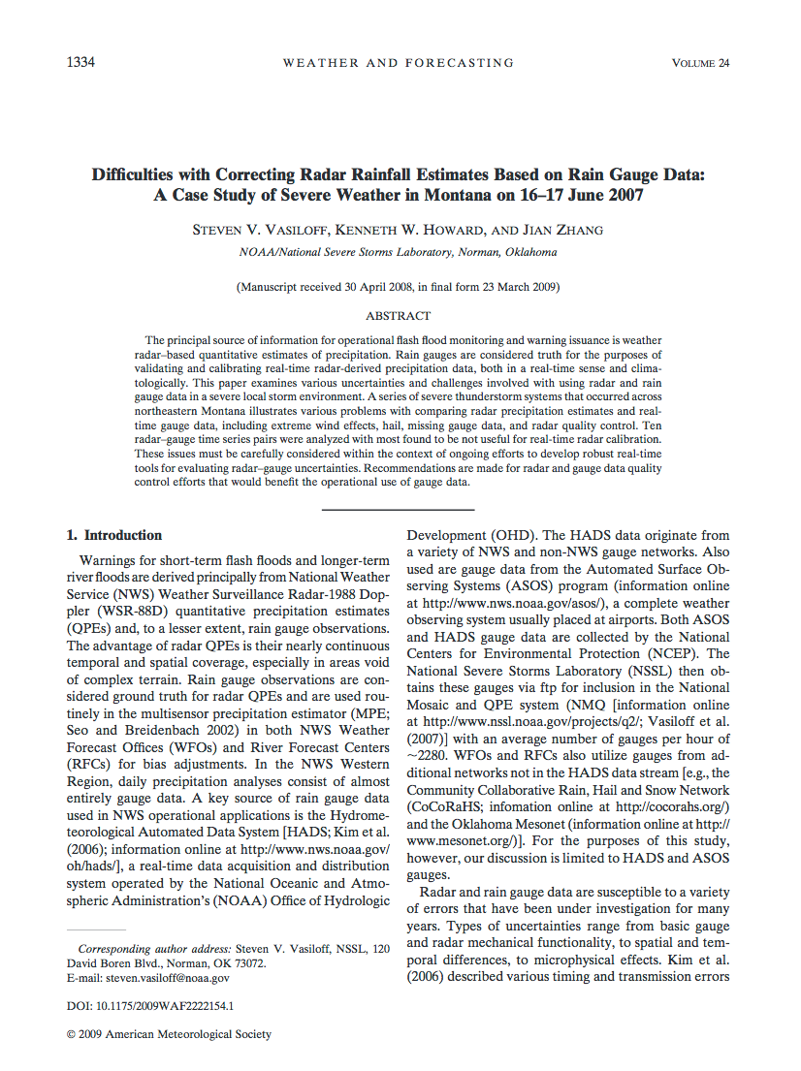
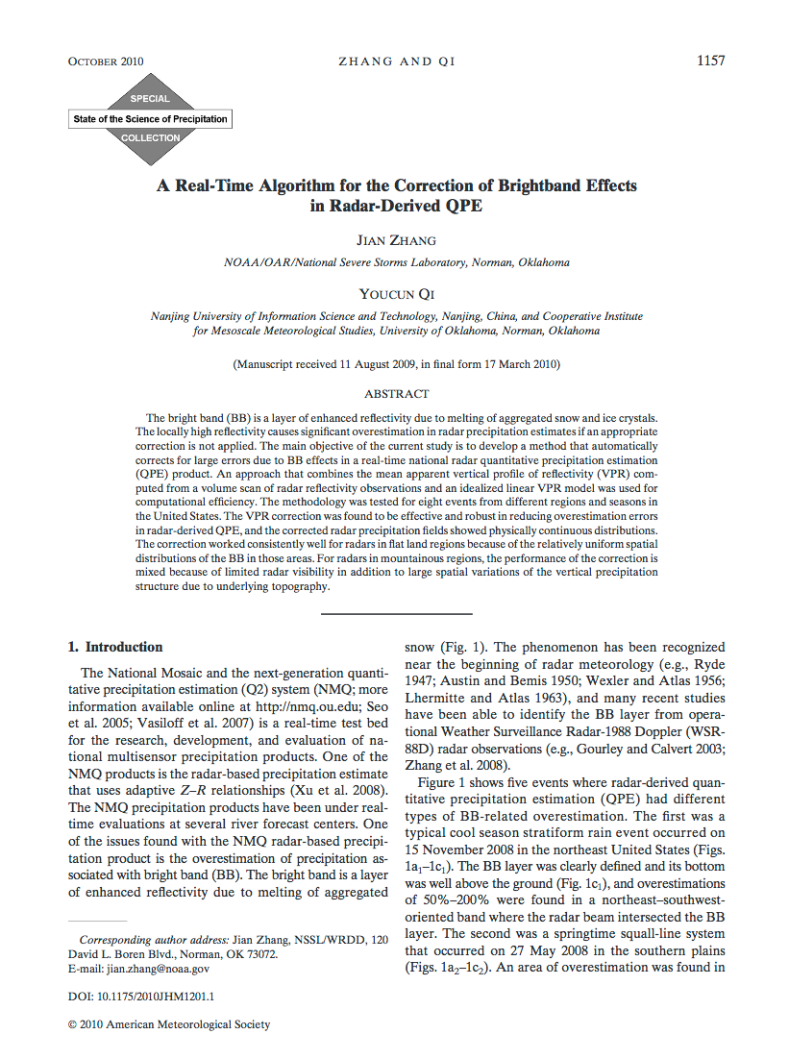
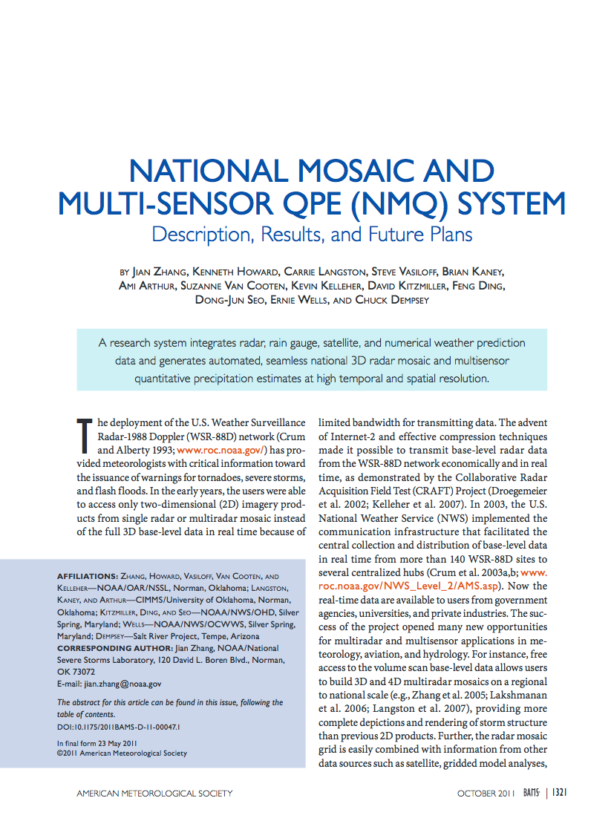
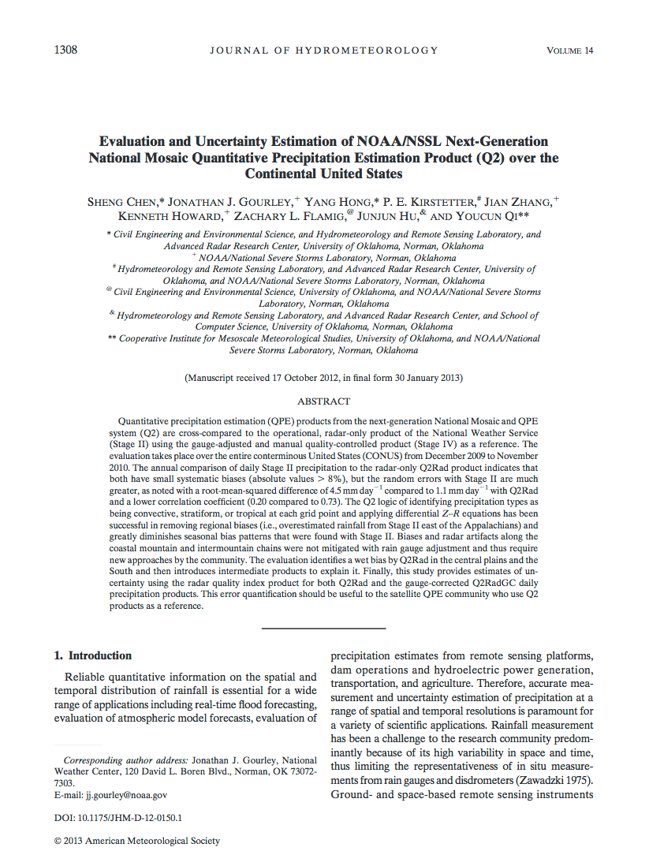
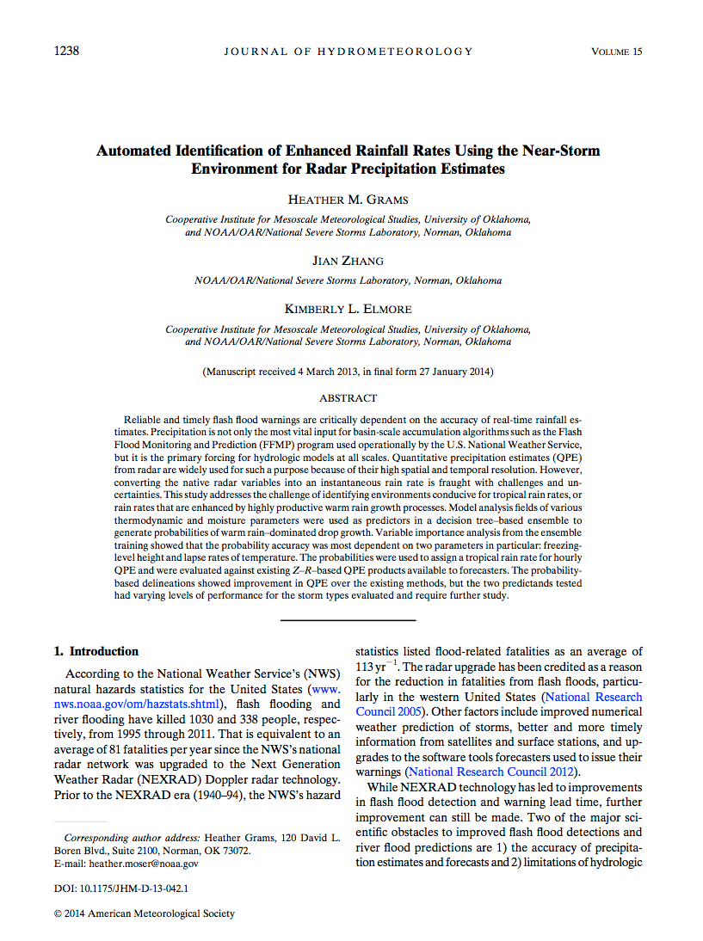
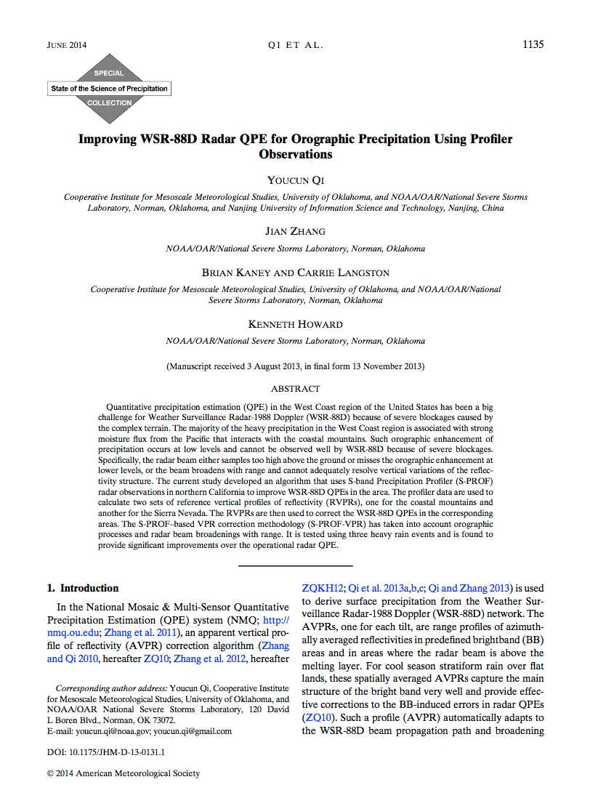
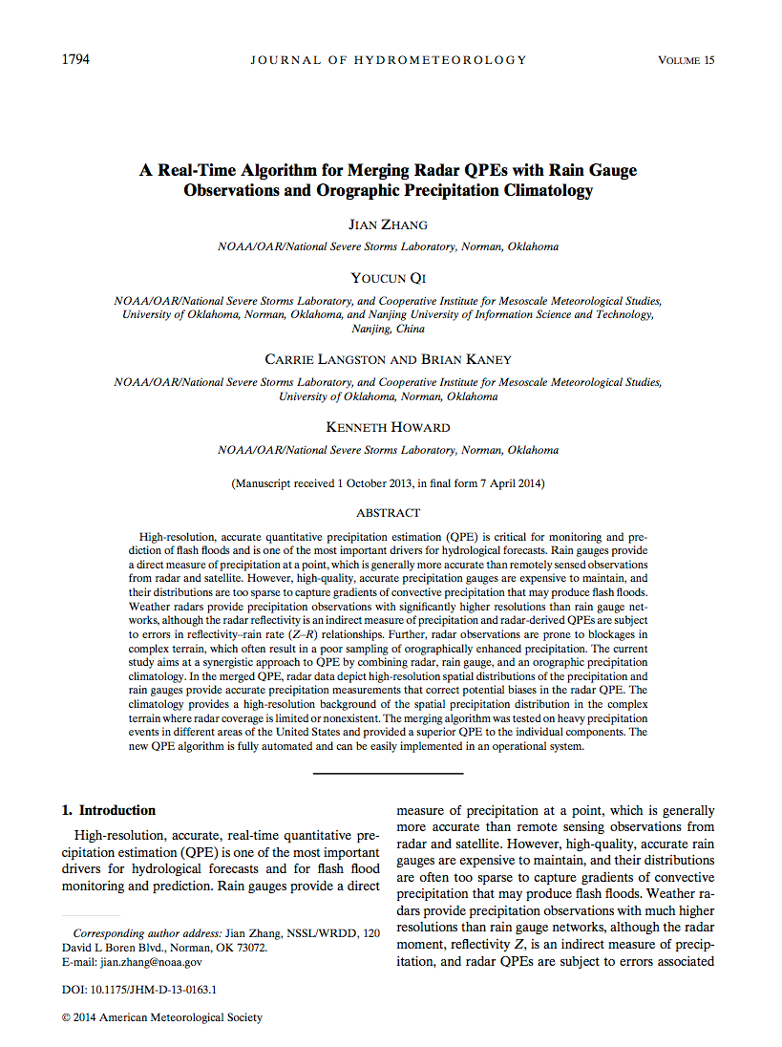
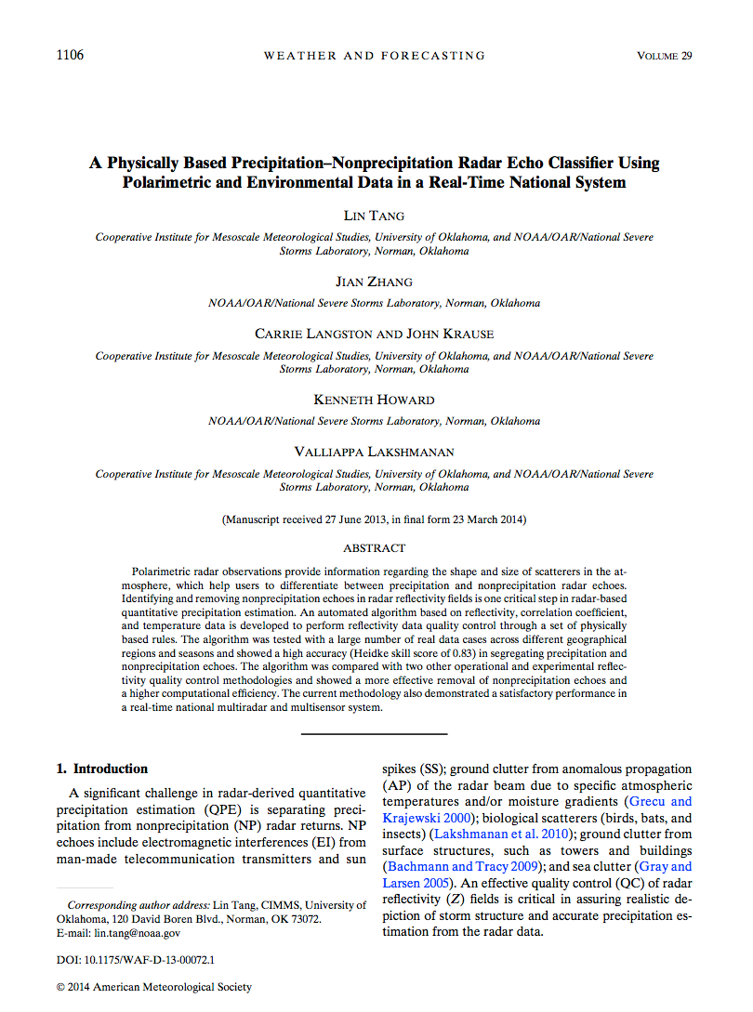
Quality
Refereed publications:
18 on MRMS QPE R&D;
40+ on MRMS product applications
Stage-II radar QPE
2009 “Q2” radar QPE
Present “Q3” radar QPE
Features
Impacts
Single-pol radar data quality control (QC)
Single-pol radar QC with environmental data
Dual-pol radar data QC
Elimination of non-meteorological echoes
Automated precipitation classification
Automated precipitation classification
More accurate spatial distributions of precipitation
One Z-R per radar domain
Five Z-Rs
Probability of Warm Rain;
Weighted mean of multi Z-Rs
Vertical Profile of Reflectivity (VPR) correction
Mitigated range-dependent radar QPE error
Higher-resolution for flash flood and urban hydrology applications
4 km, 1 hr
1 km, 5 min
1 km, 2 min
Operational in Sep. 2014
Notes:
In 2009, MRMS developed two techniques to improve the operational radar QPE, one is an automated precipitation classification and another the spatially and temporally varying Z-R relationships.
(Precipitation classification categories: stratiform rain, convective rain, tropical rain, hail, snow.)
The current MRMS has several improvements over the 2009 version.
First, the radar data quality control was upgraded from single-polarization to dual-polarization radar techniques.
Two more categories were added to the precipitation classification.
(separated stratiform rain into cold and warm seasons, and separated tropical rain into tropical/stratiform and tropical/convective rain).
A new product called “probability of warm rain” was developed to identify areas with enhanced rain rates based on atmospheric environmental data. The the precipitation rate is calculated through a weighted mean of multiple Z-R relationships based on the probability of warm rain.
(POWR is based on atmospheric environmental data, e.g., the height of freezing level, 1000-700mb mean relative humidity, 850-500mb lapse rate of temperature).
A vertical profile of reflectivity correction is developed to mitigate the range-dependent errors in radar QPE.
The research and development over the last five years resulted in 18 journal publications. In addition, MRMS products are used in various studies and appeared in over 40 AMS journal papers.
And MRMS went into operations last September.
Next I’ll show some examples of the impacts.

Slide 5
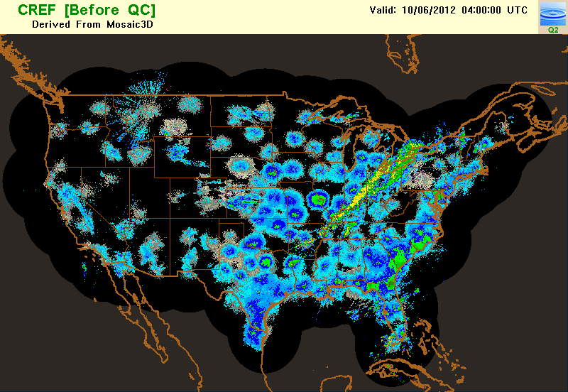
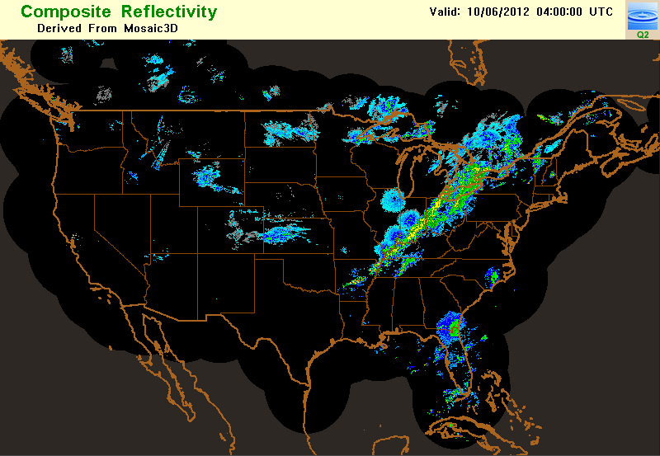
Quality (single-pol QC 2009)
Notes:
This image shows an unQC’d radar composite reflectivity mosaic over the CONUS, and this (click) is the QCed field using our 2009 radar QC technique. The red circles indicate areas with residual biological echoes that were not removed due to limitations in the single-pol radar QC technique.

Slide 6
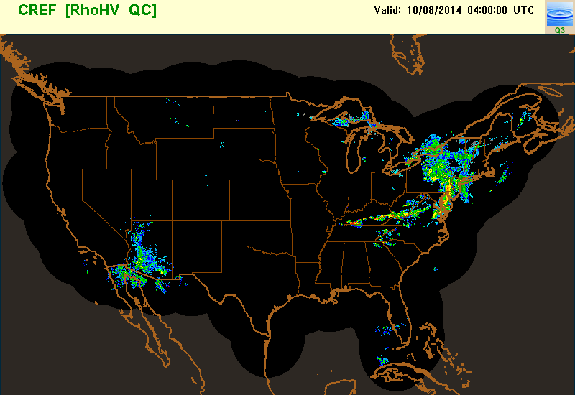
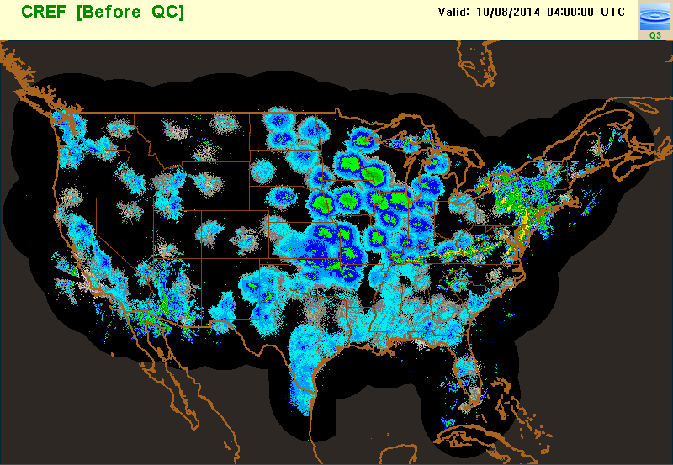
Quality (dual-pol QC present)
Notes:
This image also shows an unQC’d radar composite reflectivity mosaic over the CONUS, and this (click) shows the results after the current QC. The red circle indicates an area where biological echoes merged with rain. This would have been a challenge for single-pol radar techniques, but dual-pol radar QC eliminated the non-precipitation echoes very precisely.

Slide 7
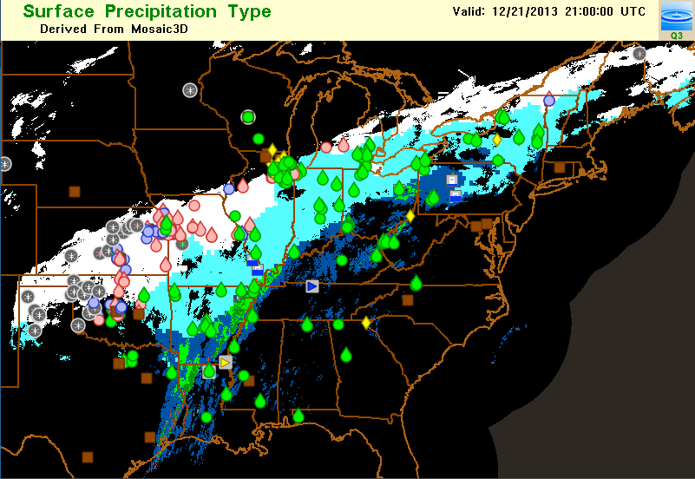
Quality (precipitation classification)
mPING obs
Notes:
This slide shows an example MRMS surface precipitation type field (color map) overlaid with the mPING observations (symbols). The rain/snow line matched the surface observations quite well in this case.

Slide 8
Performance (QPE)
Stage-II radar only (4 km, hrly, ~ 1hr latency)
MRMS radar only (1km, 2min, ~5 min latency)
MRMS local gauge bias corrected (1km, ~1hr latency)
Stage-IV (manual merging of multiple QPEs; 4-km, ~6-24hr latency)
Notes:
This slide shows the fractional mean absolute error of four daily QPEs with respect to the CoCoRaHS gauges over the entire year of 2014.
CoCoRaHS stands for community collaborative rain, hail and snow network, and the data are manually observed by volunteers.
The red line is the NWS operational radar only QPE called Stage-II, the blue line is the MRMS radar QPE, and green line MRMS local-gauge bias corrected radar QPE. All three are real-time automated QPE products. Among them, MRMS QPE has the highest spatial and temporal resolution and shortest latency since it does not need to wait for gauge data.
The orange line is another NWS operational QPE product called Stage-IV. It is manually created by forecasters using radar, gauge (including cocorahs), and sometime satellite data. Stage-IV is considered the most accurate national QPE, although it is a little coarser resolution and has a long latency due to the manual quality assurance processes.
The figure shows that the MRMS radar QPE provided consistent improvements over the Stage-II radar only QPE.
The MRMS local gauge bias corrected QPE provided further improvements over the radar QPE. Both MRMS products have been used by river forecast centers as an input for their Stage-IV product.

Slide 9
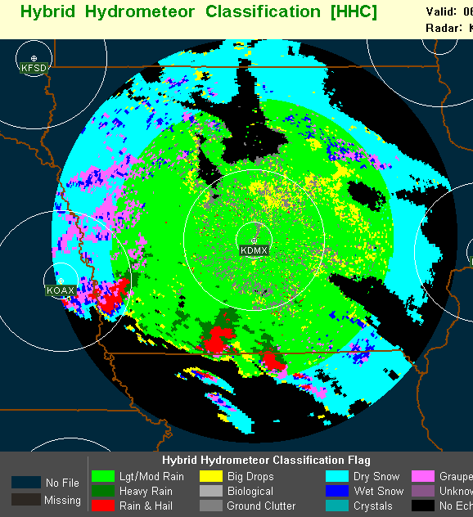
What’s Next?
Evaluate latest dual-pol radar QPE techniques across ConUS for all seasons
Based on the evaluation, develop a new synthetic dual-pol radar QPE in MRMS (“Q3DP”).
R(Z)
rain
hail/rain mix
melting layer/ice
R(A)
R(Z)
A: specific attenuation
K_{DP}: specific differential phase
Z_{VPRC}: reflectivity with vertical profile of reflectivity correction
R(K_{DP})
Towards operational implementation in 2016-17.

Slide 10
Thank You!
mrms.ou.edu

