Slide 1
NSSL’s Warn-on-Forecast Project
Dr. Lou Wicker
February 25–27, 2015
National Weather Center
Norman, Oklahoma

Slide 2
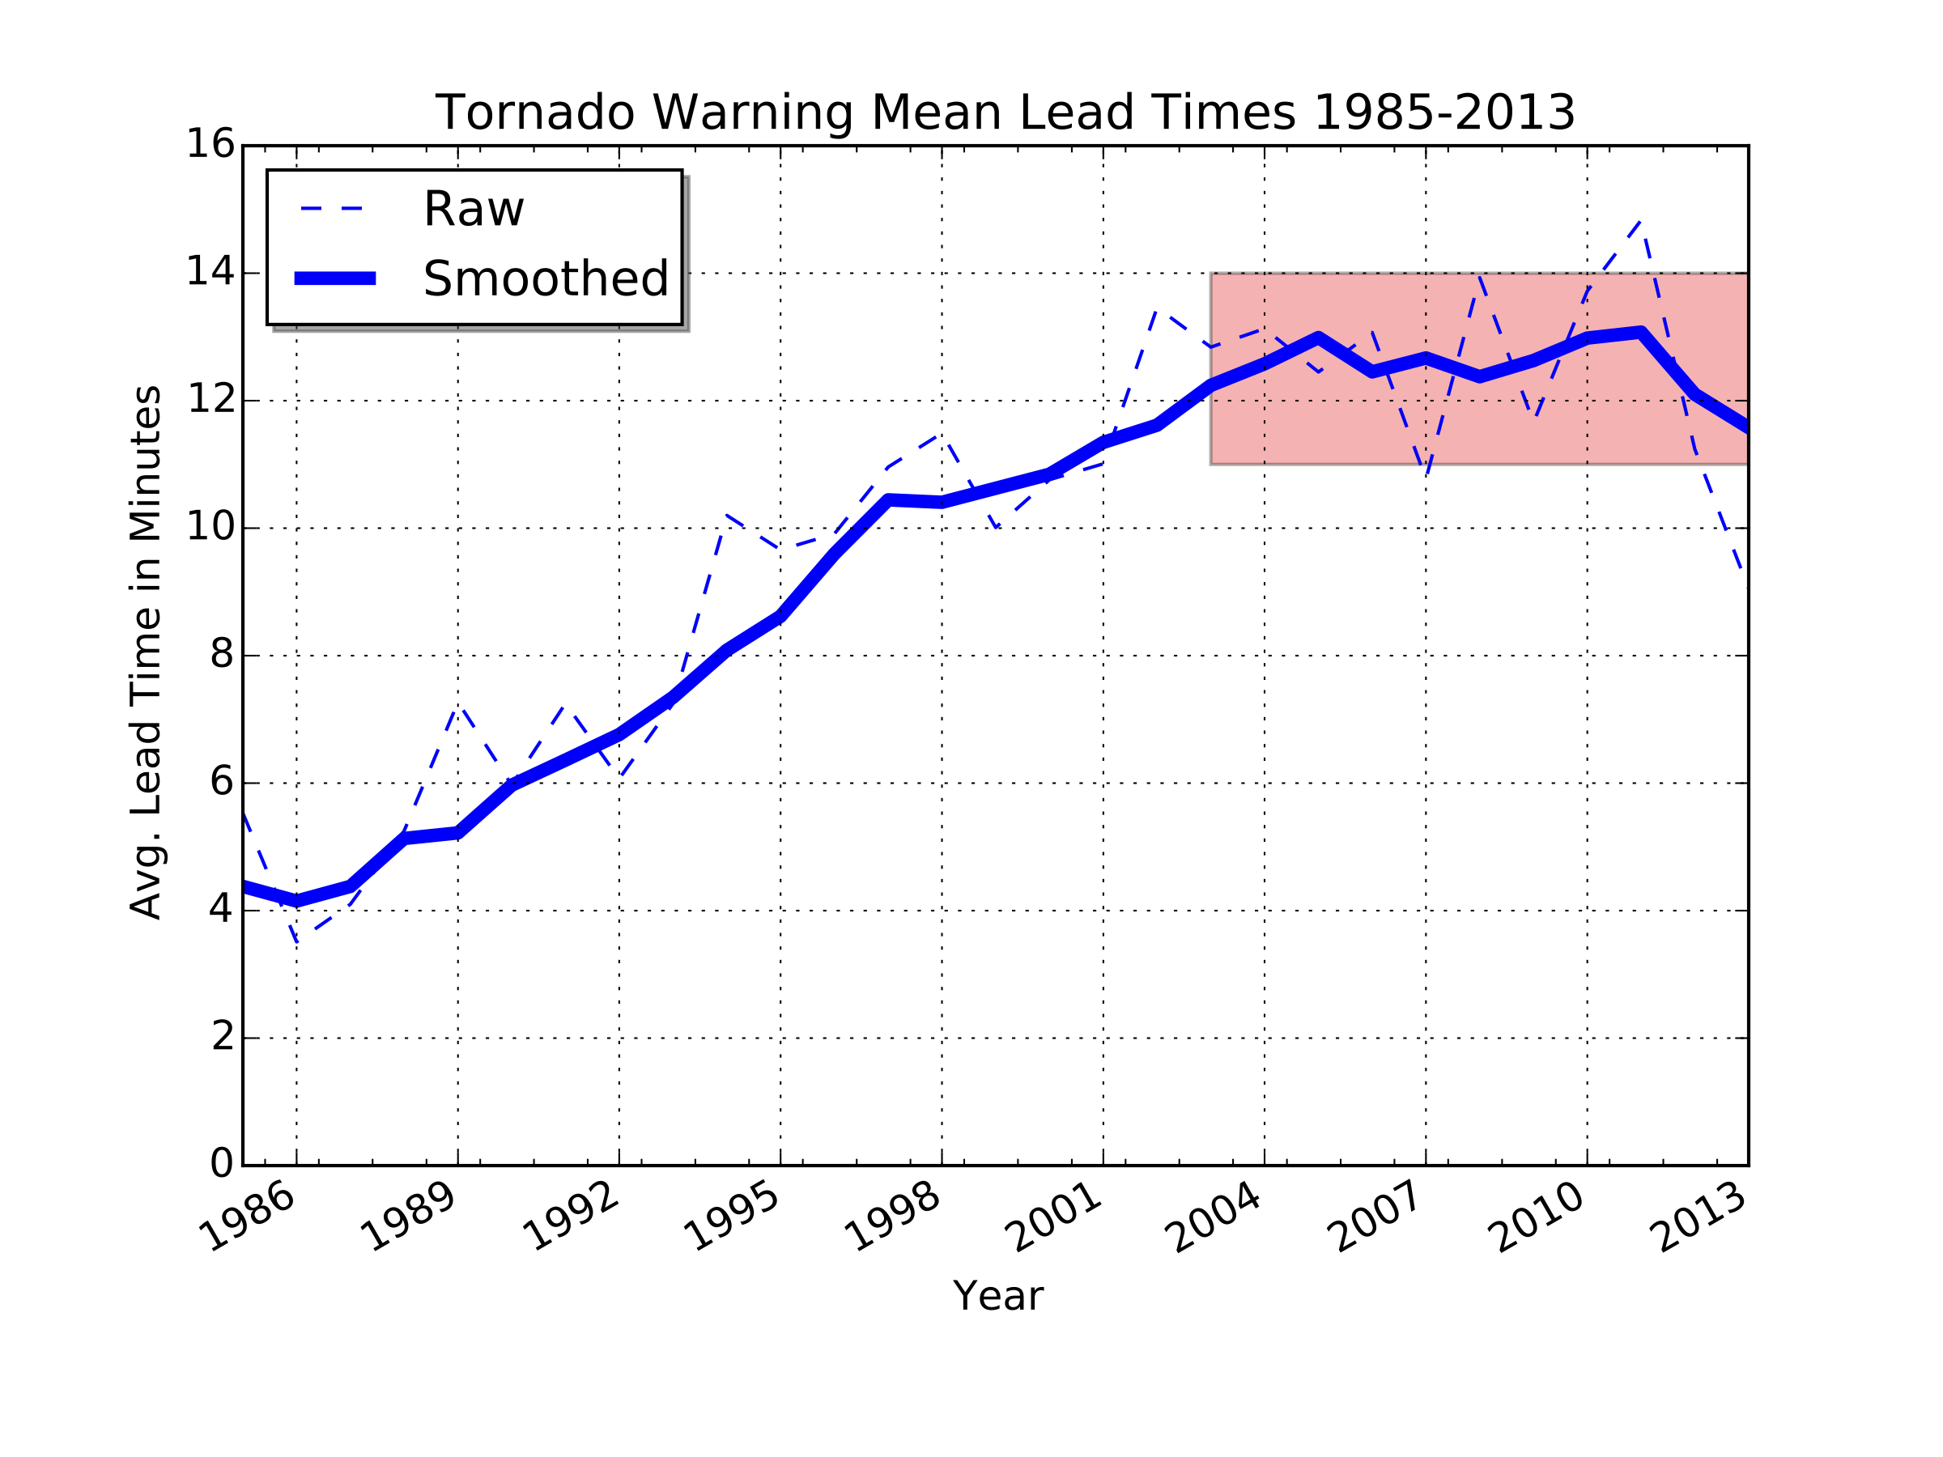

Motivation: Tornado warning lead-times have stopped improving
Notes:
Forecasters cannot use their knowledge of the environment plus the radar evolution to predict
Tornadoes much farther than 12-14 minutes ahead of time.
2013 is the last full year of verification data available. Data from later months in 2014 won’t be available for another few months.

Slide 3
Motivation: Tornado warning lead-times have stopped improving
Appear to have reached the limit for our current technologies and science….
Improvements from the WSR-88D, NWS modernization, and increased scientific knowledge of storms
Notes:
Forecasters cannot use their knowledge of the environment plus the radar evolution to predict
Tornadoes much farther than 12-14 minutes ahead of time.

Slide 4
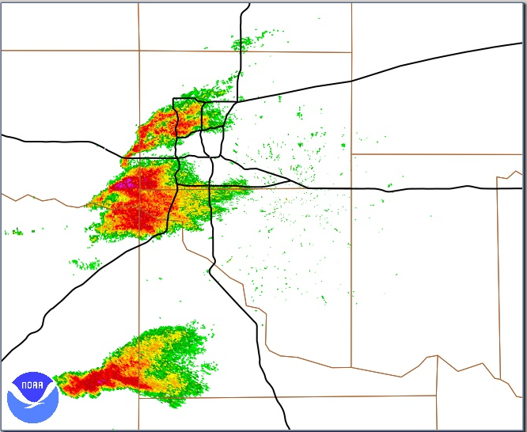
Current Warning Process: “Warn on Detection”
KTLX Radar 19:25 UTC 20 May 2013
Notes:
Forecaster sees a rapidly developing storm in an envirorment that has significant tornado potential.
Forecaster is watching for signs of rotation in radar data
No rotation yet – so he will wait….

Slide 5

Current Warning Process: “Warn on Detection”
KTLX Radar 19:25 UTC 20 May 2013
Forecaster:
Uses knowledge of environment to assess the potential tornado threat…
Notes:
Forecaster sees a rapidly developing storm in an envirorment that has significant tornado potential.
Forecaster is watching for signs of rotation in radar data
No rotation yet – so he will wait….

Slide 6
Current Warning Process: “Warn on Detection”
KTLX Radar 19:25 UTC 20 May 2013
15 minutes later…..
Notes:
15 min later – forecaster sees big changes
Developing appendage / incresase in rotation

Slide 7
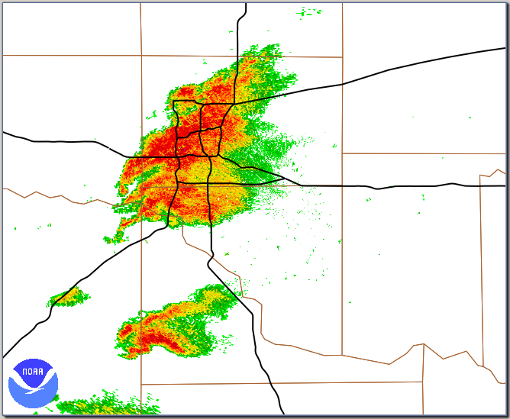
Current Warning Process: “Warn on Detection”
KTLX Radar 19:25 UTC 20 May 2013
KTLX Radar 19:39 UTC 20 May 2013
15 minutes later…..
Notes:
15 min later – forecaster sees big changes
Developing appendage / incresase in rotation

Slide 8
Current Warning Process: “Warn on Detection”
KTLX Radar 19:25 UTC 20 May 2013
KTLX Radar 19:39 UTC 20 May 2013
Forecaster:
Considers his knowledge of environment with radar trends…
Developing
circulation and
hook echo
Notes:
Starts to focus on smaller details of storm
AND considers the possible impacts due to its location
Factoring in the environment: triggers a warning..

Slide 9
Current Warning Process: “Warn on Detection”
KTLX Radar 19:25 UTC 20 May 2013
KTLX Radar 19:39 UTC 20 May 2013
Forecaster:
Combining the threat from the environment with radar trends crosses a threshold…
Tornado Warning
Issued 19:40
Lead time for Moore storm: 16 min
Notes:
Warnings are limited because the forecaster
Cannot quantitatively predict the evolution of the storm
Beyond 15 min…..WoF can help….

Slide 10
Future Warning Process: “Warn on Forecast”
KTLX Radar 19:25 UTC 20 May 2013
Notes:
Accelerate the forecaster process by using NWP…
Start the same way…..see rapidly developing storm…

Slide 11
Future Warning Process: “Warn on Forecast”
KTLX Radar 19:25 UTC 20 May 2013
Storm-Scale Forecast for 19:40 UTC
Predicted
storm
Model forecasts
developing
circulation and
hook echo
Notes:
WoF system rapidly provides an update…..

Slide 12
Future Warning Process: “Warn on Forecast”
“Probabilistic warnings enabled by combining observations with
rapidly-updating, high-resolution storm-scale models”
Storm-Scale Forecast for 19:40 UTC
Predicted
storm
WoF predicts storm for 19:40 by 19:27
Forecaster “sees” evolution “ahead” of time
Warning can be issued 13 minutes earlier
Notes:
Prediction provides an estimate for forecaster to consider
Forecaster is still integral to process

Slide 13
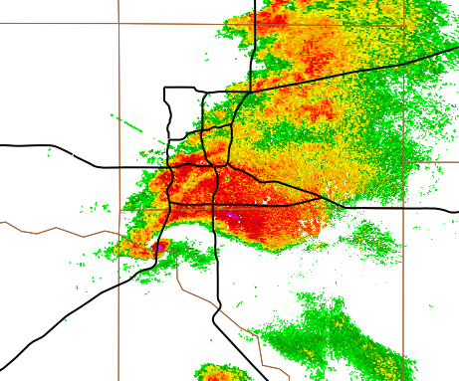
Future Warning Process: “Warn on Forecast”
“Probabilistic warnings enabled by combining observations with
rapidly-updating, high-resolution storm-scale models”
Storm-Scale Forecast for 19:40 UTC
Warnings will likely be very different…
Predicted
storm
80%
T=2100
T=2030
WoF predicts storm at 19:40
Forecaster “sees” the storm evolution “ahead” of time
Warning can be issued 15 minutes earlier
T=2000
Warning is probabilistic (information rich)
Warning is more focused (smaller area)
Threat information will have temporal and spatial distributions (binary warning)
FACETS will be the delivery system for WoF-probabilistic warnings

Slide 14
Why NSSL?
Our Core Strengths
  Radar (Doppler, dual-Pol, MPAR)
  Severe storms observations and dynamics
  Storm-scale NWP and ensembles
    NSSL has introduced these into SPC and OUN through HWT interactions
  Warnings research and applications
    NSSL has long history of R2O for NWS warning operations
Notes:
Experts in severe storm observations, dynamics, and modeling
World leaders in radar (Doppler and dual-Pol)
Leader in warning research methods and R2O via collaborations with forecasters
Provides R2O & O2R feedback loop via collaborations with forecasters

Slide 15
Warn on Forecast Overview
~$2.6M annual budget
Supports:
  Internally
    9 PhD scientists currently
    4 post-docs / 2.5 staff support
    1-3 M.S./Ph.D. students supported on average
  Externally supports (~$800K)
    funding goes to SPC, NWS OUN, GSD, CAPS, OU, PSU
    Supports 4-5 more staff positions and several senior scientist months
Other significant collaborations
  CIMSS (Wisc.), NESDIS, NCEP/EMC
  NCAR Mesoscale Prediction Group & IMAGe
Measures of Quality and Relevance and Progress (last 5 years)
  ~100 peer-reviewed papers published in the last 5 years
  ~200 presentations at national or international conferences and workshops
  ~dozen regional WoF prediction test cases completed in last two years
Notes:
Do we need the slide?

Slide 16
WoF Science…
Rest of presentation will focus on our scientific achievements…
  Practical predictability of supercells and other severe weather threats?
  Are the current prediction systems ACCURATE enough to predict these events reliably?
  Could rapid-scan radar data (MPAR) improve storm-scale forecasts?
Notes:
Can we even do this – when we started, we really did not know.
How reliably?
Are our models and radar data assimilation systems good enough?
Configurations needed
MPAR provides about 5x the temporal information – can the data assimilation system use that information?

Slide 17
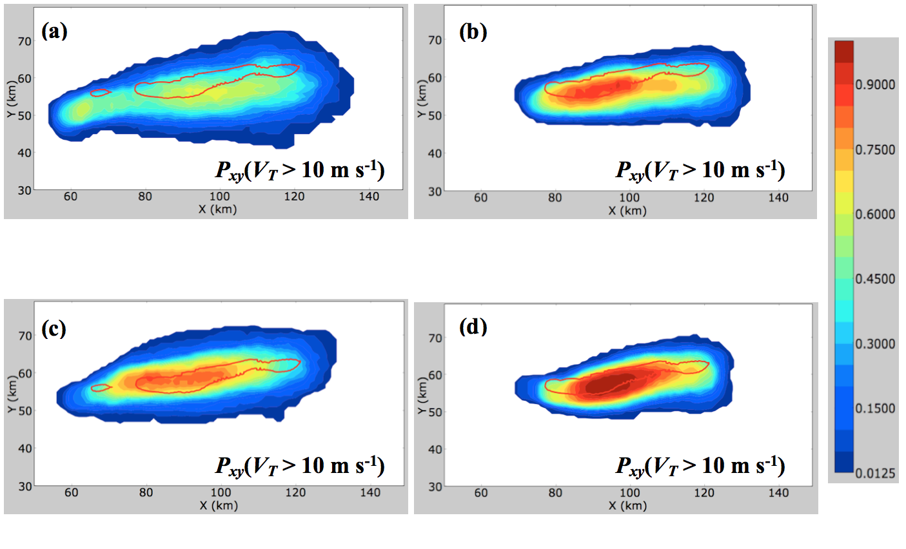
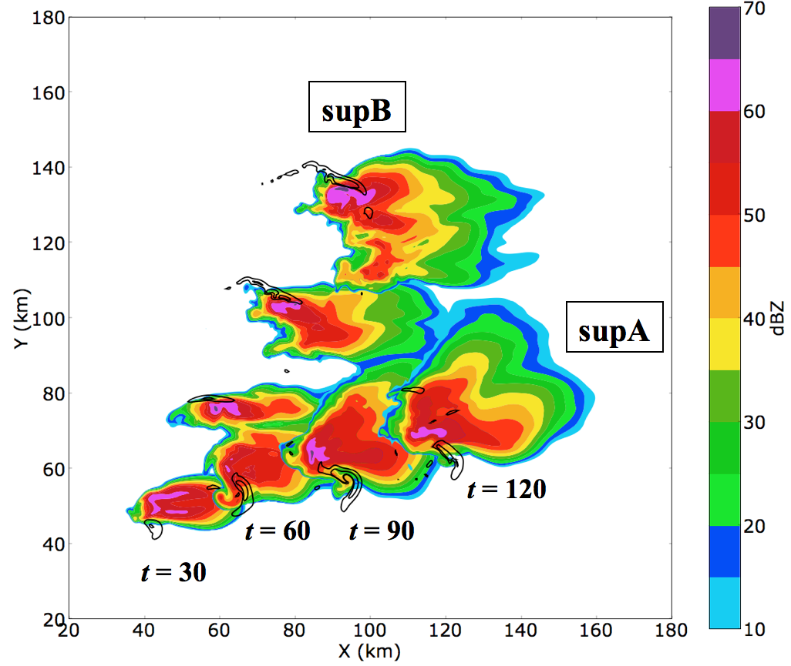
  Potvin, C. K., L. J. Wicker, 2013: Assessing ensemble forecasts of low-level supercell rotation within an OSSE framework.
  Wea. Forecasting, 28, 940–960
Practical Predictability of Supercells?
Probability of Sig. Rotation
Forecast after 7 radar Volumes
Probability of Sig. Rotation
Forecast after 11 radar Volumes
Probability
From Ensemble
Both radars located far away from storm
(> 100 km)
Truth Simulation
Red contour:
Where “truth” storm has rotational velocity > 10 m s⁻¹
What is an Observing Systems Simulation Experiment (OSSE) study?
Generate synthetic observations using “nature run” from a high-resolution prediction model
Assimilate these synthetic observations back into your NWP system
Because you know the “truth” from the “nature run” – you what the answer should be – can study…
  Best assimilation methods / impact of new observations / needed obs resolution, etc.
  Here: OSSE used to study radar location and its impact on forecasts
Problem: Hard to create OSSEs that accurately represent real-world errors: Results are too optimistic!
Notes:
OSSE study to see how well we can predict storm rotation trends.
At various distances from the radars using various environments.
Basic take away is that when radars are far away, need more time to get the storm right.
Interestingly, the angle between the radars does not seem to matter much.

Slide 18
  Potvin, C. K., L. J. Wicker, 2013: Assessing ensemble forecasts of low-level supercell rotation within an OSSE framework.
  Wea. Forecasting, 28, 940–960
Practical Predictability of Supercells?
OSSE Study
Generate synthetic observations using model
Assimilate observations back into model
Determine potential impact and predictability
Probability of Sig. Rotation
Forecast after 7 radar Volumes
Probability of Sig. Rotation
Forecast after 11 radar Volumes
Probability
From Ensemble
Both radars located far away from storm
(> 100 km)
Truth Simulation
Red contour:
Where “truth” storm has rotational velocity > 10 m s⁻¹
2nd radar 50-60 km from storm
Notes:
OSSE study to see how well we can predict storm rotation trends.
At various distances from the radars using various environments.
Basic take away is that when radars are far away, need more time to get the storm right.
Interestingly, the angle between the radars does not seem to matter much.

Slide 19
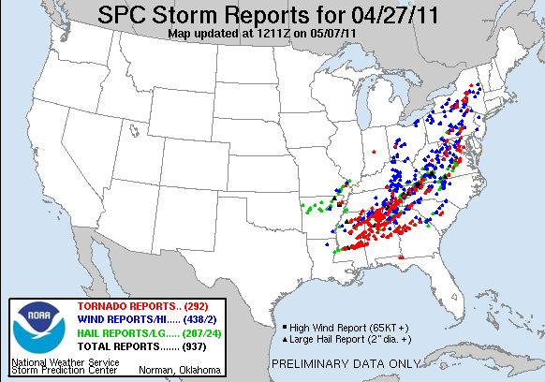
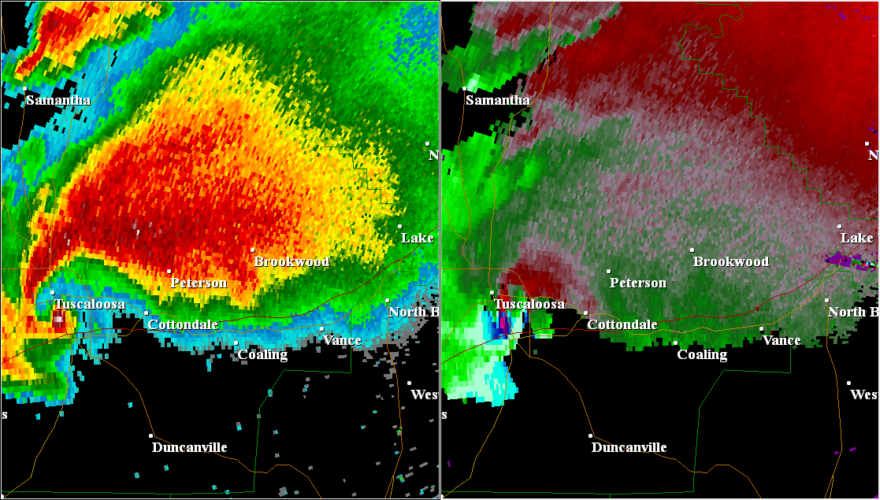
  Are Models Accurate Enough?
Yussouf, N., D. C. Dowell, L. J. Wicker, K. Knopfmeier, and D. M. Wheatley, 2015: Storm-scale data assimilation and ensemble forecasts for the 27 April 2011 severe weather outbreak in Alabama. Mon. Wea. Rev. Accepted with revisions
Storm-scale Predictions from 27 April 2011 Super Outbreak
~300 tornadoes
348 fatalities from tornadoes and other thunderstorm hazards
Tuscaloosa, AL tornado

Slide 20
  Are Models Accurate Enough?
Model Reflectivity Analysis
Valid: 2100 UTC
Rotation track prediction for
Tuscaloosa-Birmingham storm
Valid: 2100-2315 UTC (135 min forecast)
Two storms are near MS border…..
Tornado ends:
UTC
FCST track initially dominated by northern cell
Tuscaloosa-
Birmingham
Tornado Track
Tornado starts:
2143 UTC
Pre-Tuscaloosa-
Birmingham cells
~40 min lead time?
Probability

Slide 21
  Are Models Accurate Enough?
Model Reflectivity Analysis
Valid: 2130 UTC
30 Minutes Later: Rotation Track Prediction
Valid: 2130-2315 UTC (105 min forecast)
Southwestern cell becomes dominant…..
Original cell merges with a new storm along its southwestern side.
Result is the Tuscaloosa-Birmingham supercell and long-track tornado
Tornado ends:
UTC
Maximum rotation probabilities shift SE onto dominant storm cell.
Prediction system is capable of representing the details of storm-storm interactions…
Tornado starts:
2143 UTC
Probability

Slide 22
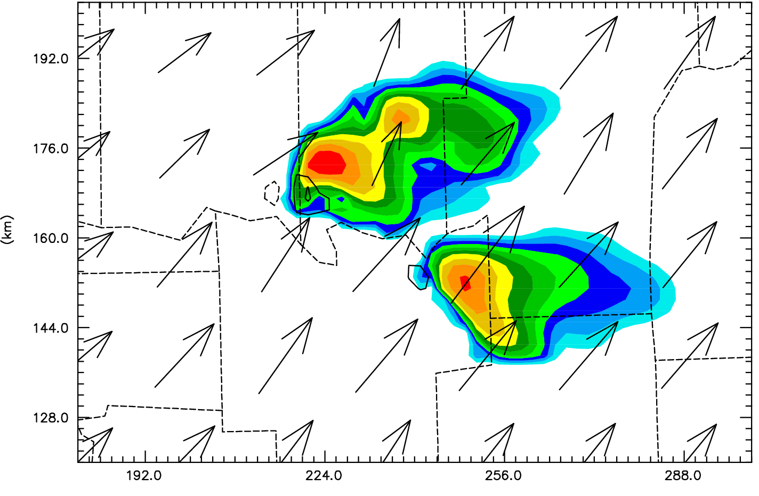
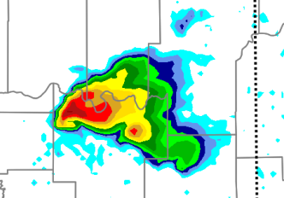
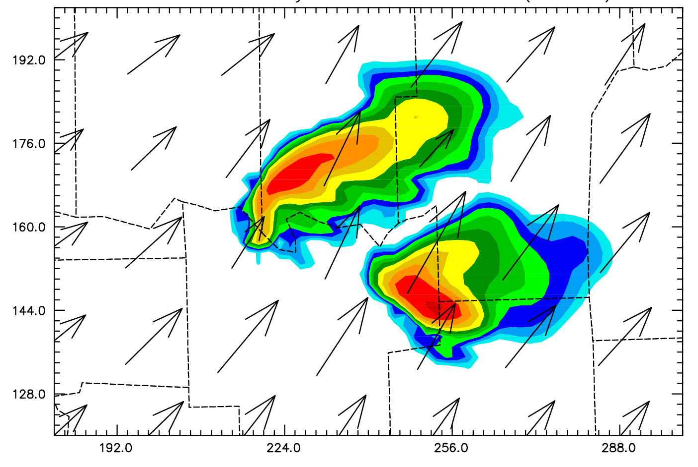
  Impact from Rapid-Scan Radar (MPAR) on Storm-scale NWP
Mean forecasts after 30 min of data assimilation
WSR88D
6 Volumes
Assimilated
Observations
0130 UTC
MPAR
31 Volumes
Assimilated
30 min forecast Valid 0130 UTC
30 min forecast Valid 0130 UTC
Cheng, J. and N. Yussouf
Mon. Wea. Rev., 2016?
Notes:
Small tornadic storm in SE OK April 2012
Not a significant event (weak tornado)
Rather far from the radar
Full ARPS enKF multi-scale DA system

Slide 23
  Impact from Rapid-Scan Radar (MPAR) on Storm-scale NWP
Mean forecasts after 30 min of data assimilation
WSR88D
6 Volumes
Assimilated
Observations
0130 UTC
MPAR
31 Volumes
Assimilated
30 min forecast Valid 0130 UTC
30 min forecast Valid 0130 UTC
Cheng, J. and N. Yussouf
Mon. Wea. Rev., 2016?
Notes:
Small tornadic storm in SE OK April 2012
Not a significant event (weak tornado)
Rather far from the radar
Full ARPS enKF multi-scale DA system

Slide 24
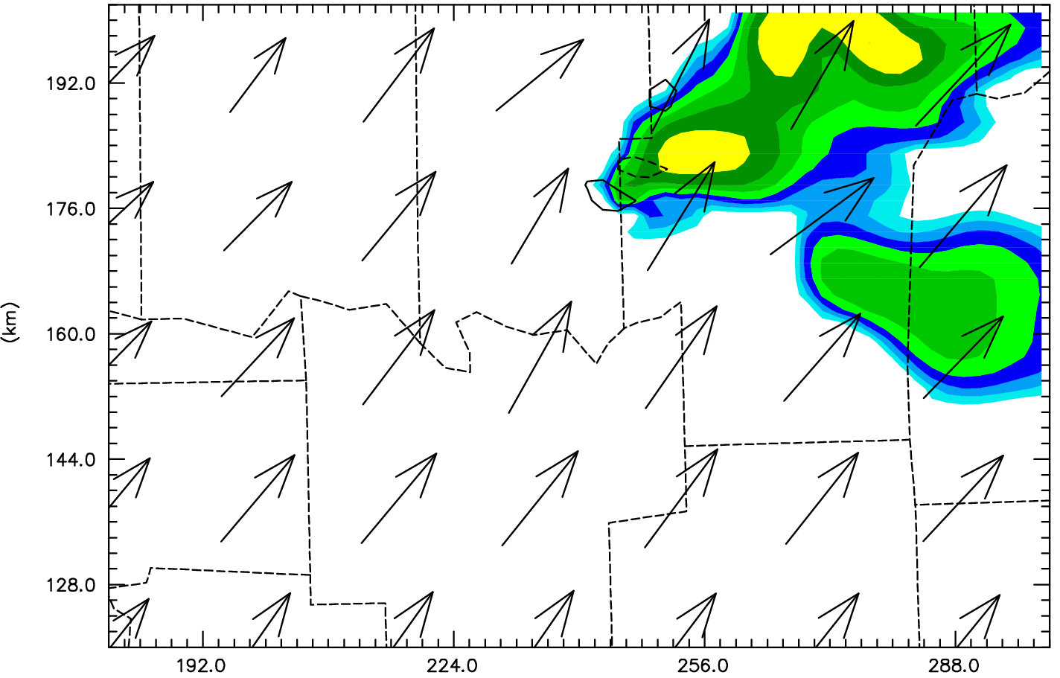
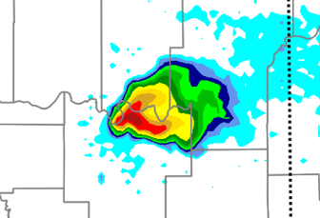
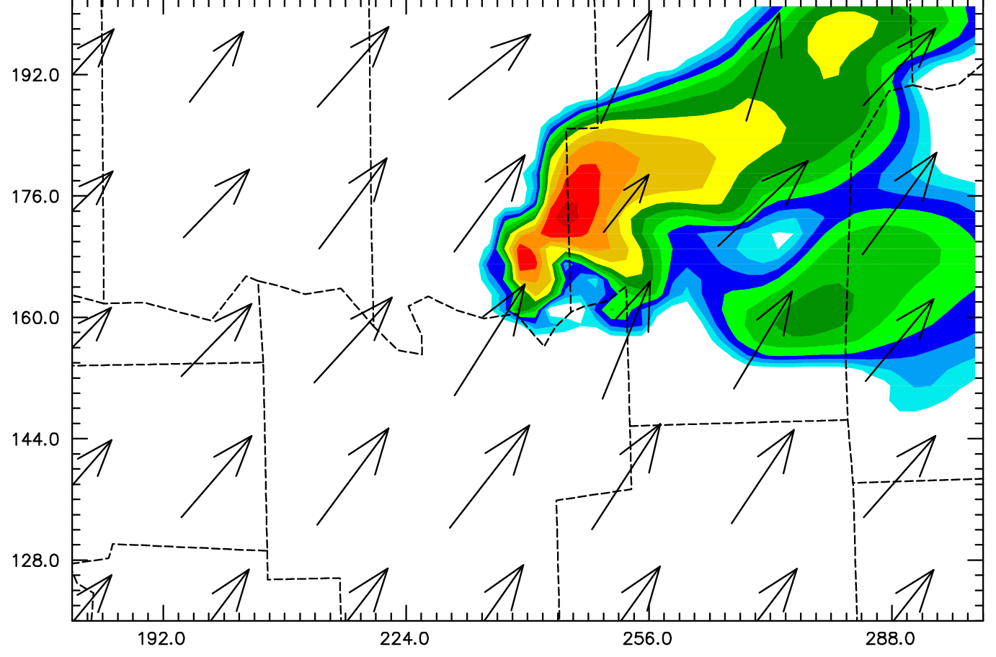
  Impact from Rapid-Scan Radar (MPAR) on Storm-scale NWP
Mean forecasts after 30 min of data assimilation
WSR88D
6 Volumes
Assimilated
Observations
0130 UTC
MPAR
31 Volumes
Assimilated
30 min forecast Valid 0130 UTC
30 min forecast Valid 0130 UTC
WSR88D
6 Volumes
Assimilated
Observations
0200 UTC
MPAR
31 Volumes
Assimilated
A
A
60 min forecast Valid 0130 UTC
60 min forecast Valid 0130 UTC
Cheng, J. and N. Yussouf
Mon. Wea. Rev., 2016?
Notes:
Small tornadic storm in SE OK April 2012
Not a significant event (weak tornado)
Rather far from the radar
Full ARPS enKF multi-scale DA system

Slide 25
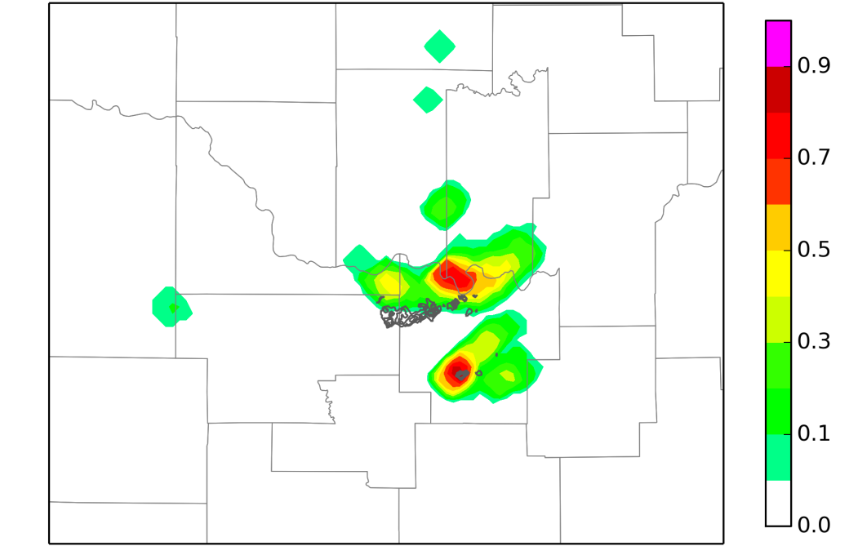
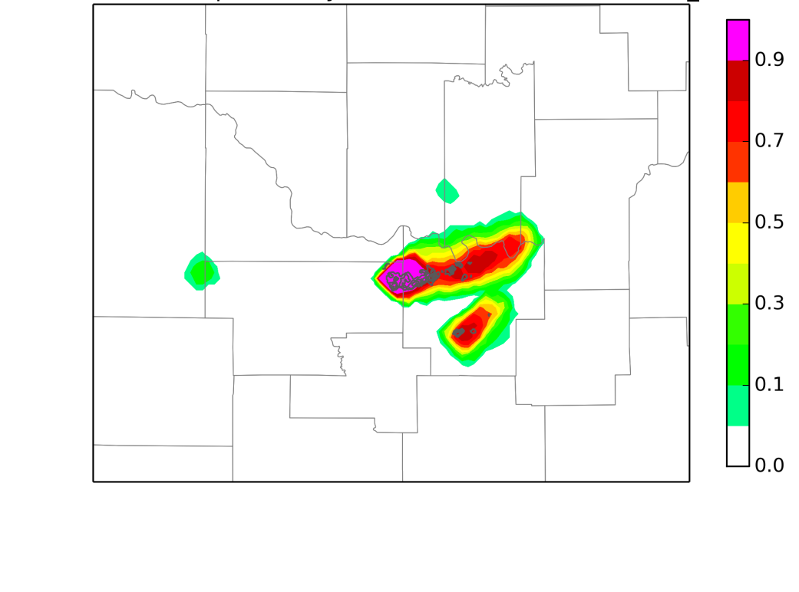
  Impact from Rapid-Scan Radar (MPAR) on Storm-scale NWP
One hour ensemble forecasts after 30 min of data assimilation
Ensemble Probability of Strong Low-level Rotation (z > 0.002 s⁻¹)
Forecast Period: 0100-0200 UTC
WSR88D
6 Volumes
Assimilated
MPAR
31 Volumes
Assimilated
Gray contours are the WDSS-II rotation locations
Tornado is from 0119-0141 UTC
Cheng, J. and N. Yussouf
Mon. Wea. Rev., 2016?

Slide 26
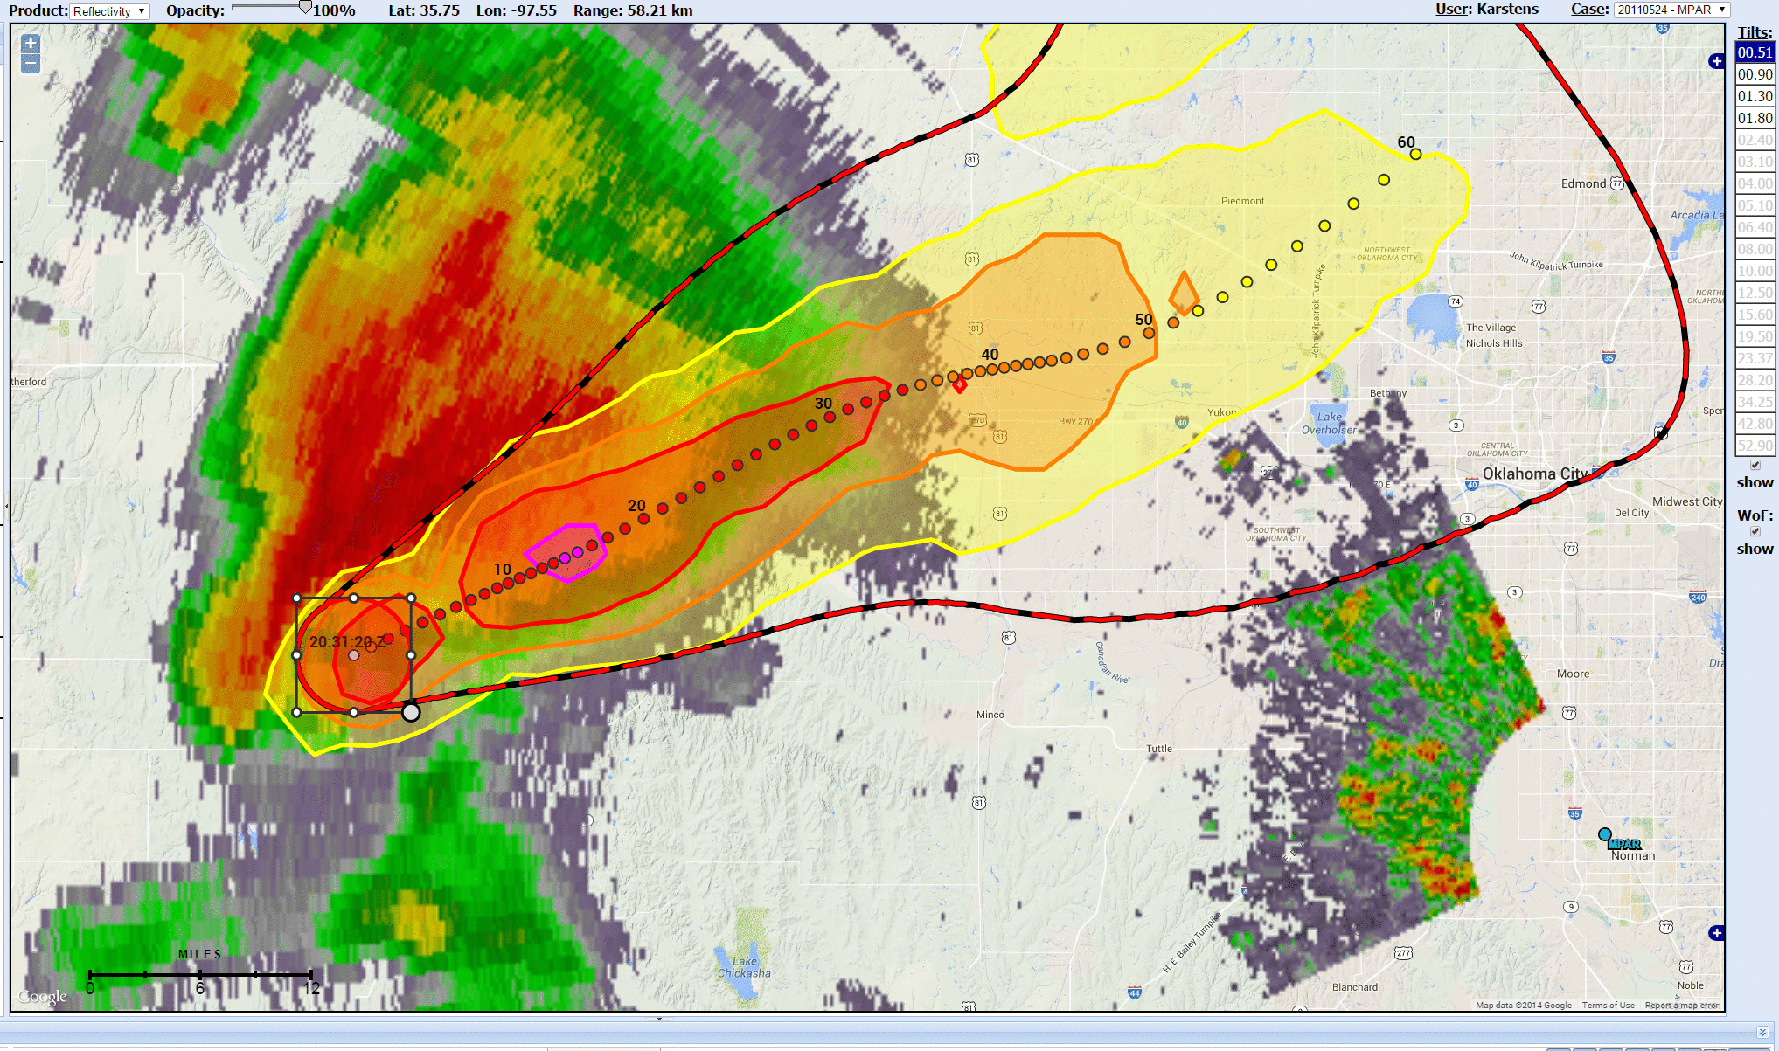
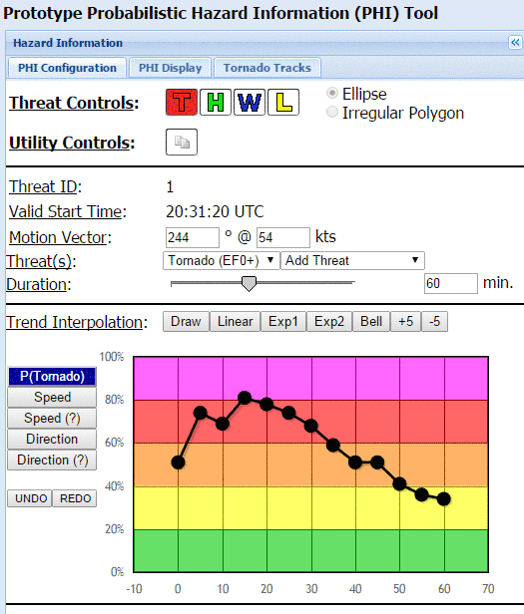
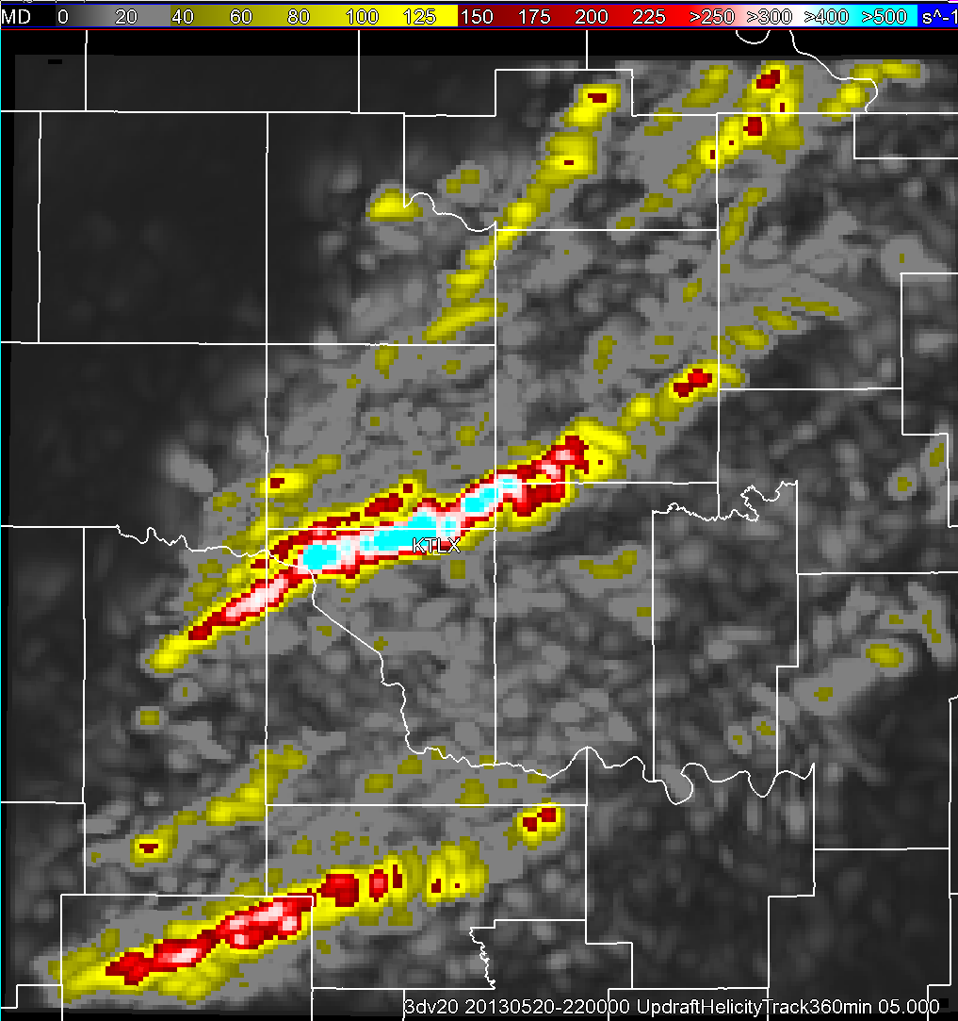
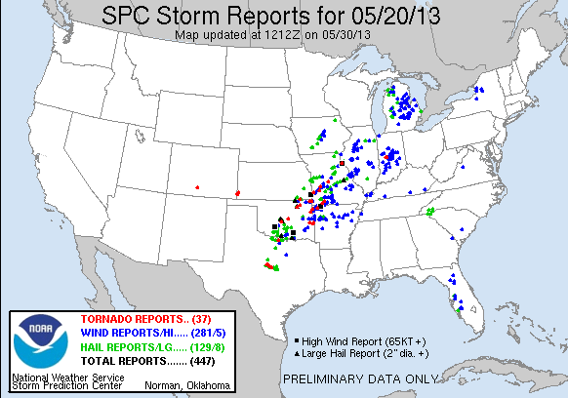
How will forecasters use a storm-scale prediction system?
NSSL experimental WoF System-enKF (NeWS-e) experiment (May 2015)
  Prototype WoF system at 3 km resolution over relocatable 700 km² domain
  Storm-scale ensemble analysis every 15 min / 90-min forecast every hour
  Output evaluated using the Probabilistic Hazard Information (PHI) tool
PHI is a
FACETS
Application
Probabilistic Hazard Information (PHI) tool display with WoF ensemble prediction for a tornadic storm in 2011

Slide 27
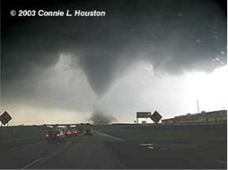
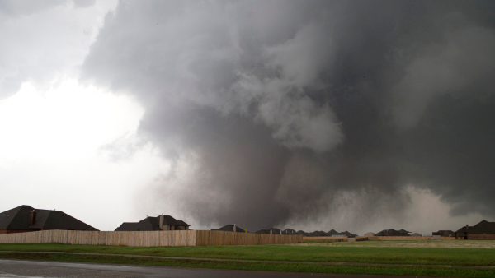
Summary
WoF project has demonstrated skill predicting storm tracks and rotational intensities for 0-2 hours for real-data case studies.
Improved forecasts from assimilation of MPAR data relative to 88D data
NSSL experimental WoF System tests of EnKF, cycled 3DVAR, hybrid all on the way…
QRP for last 5 years:
  ~100 peer-reviewed / ~200 presentations / ~ dozen case studies / real time system development
Notes:
System can be used for FF, severe winds in derechos, lightning, hail, and eventually think about the initiation….
More observations needed for better forecasts…
SPC and NWS-OUN forecasters interaction is key to developing a useable system
Model improvements

Slide 28
Summary (continued..)
Future Work
Improve balance in storm-scale analyses from remotely-sensed observations.
  Use of dual-polarization radar data in storm-scale analysis systems?
  Incorporation of dynamical constraints in analysis and reduction in model errors
Understanding how WoF output could/would be used by operational forecasters
  How to post-process ensemble data output into probabilistic forecasts: “FACETS”
  How can forecasters feedback guide our research emphasis? O2R!
For WoF to reach its full potential requires a more accurate measurement of the storm-scale environment than the current observational network permits.
  Vertical profiles of temperature, humidity and wind in boundary layer needed for CONUS.
  Ground-based thermodynamic and Doppler lidar profilers?
  More radar observations are needed for CONUS in lowest 2 km!
Notes:
System can be used for FF, severe winds in derechos, lightning, hail, and eventually think about the initiation….
More observations needed for better forecasts…
SPC and NWS-OUN forecasters interaction is key to developing a useable system
Model improvements

Slide 29
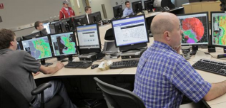








Questions?

