Slide 1
Innovative Techniques to Improve
Weather Observations
David Warde (CIMMS/OU)
February 25–27, 2015
National Weather Center
Norman, Oklahoma
Notes:
Slide 1: Introduction

Slide 2
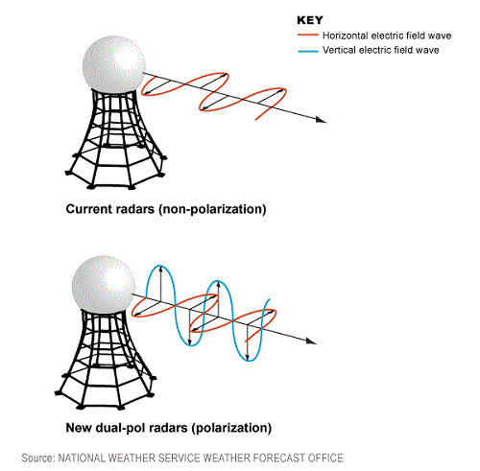
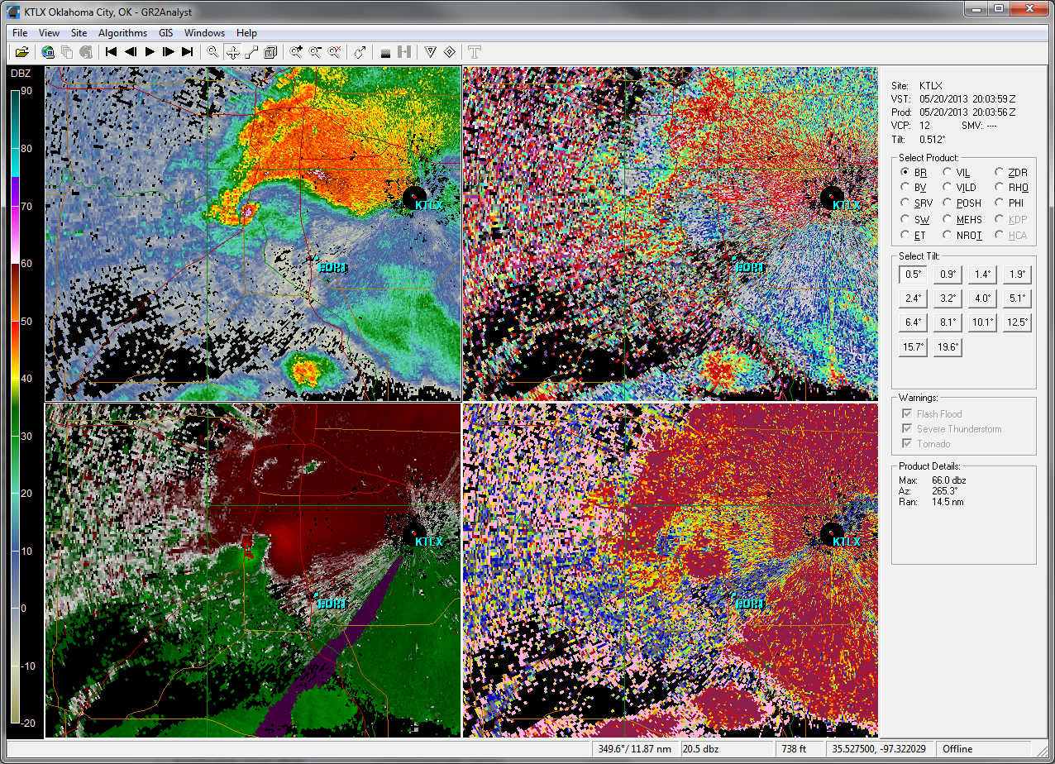
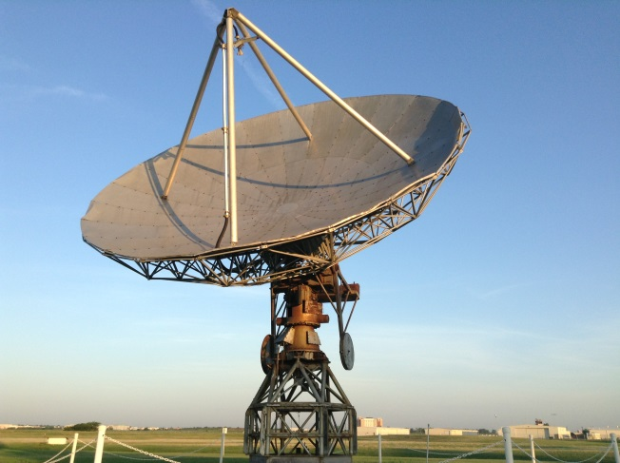
Signal Processing
Waveform
Generation
Detection
Sampling
Clutter
Filtering
Parameter
Extraction
Hardware
Functions
Adapted from Rich Ice (ROC) presentation at Baron Weather Radar Summit,
7-8 Jan. 2015
Software
Functions
Notes:
Slide 2: Signal Processing
First “Weather Radar Summit” hosted by BARON Services, Inc.
~1/3 NSSL Lab presenters
~1/3 Other NOAA
Other than NOAA/Baron
Signal Processing defined (Slide adapted from Rich Ice/ROC at Weather Radar Summit)
Evolution of Digital Signal Processing
NSSL lead activities
R2O
Clutter Mitigation

Slide 3
Signal Processing – Pre-Doppler (1960s – 1980s)
Waveform
Generation
Sampling
Clutter
Filtering
Parameter
Extraction
Detection
Clutter
Filtering
Uniformly
Spaced Pulses
Analog
Receiver
Fixed Pulse
Mostly
Non-existent
Intensity
Display
Antenna
Rotation
Speed
Envelope
Detection
MTI
Radar?
DVIP
Levels
All Hardware!
Usually with Vacuum Tubes!
Manual
Censoring
Electronically
Generated
Countours
Hardware
Functions
Adapted from Rich Ice (ROC) presentation at Baron Weather Radar Summit,
7-8 Jan. 2015
Experiments
With
R-Meters
Software
Functions
Notes:
Slide 2: Signal Processing
First “Weather Radar Summit” hosted by BARON Services, Inc.
~1/3 NSSL Lab presenters
~1/3 Other NOAA
Other than NOAA/Baron
Signal Processing defined (Slide adapted from Rich Ice/ROC at Weather Radar Summit)
Evolution of Digital Signal Processing
NSSL lead activities
R2O
Clutter Mitigation

Slide 4
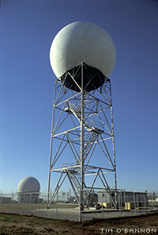
Signal Processing – Doppler (1990s)
Waveform
Generation
Sampling
Clutter
Filtering
Parameter
Extraction
Detection
Clutter
Filtering
Covariance
Estimators
(Velocity,
Spectrum Width)
Uniformly
Spaced Pulses
Analog
Receiver
Multiple
Pulse Widths
IIR Notch
Filters
Intensity
Display
Fixed Pulse
Stable/Coherent
Transmit Phase
Quadrature
Phase
Detection
Envelope
Detection
Selectable
Number of
Samples
Two-Pulse
Canceler
RV Mitigation:
Dual Scans
Dual PRFs
Clutter
Maps
Hardware
Functions
Noise
Measurement
Adapted from Rich Ice (ROC) presentation at Baron Weather Radar Summit,
7-8 Jan. 2015
SNR and
Strong Point
Censoring
Software
Functions
Notes:
Slide 2: Signal Processing
First “Weather Radar Summit” hosted by BARON Services, Inc.
~1/3 NSSL Lab presenters
~1/3 Other NOAA
Other than NOAA/Baron
Signal Processing defined (Slide adapted from Rich Ice/ROC at Weather Radar Summit)
Evolution of Digital Signal Processing
NSSL lead activities
R2O
Clutter Mitigation

Slide 5
Signal Processing – Dual Polarization (2000s)
Waveform
Generation
Sampling
Clutter
Filtering
Parameter
Extraction
Detection
Clutter
Filtering
Uniformly
Spaced Pulses
Digital IF
Receiver
(14 bits)
“Indexed”
Radials
Adaptive
Spectral
Filter
Covariance
Estimators
(Dual Pol.
Parameters,
Hybrid SW)
Phase
Coded Pulses
Digital
Matched
Filter
Selectable
Volume
Resolution
Two-Pulse
Canceler
RV Mitigation:
Dual Scans
Dual PRFs
Phase Coding
Dual Polarization
Clutter
Identification
Hardware
Functions
Adapted from Rich Ice (ROC) presentation at Baron Weather Radar Summit,
7-8 Jan. 2015
Noise
Measurement
Software
Functions
SNR and
Strong Point
Censoring
Notes:
Slide 2: Signal Processing
First “Weather Radar Summit” hosted by BARON Services, Inc.
~1/3 NSSL Lab presenters
~1/3 Other NOAA
Other than NOAA/Baron
Signal Processing defined (Slide adapted from Rich Ice/ROC at Weather Radar Summit)
Evolution of Digital Signal Processing
NSSL lead activities
R2O
Clutter Mitigation

Slide 6
Ground Clutter Mitigation using Dual Polarization
Ground Clutter obscures meteorological data
  All meteorological variables are affected
  Contamination characterized by
    Near zero Doppler velocity
    Very narrow spectrum width (i.e., small velocity distribution)
Ground Clutter Filters mitigate contamination
  May not remove all of the contaminant
  May remove some of the weather signal
    Near zero Doppler velocity
  Misapplication degrades data quality!
Notes:
Slide 3: Ground Clutter/mitigation
Ground clutter
Obscures weather data
All meteorological variables affected
Characteristics of ground clutter
Ground Clutter filter
Mitigates ground clutter contamination
Weather along zero-isodop
Misapplication

Slide 7
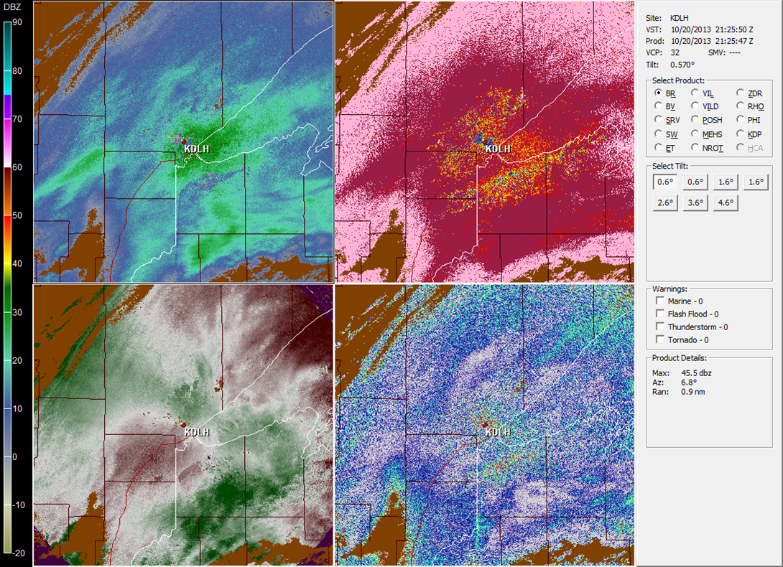
Snowing in Duluth, MN
Reflectivity
Correlation Coefficient
21:25Z
Velocity
Differential Reflectivity
Using WSR-88D Ground Clutter Mitigation
Notes:
Slide 4: Duluth, MN (October 20, 2013)
Current ground clutter mitigation
Dual Polarization based
Detection and ground clutter filter separate algorithms
Operators see ground clutter signature
correlation coefficient reduced values
Some enhancement of differential reflectivity
Not readily visible in reflectivity
Not readily visible in velocity
Mitigate using all bins clutter filter to ~50 Km
Zero-isodop loss in all estimates
Automate ground clutter mitigation (Give the operator the tools)

Slide 8
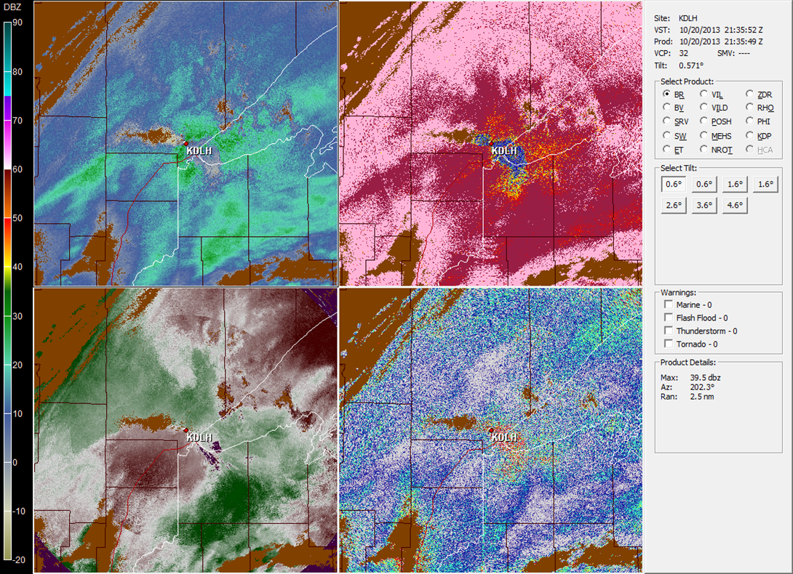
Snowing in Duluth, MN
Reflectivity
Correlation Coefficient
21:35Z
Velocity
Differential Reflectivity
All Bins Clutter Filtering to ~50km
Notes:
Slide 4: Duluth, MN (October 20, 2013)
Current ground clutter mitigation
Dual Polarization based
Detection and ground clutter filter separate algorithms
Operators see ground clutter signature
correlation coefficient reduced values
Some enhancement of differential reflectivity
Not readily visible in reflectivity
Not readily visible in velocity
Mitigate using all bins clutter filter to ~50 Km
Zero-isodop loss in all estimates
Automate ground clutter mitigation (Give the operator the tools)

Slide 9
Mix Ground Clutter/Weather
Ground Clutter
Weather
Weather Environment Thresholding
(WET)
(Detects weather
dominate regions)
CLEAN-AP¹
(Integrates ground clutter detection and filtering)
Weather Dominates
Clutter Dominates
¹CLEAN-AP © 2009 Board of Regents
of the University of Oklahoma
No Weather/No Ground Clutter
Notes:
Slide 5: Venn diagram
Clutter
Weather
Mixed Clutter/Weather
Clutter dominate
Weather dominate
Some weather estimates more sensitive to clutter contamination
CLEAN-AP/WET
CLEAN-AP (Clutter environment analysis using adaptive processing)
Integrates detection/filtering
Developed at NSSL
OU holds copyright/Government free license
R2O
Originally developed for NWRT PAR
Adapted for WSR-88D dual polarization for Staggered PRT and Uniform waveforms
Algorithm transferred to ROC
WET (Weather environment thresholding)
Detects weather dominate signals using dual polarization parameters
Passes for further processing if non-weather
Preserves best quality of weather dominate weather estimate
Current research
Presented at AMS 2015 annual meeting, Phoenix, AZ

Slide 10
Once Again… Snowing in Duluth, MN
Reflectivity
Velocity
Spectrum Width
Differential Reflectivity
Correlation Coefficient
Differential Phase
Unfiltered
Notes:
Slide 6: Duluth, MN (March xx, 2013)
Unfiltered (reflectivity, velocity, spectrum width, differential reflectivity, correlation coefficient, and differential phase)
WET/CLEAN-AP processed

Slide 11
Once Again… Snowing in Duluth, MN
Reflectivity
Velocity
Spectrum Width
Differential Reflectivity
Correlation Coefficient
Differential Phase
WET/CLEAN-AP
Unfiltered
Notes:
Slide 6: Duluth, MN (March xx, 2013)
Unfiltered (reflectivity, velocity, spectrum width, differential reflectivity, correlation coefficient, and differential phase)
WET/CLEAN-AP processed

Slide 12
Summary of R2O Activities
Transferring Innovative Techniques to the NEXRAD Network
Recent Transfers
Staggered pulse repetition time (PRT)
CLEAN-AP (uniform PRT and staggered PRT)
SZ-2 censoring
Polarimetric-variable-specific SNR thresholds
Less tapered window for super-resolution DP variables
Coherency-based thresholding
Noise estimator
Notes:
Slide 7: R2O Acitivities (DSP)
Transferred
Ready
Research
Planned

Slide 13
Summary of R2O Activities
Transferring Innovative Techniques to the NEXRAD Network
Ready for Transfer
Improved spectrum width estimator
Improved correlation coefficient estimator
Range oversampling processing
Combining H&V autocovariance estimates for Doppler velocity estimates
Notes:
Slide 7: R2O Acitivities (DSP)
Transferred
Ready
Research
Planned

Slide 14
Summary of R2O Activities
Transferring Innovative Techniques to the NEXRAD Network
Research in Progress
Combining autocovariance estimates from different scans for DP variables
Multi-lag estimators for DP variables
Using differential-phase information to improve the mitigation of ground clutter (WET)
Pulsed-interference filter
Notes:
Slide 7: R2O Acitivities (DSP)
Transferred
Ready
Research
Planned

Slide 15
Summary of R2O Activities
Transferring Innovative Techniques to the NEXRAD Network
Planned Research
Wind turbine clutter mitigation
Spatial reconstruction of censored data
Ground clutter mitigation using spectral decomposition of DP variables
Artifacts removal and data quality improvement using range-Doppler spectrum
Notes:
Slide 7: R2O Acitivities (DSP)
Transferred
Ready
Research
Planned

