Slide 1
Using Ground-based Observations at NSSL
non-radar
profiling
⌃
⌃
Dr. David Turner (NSSL)
February 25–27, 2015
National Weather Center
Norman, Oklahoma

Slide 2
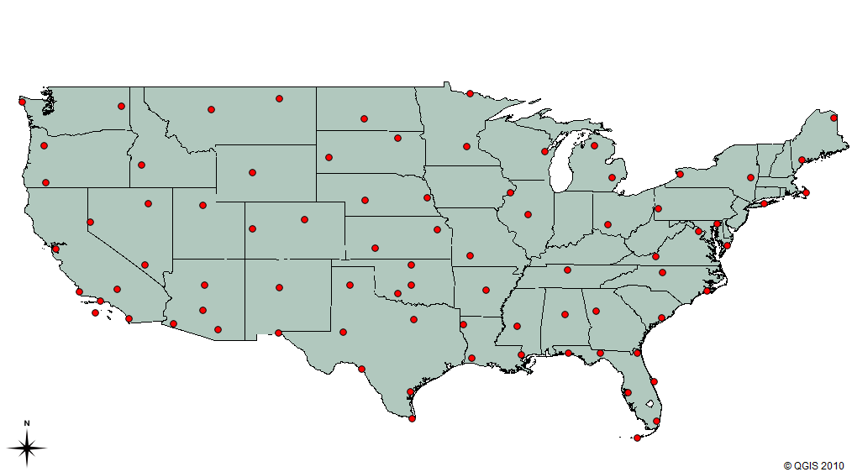
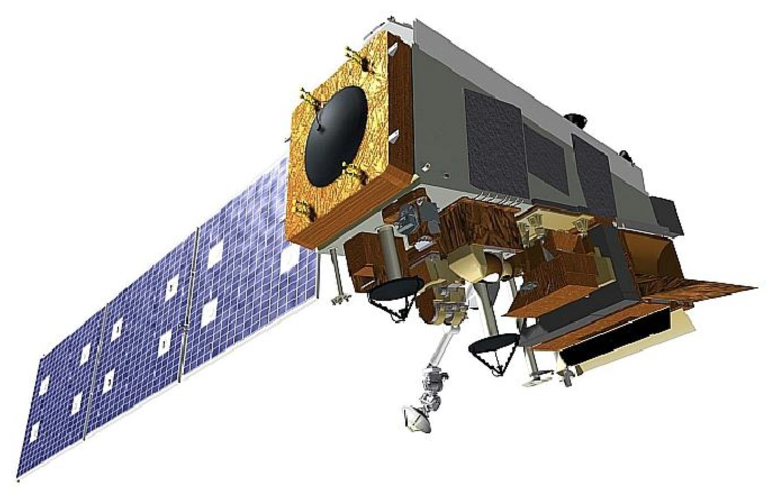
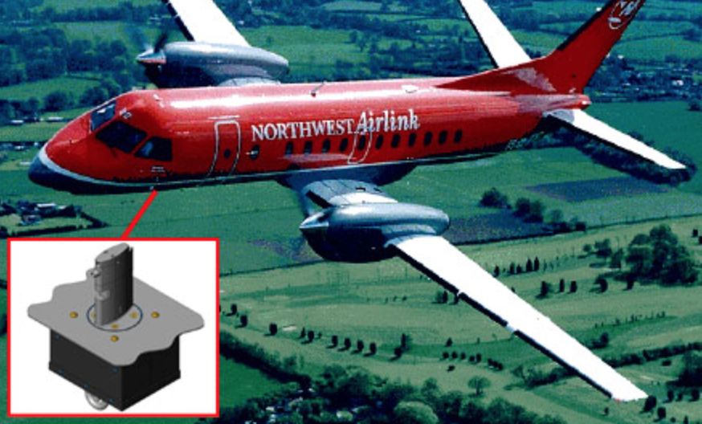
Ground-based Temperature, Humidity, & Wind (THW) Profile Obs in the Boundary Layer (BL)
Storm initiation and evolution depends strongly on THW profiles in the BL, but storms also modify these profiles
  Higher temporal and spatial THW profiles in BL needed for:
    Better understanding storm initiation and evolution
    Improved analyses, forecasts, and warnings
Spatial and temporal gaps in radiosonde network
Satellites don’t see BL well, especially in cloudy cases
Aircraft obs provide uneven sampling
Weather radars do not see true THW structure of atmosphere
Notes:
Radiosondes only launched twice per day at ~70 locations across CONUS
Clouds obscure satellite’s view of BL, and most hazardous weather have a lot of clouds around
Aircraft obs are useful, but are opportunistic (only at certain airports at certain times)

Slide 3
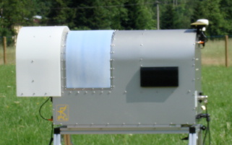
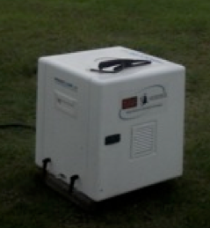
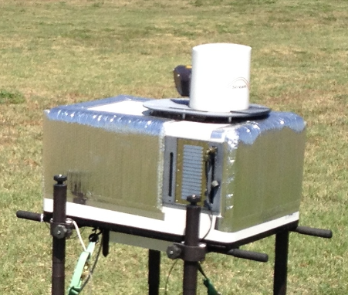
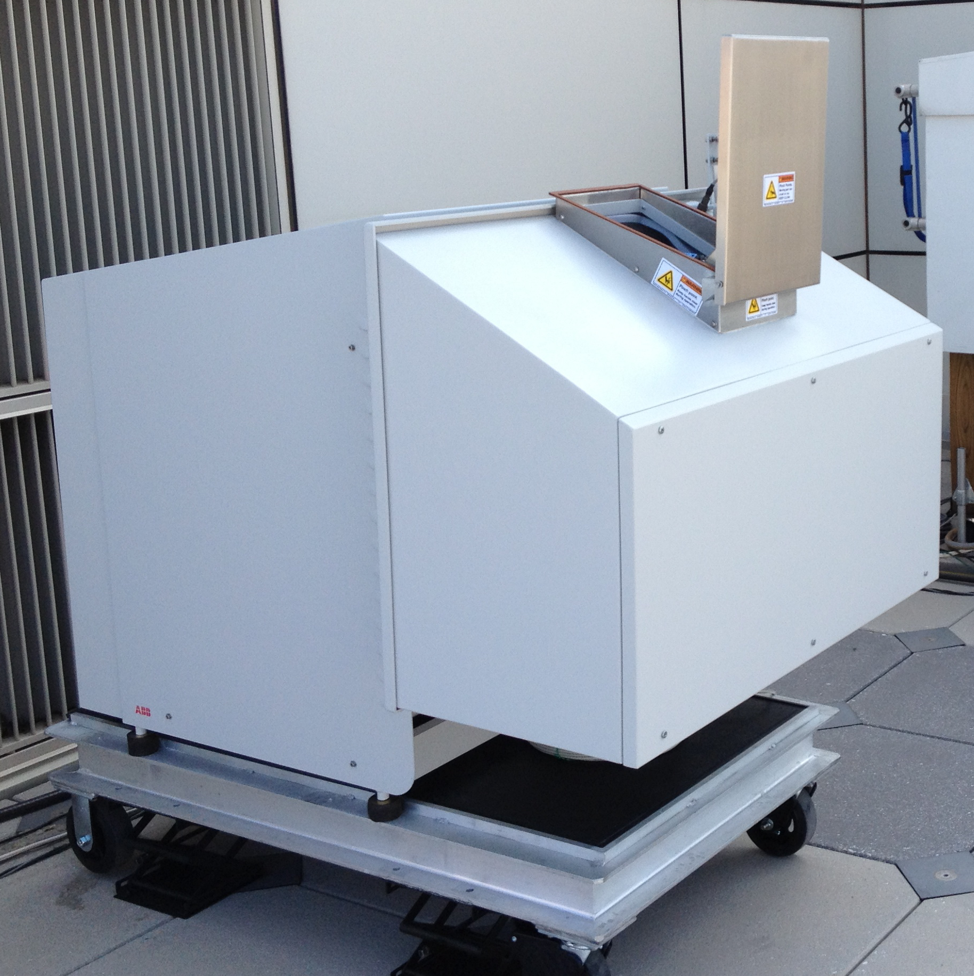
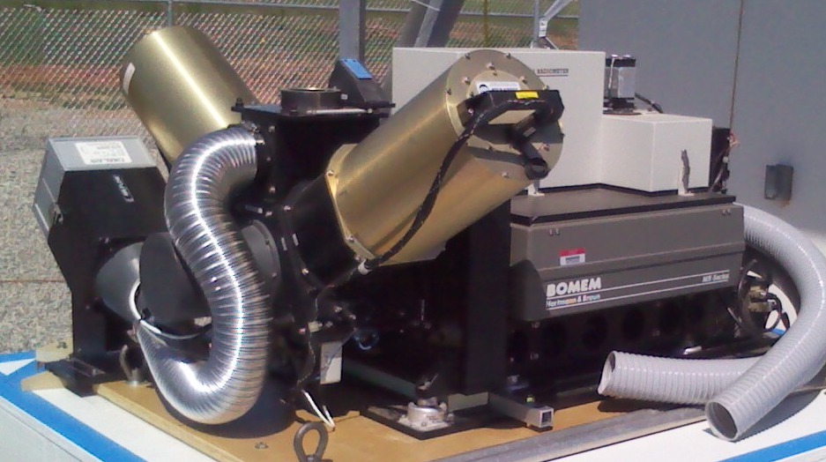
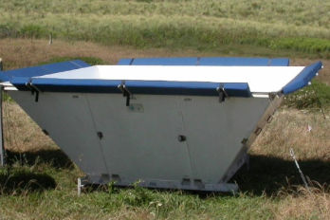
These Ground-based Remote Sensors Exist
(and are commercially available)
Thermodynamic Profiling Systems
Wind Profiling Systems
Microwave Radiometer (MWR)
Doppler Wind Lidar (DWL)
Atmospheric Emitted Radiance Interferometer (AERI)
Radar Wind Profiler (RWP)
Notes:
A “profiler” is a remote sensing system that provides a profile of temperature, humidity and/or wind
I’ve worked with these BL remote sensors for almost 20 years (numerous publications)

Slide 4
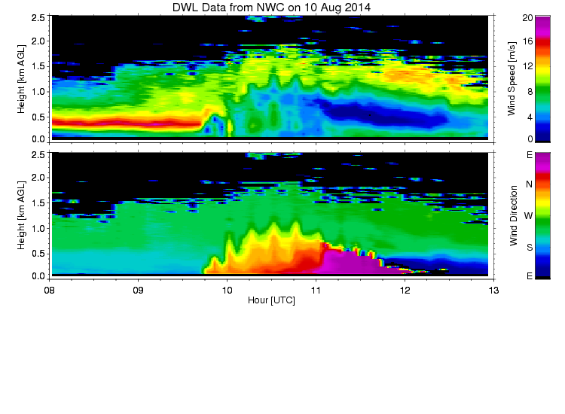
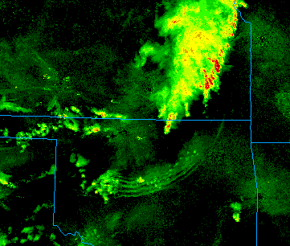
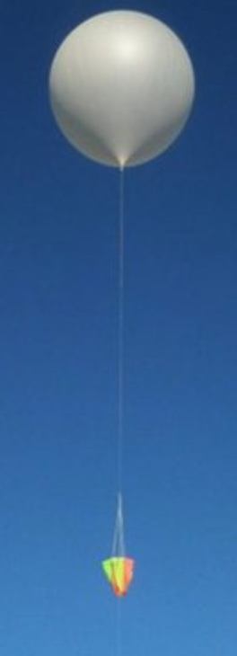
Using These New Remote Sensors: Example 1
NEXRAD 1 km MOSAIC 10 Aug 2014 09:25
Notes:
Doppler lidar at Norman during this 10 Aug 2014 case. Convective outflow from storm in Kansas created “wave packet” (bore)
Well developed low level jet, which is greatly modified by the passing “wave packet”
Rapid changes in wind speed and direction as a function of height when the waves passed over Norman
The nominal 12-hourly sonde would have missed this entire event

Slide 5
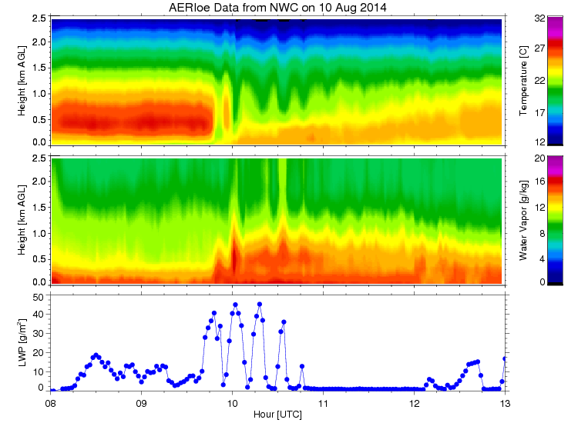
Using These New Remote Sensors: Example 1
NEXRAD 1 km MOSAIC 10 Aug 2014 09:25
Notes:
AERI was collocated with Doppler lidar, and provides thermodynamic profiles
Noctural inversion is well developed, but gets mixed out rapidly with bore passage. Oscillations in temperature field correspond to waves
Bore lifts water vapor can lead to condensation and clouds, which can lead to convection initiation (as it did just to the west)

Slide 6
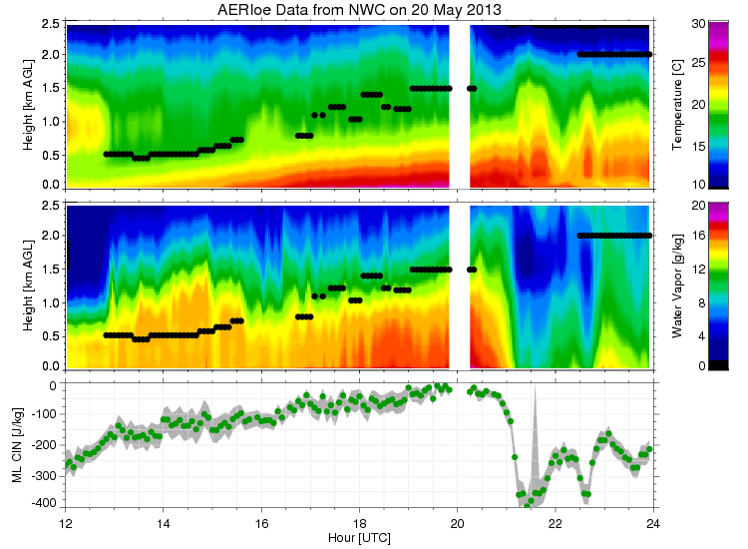
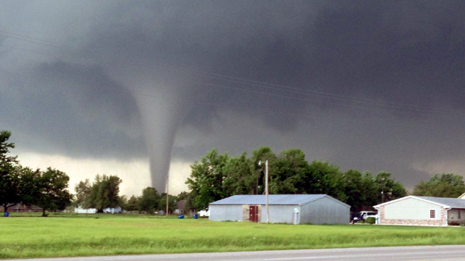
Using These New Remote Sensors: Example 2
20 May 2013
Moore / OKC
Tornado
Tornado touches down
Notes:
Tornado event in Moore / OKC in May 2013. Had AERI at NWC rooftop during event. Tornado touched down ~19:50 UTC
BL evolving rapidly, with large increase in moisture ~2 hours before touchdown
CIN is a measure of the atmosphere’s ability to “resist” convection, and we see this value decreasing, and then suddenly going to zero at touchdown
Radiosondes launched at 12 and 24 UTC entirely missed the evolution of this event

Slide 7
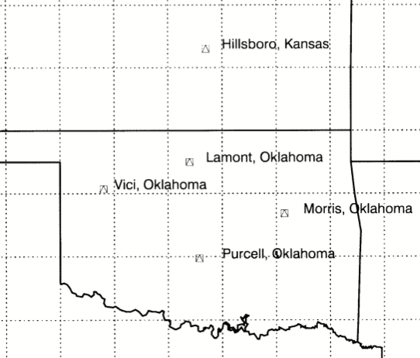
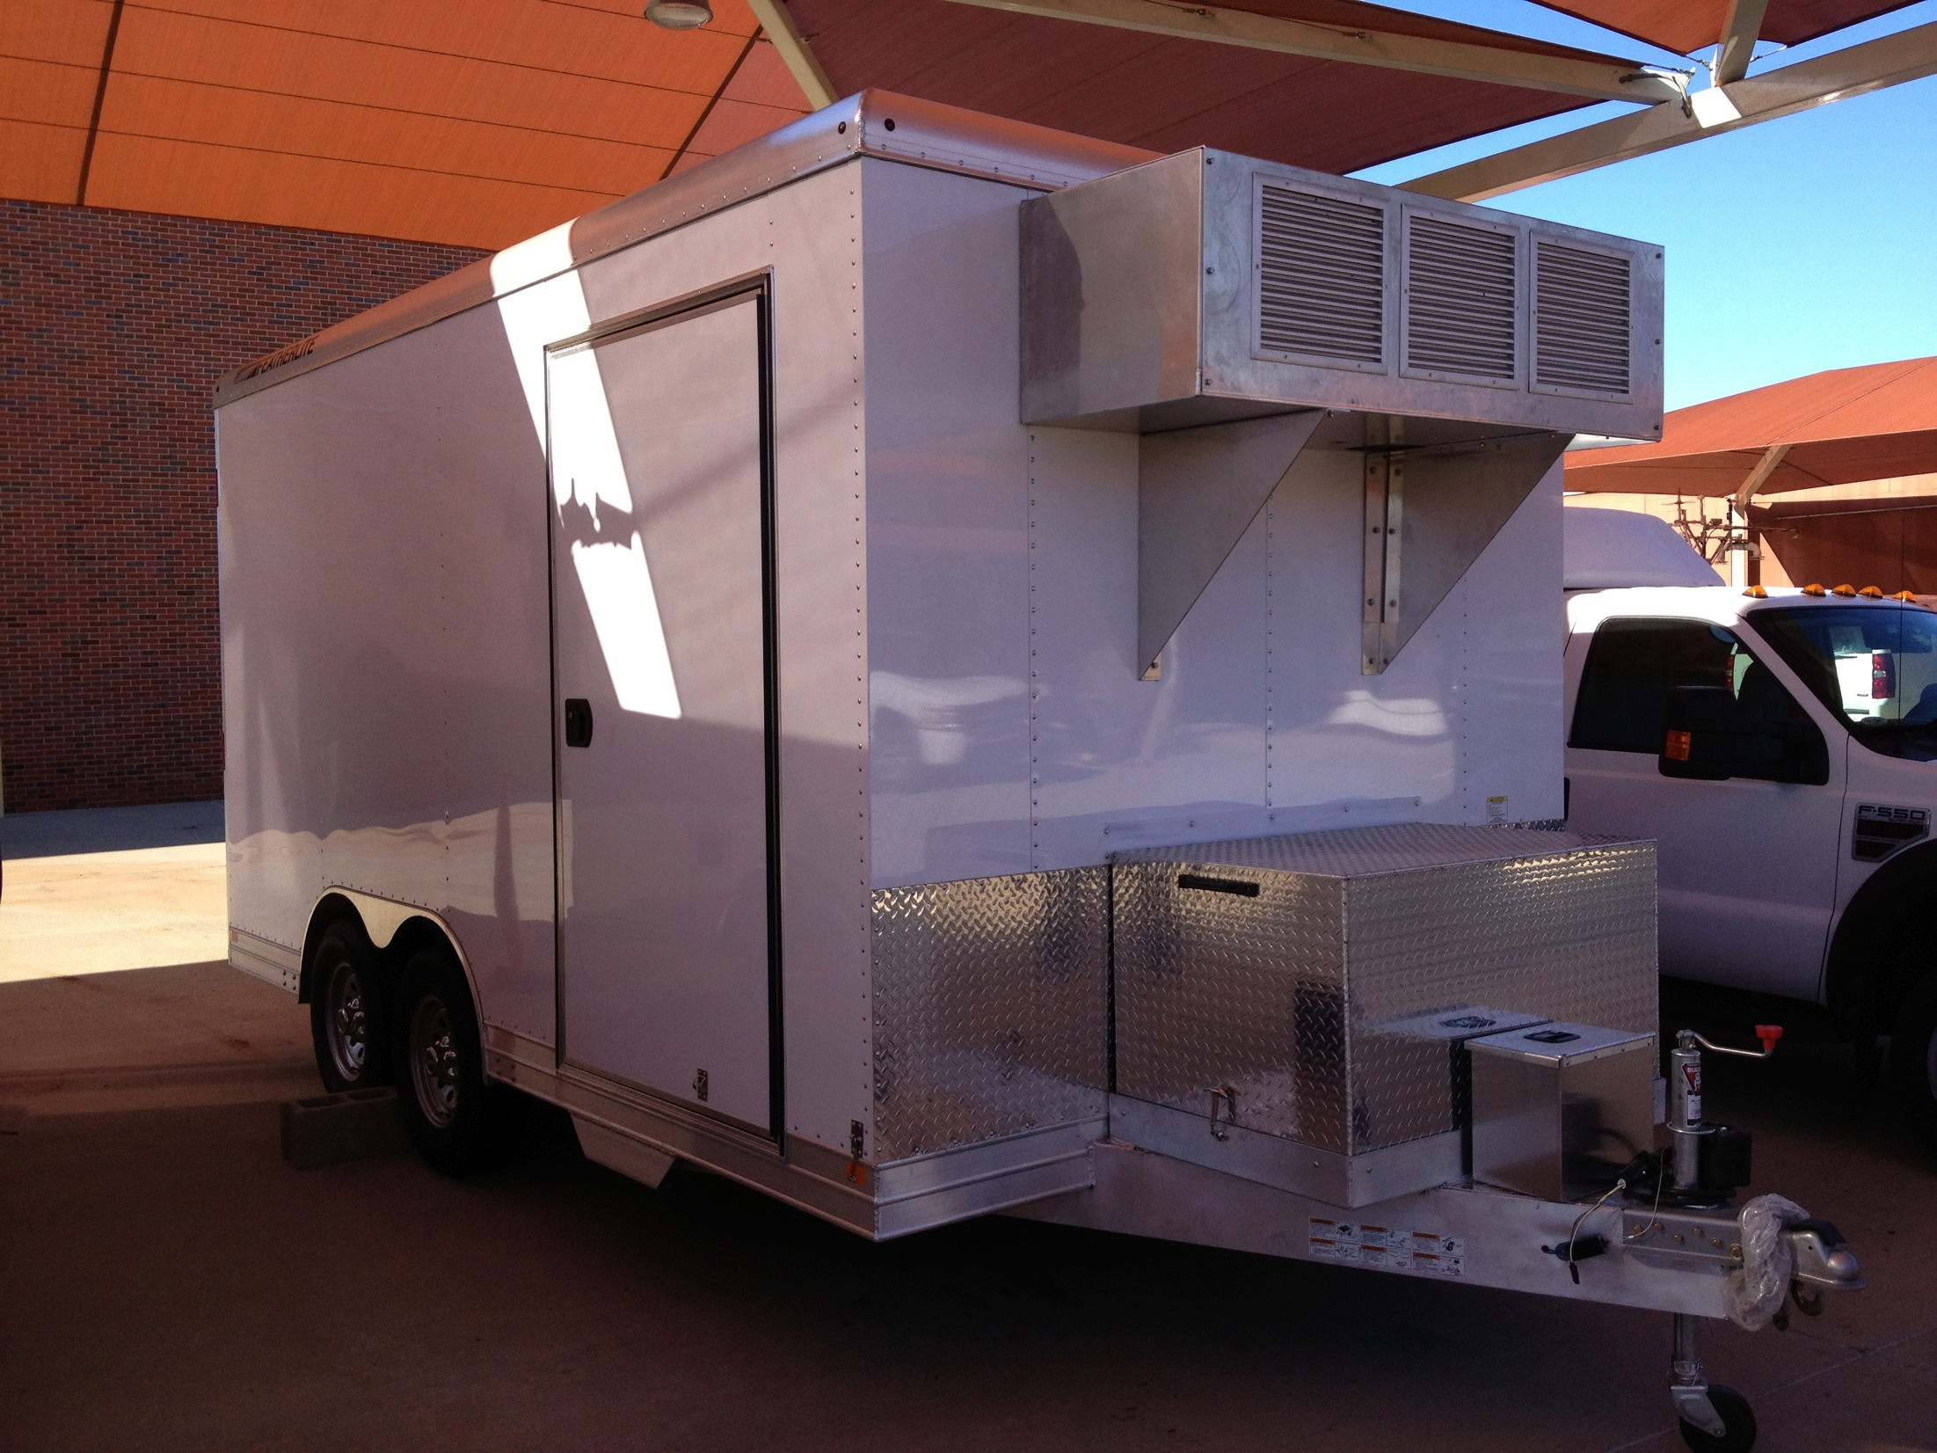
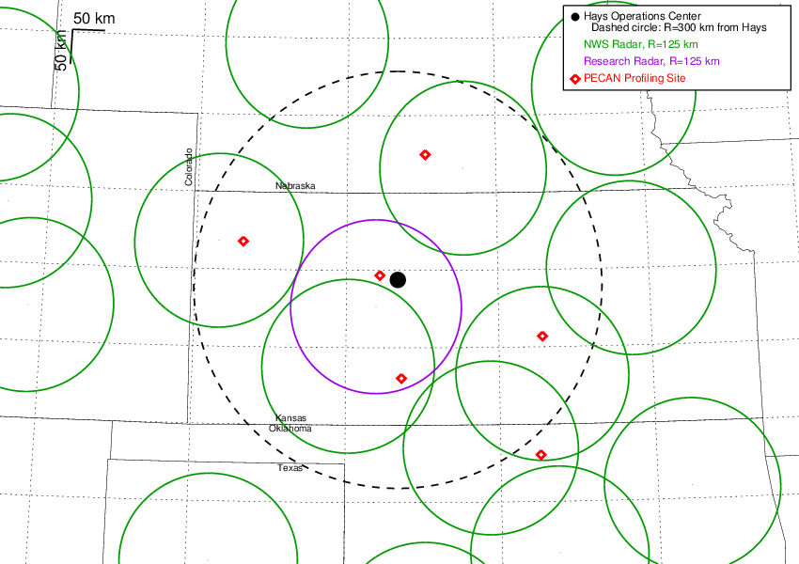
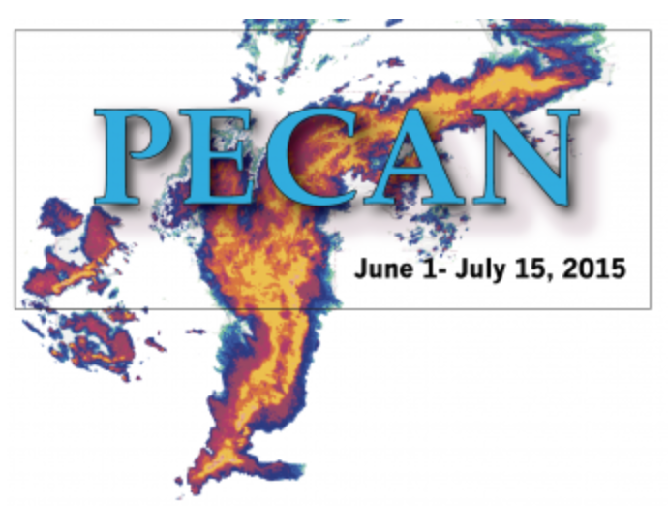
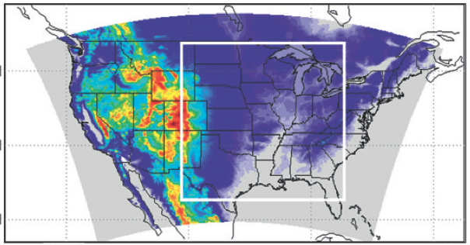
Summary: A Future Ground-based Network?
Network for 4 years (1998-2003)
Central Facility for 20+ years
Using Historical Datasets
(NWC rooftop and DOE)
DOE also has sites in the Arctic, tropics, and other locations
Univ Oklahoma & NSSL
Collaborative Lower Atmospheric Mobile Profiling System (CLAMPS)
(under construction)
AERI, MWR, DWL, Sfc Met
Plains Elevated Convection at Night (PECAN)
1 June through 15 July 2015 (NSF, NOAA, NASA, DOE)
6 fixed profiling sites and 4 mobile profiling facilities
Wintertime OSSE showed improved precip location and intensity in midwest
Observation System Simulation Experiments (OSSEs)
Notes:
Would these thermodynamic remote sensing instruments offer significant value in a future ground based network? To evaluate this, we are:
1) Analyzing the historic dataset collected by the DOE ARM Program (ARM’s focus was climate, we are looking at weather events)
2) Building CLAMPS to support NSSL’s field experiments. CLAMPS is a joint OU/NSSL project funded by NSF
3) Evaluating these remote sensors as part of PECAN field experiment. CLAMPS will be among the instruments in PECAN, but will also have 8 AERIs, 4 MWRs, and 8 Doppler lidar / radar wind profilers in the PECAN domain.
4) Perform OSSEs to look at how different network configurations may improve analyses and forecasts. One OSSE during in wintertime convective case showed big impact on precipitation forecase. This is just an example of an OSSE – we are currently conducting others to look at impact of different THW observations on improving storm modeling (e.g., ABI, hyperspectral sounder, how GB networks might improve WoF analyses)
** Ultimately, this work ties to NOAA’s “improving observations” objective, and to NSSL’s grand challenges #1 (improving prob guidance products) and #5 (developing reliable nowcasting for CI)

