Slide 1
MPAR Engineering Research
Dr. Sebastián Torres (CIMMS)
February 25–27, 2015
National Weather Center
Norman, Oklahoma

Slide 2

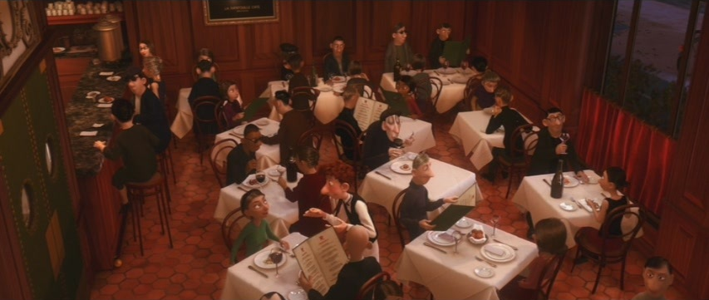







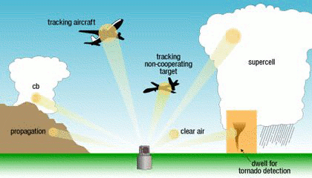




Stills from Ratatouille (Walt Disney Pictures, 2007)
Through MPAR engineering research, NSSL is
devising a practical implementation of the MPAR concept that addresses evolutionary users’ needs with the available resources.
Good quality
Fast
Many customers
Animation courtesy of Chris Curtis, NSSL

Slide 3
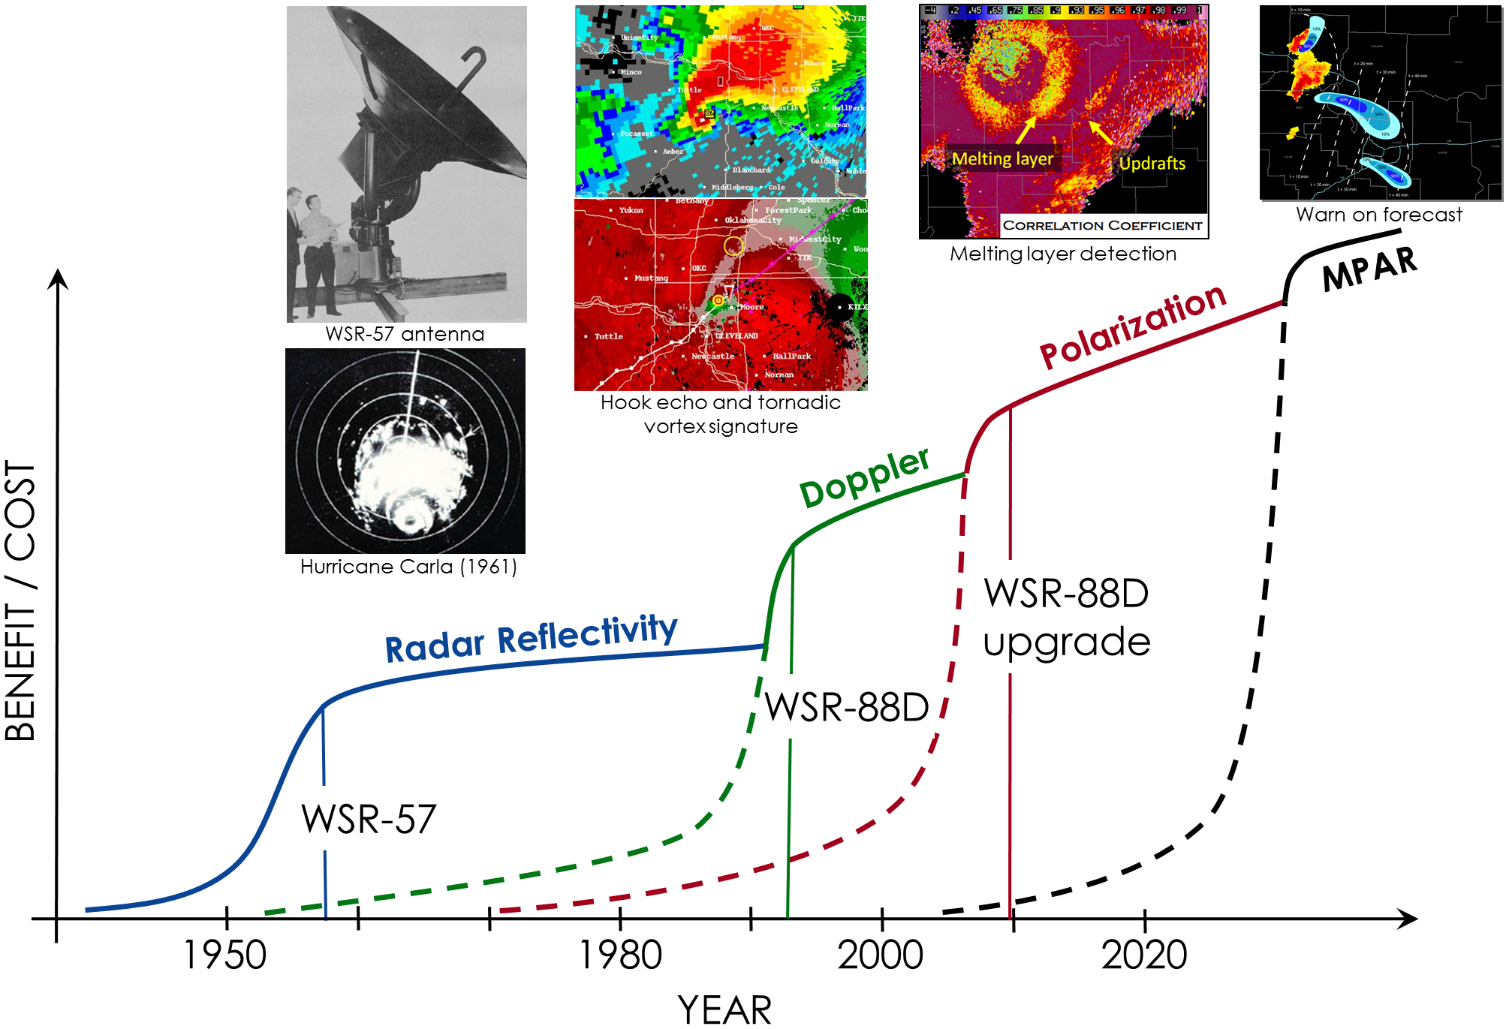

The next revolution in weather observation technology is here!
Improving observations
  technology obsolescence
  data quality & timeliness
PAR’s unique capabilities
  beam agility & adaptability
MPAR challenges
  cost, dual pol, multifunction
Image adapted from Dusan Zrnić, NSSL
NSSL is pioneering the development and demonstration of PAR technology
for improved weather observations in a multifunction environment

Slide 4


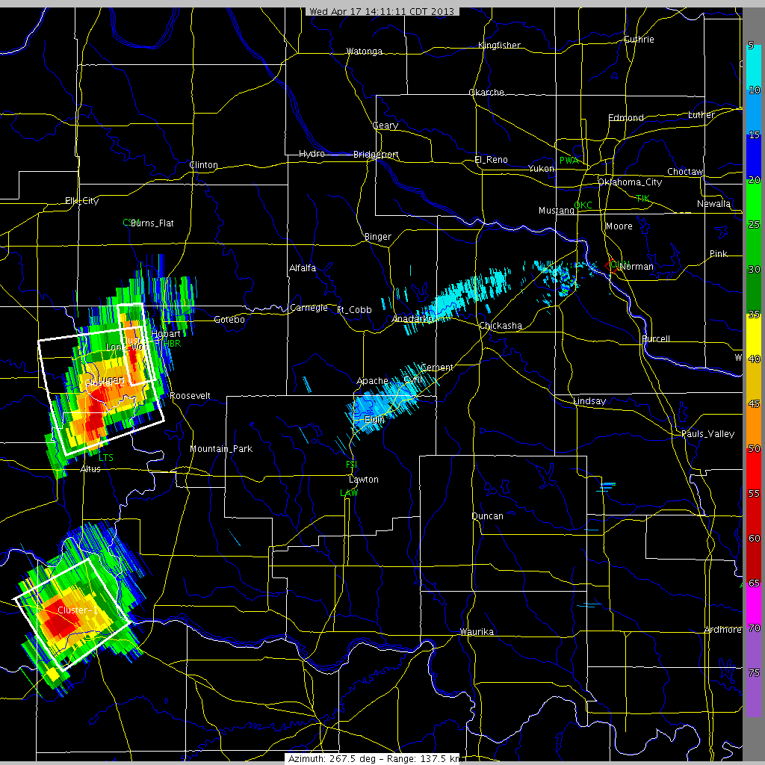
Today: Conventional Scanning
The Future: Adaptive Scanning
Giving users what they need when they need it
Reflectivity at 0.5 deg
el
What do users want?
  learning through HWT
Adaptive scanning
  focused observations
  tailored observations
  dynamic schedule
scan B
surveillance scan
scan X
every 2 min
every 1 min
storm 2
scan A
storm 2
every 20 sec
storm 1
storm 1
storm1
fast updates
every 1 min
clear air
slow updates
0°
PAR
90°
az
All regions are scanned the same
Focus is on storm regions
using tailored strategies
storm 2
normal updates
Animation courtesy of David Priegnitz, NSSL
Adaptive scanning using PAR
is key to improving weather warnings and forecasts

Slide 5
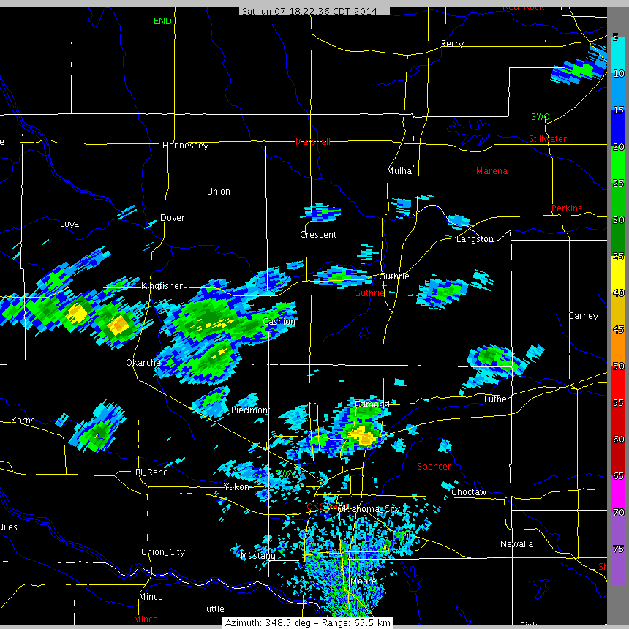
Multifunction
Can one radar do it all?
Reflectivity at 0.5 deg
plus aircraft tracks
aviation
50%
4.8 s updates
weather
50%
136 s updates
Animation courtesy of David Priegnitz, NSSL
Multifunction operation with the NWRT/PAR allows for
simultaneous observation of weather and tracking of aircraft

Slide 6
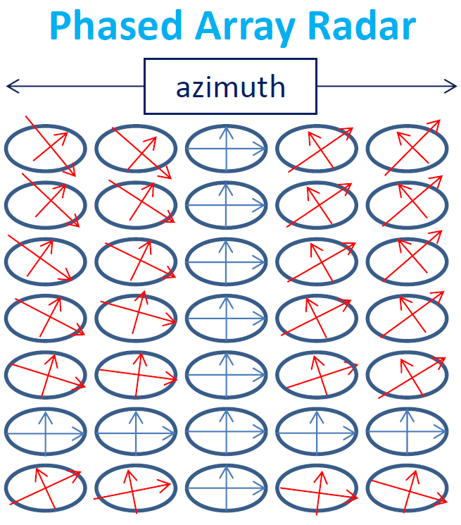
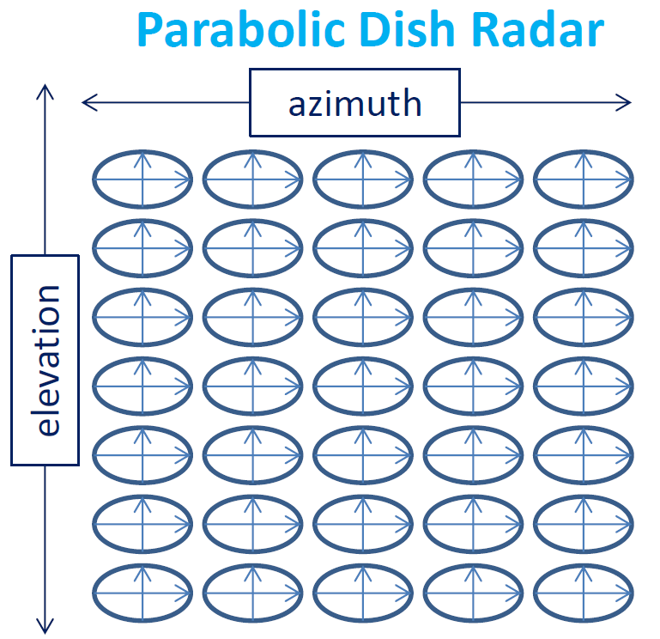
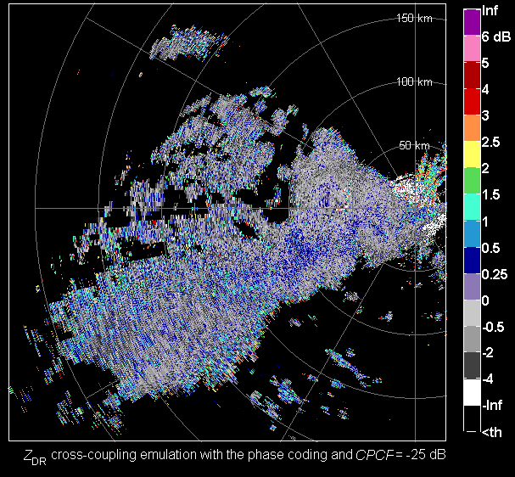
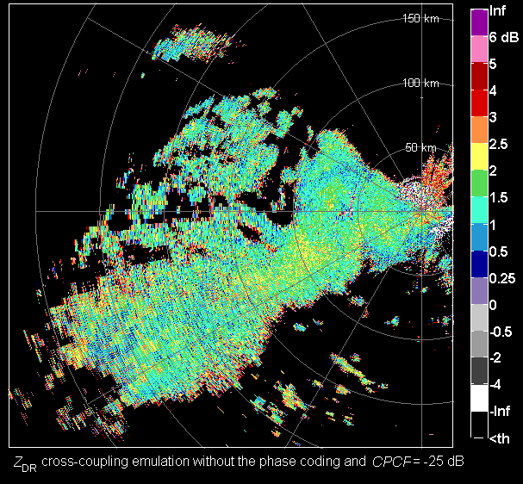
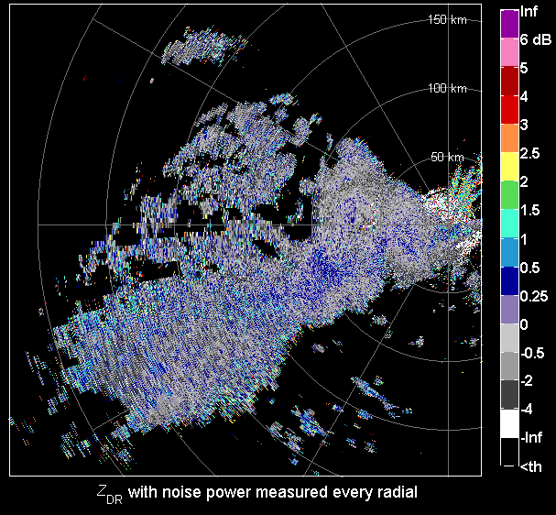
Dual Polarization
Can MPAR match NEXRAD?
NEXRAD-like Differential Reflectivity
PAR-like Differential Reflectivity
One vs. many beams
  alignment & orthogonality
  co-polar matching
  cross-polar coupling
Reducing cross-polar coupling
  channels are encoded
  signal processing reduces
  bias of differential reflectivity
PAR-like Differential Reflectivity with CODING
Image courtesy of Kurt Hondl, NSSL
Images courtesy of Igor Ivić, NSSL
NSSL is developing and demonstrating dual-polarization
weather-observation capabilities for PARs

Slide 7
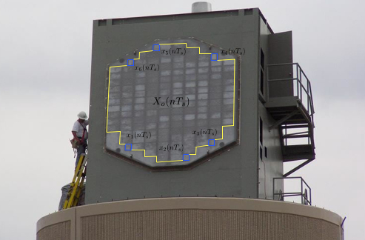
Adaptive Beamforming
Where one beam does NOT fit all
Adaptive Beamforming
Conventional Beamforming
Main lobe
Side lobes
NWRT/PAR antenna
Doppler
Velocity
Adaptive Beamforming can be used
to mitigate clutter and interference
Reflectivity
Images courtesy of Chris Curtis, NSSL
NSSL is exploring PAR’s unique capabilities
to address evolutionary needs for weather observations

Slide 8




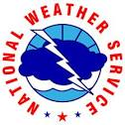



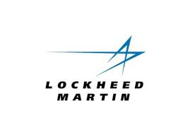






Summary
MPAR Engineering Research at NSSL
remember the chef!
System Design
  definition of requirements
  industry studies
  cylindrical vs. planar
  all-digital architecture
Dual Polarization
  10-panel demonstrator
  Adv. Tech. Demonstrator
  cross-polar isolation
  calibration
Adaptive Scanning
  focused & tailored scans
  multifunction
Adaptive Beamforming
  clutter mitigation
  interference mitigation
Through partnerships with government, industry, and academia, NSSL is
leading the development and demonstration of the MPAR concept

