Slide 1
Polarimetric Radar and NWP Synergies
Jeffrey Snyder (NRC)
February 25–27, 2015
National Weather Center
Norman, Oklahoma

Slide 2
Numerical Model + Radar Data Interaction
Forward Operator
(Radar Emulator)
Numerical Models:
Temperature, Moisture, Hydrometeor Distributions, etc.
Polarimetric Radars:
Z_{H}, Z_{DR}, K_{DP}, ρ_{hv}, etc.
Retrieval Equations
Many of the most “polarimetrically interesting” signatures occur where complexities and uncertainties can be significant.
Radar quantities can be affected by
Size distribution
Water fraction and distribution*
Particle density*
Shape, canting angle, and variability*
Radar frequency
* Generally not predicted

Slide 3
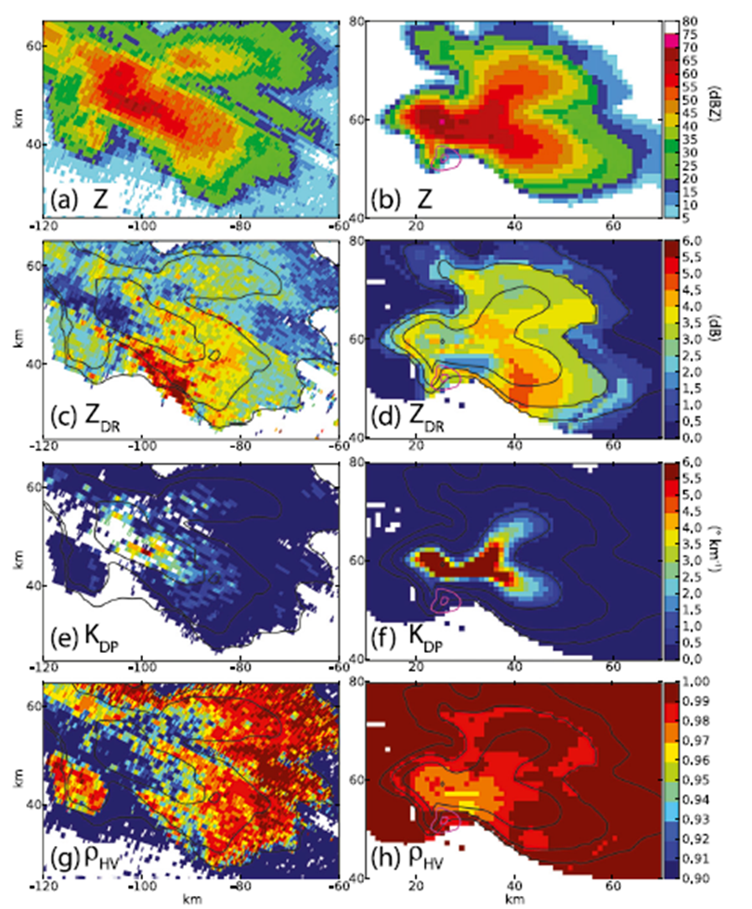
Forward Operators
Observed Simulated
Jung et al. (2010); Ryzhkov et al. (2011)
Valuable uses:
Evaluation of models
Study of relationships between radar signatures and microphysical processes, etc.
Development of data assimilation (using radar data directly in model)
Many potential error sources:
Model (e.g., fixed density, no water fraction / wet ice, “simple” size distributions)
Forward operator (e.g., fixed temperatures in calculations, water fraction routines)
Dawson et al. (2014)

Slide 4
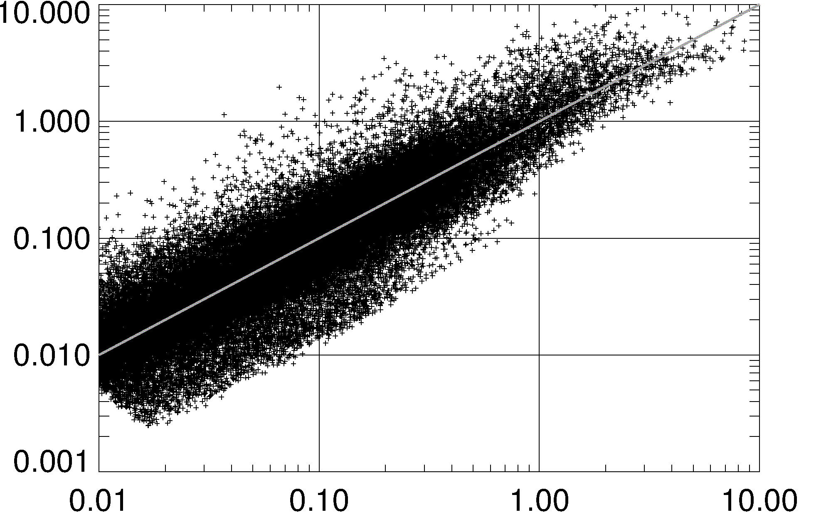
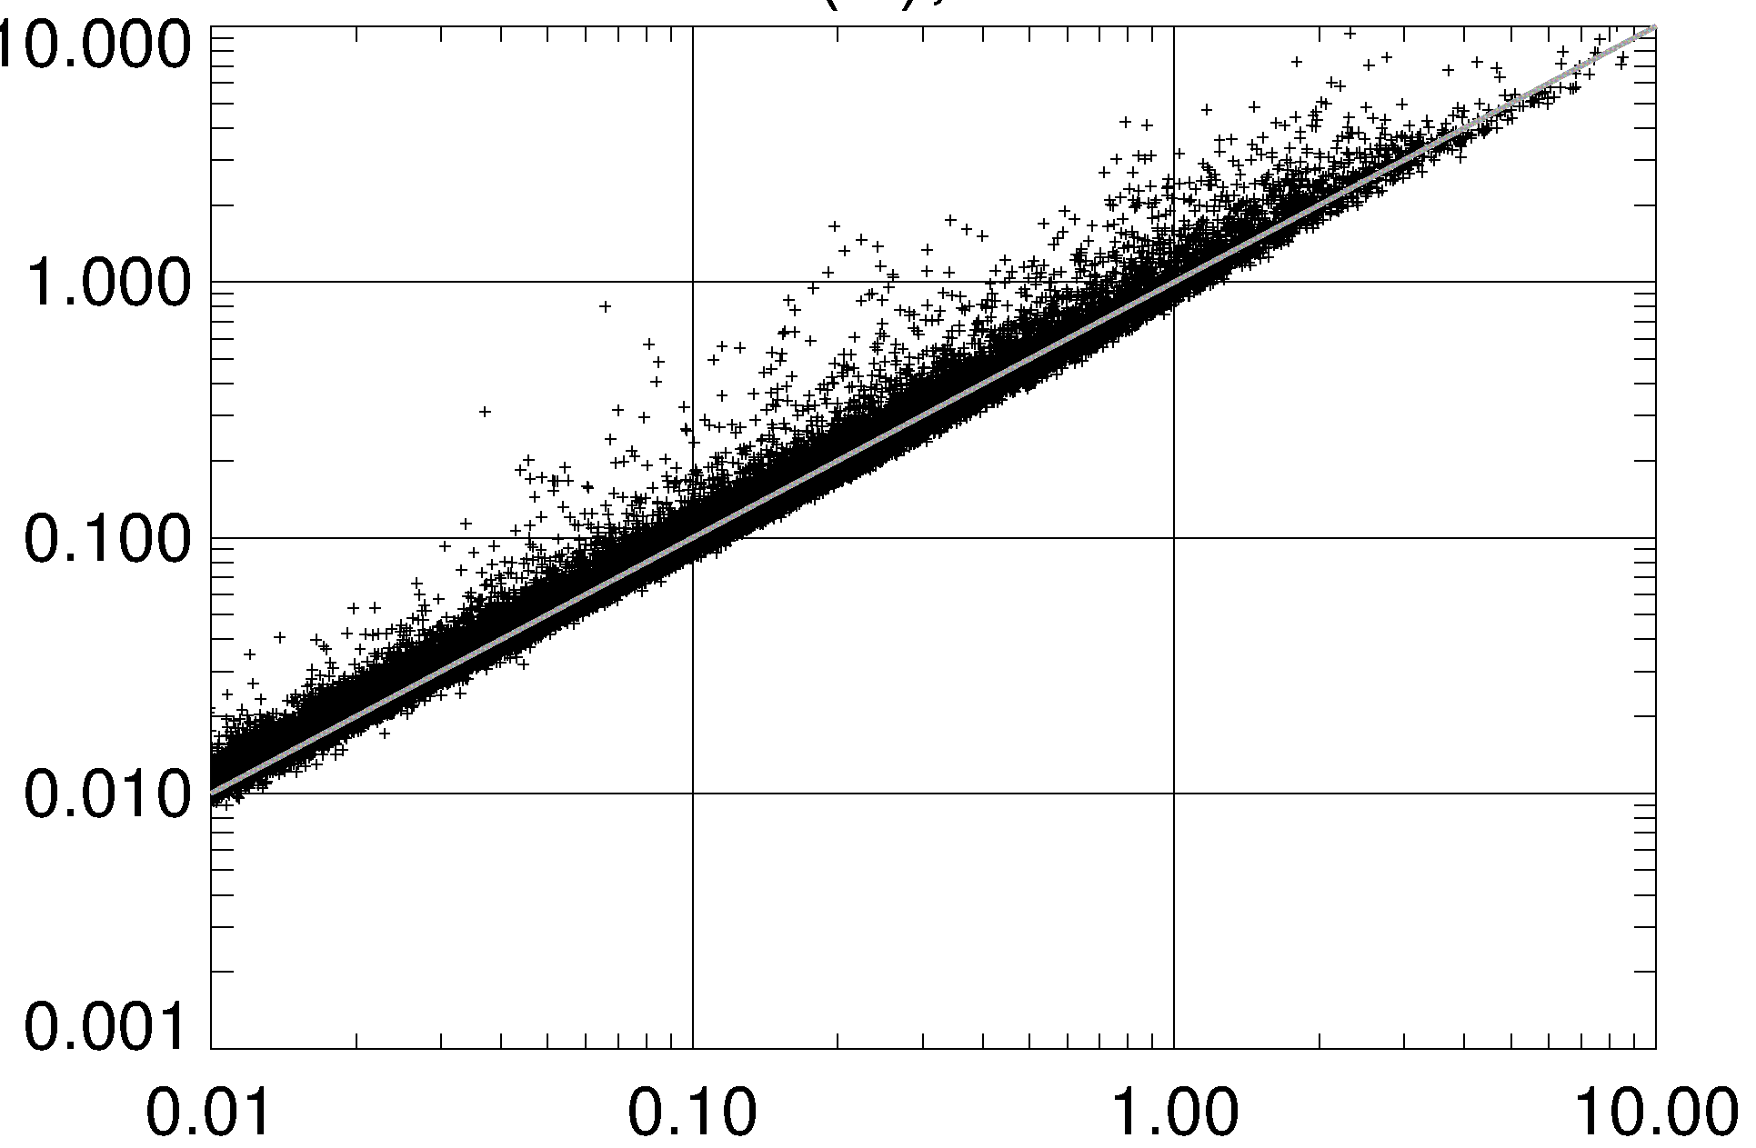
Microphysical Retrievals
Polarimetric information can aid estimates of rain and ice characteristics
Naturally-occurring variability in hydrometeor distributions means that “one size fits all” retrieval equations are often suboptimal
Liquid Water Content (LWC)
Single Polarization (Conventional)
Dual Polarization
Z_{H}-Retrieved LWC (g/m³)
A_{H}-Retrieved LWC (g/m³)
“True” LWC (g/m³)
“True” LWC (g/m³)
Above – Less scatter = better

Slide 5
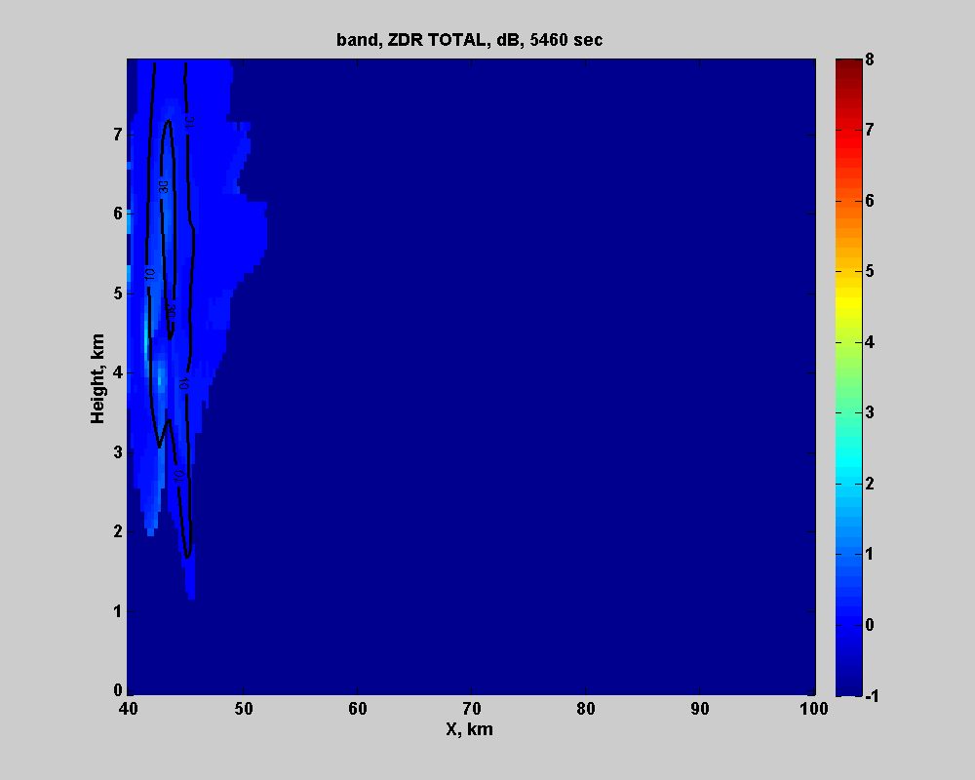
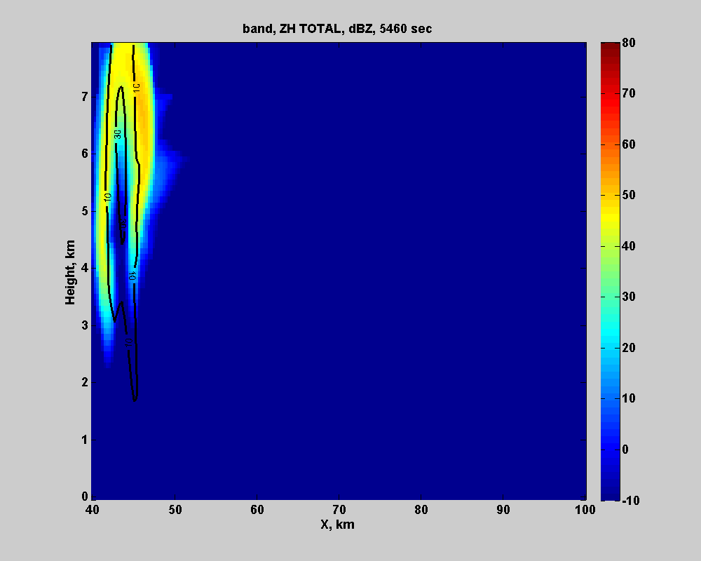
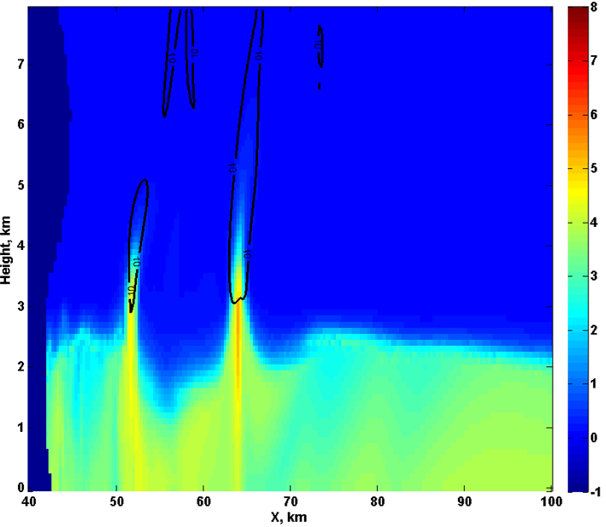

Z_{DR} Columns – Example of Potential Utilization
Hebrew University Cloud Model
Height
Z_{DR}∝$\frac{Width}{Height}$
Rain
Hail
Snow
Z_{DR} (dB) W (contoured)
Z (dBZ) W (contoured)
Width
Large drops
Wet hail
0ºC
0ºC
0ºC
0ºC
Relevant to
Operations – large hail growth, updraft evolution (intensification/dissipation)
Research – identify regions and extent of latent heating associated with condensation
Small drops
Dry snow/hail
See Kumjian et al. (2014) and Snyder et al. (2014)

Slide 6
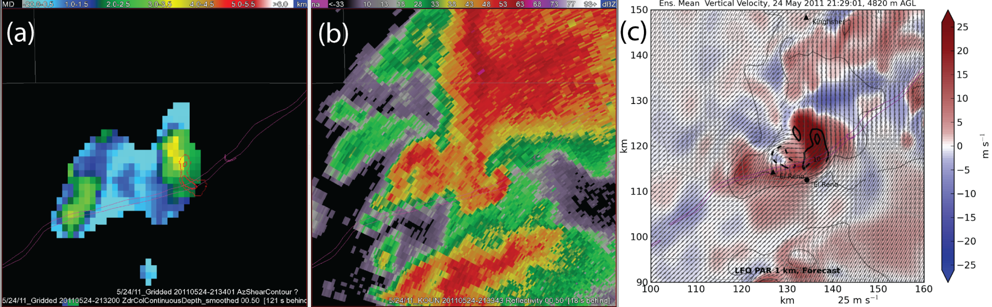
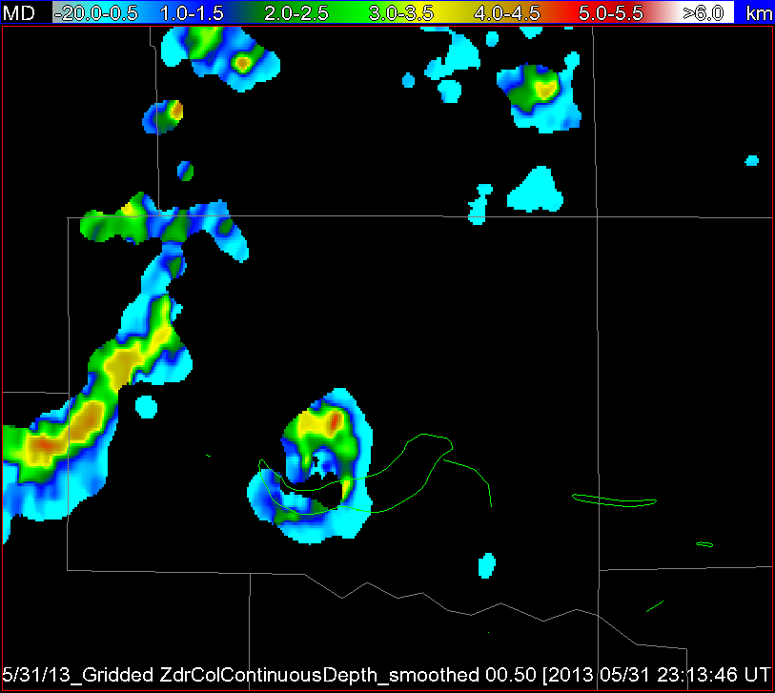
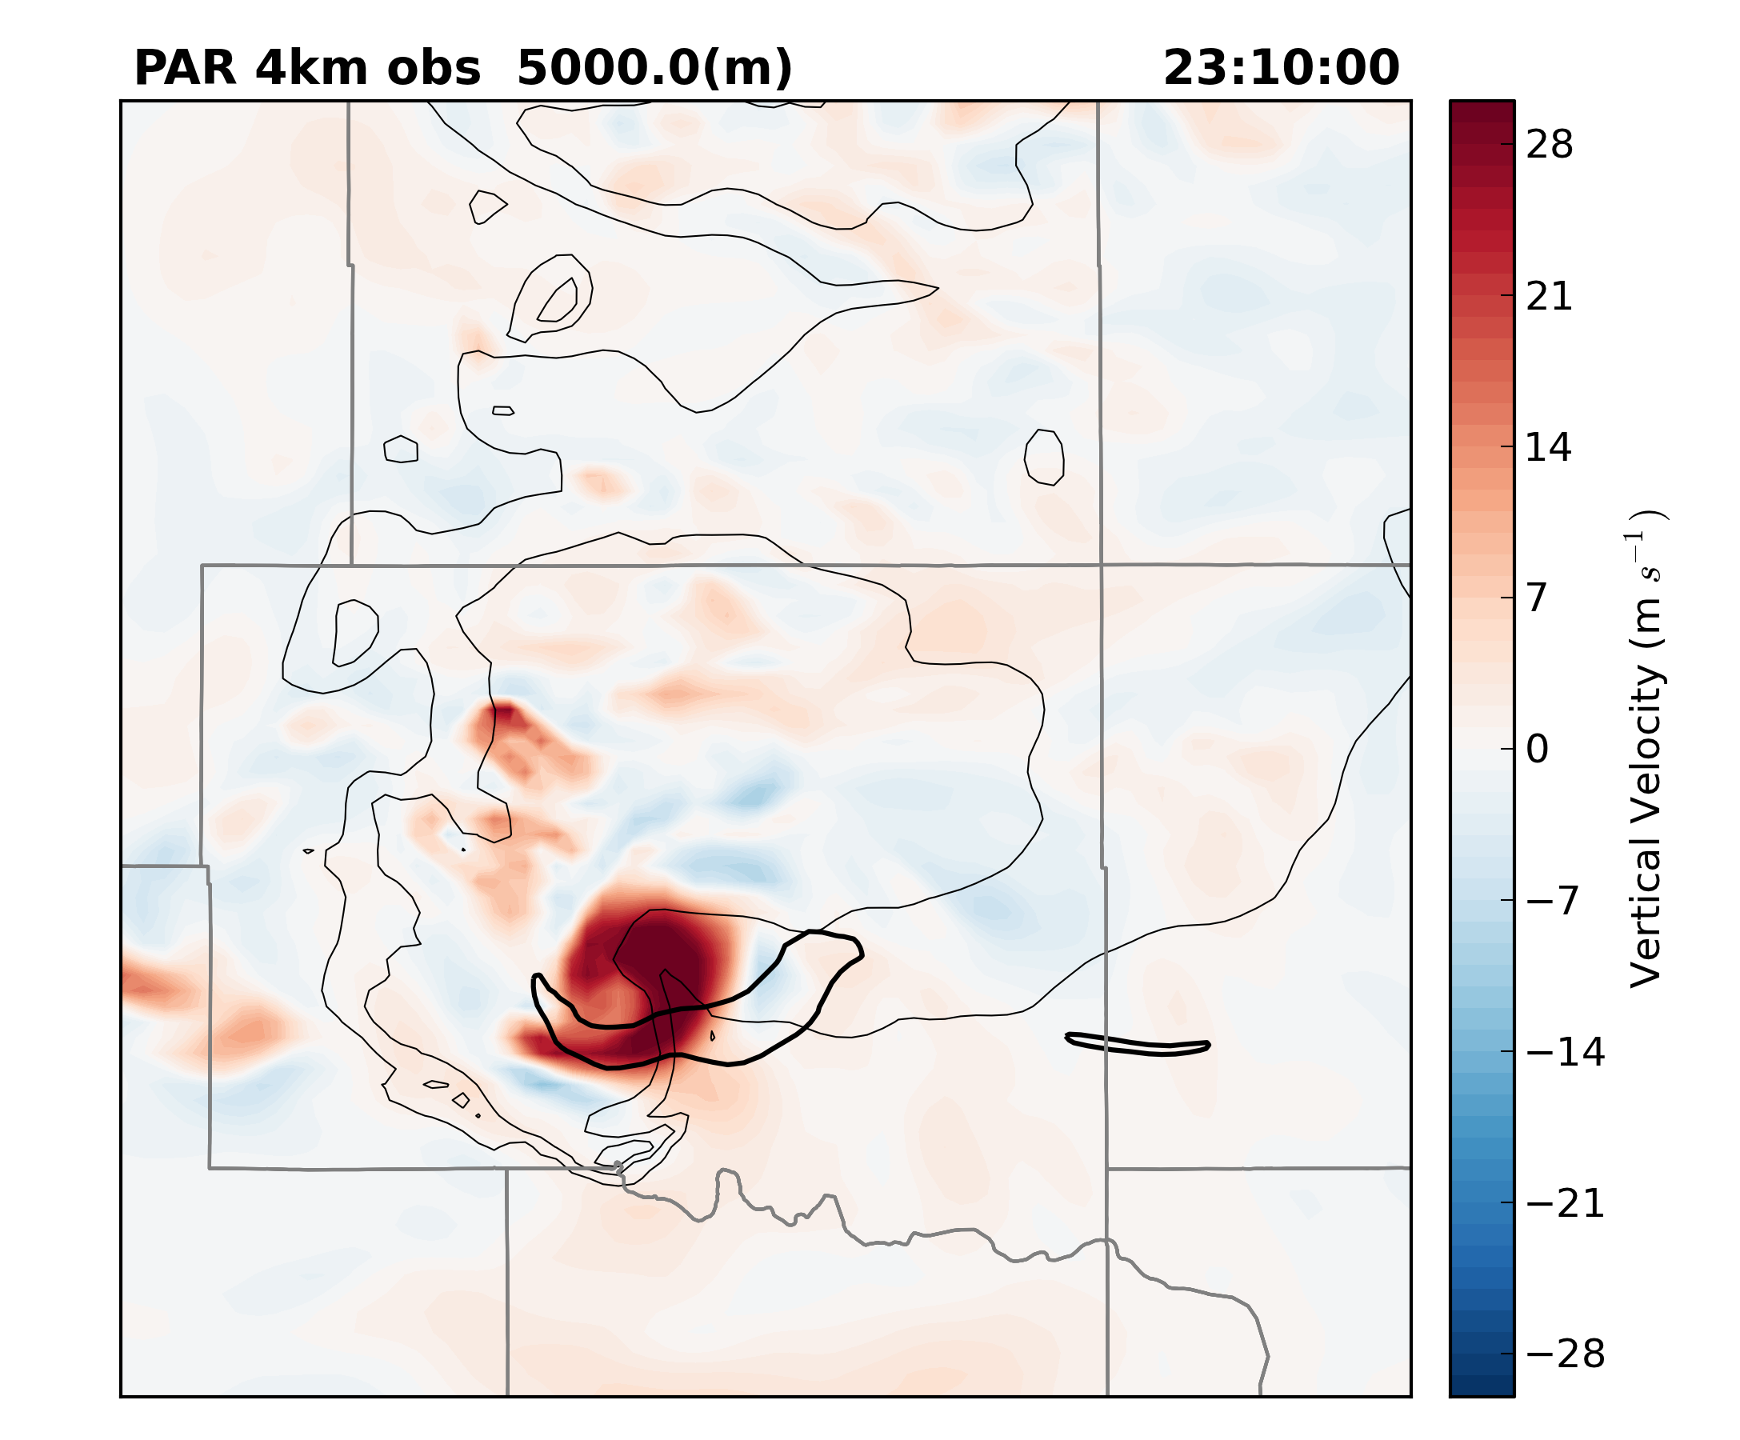
0.5º Z_{H}
Z_{DR} Column Depth
EnKF W (MPAR)
24 May 2011
Violent tornado in OK
Courtesy Robin Tanamachi
Z_{DR} Column Depth
EnKF W (MPAR)
31 May 2013
Intense tornado in OK
Courtesy Patrick Skinner

Slide 7
Summary
Build collaborations between those in the cloud modeling and radar communities to leverage expertise
Research (e.g., post-event analysis, sensitivity experiments)
Operations (e.g., R2O-focused algorithm development)
Continue to use insight gained from modeling efforts coupled with forward operators to establish new relationships between observed and unobserved quantities
  Z_{DR} columns → updrafts (latent heating, etc.)
  Tendencies/Structures of Z, Z_{DR}, and K_{DP} → evaporation, aggregation and accretion, etc.
  Polarimetric data and microphysical retrievals
    Hydrometeor classification → focus hydrometeor distributions (e.g., apply different relationships depending upon inferred hydrometeor composition)
    Retrieved drop-size distributions

