Slide 1
Multi-Radar / Multi-Sensor Applications for Severe Weather Warning Operations
Travis Smith (OU/CIMMS)
February 25–27, 2015
National Weather Center
Norman, Oklahoma

Slide 2
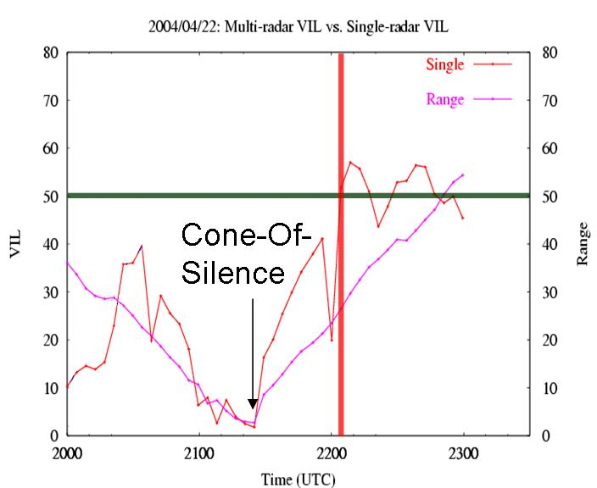
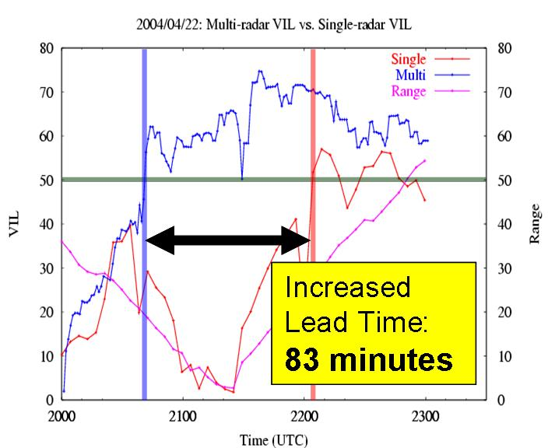
MRMS-Severe
MRMS-Hydro
MRMS-Severe
MRMS-Aviation
Radars in network supplement each other:
Overlapping coverage
Fills in gaps from cones-of-silence and terrain blockage
Increased sampling frequency
Seamless, consistent
QPE
Flash Flood
Vertically Integrated Liquid
Single-radar cross-section
VIL
Time (UTC)

Slide 3
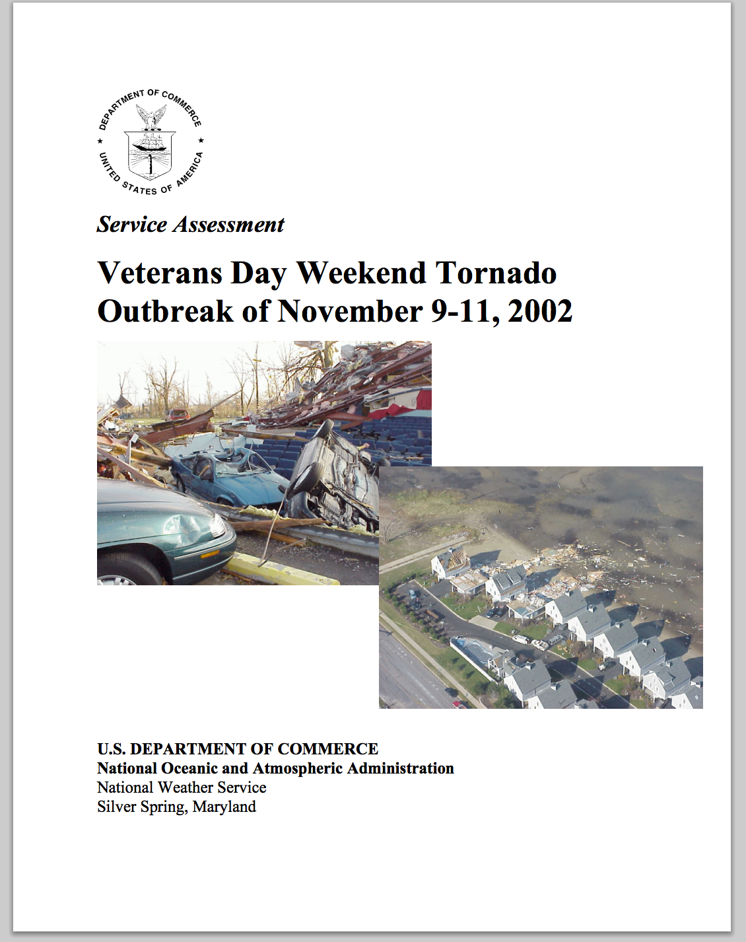
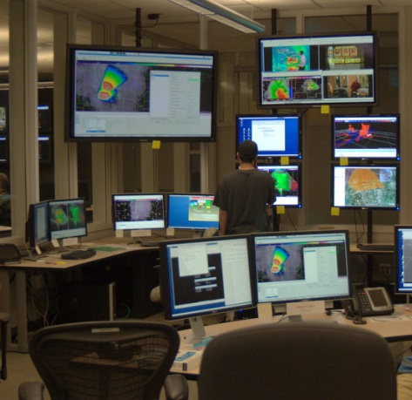
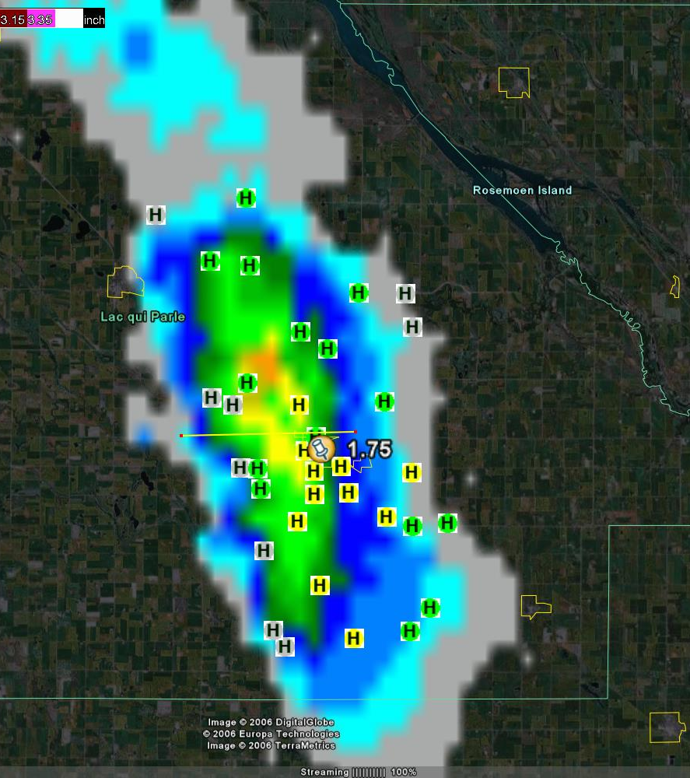
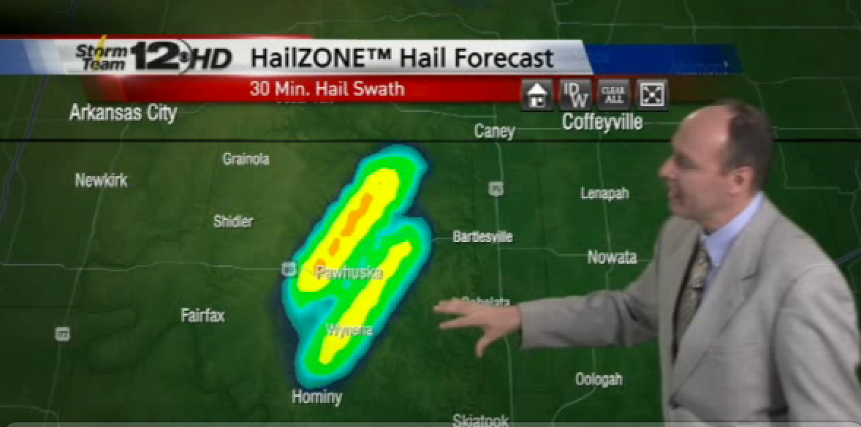
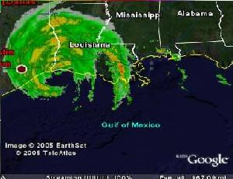
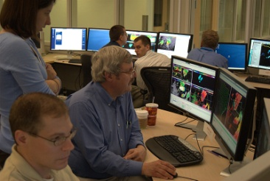
MRMS-Severe
2001 – present: WDSS-II available at select NWSFOs
Visiting NSSL scientists 2002-2004
2005 – present: CONUS real-time WDSS-II system (w/ SPC)
2006 – present: Severe Hazards Analysis and Verification Experiment
2008 – present: Hazardous Weather Testbed
Focus in 2009/10/13/14
AWIPS2 integration
2008 – present: licensing to private sector
e.g. 50% of US TV market
RECOMMENDATION: These capabilities should be prioritized for inclusion in future AWIPS and future Open Radar Product Generator (ORPG) builds.
Targeted high resolution phone calls by OU students
100,000 since 2006

Slide 4
Examples: Multi-sensor data fields
Near-surface reflectivity
Total Lightning Density
Show physical relationships between data fields from multiple sensors
Storm tracks and trends can be generated at any spatial scale, for any data fields
Reflectivity @ -20 C
Max Expected Size of Hail
(~6.5 km AGL)

Slide 5
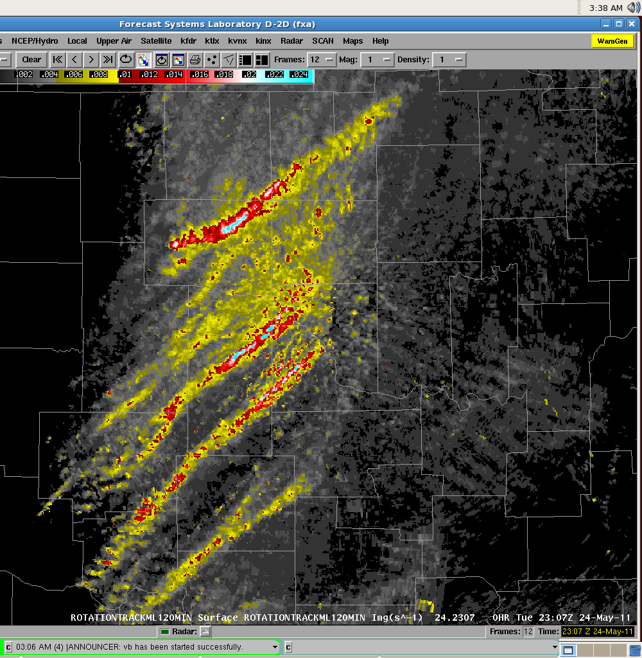
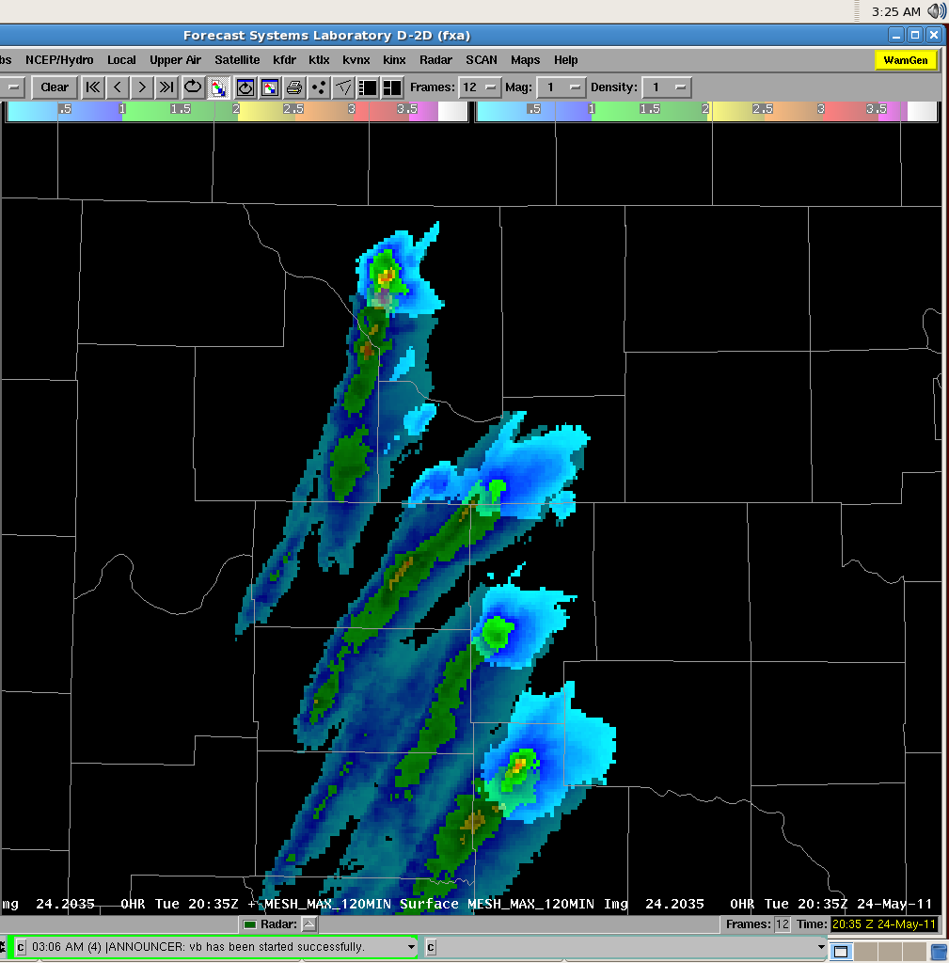
Initial Operating Capability at NCEP
2-hour Rotation Track (max Azimuthal Shear
Rotation Tracks
Maximum Estimated Size of Hail (MESH) and MESH Swath
Vertically Integrated Ice/Liquid (VII & VIL)
Thickness of Reflectivity Core
Echo Top - 18, 30, 50, 60 dBZ
Isothermal Reflectivity
Composite Reflectivity
Reflectivity At Lowest Altitude (RALA)
CG Lightning Density
Lightning Probability
2-hour MESH Swath
Widely used in NWSFOs since 2002.

Slide 6
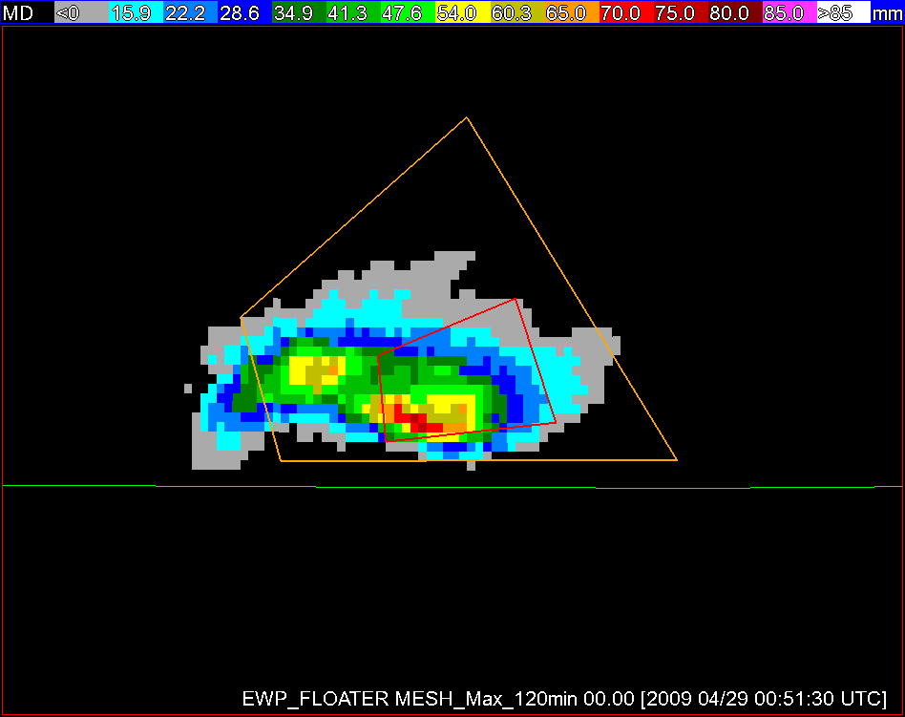
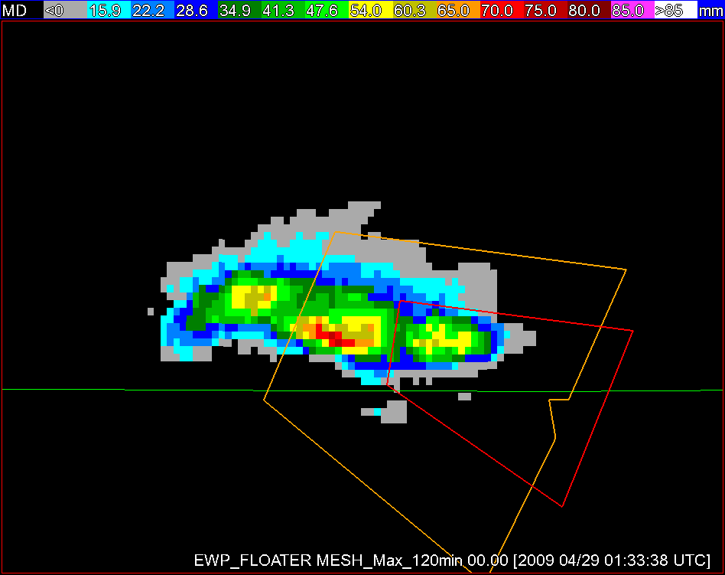
MRMS-Severe Best Practices Experiment
Collaboration w/ NWS Warning Decision Training Branch
Forecasters issued warnings with and without MRMS data in controlled setting
Results:
Improved warning polygon alignment and precision
Faster storm diagnosis
Improved lead time to first severe report
NWS Warnings – polygon alignment
HWT Warnings
EWP Warnings – polygon alignment

Slide 7
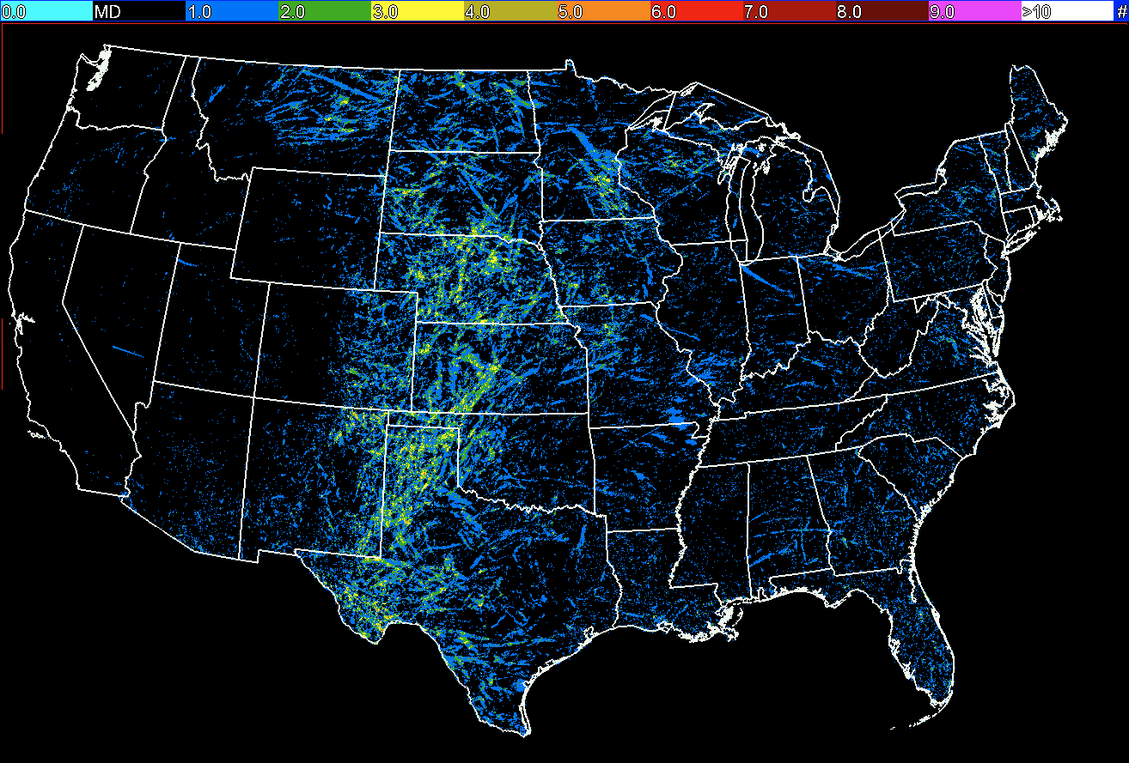
What’s Next?
Multi-Year Reanalysis of Remotely Sensed Storms (MYRORSS)
15+ years of storm statistics
FACETs / Probabilistic Hazard Information
Data Mining
Improvements:
Rotation Tracks
Lightning Jump
Tornado Debris Signature
Hail size estimates
Number of Hail Days in 2007
MRMS & MYRORSS are foundational to the effort to improve NWS warning services

Slide 8
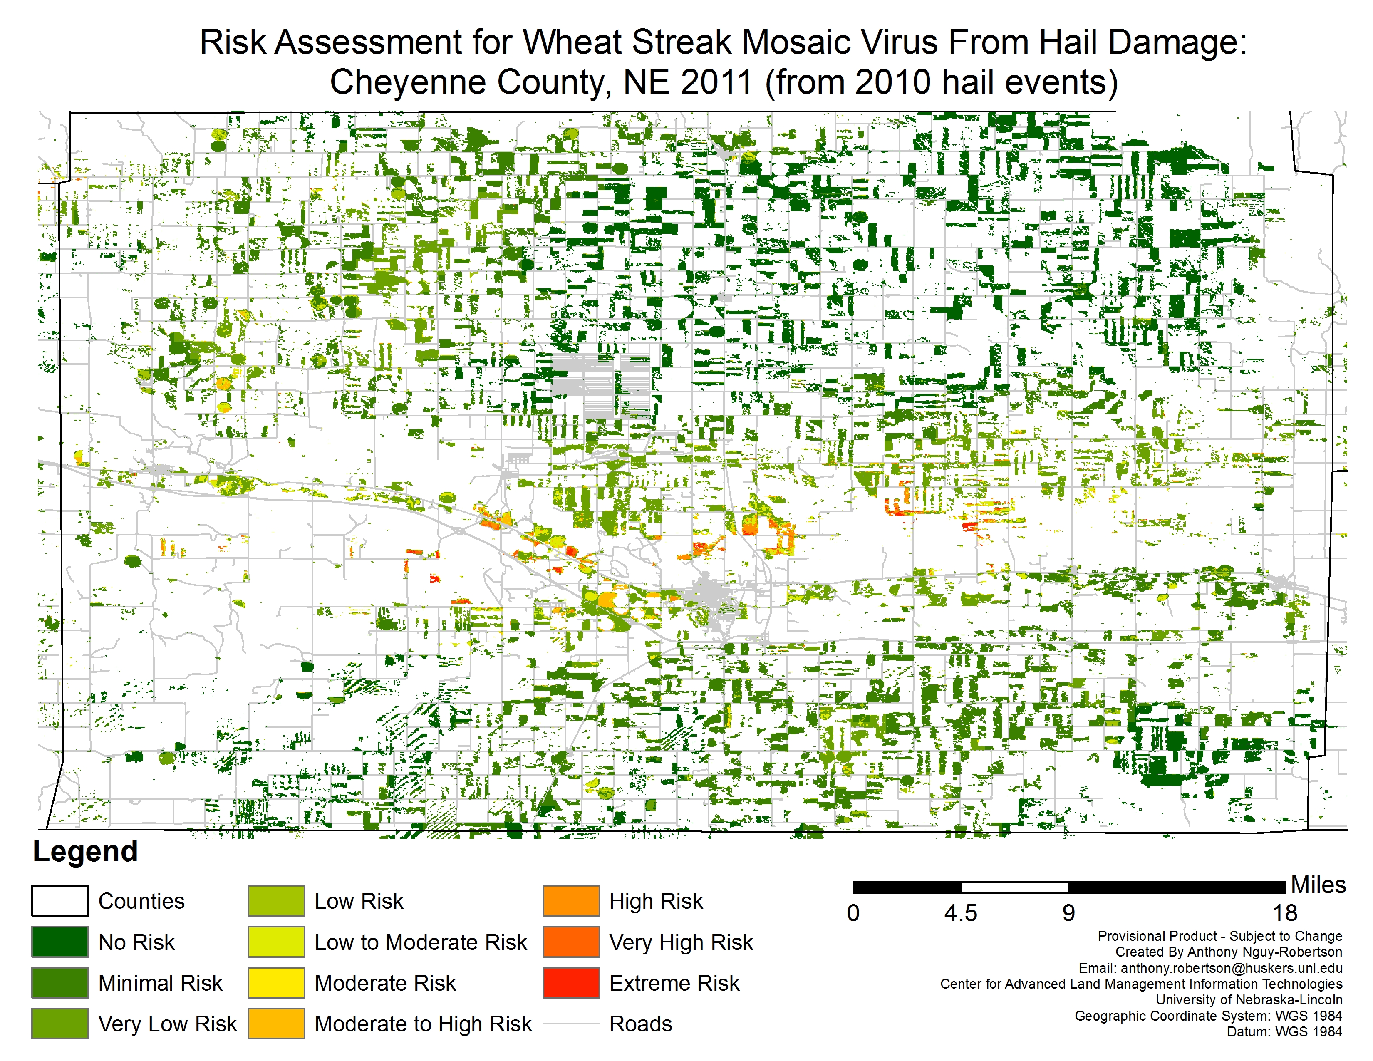
What’s Next?
Extensive collaboration with the NWS and private sector since 2001.
Additional user base:
Emergency management – FEMA, Red Cross
Academia
Agriculture
Ornithology (bird migration)
Insurance / Reinsurance

