Slide 1
Hydrometeor Classification Algorithm 2 (HCA2)
Terry Schuur (CIMMS)
February 25–27, 2015
National Weather Center
Norman, Oklahoma

Slide 2
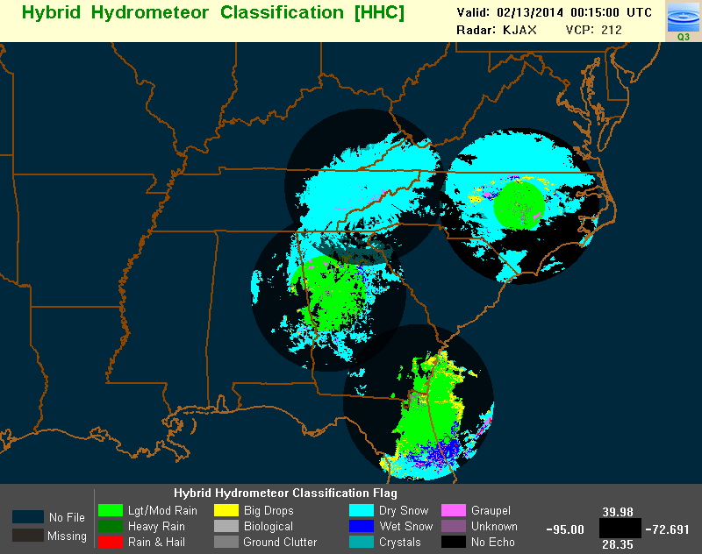
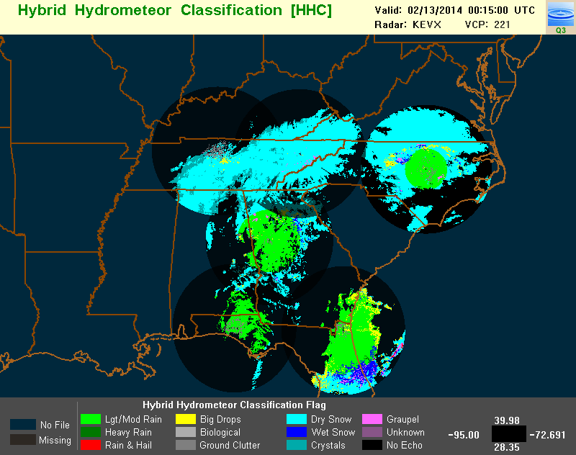
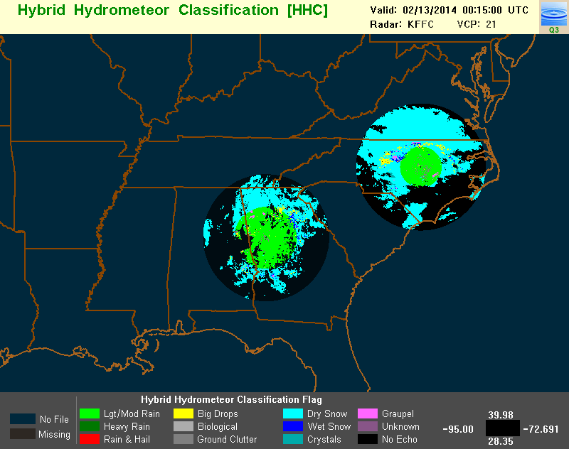
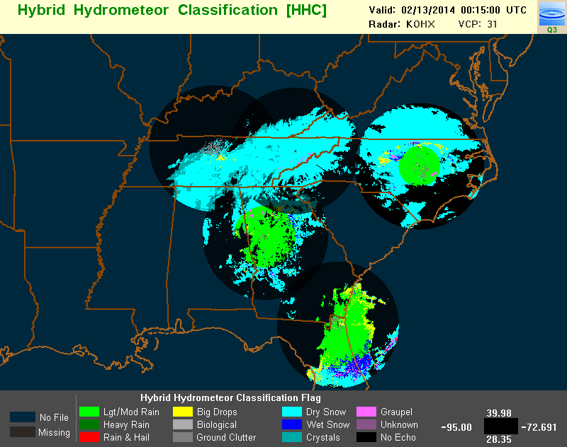
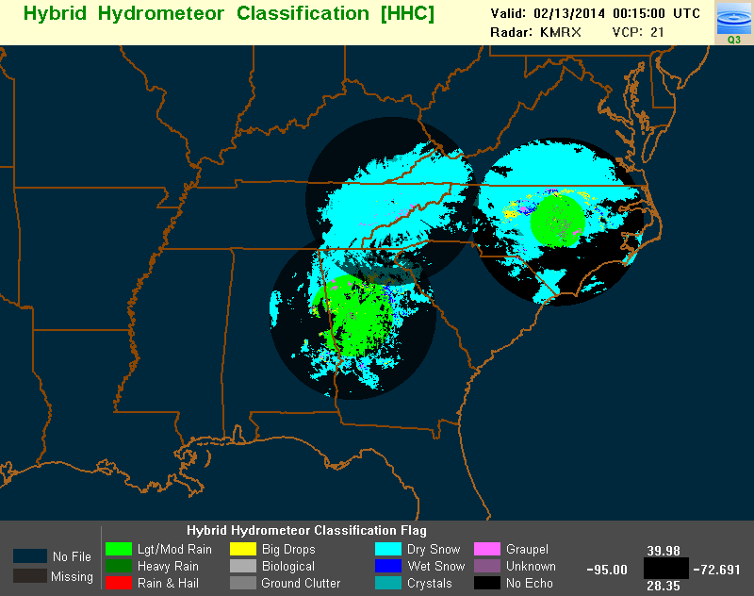
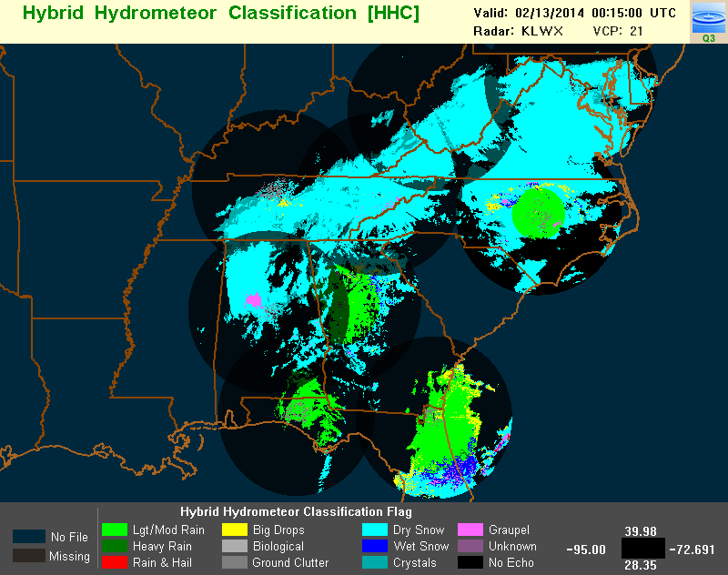
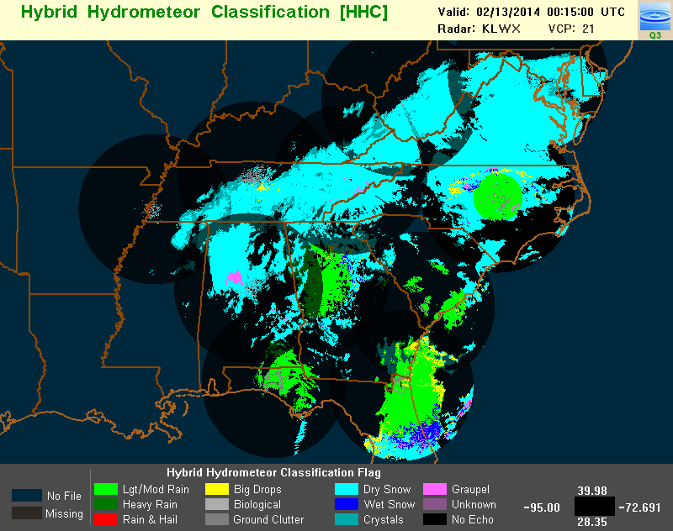
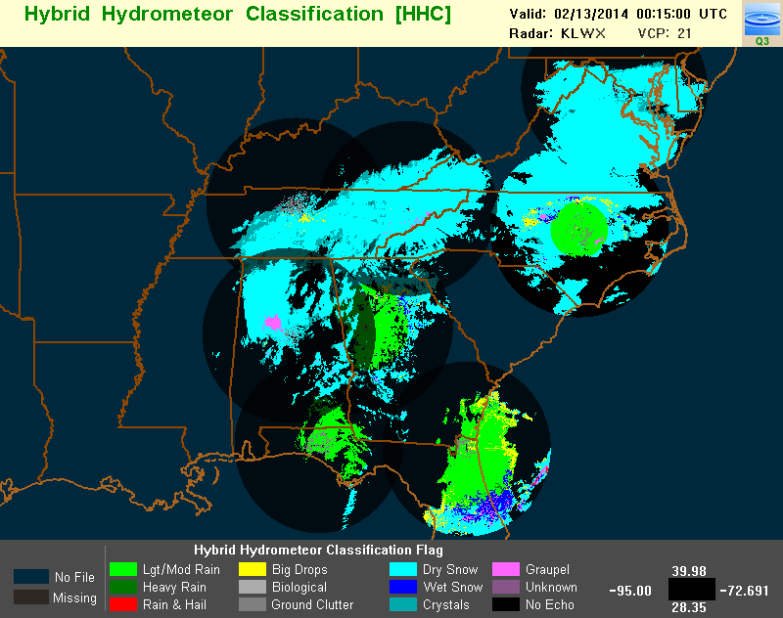
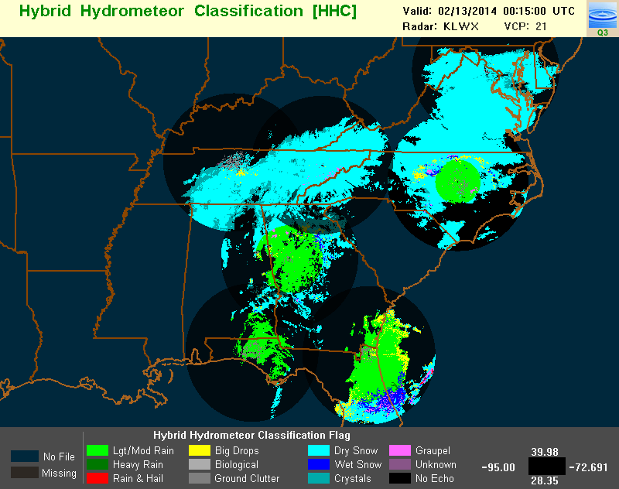
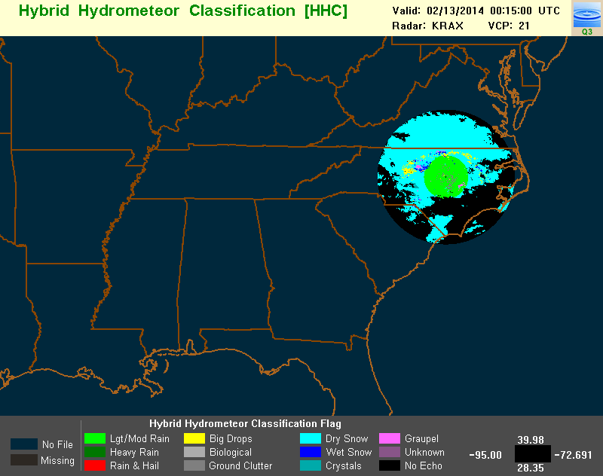
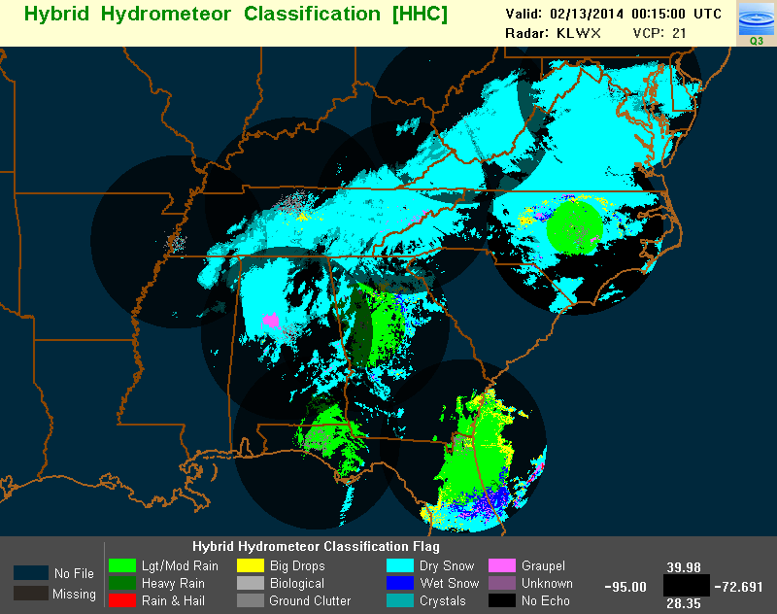
Existing Hydrometeor Classification Algorithm (HCA)
Developed primarily for warm season precipitation
Provides classification on conical surfaces. Not always representative of precipitation type observed at ground level
Does not include precipitation categories such as freezing rain and ice pellets
Radar by radar product. Significant “no data” gap frequently exists between radars
New concept: Model-based background precipitation type classification that is modified, when necessary, by radar observations.

Slide 3
Vision: Develop an “all-season” surface-based HCA
Cold
Season
Transitional
Warm
Season
2.5º
2.5º
1.5º
1.5º
0.5º
0.5º
Project 0.5º elev. categories to surface as cold-season precipitation
Project 0.5º elev. categories to surface as warm-season precipitation
M E L T I N G L A Y E R
wet
snow
Run fuzzy-logic based HCA algorithm. Project the classification results to the surface.
If T_{w} < -5ºC for entire column, ice categories projected from the 0.5⁰ elevation to surface as ice crystals or snow.
If T_{wSurface} > 5ºC, ice categories are projected from the 0.5⁰ elevation to the surface as rain, big
drops, or hail.
For intermediate “transitional winter weather” conditions, the background classification is determined from the HRRR model. Polarimetric radar observations are then used to either modify or provide value-added information to the model-based background classification.
snow
rain
rain
snow
(?) snow, wet snow, sleet, freezing rain, rain (?)
snow
Model-based background, radar modified classification
T_{Wsurface} > 5ºC
T_{Wcolumn} < -5ºC

Slide 4
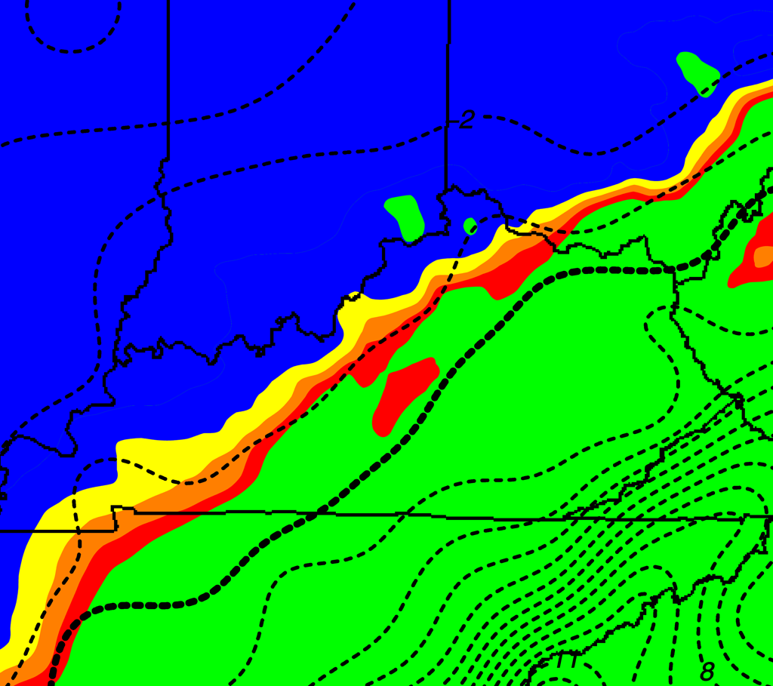
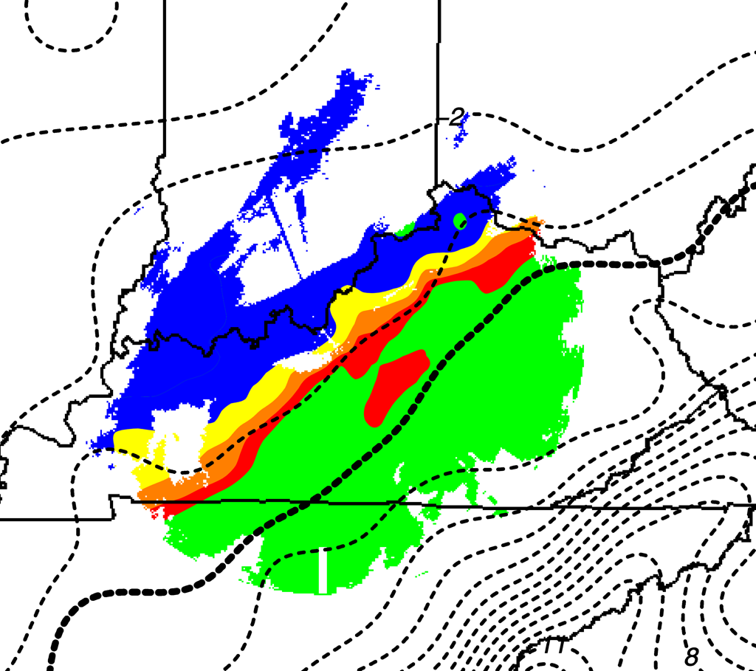
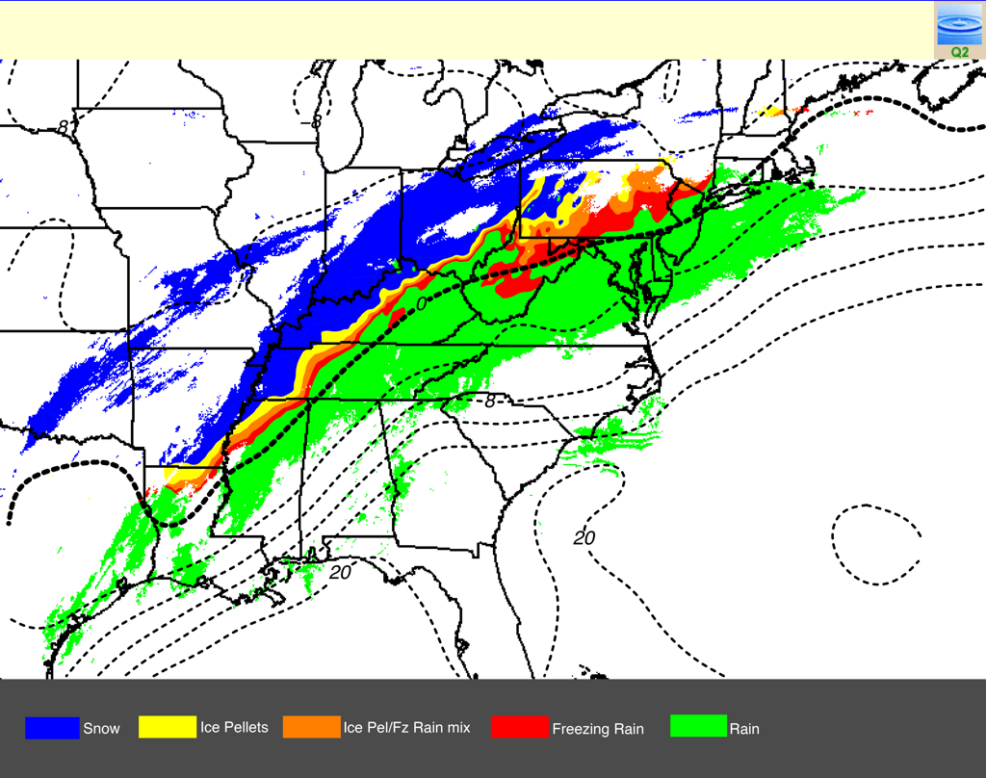
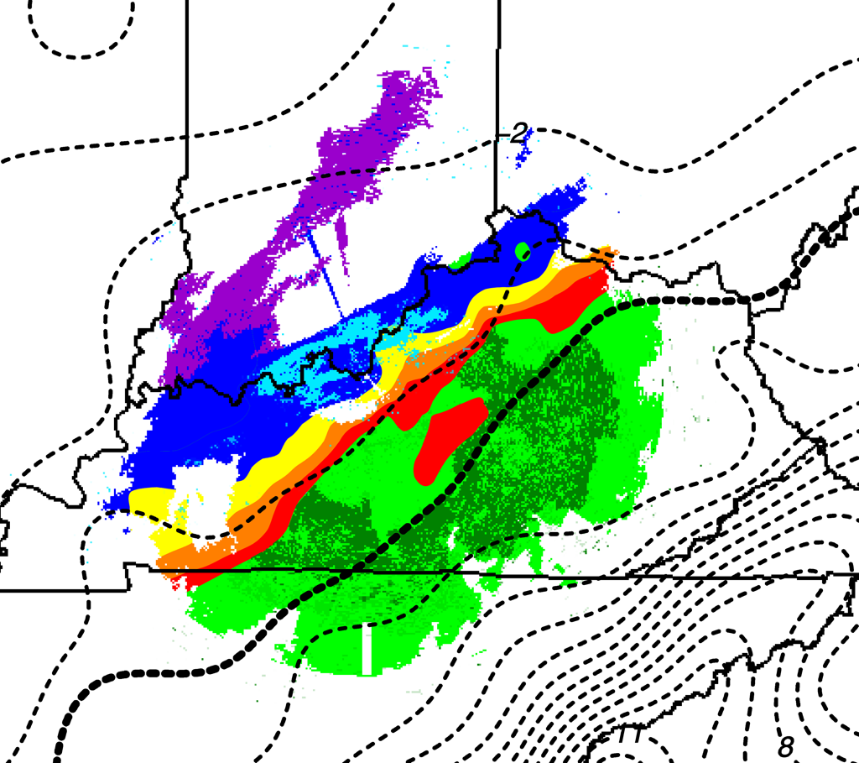
Model-based Background Classification
Model-based background classification produced from the High Resolution Rapid Refresh (HRRR) model. Three techniques have been explored:
Explicit determination of surface precipitation type from HRRR wet-bulb temperature profiles
Statistical “random forest” technique that uses attributes derived from the HRRR
Spectral bin model where processes of melting, ice nucleation, and refreezing are treated explicitly
Step 1: create background class over CONUS
Step 2: Use radar to filter non-precipitating areas
Ice Crystals
Snow
Wet Snow
Ice Pellets
Ice Pellets
Freezing Rain
Mix
Step 4: “stitch” final HCA
output tiles together
Step 3: Refine using
polarimetric radar
Freezing Rain
Rain
Heavy Rain
“Bakeoff” continues to determine the optimal background classification
Ice Pellets

Slide 5
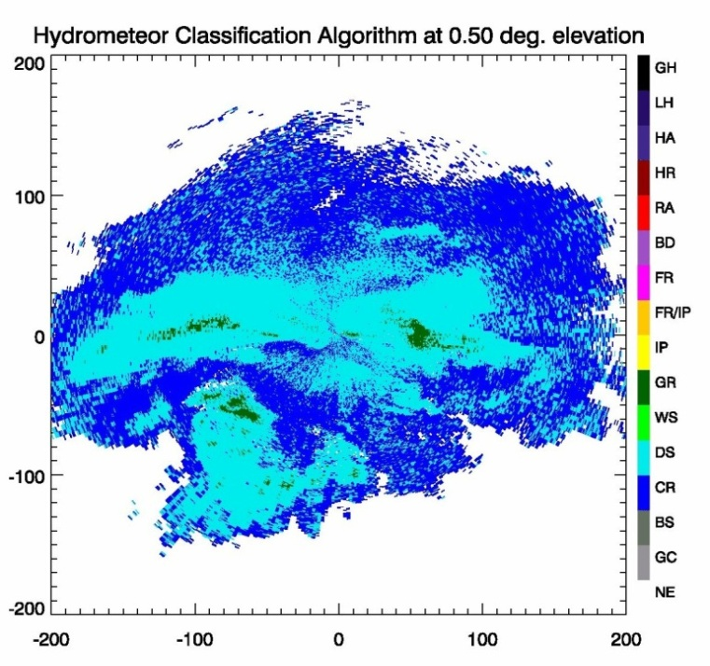
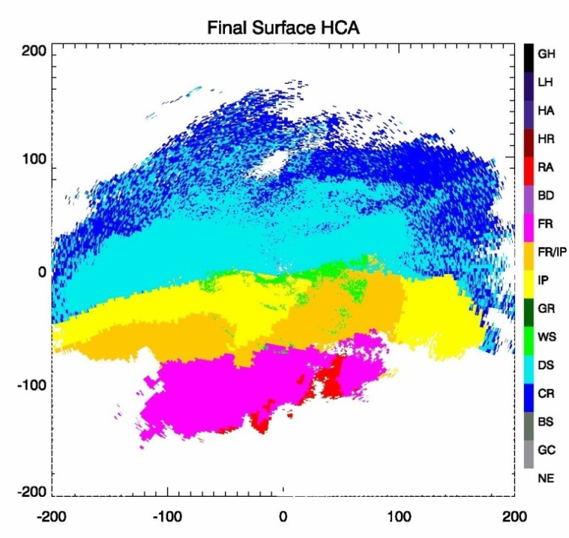
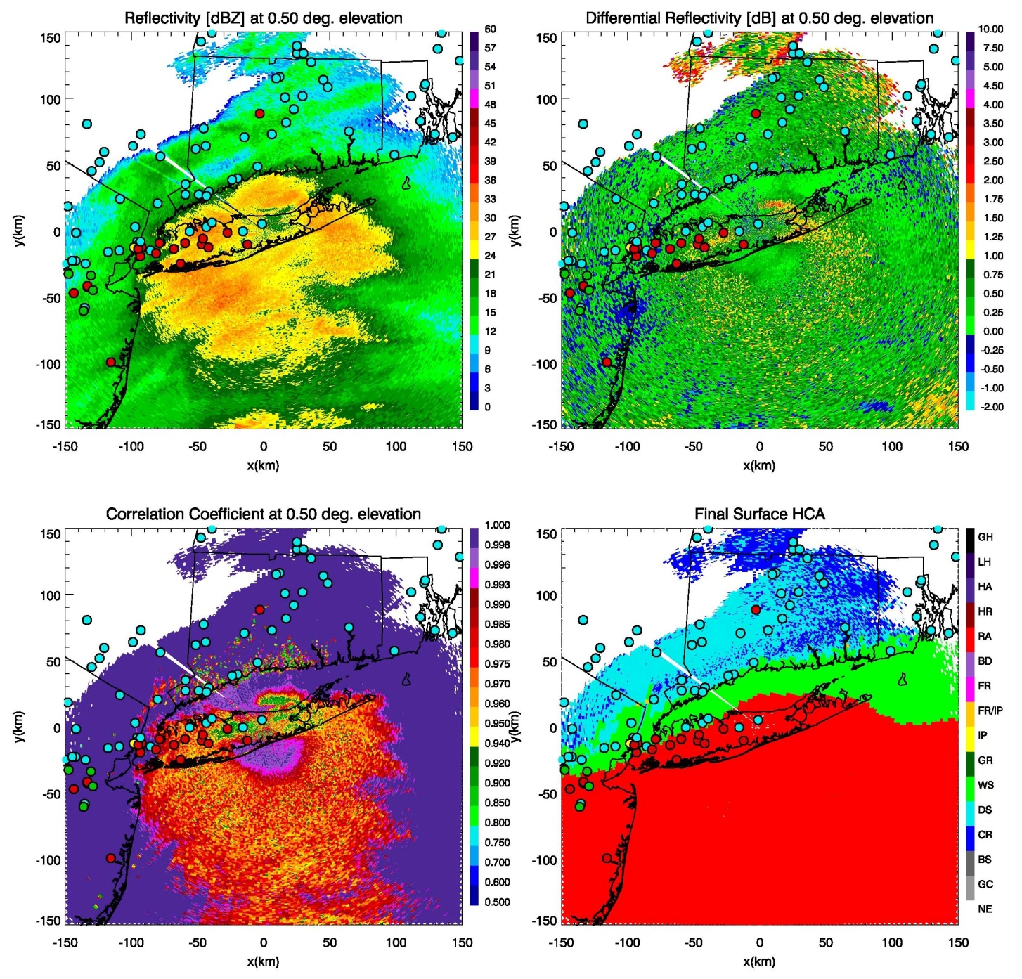
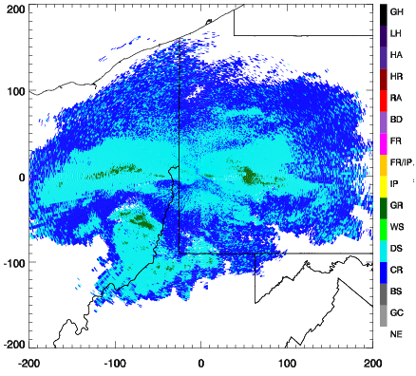
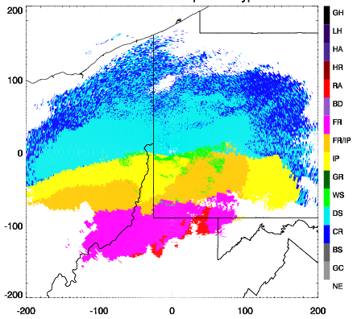
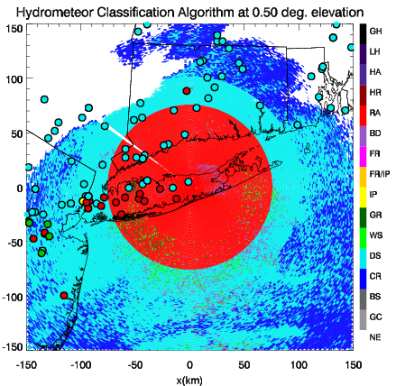
Radar-based Modification
Example 1: Pittsburgh, PA (KPBZ) on January 21, 2012
The radar-based modification of the background classification is accomplished in a variety of ways:
Using radar-based detection of the melting layer (ML) to determine whether or not the underlying background classification is consistent with observations
Identifying regions of wet snow where the ML reaches the ground
Utilizing the newly-discovered “refreezing signature” to identify regions of sleet
Using Z-Z_{DR} scatterplots to discriminate between sleet and freezing rain
Giant Hail (GH)
Large Hail (LH)
Hail (HA)
Heavy Rain (HR)
Rain (RA)
Z
Z_{DR}
Big Drops (BD)
Old Classification
New Classification
Freezing Rain (FR)
Example 2: New York, NY (KOKX) on February 8, 2014
FR/IP
Ice Pellets (IP)
Graupel (GR)
Wet Snow (WS)
Dry Snow (DS)
Crystals (CR)
C
Birds/Insects (BI)
Old Classification
New Classification
Ground Clutter (GC)
No Echo (NE)
Classification results are validated using precipitation type observations collected by the Meteorological Phenomena Identification Near the Ground (mPING) project.

Slide 6
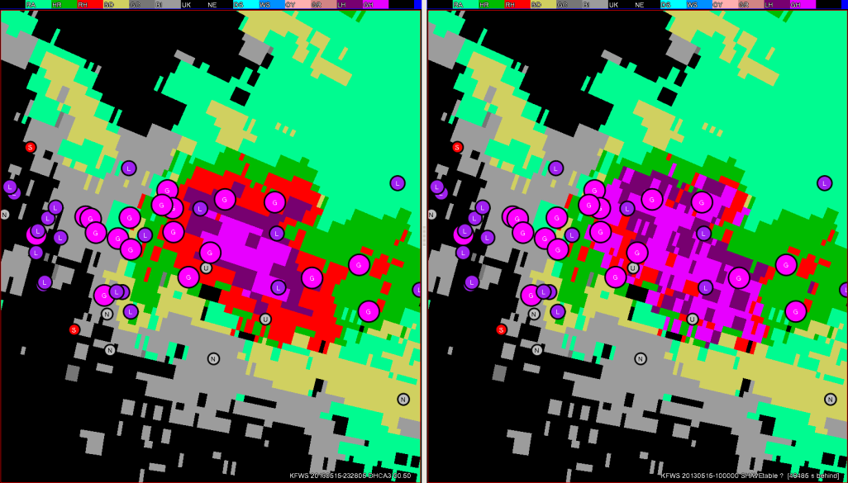
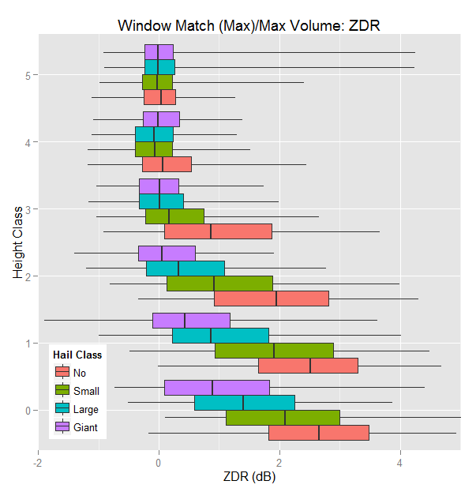
Hail Size Detection Algorithm (HSDA)
Example: Fort Worth, TX (KFWS) on May 15, 2013
New
Original
Reports collected by Severe Hazards Analysis and Validation Experiment (SHAVE, team of students “cold calling” the public to obtain high-resolution data)
3,257 hail reports compared to dual-pol variables and HSDA output
1,115 ‘no hail’ and 1,150 non-severe reports
Through evaluation, the HSDA has been modified to reduce large areas of giant hail detection
Modifications have greatly reduced False Alarm Rate while maintaining a similar overall skill

Slide 7
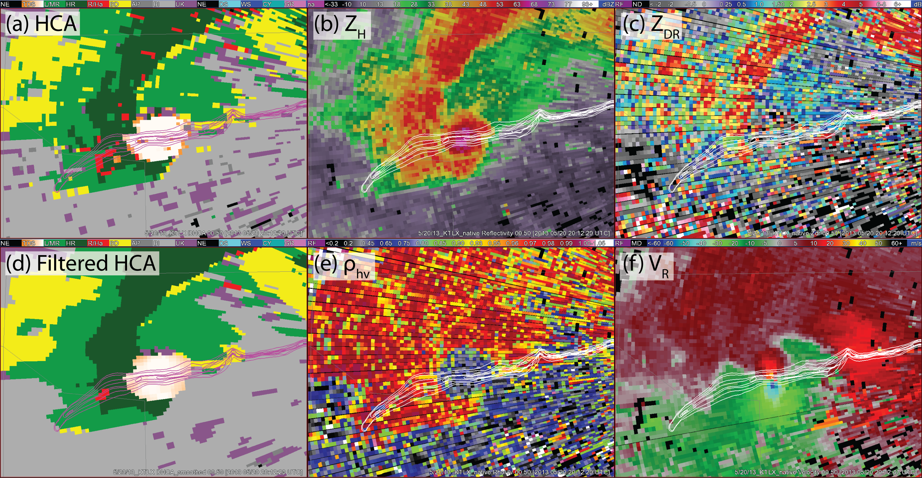
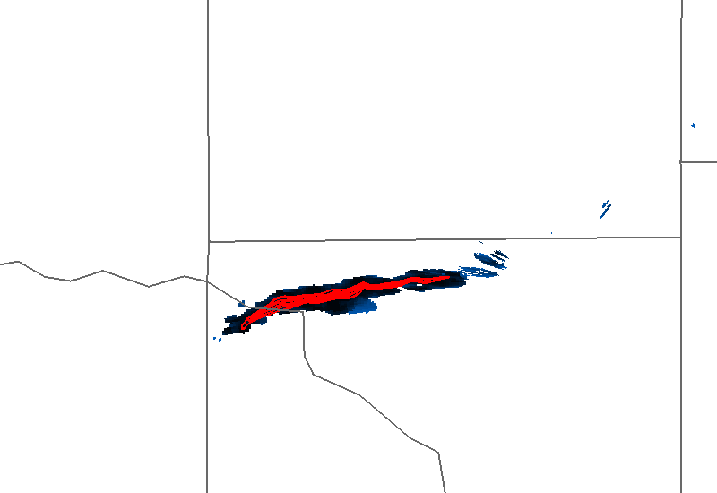
Tornadic Debris Signature (TDS)
Polarimetric radar provide a distinct signature associated with debris lofted by tornadoes
The fuzzy-logic classification scheme of the HCA has been modified to use polarimetric variables and azimuthal shear to provide a new TDS category
The new TDS category can be added to the final HCA product to help operational forecasters verify and track tornadoes
Black – Damage path from polarimetric TDS detections
Red – Verification of damage path from storm survey
Example: Oklahoma City, OK (KTLX) on May 20, 2013

Slide 8
Summary
The fuzzy-logic Hydrometeor Classification Algorithm (HCA) that is currently deployed on the WSR-88Ds provides precipitation type designations on a conical surface. In transitional winter weather, these designations are not always in agreement with the precipitation type observed at ground level.
A new surface-based HCA (referred to as HCA2) is being developed. With HCA2, polarimetric radar data are used to modify and provide value-added information to a model-based background classification.
Additional algorithms under development will help operational forecasters gauge maximum hail size, as well as verify the occurrence and real-time damage path of ongoing tornadoes.

