Slide 1
New Concepts in Utilization of Polarimetric Weather Radars
Alexander Ryzhkov (CIMMS)
February 25–27, 2015
National Weather Center
Norman, Oklahoma

Slide 2
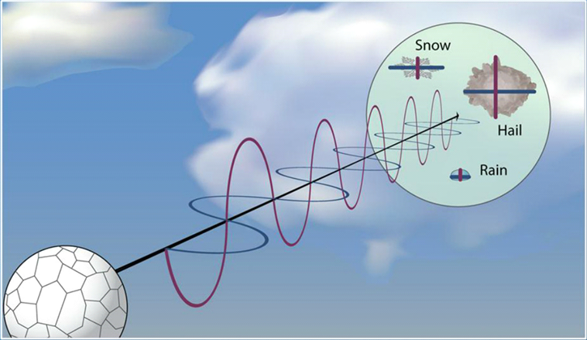
Dual-polarization basics
Differential reflectivity Z_{dr} = Z_{h}/Z_{v}
Shape
Z_{v}
Z_{h}
Orientation
Polarimetric radar variables are sensitive to hydrometeor (1) size, (2) shape, (3) orientation, (4) density, and (5) water content
Phase composition
water
ice

Slide 3
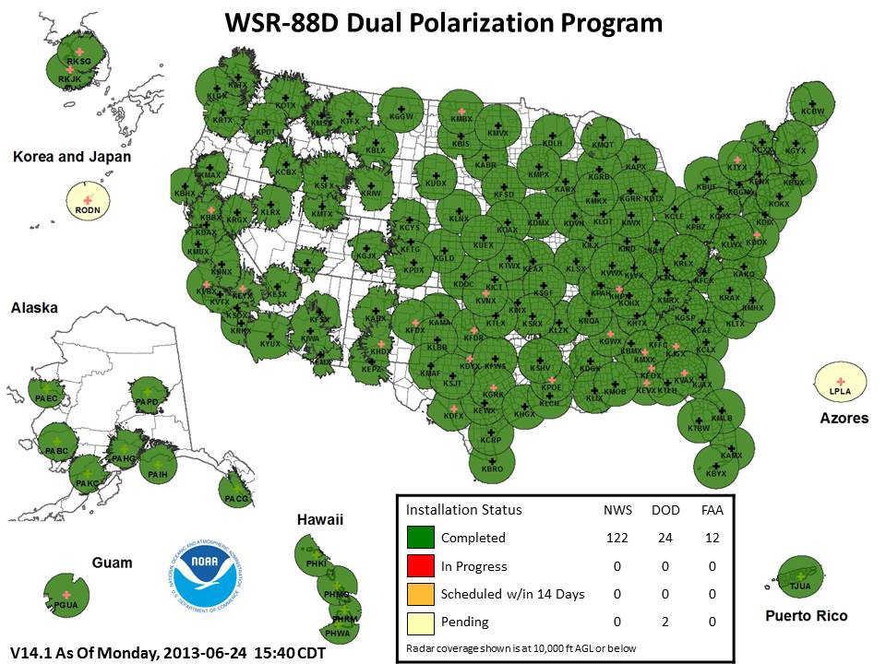
Polarimetric upgrade of NEXRAD radars
160 research-quality dual-polarization operational radars
Role of NSSL in the NEXRAD polarimetric upgrade
Basic system design and participation in validation of radar variables and products
Providing initial set of operational algorithms
Developing necessary modifications of polarimetric radar algorithms and creating the new ones

Slide 4
Classification of different types of radar echo Hydrometeor Classification Algorithm (HCA)
Existing classes
GC/AP – ground clutter / AP
BS – biological scatterers
DS – dry aggregated snow
WS – wet snow
CR - crystals
GR – graupel
BD – “big drops”
RA – light and moderate rain
HR – heavy rain
HA – hail (possibly mixed with rain)
New classes to be added
FRZ – freezing rain
IP – ice pellets
SH - small hail (D < 2.5 cm)
LH – large hail (2.5 < D < 5.0 cm)
GH – giant hail (D > 5.0 cm)
TDS – tornado debris signature
Novel approaches
Combining radar and NWP models
Using new crowd-sourcing techniques (SHAVE and mPING) for HCA validation

Slide 5
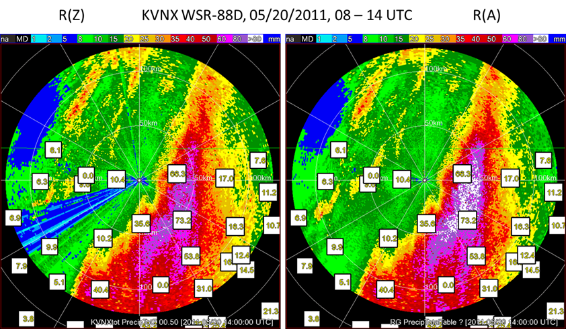
Novel polarimetric techniques for rainfall estimation Advantages of using specific attenuation A
Lower sensitivity to the variability of drop size distributions
Immunity to radar miscalibration, partial beam blockage, attenuation and impact of wet radome
Ideal for networking and compositing of rainfall maps from different radars
Gauge rain totals
The bias due to beam blockage is eliminated in the R(A) rain total map

Slide 6
Networking polarimetric radars
Mosaic rainfall map exhibits discontinuity if the R(Z) relation is used
The use of R(A) produces seamless mosaic rainfall map
6 hr rain total
Discontinuity

Slide 7
Identification of the polarimetric “fingerprints” of various microphysical processes using cloud models and radar observations
Microphysical processes
Size sorting
Evaporation
Coalescence
Breakup
Freezing / refreezing
Depositional growth of ice
Aggregation
Riming
A catalog of polarimetric fingerprints of individual microphysical processes has been created
The fingerprints help forecasters to interpret radar data
Cloud modelers can use fingerprints to improve microphysical parameterization and assimilation of radar data
Polarimetric radar observation operator for cloud models has been developed

Slide 8
Example of polarimetric fingerprints
Z
Z_{DR}
ρ_{hv}
melting
riming
size sorting
Z_{H} Z_{DR} ρ_{hv}
Z_{H} Z_{DR} ρ_{hv}
Z_{H} Z_{DR} ρ_{hv}

Slide 9
Summary
Successes
Polarimetric weather radar technology was brought to operations
The algorithms for hydrometeor classification and rainfall estimation have been further refined using novel concepts
The concept of “polarimetric fingerprints” has been introduced
Remaining challenges
Utilization of dual-polarization radars for improvement of the performance of the NWP models is a next frontier of research

