Slide 1
Dual-Polarization Research: Winter Microphysics
Heather Reeves (CIMMS)
February 25–27, 2015
National Weather Center
Norman, Oklahoma

Slide 2
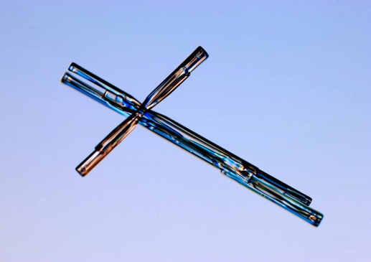
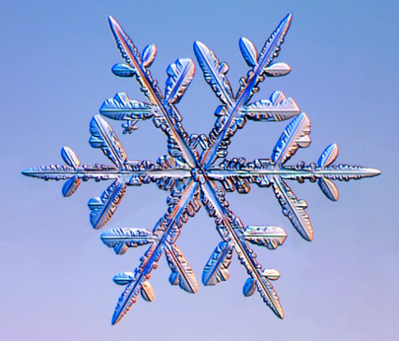
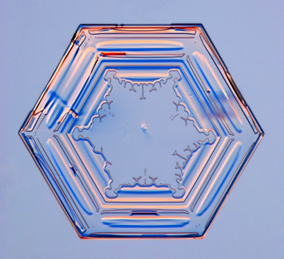
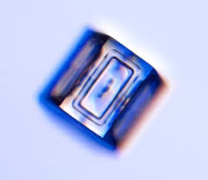
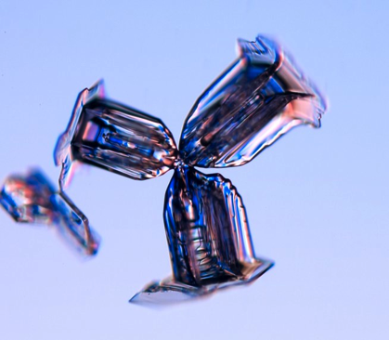
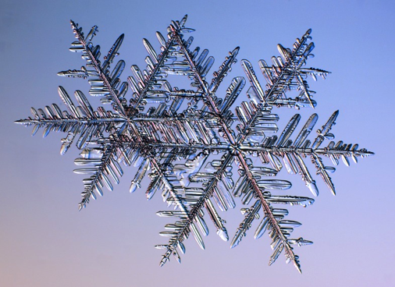
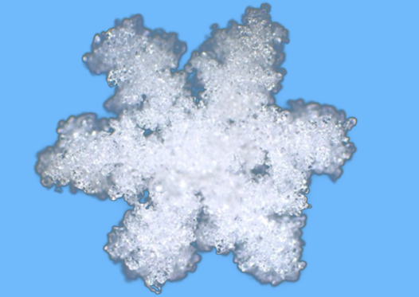

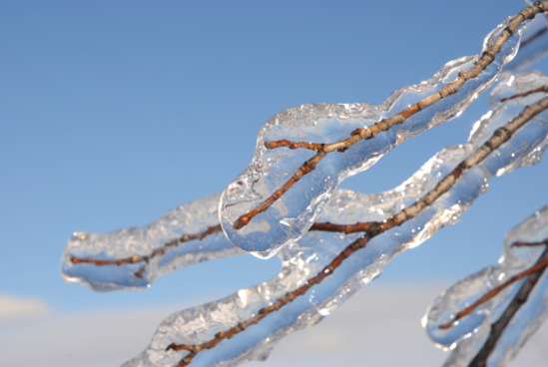

Types of crystals in winter storms
Highly anisotropic: high Z_{DR}
Intermediate forms: Z_{DR} depends on canting angle
Nearly isotropic: Z_{DR} near 0 dB
Polarimetric “fingerprints” can be used to
Improve the warning/decision-making process
Improve microphysical parameterization schemes and assimilation of radar data
See K. Elmore talk

Slide 3
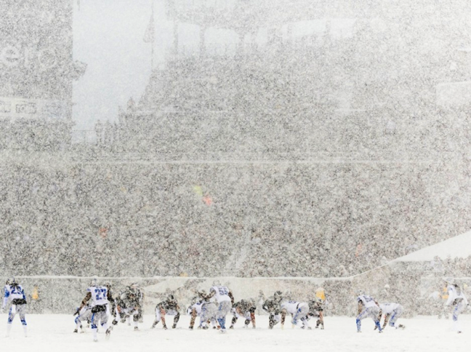
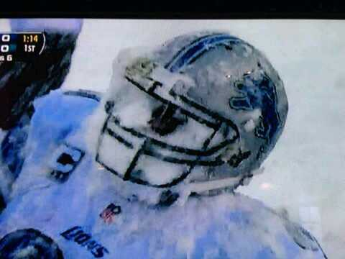
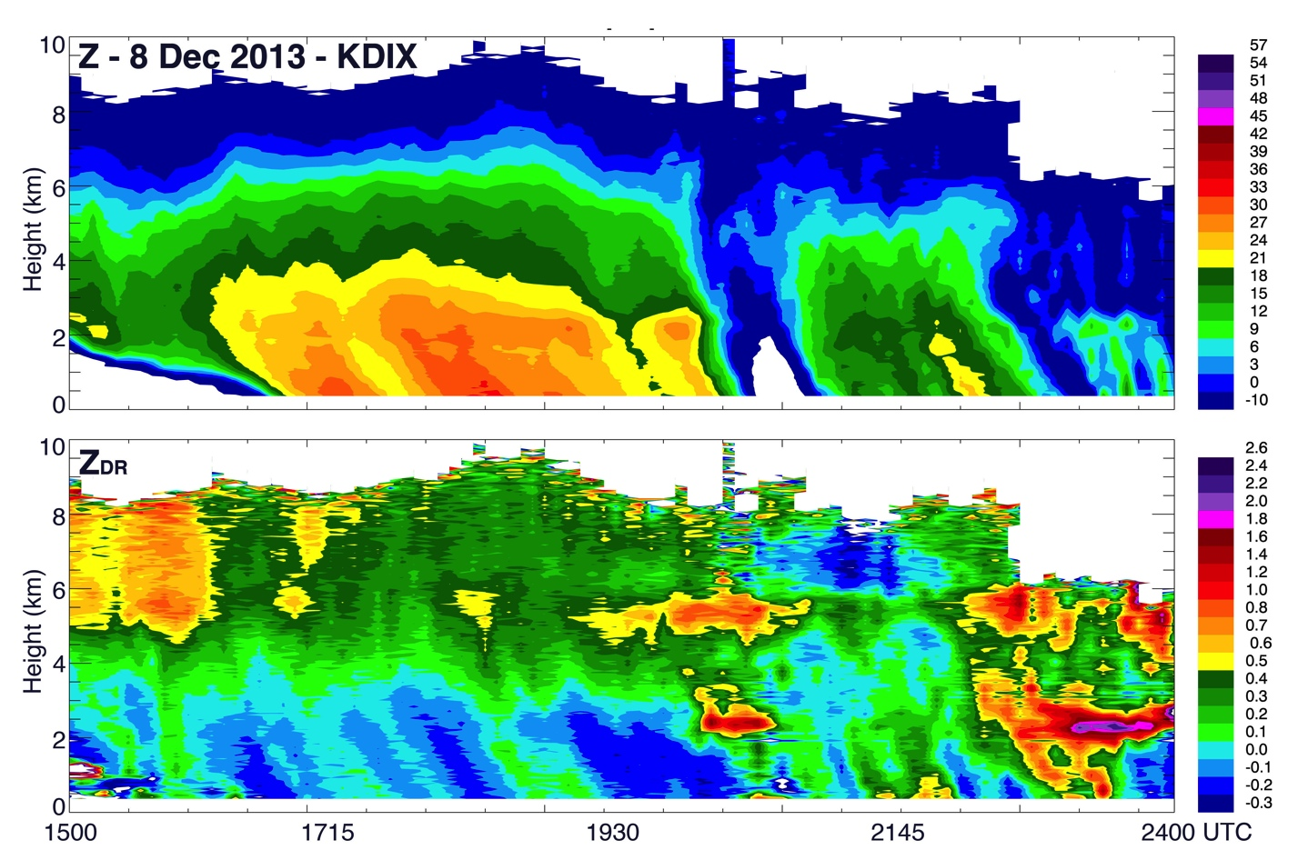
Polarimetric fingerprints:
Operational utility
Dendrites –
Enhanced Z_{DR}/gradient in Z
Aggregation –
Low Z_{DR}/High Z:
Melting aloft (freezing rain at sfc) – enhanced Z_{DR}
Highly anisotropic - High Z_{DR}
NSSL Lab Review Feb 25–27, 2015

Slide 4
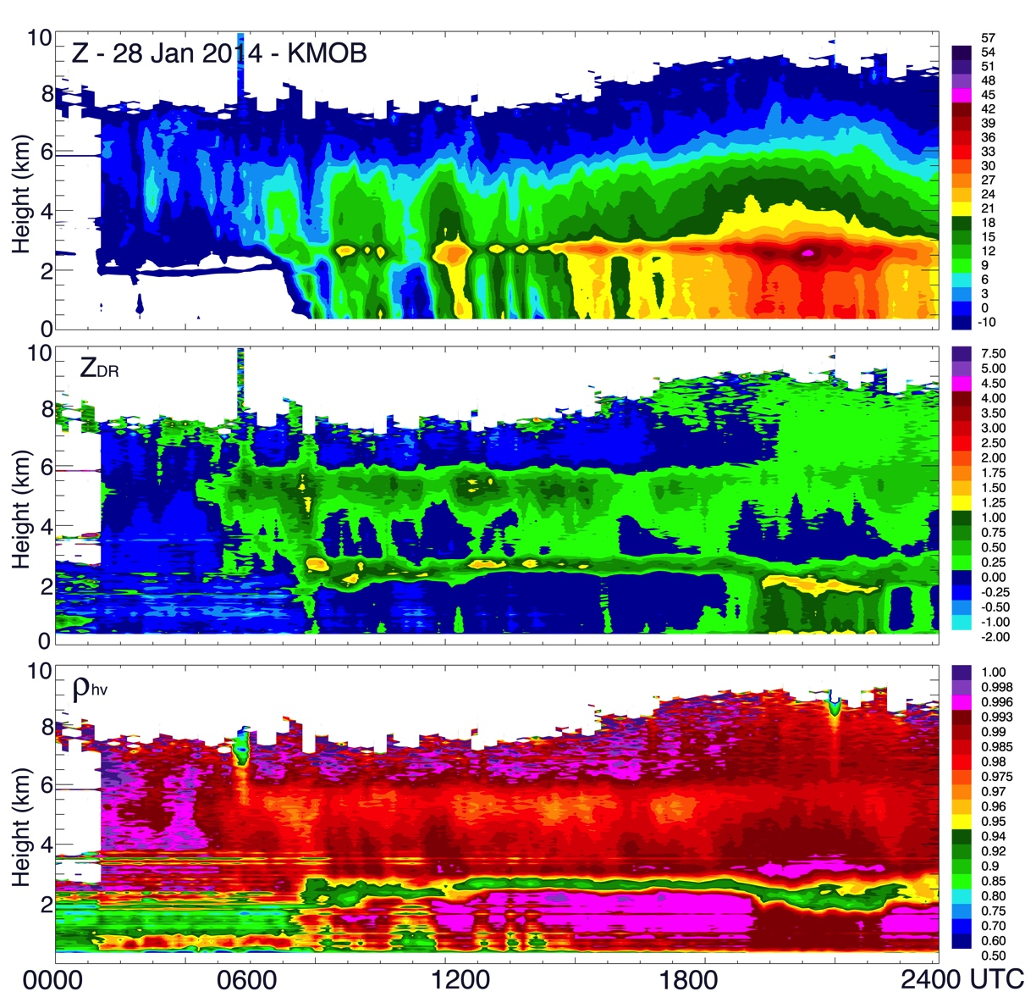

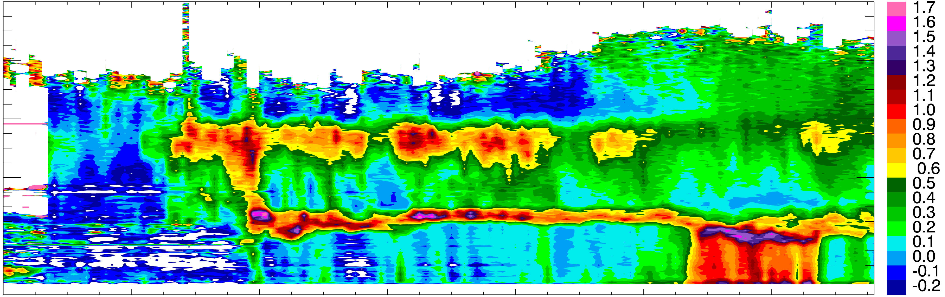
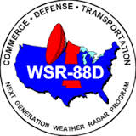
Polarimetric fingerprints: research value
Riming
Refreezing
Z_{DR}
Notes:
More details on fingerprinting can be found at
Ryzhkov, A.V., P. Zhang, H.D. Reeves, M. Kumjian, S. Troemel, and C. Simmer, 2015: Quasi-vertical profiles – a new way to look at polarimetric data. J. Atmos. Oceanic. Tech., in review.
Elmore, K.L., Z.L. Flamig, V. Lakshmanan, B.T. Kaney, V. Farmer, H.D. Reeves, L.P. Rothfusz, 2014: mPING: Crowd-souring weather reports for research. Bull. Amer. Meteor. Soc., 95, 1335-1342.
Griffin, E.M., T.J. Schuur, A.V. Ryzhkov, H.D. Reeves, and J.C. Picca, 2014: A polarimetric and microphysical investigation of the northeast blizzard of 8-9 February 2013. Wea. Forecasting. 29, 1271-1294.
Troemel, S. A. Ryzhkov, P. Zhang, and C. Simmer, 2014: Investigations of backscatter differential phase in the melting layer. J. Appl. Meteor. Climatology, 53, 2344-2359.
Kumjian, M.R., A.P. Khain, N. Benmoshe, E. Ilotoviz, A.V. Ryzhkov, V.T.J. Philips, 2014: The anatomy and physics of Z_{DR} columns: Investigating polarimetric radar signature with a spectral bin microphysical model. J. Appl. Meteor. Climatology, 53, 1820-1843.
Kumjian, M.R., A.V. Ryzhkov, H.D. Reeves, T.J. Schuur, 2013: A dual-polarization radar signature of hydrometeor refreezing in winter storms. J. Appl. Meteor. Climatology, 52, 2549-2566.
Andric, J., M. Kumjian, D. Zrnic, J. Straka, and V. Melnikov, 2013: Polarimetric signatures above the melting layer in winter storms: An observational and modeling study. J. Appl. Meteor. Climatology, 52, 682-700.
Ryzhkov, A., M. Kumjian, S. Ganson, and A. Khain, 2013: Polarimetric radar characteristics of melting hail: Part I: Theoretical simulationsusing spectral microphysical modeling. J. Appl. Meteor. Climatology., 52, 2849-2870.
Ryzhkov, A., M. Kumjian, S. Ganson, and P. Zhang, 2013: Polarimetric radar characteristics of melting hail: Part II: Practical implications. J. Appl. Meteor. Climatology, 52, 2871-2886.
Kumjian, M.R., and A.V. Ryzhkov, 2012: The impact of size sorting on the polarimetric radar variables. J. Atmos. Sci., 69, 2042-2060.
Zhang, G. S. Luchs, A. Ryzhkov, M. Xue, L. Ryzhkova, and Q. Cao, 2011: Winter precipitation microphysics characterized by polarimetric radar and video disdrometer observations in central Oklahoma. J. Appl. Meteor. Climatology, 50, 1558-1570.
Isaac, G.A. and coauthors, 2012: Science of nowcasting Olympic weather for Vancouver 2010 (SNOW-V10): A world weather research programme project. Pure and Applied Geophysics, doi:10.1007/s00024-012-0579-0.
Schuur, T.J., A.V. Ryzhkov, D.E. Forsyth, P. Zhang, and H.D. Reeves, 2012: Cloud observations with NSSL’s X-band polarimetric radar during the SNOW-V10 campaign. Pure and Applied Geophys., doi:10.1007/s00024-012-0569-2.
Isaac, G.A. and co-authors, 2012: Science and nowcasting of Olympic weather for Vancouver 2010 (SNOW-V10): A world weather research programme project. 3rd WMO/WWRP International Symposium on Nowcasting and Very Short Range Forecasting. Rio de Janeiro, Brazil.
Kumjian, M., S. Ganson, and A. Ryzhkov, 2012: Freezing of raindrops in deep convective storms: A microphysical and polarimetric model. J. Atmos. Sci., 69, 3471-3490.
Kumjian, M.R., and A.V. Ryzhkov, 2010: The impact of evaporation on polarimetric characteristics of rain: Theoretical model and practical implications. J. Appl. Meteor. Climatology, 49, 1247-1267.
Kumjian, M.R. and A. Ryzhkov, 2009: Storm-relative helicity revealed from polarimetric radar measurements. J. Atmos. Sci., 66, 667-685
Elmore, K.L. and H.D. Reeves, 2014: Using crowd-sourced precipitation observations to build a winter surface hydrometeor classification algorithm. 12th Conf. on Artifical and Computational Intelligence and its Applications to the Environmental Sciences. Atlanta, GA.
Elmore, K.L., Z.L. Flamig, V. Lakshmanan, B. Kanay, V. Farmer, H.D. Reeves, and L. Rothfusz, 2014: mPING: crowd-sourcing weather reports for research. 9th Symposium on Policy and Socio-Economic Research, Atlanta, GA.
Griffin, E.M. A.V. Ryzhkov, T.J. Schuur, H.D. Reeves, K.L. Elmore, M.R. Kumjian, and J.C. Picca, 2013: A polarimetric and microphysical investigation of the northeast blizzard of 8-9 February 2013. 36th Conf. on Radar Meteorology, Breckenridge, CO.
Ryzhkov, A.V., H.D. Reeves, T.J. Schuur, M.R. Kumjizn, and D.S. Zrnic, 2011: Investigations of polarimetric radar signatures in winter storms and their relation to aircraft icing and freezing rain. 35th Conf. on Radar Meteorology, Pittsburgh, PA.
Reeves, H.D., A.V. Ryzhkov, T.J. Schuur, D. Forsyth, 2011: Dual-polarized measurements of the melting layer during SNOW-V10. 24th Conf. on Weather and Forecasting/20th Conf. on Numerical Weather Prediction, Seattle, WA.

Slide 5
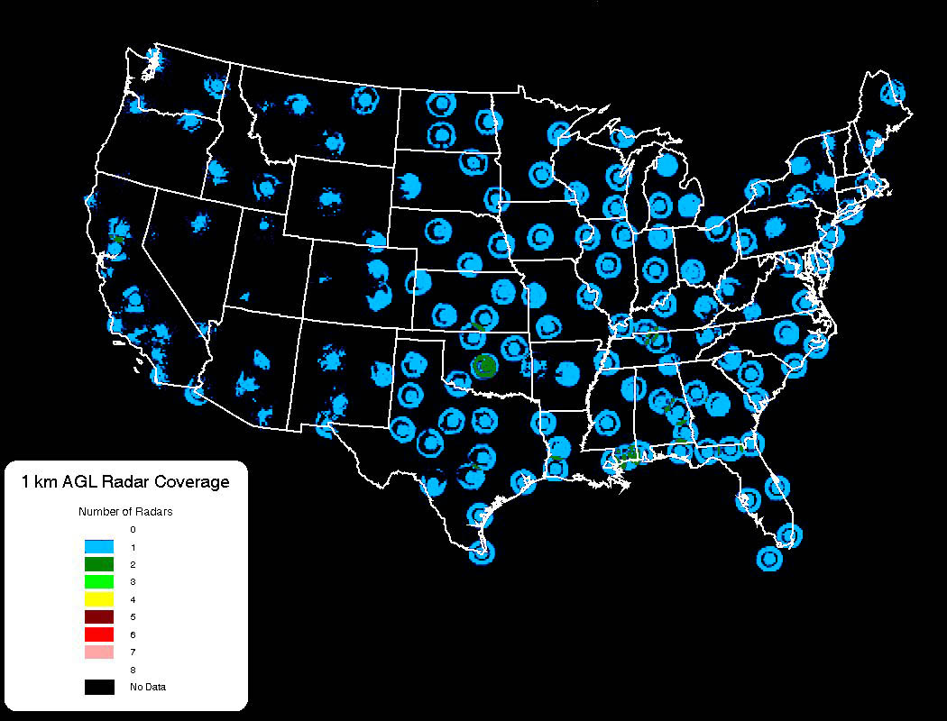
Next Frontier: Combined data approaches
Radar observations
+
Profiles of temperature & humidity from numerical models
Spectral Bin Classifier (SBC):
3D depiction of cloud habit viewable in MRMS
(see K. Howard talk)
Radar coverage in lowest 1 km: very limited

Slide 6
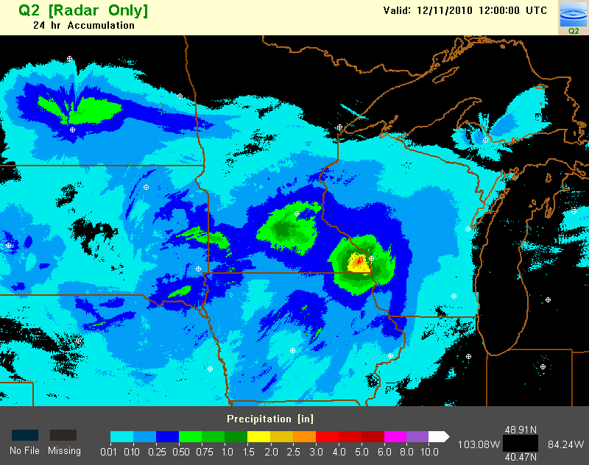

Next Frontier: Combined data approaches
Other beneficiaries of this approach:
Melting layer detection
Hail size detection
Quantitative precipitation estimate (QPE) for snow
POD of surface precipitation type for different types of precipitation and different classifiers
 | SNOW | RAIN | SLEET | FRZ. RAIN
SBC | 95.2 | 98.3 | 73.6 | 71.0
NCEP1 | 86.7 | 96.1 | 89.6 | 28.4
NCEP2 | 97.1 | 96.1 | 56.0 | 28.4
NCEP3 | 92.6 | 96.1 | 50.4 | 48.8
NCEP4 | 94.9 | 99.6 | 25.6 | 65.4
Z
Z
Z_{DR}
QPE bulls-eyes (see K. Howard talk)
Notes:
Relevant details can be found at
Elmore, K.L., H. Moser, D. Apps, and H.D. Reeves, 2015: Evaluation of precipitation type forecasts by three operational models. Wea. Forecasting, in review.
Philips, V.T.J., A. Khain, N. Benmoshe, E. Ilotoviz, and A. Ryzhkov, 2015: Theory of time-dependent freezing. Part II: Scheme for freezing raindrops and simulations by a cloud model with spectral bin physics. J. Atmos. Sci., 72, 262-286.
Reeves, H.D., K.L. Elmore, A. Ryzhkov, T. Schuur, and J. Krause, 2014: Sources of uncertainty in precipitation-type forecasting. Wea. Forecasting, 29, 936-953.
Schuur, T., H-S. Park, A.V. Ryzhkov, and H.D. Reeves, 2012: Classifiation of precipitation types during transitional winter weather using the RUC model and polarimetric variables. J. Appl. Meteor. Climatology, 51, 763-799.
Ryzhkov, A.V., H.D. Reeves, J. Krause, and H. Burcham, 2014: Discrimination between winter precipitation types based on explicit microphysical modeling of melting and refreezing in the polarimetric hydrometeor classification algorithm. 8th European Conf. on Radar Meteorology, Garmish-Partenkirchen, Germany.
Schuur, T.J., A.V. Ryzhkov, H.D. Reeves, J. Krause, K.L. Elmore, K.L. Ortega, 2014: Recent modifications to a new surface-based polarimetric hydrometeor classfication algorithm for the WSR-88D network. 8th European Conf. on Radar Meteorology, Garmish-Partenkirchen, Germany.
Reeves, H.D. K.L. Elmore, A.V. Ryzhkov, T.J. Schuur, K.L. Ortega, and J. Krause, 2014: Sources of uncertainty in precipitation type determination and forecasting. 26th Conf. on Weather Analysis and Forecasting/22nd Conf. on Numerical Weather Predication, Atlanta, GA
Reeves, H.D., T.J. Schuur, A.V. Ryzhkov, K.L. Elmore, J. Krause, and K.L. Ortega, 2013: Testing of a background classification algorithm for use with dual-polarized radars in determining precipitation type at the surface 36th Conf. on Radar Meteorology, Breckenrige, CO.
Scuhhr, T.J., A.V. Ryzhkov, H.D. Reeves, M.R. Kumjian, K.L. Elmore, and K.L. Ortega, 2013: A new surface-based polarimetric hydrometeor classfication algorithm for transitional winter weather to be used on the WSR-88D network. 36th Conf. on Radar Meteorology. Breckenridge, CO.
Reeves, H.D., K.L. Elmore, A.V. Ryzhkov, K.L. Ortega, T.J. Schuur, and J. Krause, 2013: Source of uncertainty in precipitation type determination and forecasting. 15th Conf. on Mesoscale Processes, Portland, OR.
Elmore, K.L., H.D. Reeves, A. Ryzhkov, T. Schuur, K. Ortega, M. Kumjian, and J. Krause, 2012: Developing a winter surface hydrometeor classification algorithm for the WSR-88D polarmetric upgrade. 37th National Weather Association Annual Meeting, Madison, WI.
Reeves, H.D. and co-authors, 2012: Development and testing of a new winter surface precipitation type algorithm at the NOAA/National Severe Storms Laboratory. CMOS 2012 Congress and AMS 21st NWP and 25th WAF Conferences, Montreal, Canada.
Schuur, T.J. A.V. Ryzhkov, H.D. Reeves, 2011: Polarimetric classification of winter weather precipitation using thermodynamic input from numerical models. 35th Conf. on Radar Meteorology. Pittsburgh, PA.
Park, H-S., A. Ryzhkov, and H.D. Reeves, 2009: Classification of precipitation types during transitional winter weather using the RUC model and polarimetric radar retrievals. 34th Conf. on Radar Meteorology, Williamsburg, VA.

Slide 7





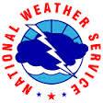




Summary
Fingerprinting will aid in operational decision making.
Fingerprinting reveals new knowledge of microphysical processes.
New technology (QVPs: Quasi-Vertical Profiles) allows users to quickly interrogate radar data and is in the process of being transferred to operations.
A revolution in the way radar algorithms work is underway – the combined data approach.
Z
Z_{DR}
NSSL is continuing our legacy of revolutionizing the way forecasters use radar observations in all four seasons.
Our external partners
Notes:
Ortega, K.L., A.V. Ryzhkov, J. Krause, P. Zhang, and M.R. Kumjian, 2013: Evaluating a hail size discrimination algorithm for dual-polarized WSR-88Ds using high-resolution reports and forecaster feedback. 36th Conf. on Radar Meteorology, Breckenridge, CO.
Krause, J., V. Lakshmanan, and A. Ryzhkov, 2013: Improving detection of the melting layer in the dual-polarimetric radar volume using model data and object identification techniques. 36th Conf. on Radar Meteorology, Breckenridge, CO.

