Slide 1
Lightning and Storm Electricity Research
Don MacGorman
February 25–27, 2015
National Weather Center
Norman, Oklahoma

Slide 2
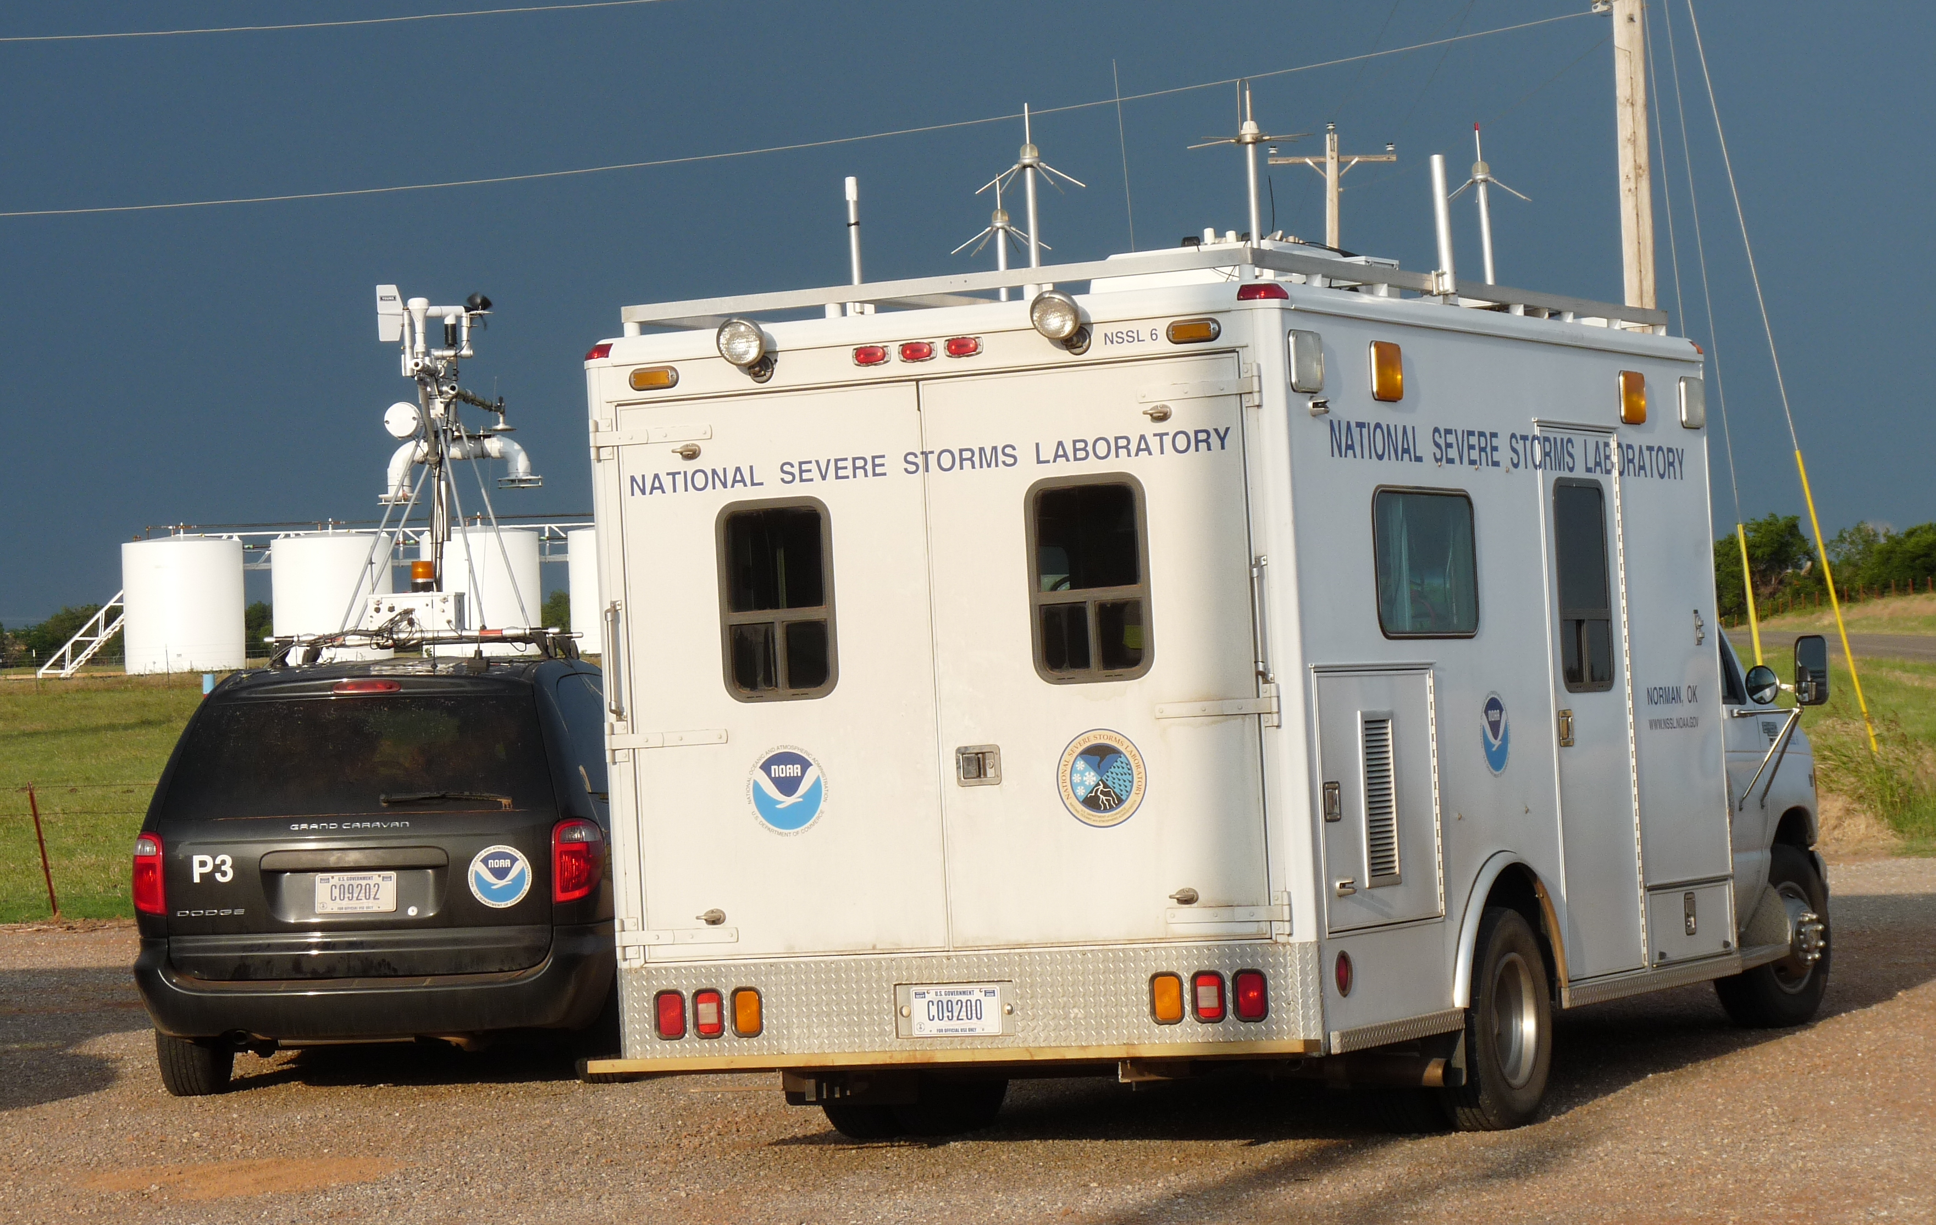
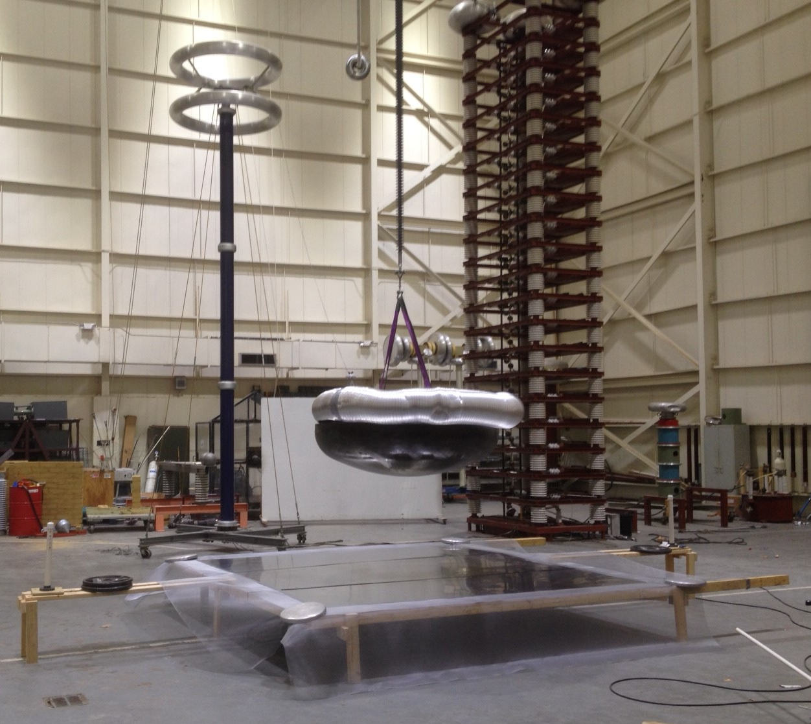
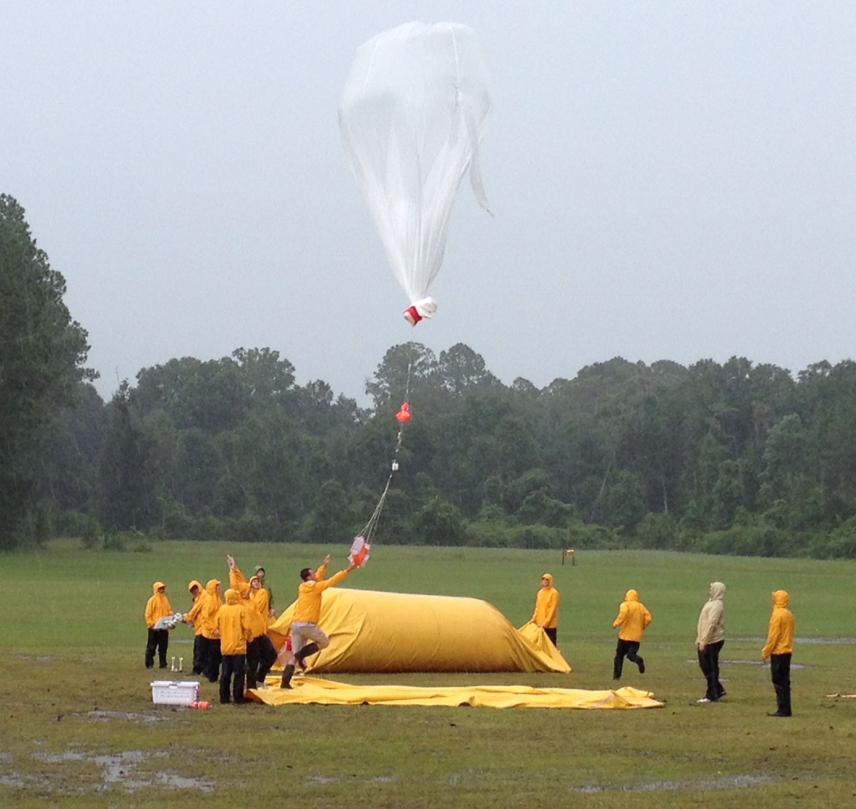
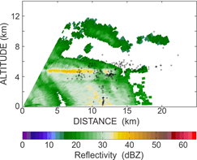
Field Experiments
Mississippi High Voltage
Laboratory (2014)
2012 Deep Convective Clouds & Chemistry Experiment (DC3)
Barth, M., et al., 2015: Bull. Amer. Meteor. Soc., doi: 10.1175/BAMS-D-13-00290.1, in press.
2013 & 2014 Florida Ballooning
(see Sean Waugh poster for
Videosonde)
Charge
Density
Melting
Layer
Rocket
Triggered
Flash

Slide 3
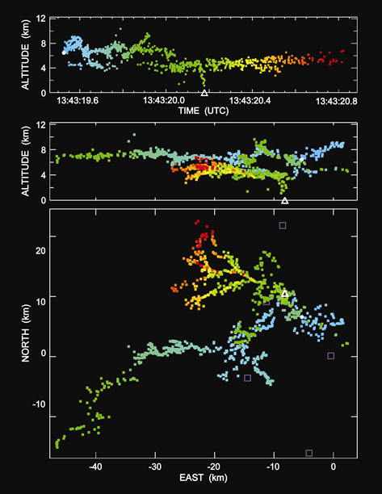
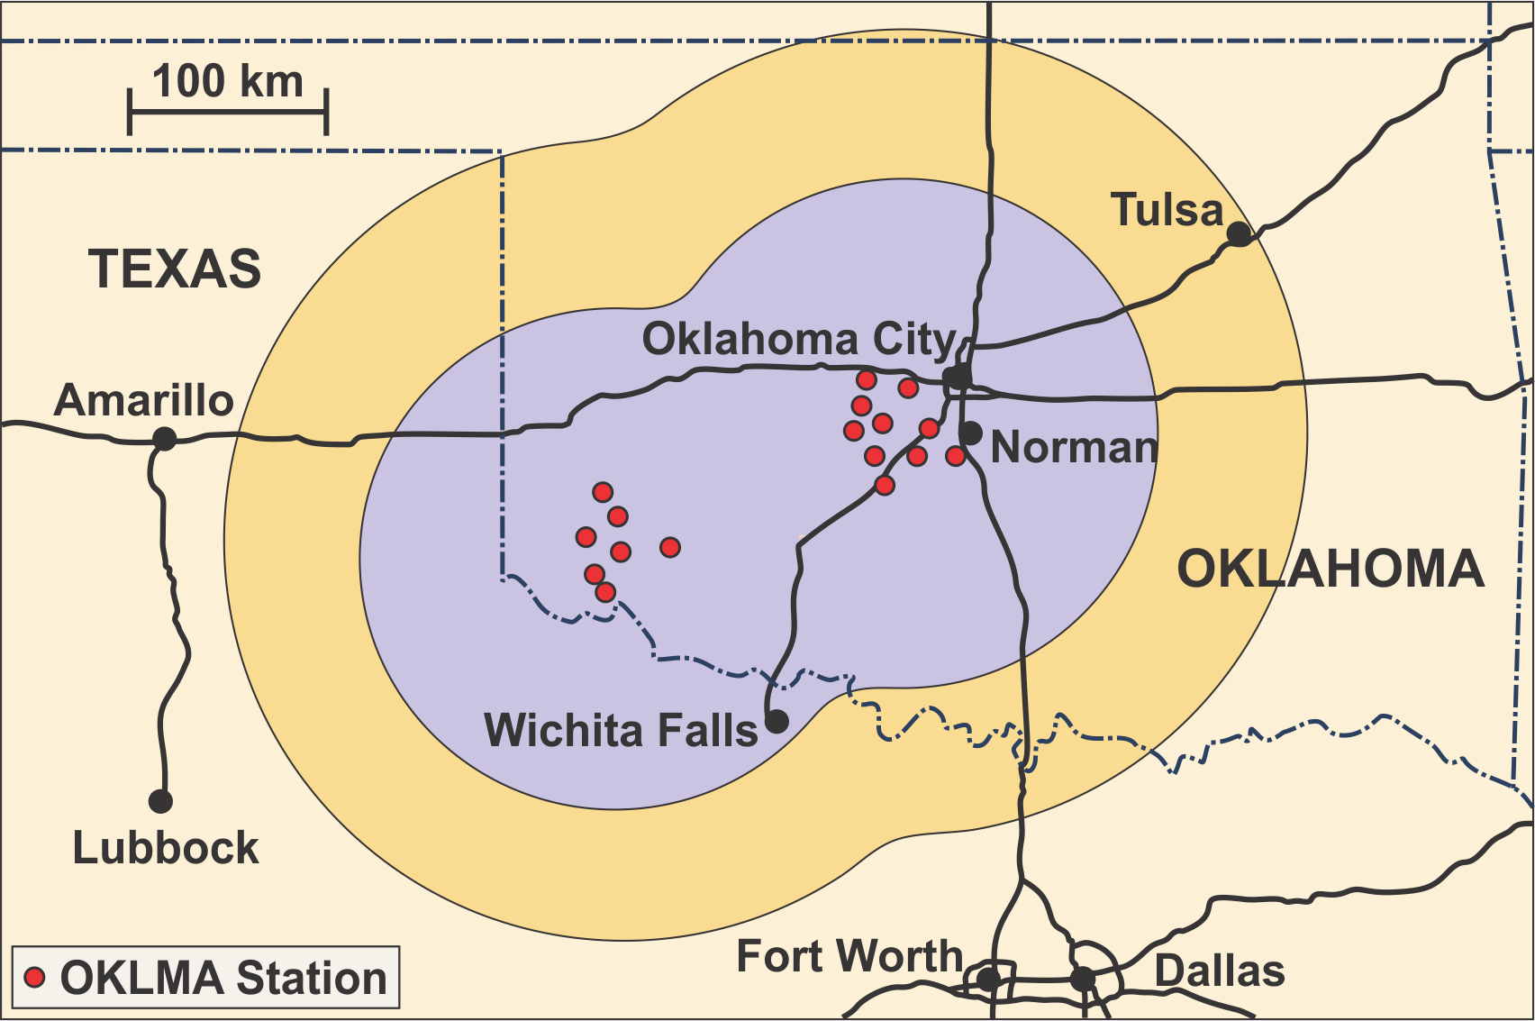
Lightning Mapping Array (operated with the University of Oklahoma)
ALTITUDE (km)
Expanded in 2012
Enabled Study of Total Lightning
Proxy Data for GOES-R Geosynchronous Lightning Mapper (GLM)
Ground Truth for GLM (launch March 2016)
EAST (km)
3-D Mapping
2-D Mapping
Original array described in MacGorman et al. 2008: Bull. Amer. Meteor. Soc., doi: 10.1175/2007BAMS2352.1.

Slide 4
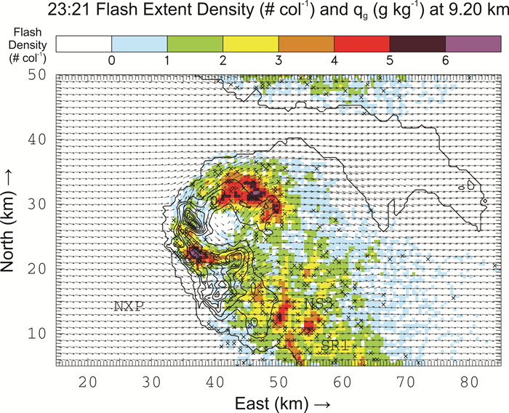
Lightning Data Analyses
Lightning Relationships with
Storm Kinematics, Dynamics, Microphysics, & Severe Weather
Focus on potential to aid severe weather forecasts & warnings
29 May 2012, 23:21 UTC
Column Flash Density versus
Graupel Mixing Ratio (g of graupel per kg of air) at 9.2 km MSL
Max Height of Reflectivity and Number of Lightning Channel Segments versus Time
Segments per 200 m layer per minute
1 16 64 256 1024
24 May 2011
18 dBZ
30 dBZ
40 dBZ
X = flash initiation
50 dBZ
60 dBZ
Strong Updraft
Altitude (km, MSL)
Graupel
Hail
Estimate
Hail Diameter (cm)
Tornado
Tornado
From DiGangi, E., 2014: MS Thesis, Univ. Oklahoma.
TIME (UTC)
From Elliott, M., 2013: MS Thesis, Univ. of Oklahoma.

Slide 5
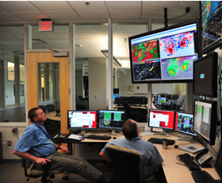
Applied Research (presentations by Kristin Calhoun and Darrel Kingfield)
Lightning Jump Algorithm
Earth Networks Warning Boxes
Hazardous Weather Testbed
GOES-R Proving Ground

Slide 6
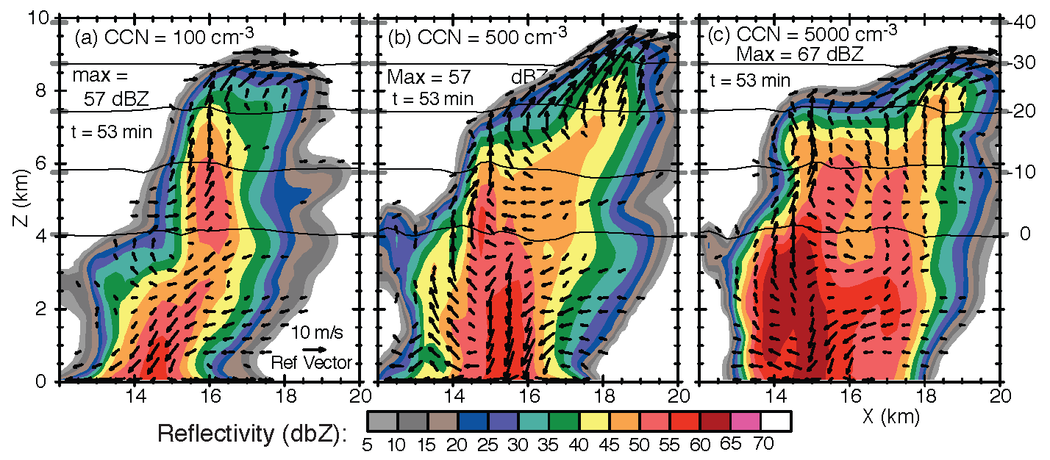
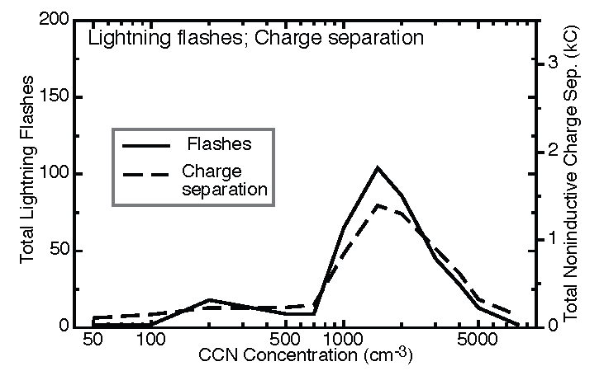
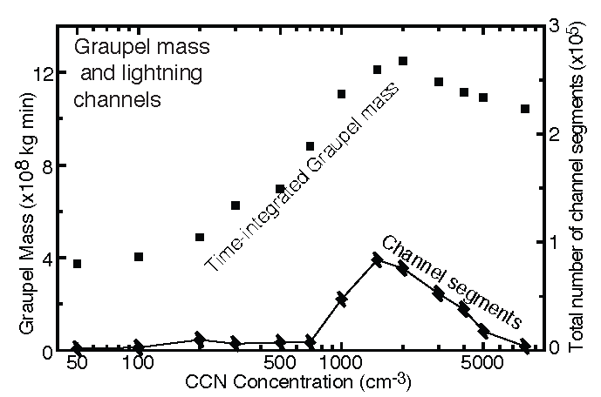
Electrified Storm Modeling
Varying Cloud Condensation Nuclei (CCN) Concentrations
Features Developed
Electrification in microphysics package
Lightning parameterizations
Models Used
COMMAS & WRF-ARW
o
o
-20 C
-10 C
o
0 C
Graupel
Lightning
From Mansell, E. R., and C. L. Ziegler, 2013: J. Atmos. Res., 70, doi: 10.1175/JAS-D-12-0264.1

Slide 7
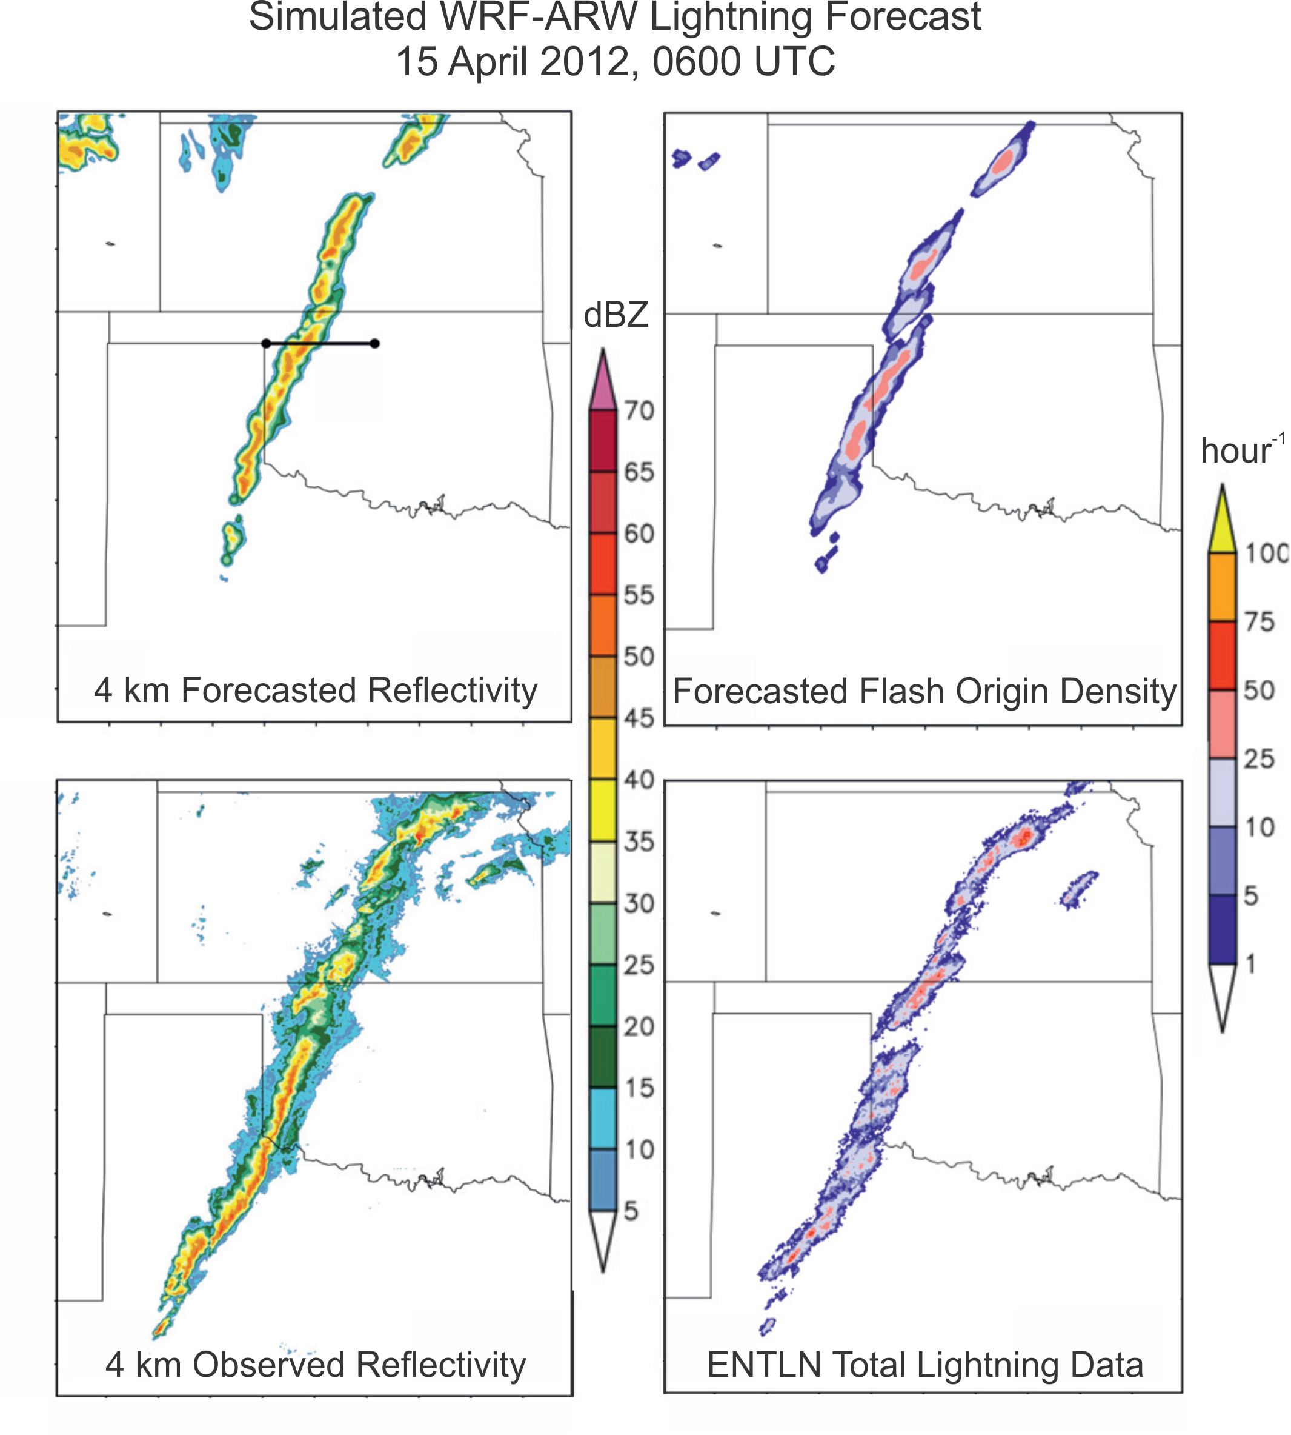
Lightning Forecasting & Data Assimilation
Lightning Data Assimilation (see poster by Mansell)
Lightning Forecasting in WRF-ARW (Grand Challenge #4)
Assimilation:
Fierro, A., et al., 2014: Mon. Wea. Rev., 142, doi:10.1175/MWR-D-13-00142.1.
Lightning forecasting figure from:
Fierro, A., E. Mansell, D. MacGorman, and C. Ziegler, 2013: Mon. Wea. Rev.,141, doi: 10.1175/MWR-D-12-00278.1.

Slide 8
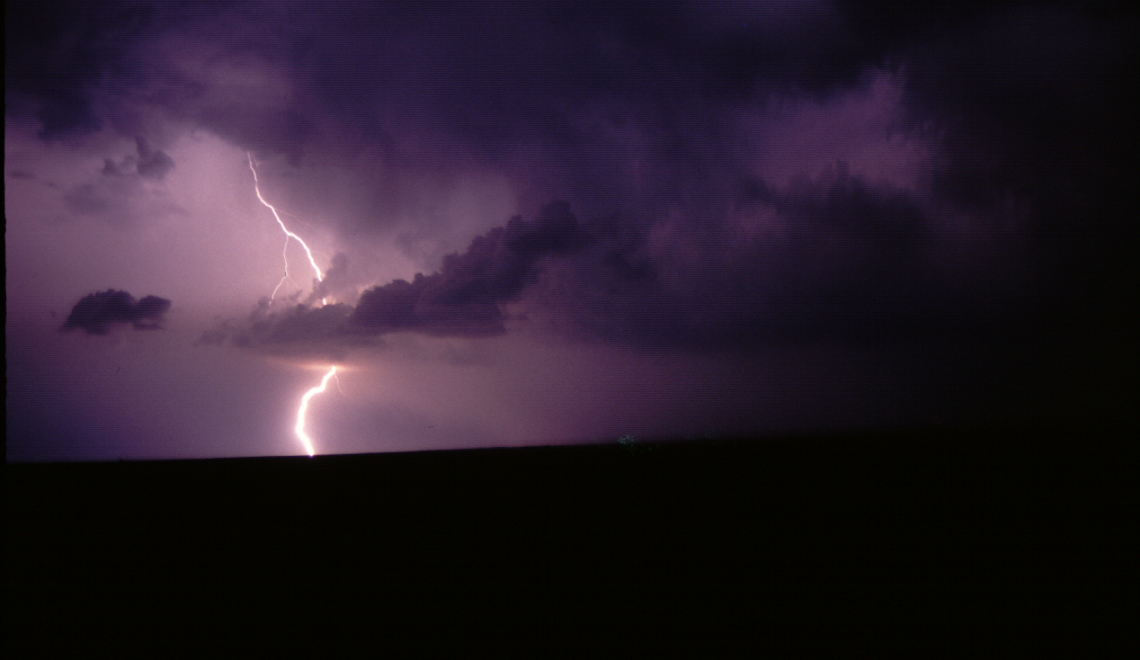
Summary
Successes
Have learned much about macroscale electrical and kinematic processes that produce lightning
Electrified numerical storm model that produces realistic charge distributions and lightning
Initial lightning data assimilation and forecasting
Remaining challenges
Microscale details of lightning initiation
Particle charging outside mixed-phase region
Best operator for lightning assimilation into forecast models
Efficient lightning parameterization for lightning forecasts
Getting correct forecasted location and characteristics of storms

