Slide 1
National Severe Storms Laboratory Review
Dr. Steven Koch
February 25–27, 2015
National Weather Center
Norman, Oklahoma

Slide 2

NOAA National Severe Storms Laboratory
VISION
The National Severe Storms Laboratory will be the world’s leader in basic and applied research on severe convective storms to support an informed society that is resilient to high impact weather.
MISSION
The National Severe Storms Laboratory conducts fundamental research to advance our knowledge and understanding of meteorological processes associated with severe convective storms.
NSSL performs applied research and development leading to the transition of new and improved tools and techniques for observation, analysis, and prediction to the National Weather Service and other stakeholders.
These efforts are aimed at improving the accuracy and lead-time of severe weather forecasts and warnings, lending support to a Weather-Ready Nation that is resilient in the face of increasing vulnerability to severe and disruptive weather.

Slide 3
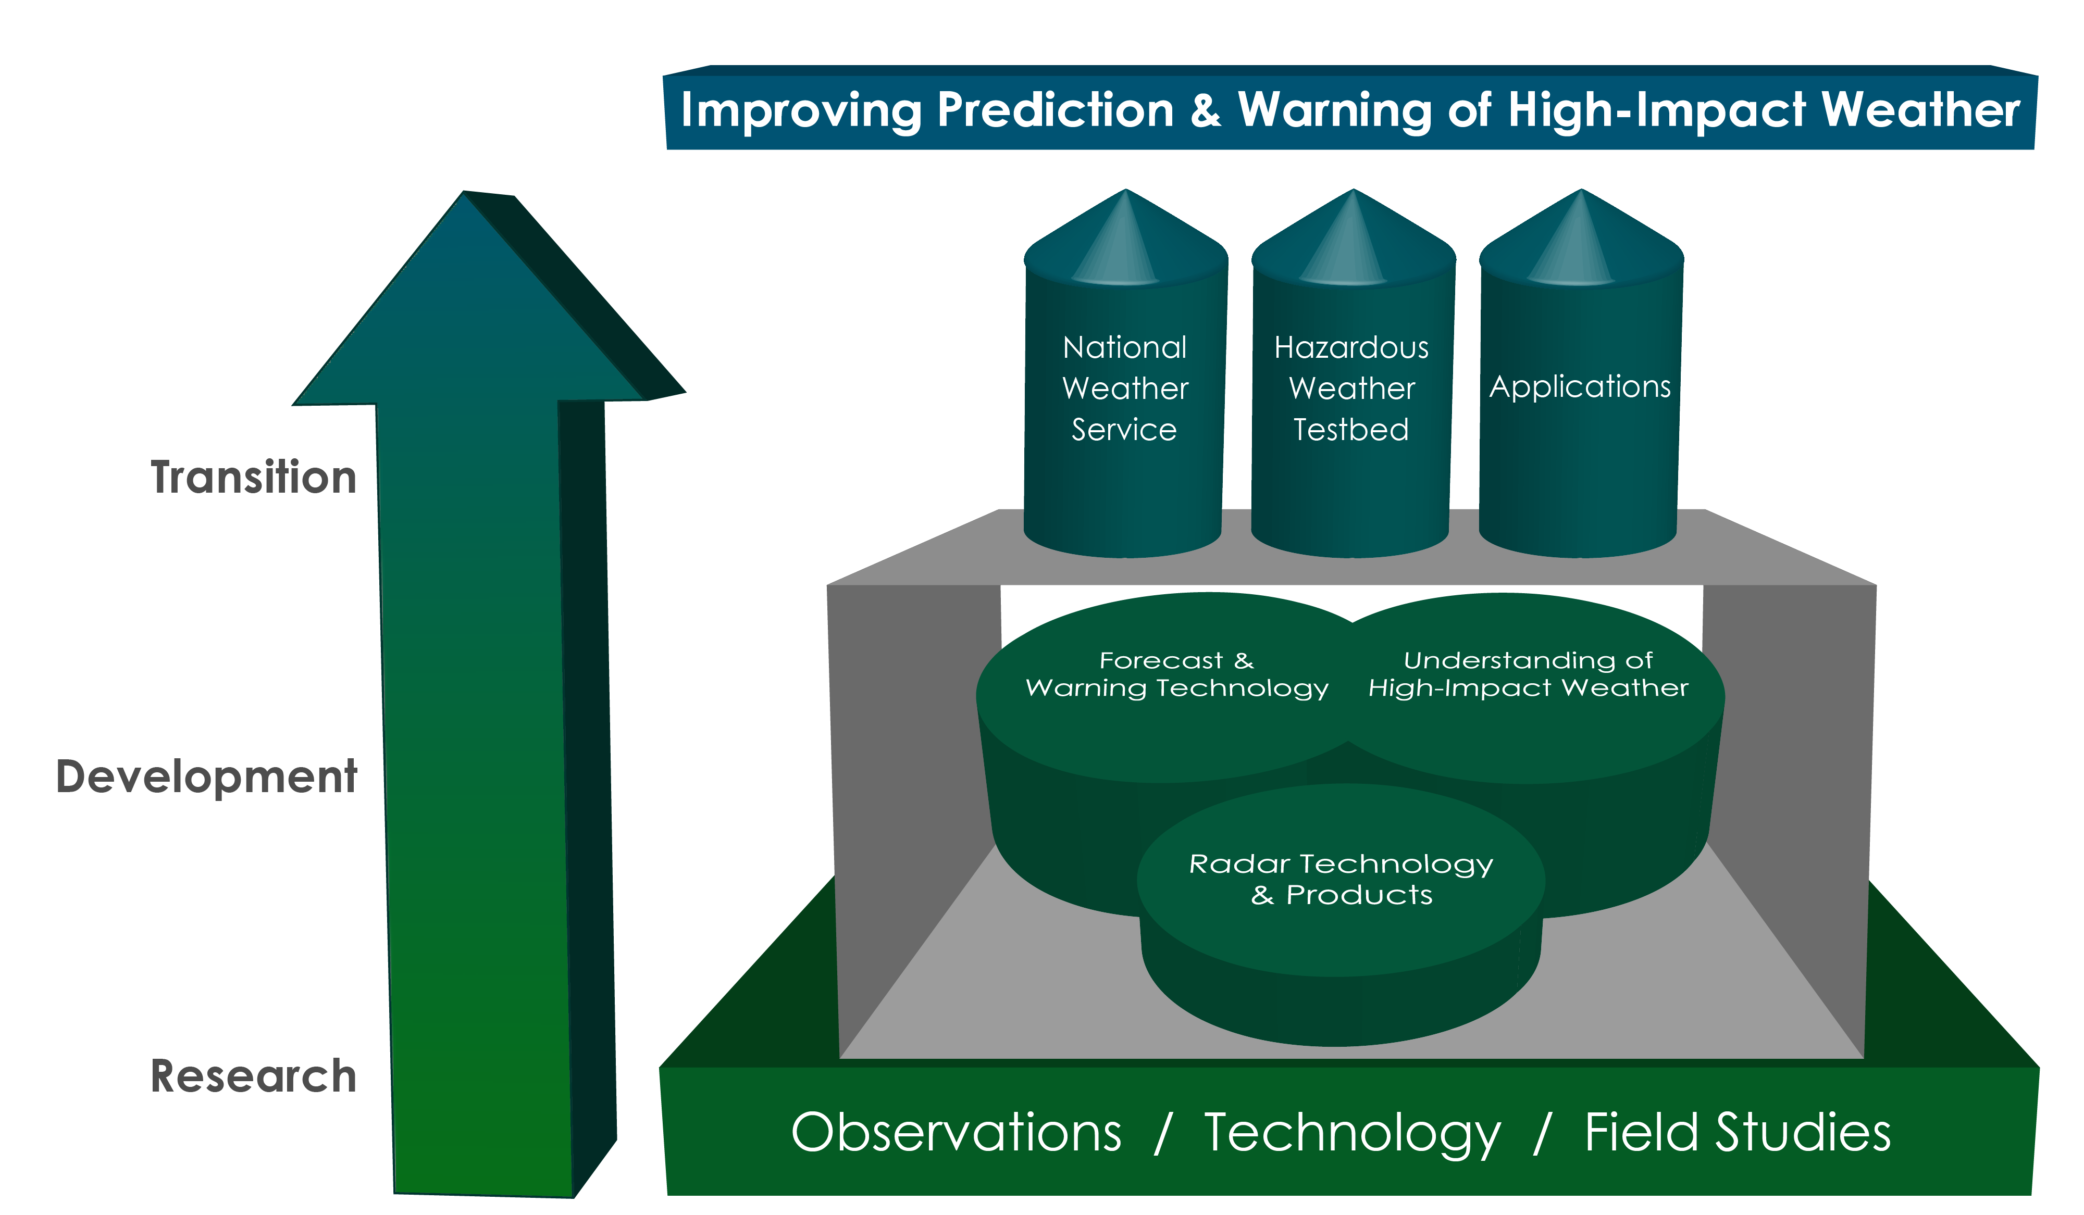
NSSL Research Themes

Slide 4

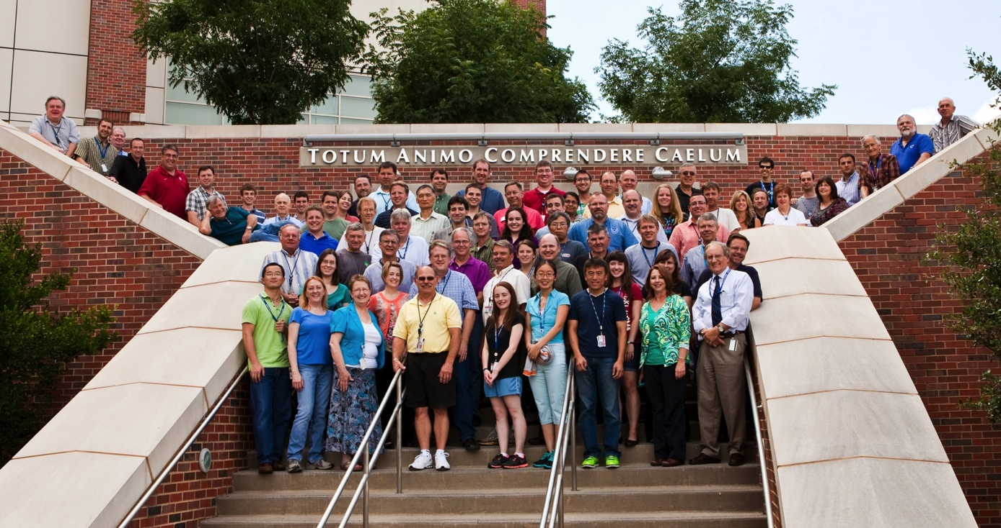




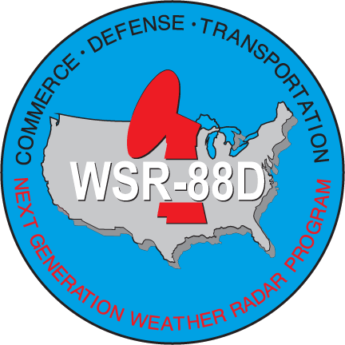






Notes:
They wanted a slide to show our relationship with CIMMS?

Slide 5
NSSL Organization Chart
Director’s Office
Steven Koch, Director
Lans Rothfusz, Deputy Director
Radar Research & Development
Mike Jain
Acting Division Chief
Warning Research & Development
Dave Jorgensen
Division Chief
Forecast Research & Development
Jack Kain
Division Chief
Field Observing Facilities
Doug Kennedy, Lead
Administrative Services
Patrina Gregory,
Administrative Officer
Information & Technology Service
Jeff Horn, Lead
CIMMS
Randy Peppler, Acting Director
Sebastian Torres, CIMMS/NOAA Liaison

Slide 6
Workforce Distribution
Federal | CIMMS | Contract | Total
42 | 48 | 10 | 100
* Federal: 16 Ph.D., 8 M.S.
* CIMMS: 25 Ph.D., 15 M.S.

Slide 7
Workforce Diversity
Total Workforce by Gender
Total Workforce by Race

Slide 8
Federal Employee Retirement Eligibility
2009
Average age of Federal Scientists = 53.6
% Eligible to retire = 43.5
2014
Average age of Federal Scientists = 58.1
% Eligible to retire = 41.4
Attrition rate is stable (number retiring ~ number reaching retirement age)

Slide 9
15-year Staff History
Last NSSL Review

Slide 10
Hires at NSSL since Feb 2009 Lab Review
Recommended Hires from July 2010 Review Response | Organizational New Hire | Additional Hires made since 2009 NSSL Lab Review | Organization
Radar hardware engineer | CIMMS | IT Security Officer | NSSL
VORTEX-2 process scientist | NRC (2) | AWIPS-2 Software Engineer | CIMMS
Microphysicist/radiation | NSSL + NRC | Warnings Software Engineer | CIMMS
HWT Warning Leader | NSSL | Warn On Forecast Programmer | CIMMS
Radar systems specialist | CIMMS | VORTEX-2 Meteorologist Analyst | NRC
Hydrologic modeler | NRC | MPAR Case Study Scientist | CIMMS
HWT applied statistician | CIMMS | NSSL Deputy Director | NSSL
Atmospheric electricity scientist | CIMMS | NSSL Administrative Officer | NSSL
Verification researcher | --- | HWT Meteorological Modeler | NSSL
Field observing systems lead | --- | HWT Forecast Lead | NSSL (hiring)

Slide 11
Quality

Slide 12
Quality: Annual Peer-Reviewed Publications
Last NSSL Review
Average publications per scientist 2005–2009 = 0.88
Average publications per scientist 2010–2014 = 1.11
Notes:
FY13 107
FY14 107
Data from NSSL publication database, fiscal year

Slide 13
Quality: Citations
# of NSSL authors in each range
Successful
scientist
Outstanding
scientist

Slide 14
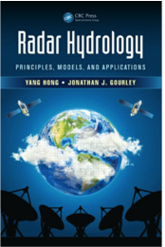
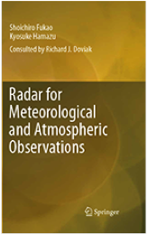

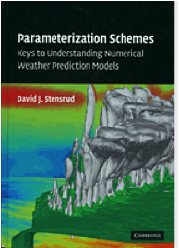
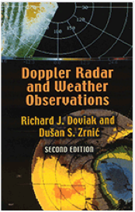
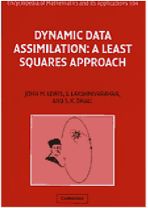
Quality: Authored Textbooks
2014: Gourley
2013: Doviak (consultant)
2012: Lakshmanan
Last 5 years
2007: Stensrud
2006: Doviak & Zrnic
2006: Lewis
Previous 5 years

Slide 15
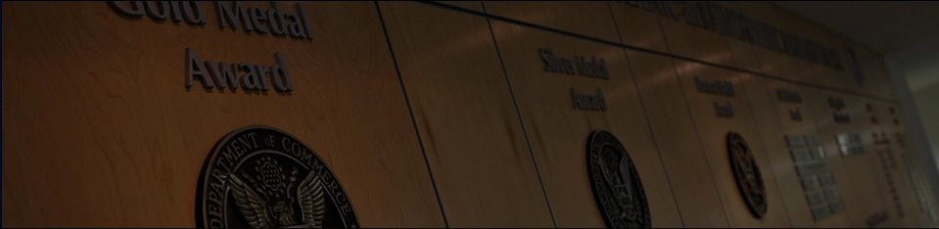
Quality: DoC Awards 2010–2014
Department of Commerce Gold Medals
  2014
  Jorgensen (NSSL), Kuligowski (NIST), Lombardo (NIST), and Phan (NIST), for conducting the Federal investigation of the 2011 Joplin Tornado.
  Office of Science and Technology, Office of Operational Systems, Office of Climate, Water and Weather Services, and National Severe Storms Laboratory, for “developing and implementing Dual-Polarization technology on the Next Generation Weather Radar network to improve weather hazards warning services.”
  2011
  NSSL/CIMMS Radar Research and Development Division, for “scientific and engineering excellence in adapting military phased array radar technology to improve U.S. weather radar capabilities.”

Slide 16
Quality: NOAA Awards 2010–2014
2011 – NOAA Bronze Medals
  Howard, Zhang, Gourley and Vasiloff, for the design and implementation of a seamless gridded system for multi-sensor-derived precipitation estimation over the continental U.S.
  Brown, Wood, Parish, Enders, Ahlert, Peabody, Horvat, Weeks, Jing, for “excellence in transferring research to operations and providing a new WSR-88D radar capability that significantly enhanced forecast operations.”

Slide 17
Quality: NOAA Awards 2010–2014
NOAA Distinguished Career Awards
  2014 - Richard J. Doviak, “for development of breakthrough radar methods that have greatly enhanced operational severe weather detection and advanced meteorological research.”
  2014 - David J. Stensrud, “for exemplary service as a brilliant scientist, inspiring mentor, and generous collaborator in 28 years with the National Severe Storms Laboratory.”
  2011 - W. David Rust, “for contributions to the understanding of lightning and storm electrification and to the development of mobile storm observing systems.”
  2010 - Robert Davies-Jones, “for scientific achievements in the application of observations and theory to the understanding of the dynamics of severe convective storms and tornado genesis mechanisms.”

Slide 18
Quality: NOAA Awards 2010–2014 (cont.)
2013 – NOAA Technology Transfer Award
Smith (CIMMS), Ortega (CIMMS), Stumpf (MDL), Manross (NCAR), Lakshmanan (CIMMS), Cooper (INDUS), Miller (CIMMS), Cintineo (UW-CIMSS) and Jorgensen (NSSL) were recognized “for leading the development of an on-demand, near real-time, web-based tool for tracking severe weather and hail swaths across the continental US.”
2012 – NOAA Research Albritton Outstanding Scientific Communicator Award
Harold Brooks, “in recognition of outstanding achievement in communicating the meaning and value of NOAA-related science and research to non-scientific audiences.”
2011 – OAR Outstanding Paper Award
Kumjian and Ryzhkov, for Storm-Relative Helicity Revealed from Polarimetric Radar Measurements, Journal of Atmospheric Sciences, 2011.

Slide 19
Quality: Non-NOAA Awards 2010–2014
2014 – AMS Charles Franklin Brooks Award
  David P. Jorgensen for over two decades of substantial contributions to, and visionary leadership of, the Society's all-important scientific publication process, including tireless service as Publications Commissioner (2007–2012).
  2013 –Presidential Early Career Award
  Adam Clark (NSSL/CIMMS), for pioneering contributions to the study of forecast-system predictability, significant mentoring of students, and building bridges between the different components of the weather enterprise.
2012 - AMS Kenneth Spengler Award
  NOAA Hazardous Weather Testbed Team - Bright (NWS), Carbin (SPC), Coniglio, Kain, Levit (NWS), Liang (SPC), Schneider (SPC), Weiss (SPC), for “bringing the government, academic, and private sectors together in a visionary, proactive, and exemplary manner to deal with the challenges posed by hazardous weather.”

Slide 20



Quality: Prestigious Memberships
Dusan Zrnic
Harold Brooks
Rodger Brown
Dusan Zrnic
Richard Doviak

Slide 21

Quality: 11 Current AMS/AGU Fellows
  Harold Brooks
  Donald Burgess
  Robert Davies-Jones (ret.)
  Richard Doviak
  Douglas Forsyth
  David Jorgensen
  Steven Koch
  John Lewis
  Donald MacGorman
  Dave Rust (ret.)
  Dusan Zrnic

Slide 22
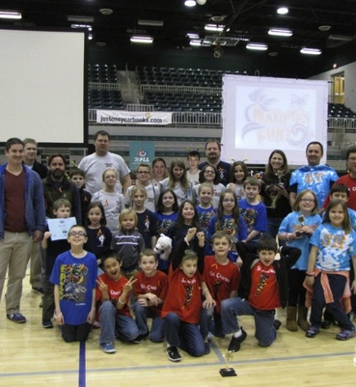
Quality: Service
AMS Publications Commissioner (Jorgensen)
21 Chief, Co-Chief, Associate Editors of professional journals since 2009
31 members on national/international scientific and technical advisory committees
Nat’l Institute of Science and Technology (NIST) team investigating the May 22, 2011 Joplin, Missouri tornado (Jorgensen)
AMS Editor’s Awards (3)
Volunteerism (38 separate organizations)

Slide 23




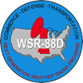














































































































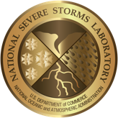

Quality: Collaborations
Private Sector
International
University
Cooperative Institute, State
Federal

Slide 24
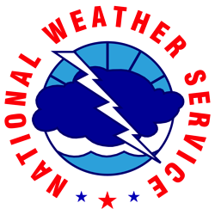










Quality: CRADAs and MOUs
Formal Reimbursable Agreements
Memorandum of Understanding (MOU)
Cooperative Research and Development Agreement (CRADA)

Slide 25
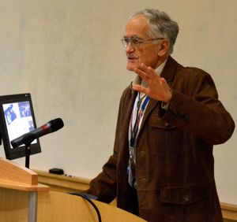
Quality: Involvement in Education
NSSL and CIMMS scientists:
  Have faculty appointments in meteorology, electrical engineering, computer science, and physics. Courses taught by some.
  24 serve as adjunct, affiliate, or emeritus faculty at OU or other universities
NSSL/CIMMS faculty have served on 98 M.S. and 69 Ph.D. committees since 2009. Many OU GRA stipends are paid by NSSL.
NSSL and CIMMS scientists have mentored 69 undergraduate students (e.g. Hollings Scholars, Senior Capstone projects)

Slide 26
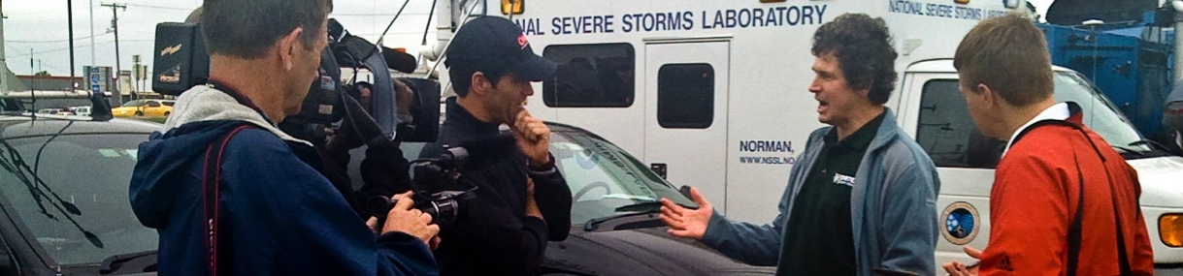

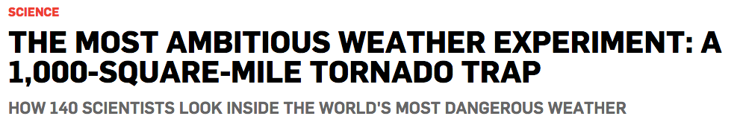
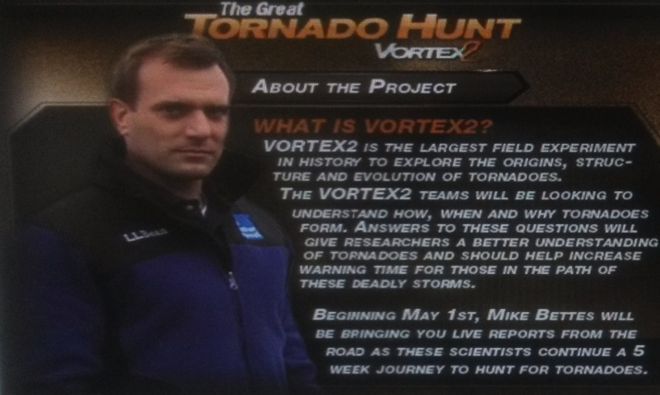
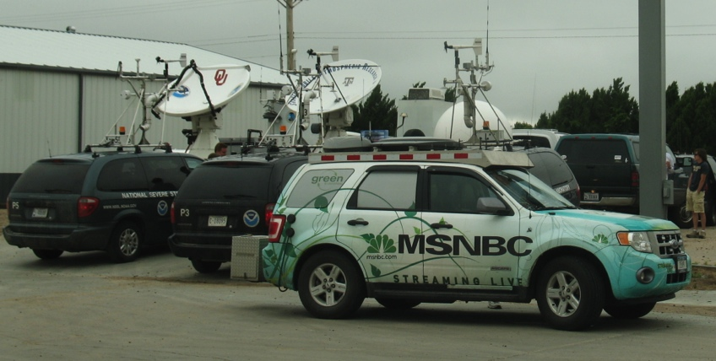



Quality: Media Stories
“Lack of Twisters Aside, VORTEX2 Gets Useful Data”
“Tornadoes Are Now Ganging Up in the United States”
“This App Uses The Power Of You To Report The Weather”

Slide 27
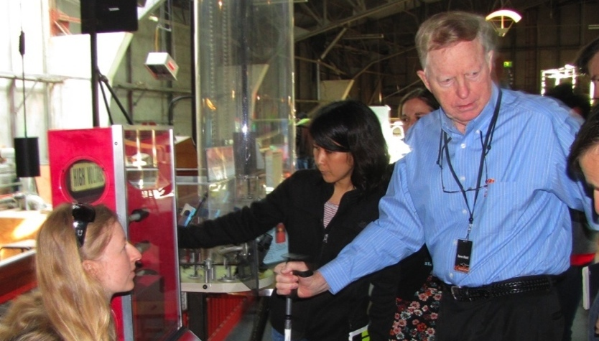
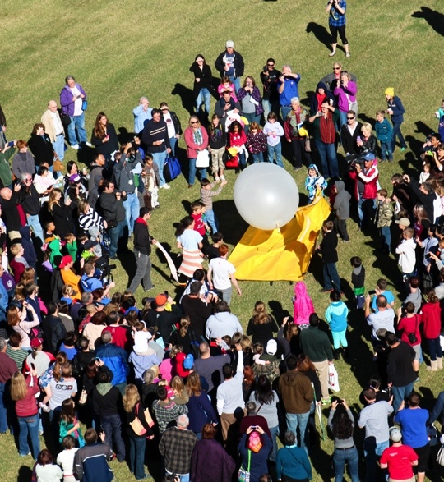
Quality: Community Connections
Rust: NOAA Scientist in Residence at San Francisco Exploratorium
5,000 visitors to Annual National Weather Festival
NSSL Website redesigned in 2012 to be public-friendly
Severe Weather 101 education pages, NSSL News Blog, strong social media presence (21 YouTube videos, 70K FaceBook followers, 20K Twitter)
Brooks: contributed to the Norman Public Schools tornado safety review, served on the OKC Mayor's Safety Task Force and the Moore Tornado Science Working Group

Slide 28
Relevance

Slide 29

Relevance: In General
Our research addresses existing (and future) societally relevant needs (national and international)
Research at NSSL addresses issues identified in the NOAA research plans and other guiding documents
NSSL’s customers are engaged from the beginning of projects to ensure relevance of research
There are few, if any, topics relevant to national needs and NOAA research and development priorities that NSSL should be pursuing but is not

Slide 30
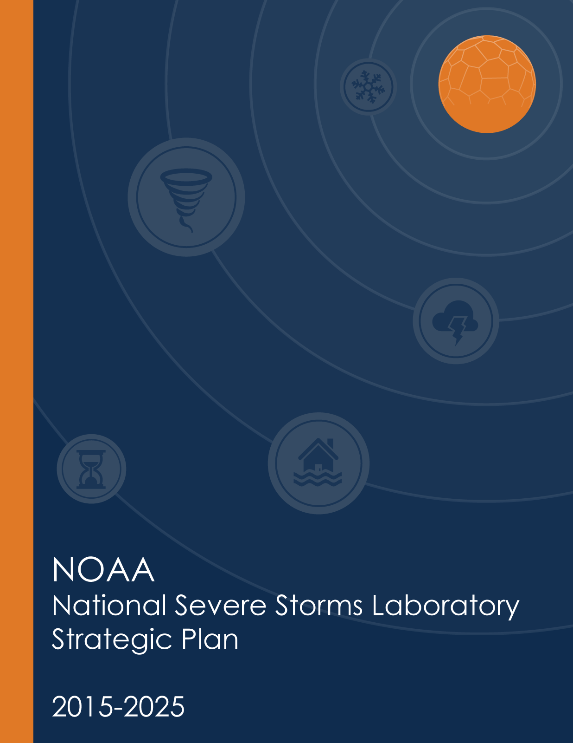

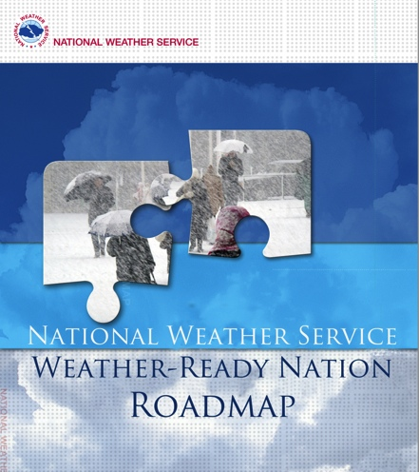
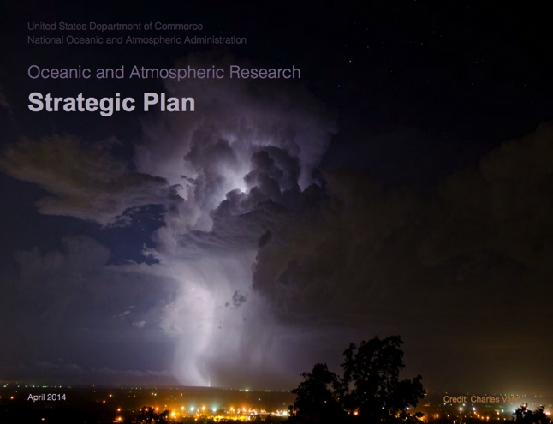
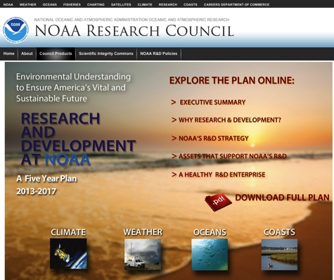
Relevance to NOAA Planning
(details to follow in subsequent presentations)

Slide 31


Relevance of NSSL Research to NOAA and OAR Missions
NOAA Strategic Plan:
  “Society is prepared for and responds to weather-related events”
  “A holistic understanding of the Earth system through research”
  “Accurate and reliable data from sustained and integrated earth observing systems”
OAR Strategic Plan:
  NSSL focuses on “How can we improve forecasts, warnings, and decision support for high-impact weather events?”

Slide 32
Relevance: NOAA 5-Year Research Plan
HWT
NOAA Hazardous Weather Testbed
FACETs: Forecasting a Continuum of Environmental Threats
NOAA Mission: Science, Service, Stewardship
To understand and predict changes in climate, weather, oceans, and coasts.
To share that knowledge and information with others
To conserve and manage coastal and marine ecosystems and resources
Basic and applied research
Observation systems, WSR-88D improvements, and field programs
FLASH
Flooded Locations and Simulated Hydrographs
WoF
Warn-on-Forecast
CI-FLOW
Coastal and Inland Flooding Observation and Warning
National Weather Radar Testbed (NWRT) Multi-function Phased Array (MPAR)
MRMS
Multiple-Radar Multiple Sensor System

Slide 33
Relevance to NOAA
Administrator’s Top Priorities
Acronyms: see previous slide
Provide information and services to make communities more resilient
  Dual Pol & other WSR-88D enhancements, MRMS, CI-FLOW
  Leadership in Weather Ready Nation symposia
Evolve the Weather Service
  Warn On Forecast, MRMS, FACETs, FLASH
Invest in observational infrastructure
  WSR-88D, MPAR, CLAMPS, OSSEs, UAS, Field projects
Achieve organizational excellence
  Strong emphasis on Research → Operations/Applications
  Vital Signs Survey, NSSL Futures Conference, AOP Milestones met

Slide 34
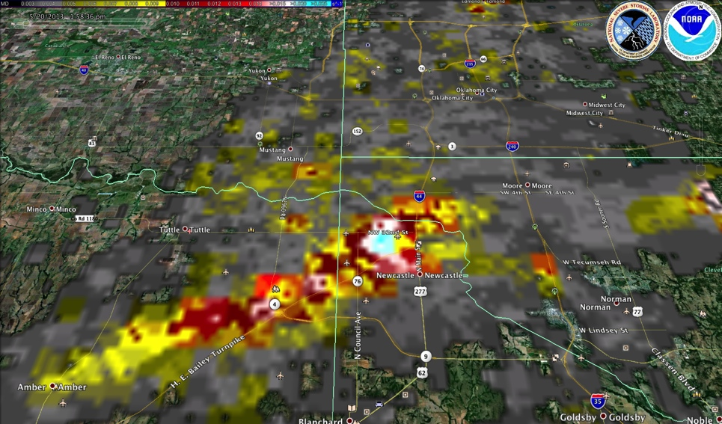
Relevance:
Quotes from Users of NSSL WDSS-II
(Warning Decision Support System – Integrated Information)
Known users of WDSS-II On Demand:
FEMA
DHS
NWS Forecast Offices
Virginia Department of Emergency Management
American Red Cross
WDSS-II Rotation Tracks:
20 May, 2013 Moore, OK
“This technology cut our disaster assessment time down from 72 to 24 hours”
- Steven Klapp, a volunteer and disaster assessment team leader for the American Red Cross of Central Oklahoma
“This kind of technology has been nothing short of a blessing for the American Red Cross and those we serve”
- Rusty Surette, Director of Communications for the American Red Cross of Central Oklahoma

Slide 35
Performance

Slide 36
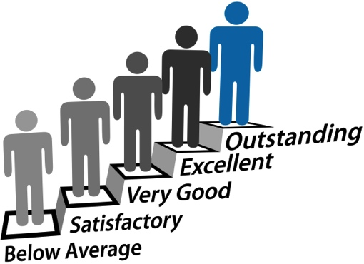
Performance: General
NSSL managed and structured to optimize conduct of research even with big changes in management since last Lab Review
Nice proportion of external to internal funding (17%)
Adequate human, technical and support services (but in the future?)
Projects on track – meeting annual milestones & targets

Slide 37
Performance: General
Work well integrated with NOAA’s planning and execution activities:
  Leadership on “OAR Tiger Team” (2012) and OAR Strategic Planning (2013)
  Broad NSSL input to OAR Strategic Plan and Priorities Exercise (2014)
  Active involvement in development of OAR Budget Initiatives
NSSL 10-year Strategic Plan
Major Project Planning
  Program Plans and Annual Operating Plans for MPAR, WoF, WSR-88D tasks
Response to recommendations from previous NSSL Lab Review
  Hiring recommendations implemented
  NSSL Division Chief to detail other responses

Slide 38
Performance: FY14 Income and Expenses
(Total: $31.3M)
(17%)
(25%)
(41%)
(42%)
(58%)
Infrastructure: NWC Lease, Line Office Overhead, CIMMS, copiers/telephones, other lease and utilities, Tech Transfer
Operations: CIMMS, contracts, property, federal travel

Slide 39
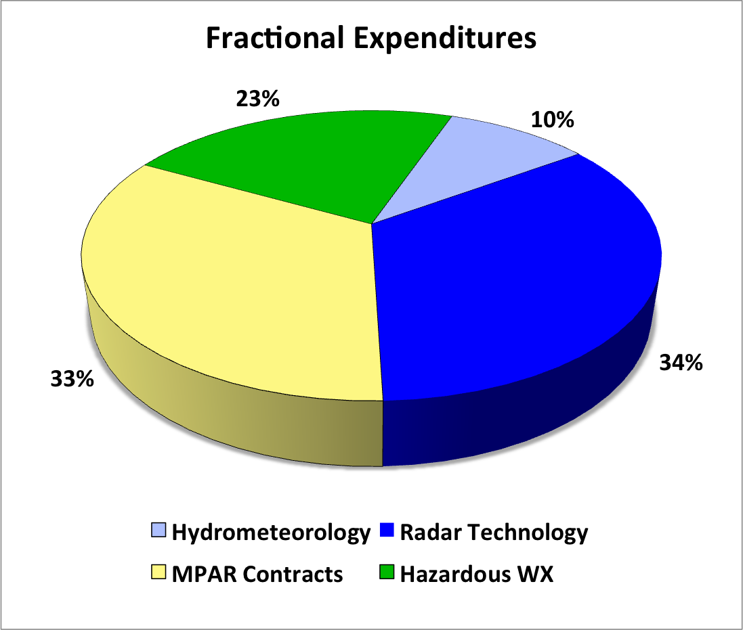
Performance: Expenses by Science Theme
(excludes administration/infrastructure costs)

Slide 40
Performance: Healthy Funding
Sandy
Supplemental
WoF
MPAR
ATD
MPAR
OAR+
12%

Slide 41
Grand Scientific Challenges from the NSSL Strategic Plan for 2015-2025
Goal 1: Aim to develop reliable severe convective probabilistic guidance products with a lead-time of 60 min for weather hazards including tornadoes via the Warn-on-Forecast program.
Goal 4: Attempt to predict useful warnings of lightning activity one hour in advance from the very onset of convection to its demise.
Goal 2: Produce enhanced radar capabilities for WSR-88D as well as radar replacement technologies such as phased array radar.
Goal 5: Develop and field test innovative atmospheric observing systems needed for reliable nowcasting of convection initiation.
Goal 3: Intend to achieve the proven capability to reliably predict flash flooding for both urban and complex landscapes several hours in advance.
Goal 6: Provide grid-based probabilistic uncertainty information for high impact weather to reduce warning false alarms.

Slide 42
Performance:
Research Leadership & Planning
2012 — Vital Signs Survey (NSSL management initiated)
2013 — NSSL management team building
2014 — NSSL Management Retreat
2014 — NSSL All-Hands Futures Conference
2015 — NSSL/ESRL/GLERL Water Prediction Summit

Slide 43
Performance:
Progress from Vital Signs Revisited Report
Excellence
  NSSL progressed in 5 of the 6 Indicators of Corporate Health

Slide 44
Performance:
Workforce Management Plan
HIRING
  NSSL Management Retreat → Strategic Hiring Plan
  Use of Research Experience for Undergraduates (REU), NOAA Hollings Scholars program, National Research Council (NRC) post-doc, and NOAA Educational Partnership Program
RETENTION
  Individual Development Plans and Stay Interviews
  LEAP (Leadership Effectiveness & Advancement Program) and other opportunities
  Strong emphasis on award nominations (with results)
  Merit Principles consistently applied to Employee Performance Evaluations
SUCCESSION PLANNING
  Visiting Scientist and IPA personnel arrangements
  Assignments to OAR HQ for career enhancement / efficient research to operations efforts
  CIMMS-NSSL rotating liaison position

Slide 45
Performance:
Research Leadership & Planning
Director’s Discretionary Research Fund
  $300–400K annually
  High-risk exploratory research seed projects competitively awarded
  Usually 5-7 projects → some are proposed for future NOAA funding
MOU/SLA agreements for NWS projects (e.g., WSR-88D improvements)
Clearly defined project objectives, scope, and methodologies in Annual Operating Plan, Strategy, Execution, Evaluation (SEE) documentation, Memorandum Of Understanding (MOUs) with agencies
Project termination when technology transitioned, customer support dies, or reimbursable funding ends

Slide 46
Performance:
Examples from FY 2014 Annual Operating Plan
Measure | Target | Actual
Number of NSSL journal articles published in peer-reviewed literature | 50 | 78
Cumulative number of experiments conducted in the HWT | 13 | 13
Cumulative number of events demonstrating improved severe weather warning decision performance using the NWRT Phased Array Radar data compared to the WSR-88D data within the HWT | 3 | 4
Cumulative number of years completed in historical re-analysis of CONUS WSR-88D data | 14 | 14
Notes:
Needs explanation

Slide 47
NSSL Research Themes

Slide 48
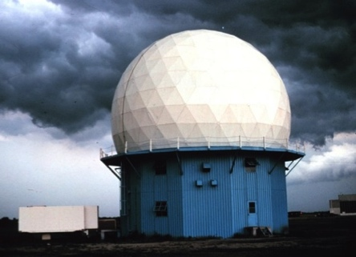
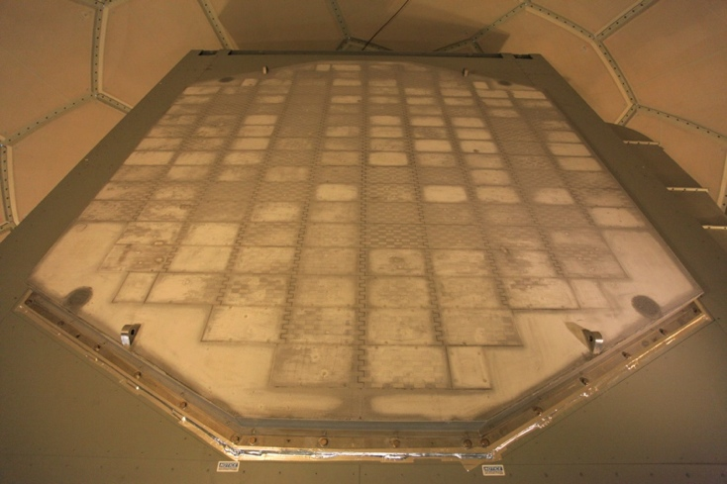
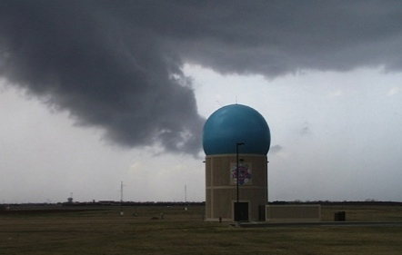
R2O Performance:
Radar Technology and Products
  NOAA’s primary weather radar lab
  Continuous technology infusion to help NWS improve operational NEXRAD radar system
  Developed dual-polarization technology, national NWS radar upgrade completed
  National Weather Radar Testbed
  Exploring replacement for the aging NWS NEXRAD and FAA radars by MPAR (Multifunction Phased Array Radar) at a savings of $5B to the Nation
WSR-88D Doppler
MPAR/NWRT

Slide 49
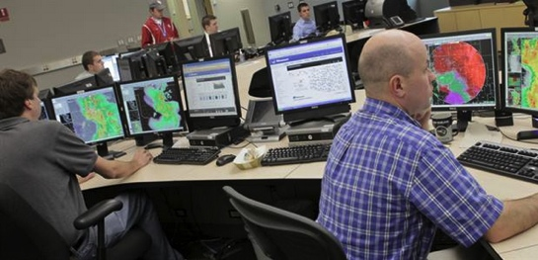
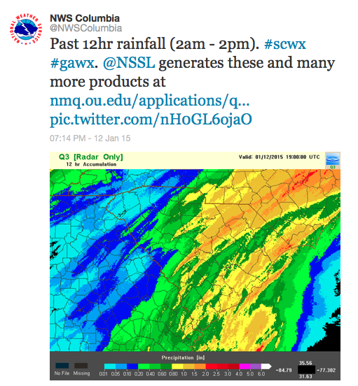
R2O Performance:
Forecast and Warning Technology
Decision support system for more accurate, precise, and timely hazardous weather warnings (MRMS: Multi-Radar / Multi-Sensor) now in NWS operations
Flash flood forecasting demonstration system: Flooded Locations and Simulated Hydrographs (FLASH) used at NWS River Forecast Centers
WOF: Warn-On-Forecast research leading to quadrupling tornado warning lead time to 60 min on the basis of ensemble model forecasts

Slide 50
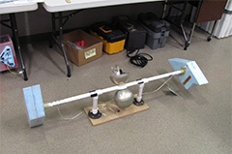
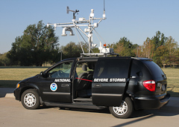
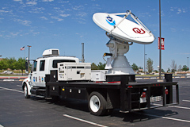
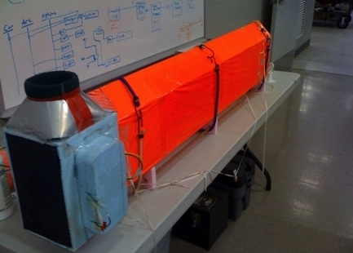
Performance:
Understanding High-Impact Weather
Jointly with NCDC, recalibration of 15 years of WSR-88D data nearly completed under the Multi-Year Reanalysis Of Remotely Sensed Storms (MYRORSS)
Field program planning, leadership, and deployment
Design and develop innovative instruments
Electric Field Meter
Mobile Mesonet
NOXP DP Radar
HD Particle Imager

Slide 51
Performance: Research to Operations (R2O)
NSSL has implemented more than 60 research to operations projects over the past decade. Some of the most prominent ones – past and current – are shown below in terms of Technology Readiness Levels:
Project | 1 Basic Science | 2 Concept formulated | 3-4 Exp. Design & Validate | 5-6 Prototype Developed | 7 Demo in Testbed | 8 Implement | 9 Transition / Deploy
Dual-pol
MRMS
FLASH
CI-FLOW
WoF
MPAR |  |  |  | In progress
FACETs |  |  |  | In progress
In progress
In progress
10 - 20 years

Slide 52
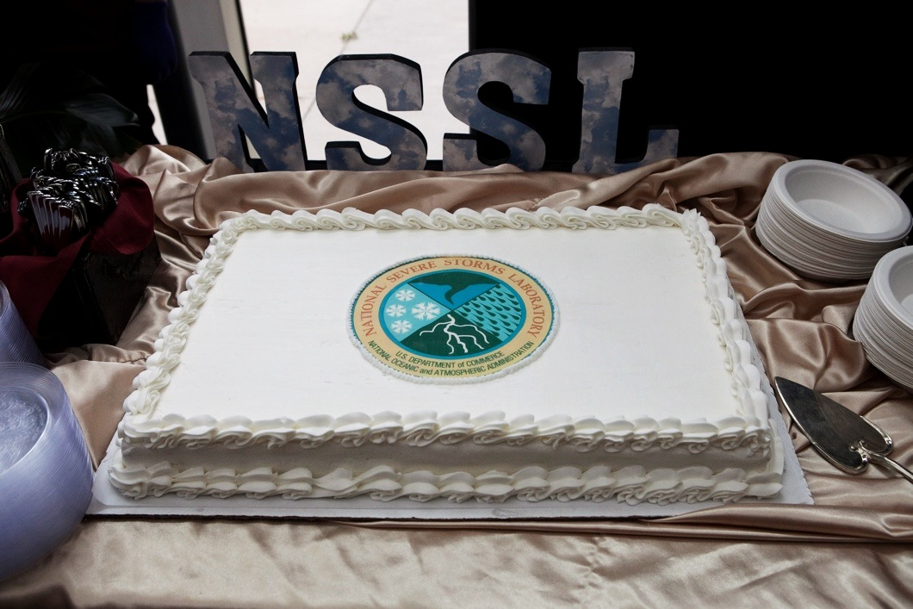
Summary
Successes
  Preeminent severe storm research
  Strong sense of vision
  Improving NWS capabilities (R2O)
  Enthusiastic, dedicated professionals
Remaining challenges
  Maintaining “brain trust” in face of budget uncertainties
  Workforce diversity: age, gender, race
  Phased array radar decisions by NOAA & FAA
Celebrating 50 Years
of service to the nation!

