Slide 1
HWT Experimental Warning Program: History & Successes
Darrel Kingfield (CIMMS)
February 25–27, 2015
National Weather Center
Norman, Oklahoma

Slide 2
The Experimental Warning Program (EWP)
Technology Specialists
Trainers & Social Scientists
Researchers
Forecasters
Goals:
1) Evaluate new techniques, observation systems, and applications at the “warning scale” (0-2 hour time period).
2) Gather feedback for product improvement, best practices training, and evidence of relevancy in NWS operations.
Notes:
What is the experimental warning program? Well, we are part of NOAA’s Hazardous Weather Testbed and our mission is the evaluate new technologies, methodologies, observation systems, applications, and meteorological techniques at the warning scale (~0-2 hour time period) in both real-time and displaced real-time. In our experiments. we work heavily with internal and external researchers, algorithm developers and technology specialists, training developers and social scientists as well as forecasters to capture feedback for further improvement of products, development of best practices training, and demonstrate quality and relevancy in NWS operations.

Slide 3
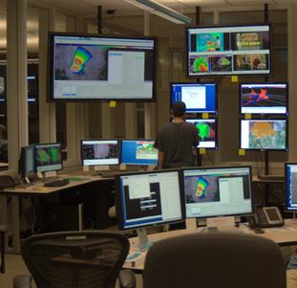
EWP Technology
Advanced Weather Interactive Processing System (AWIPS)
AWIPS-1: 2008-2011
AWIPS-2: 2012-present
10 AWIPS-2 workstations
Can replicate any NWS forecast office
Satellite Broadcast Network Access
Every operational product available to the NWS
Situational Awareness
Display
2 TVs
4 monitors
Benefit: An analog environment of a NWS office that a forecaster is familiar with while providing a head start to operational implementation.
Notes:
How we execute these experiments is based on a strong technological backbone in our program. Since 2008 we’ve been using the Advanced Weather Interactive Processing System (or AWIPS), which is the same software environment that forecasters use in day-to-day operations. The NWS has been transitioning to a next generation AWIPS-2 software system for several years and we were the first NOAA testbed to utilize AWIPS-2 for performance evaluation. We have 10 AWIPS-2 workstations in the HWT that we can localize to any NWS office in the nation as our study region can change from day-to-day. Furthermore, we have a satellite broadcast access feed that provides every product available to the NWS also available for us in the testbed. We did this because we don’t want to innovate in a vaccum, we want to see how these new products and techniques look side-by-side with current products and observe how forecasters pair these products together for best practices and ultimately provides an analog of an NWS forecast office that they are familiar with.

Slide 4
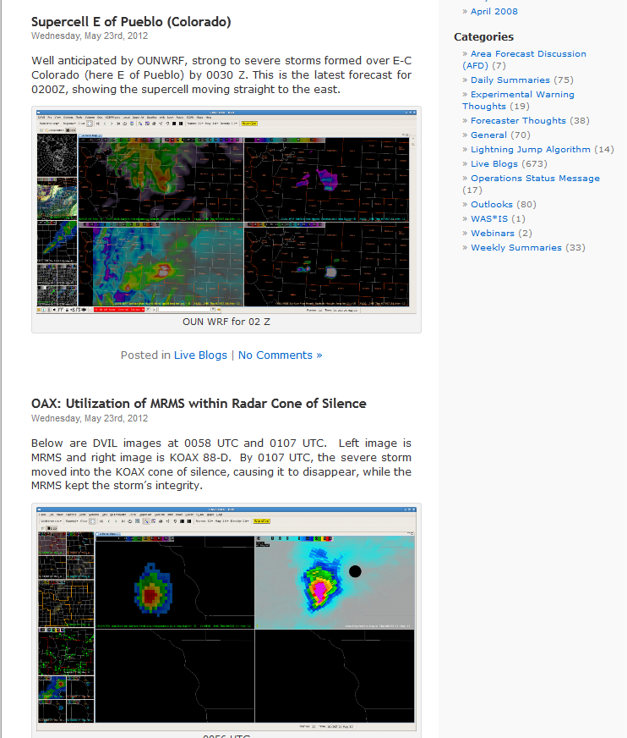
Receiving Forecaster Feedback
Blogging
Daily/Weekly Surveys
Daily/Weekly Debriefs
Dedicated face-to-face time between forecasters and developers on the evaluated products.
Pre-warning decision
Making thoughts and
Images in real-time.
Strengths/Weaknesses of the applications evaluated.
Flexible metrics of data capture allow investigators to receive quality feedback on their terms while providing transparency in the evaluation process.
Notes:
So we have the system to display information but how to we capture forecaster feedback? It’s ultimately dependent on the experiment but for our big real-time spring program we use a mixed media approach. During operations we use blogging to capture key judgments and allows forecaster to describe in free form what they are seeing. Forecasters will take daily and/or weekly questionnaires developed by the project investigators to provide direct assessment of their products. Furthermore, we will have face-to-face daily and weekly debriefs with all partners for questions and concerns to be raised and captured. This system has provided a great amount of transparency in the evaluation process.

Slide 5
Past Successful Initiatives: NSSL 3DVAR
3DVAR = A storm-scale data assimilation system blending observational and numerical model data
NSSL 3DVAR
Reflectivity and radial velocity from nearby WSR-88D radars blended with 12km model background
Four floating 200x200 analysis domains
1km horizontal resolution, 500m vertical resolution (31 total levels) every 5 min.
200 km² Analysis Domain
500 km² Radar Domain
Goal: Synthesize storm dynamics in a manner that is quick and easy for forecasters to interrogate.
Notes:
So what have we evaluated in the HWT in the past? We’ll take you through some our prior initiatives. First, we’ll discuss 3DVAR. 3DVAR is a data assimilation technique that objectively blends model data and observations. Why did we look at 3DVAR? It serves as one of the proposed vehicles for Warn-On-Forecast (which examines warning methods where NWP plays a larger role). Using the 3DVAR system, numerous derived fields were available in AWIPS at 1km spatial and temporal resolution which is much higher than current product display capabilities in a NWS forecast office. We ran this project for two years and capitalizing on forecaster feedback, we were able to swap out weaker performing products with new ones that forecasters suggested.

Slide 6
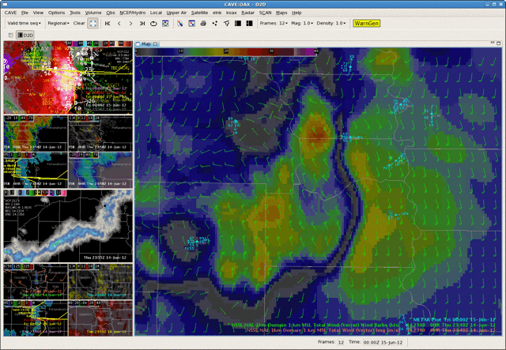
Past Successful Initiatives: NSSL 3DVAR
Multi-year experiment allowed for integration of feedback for re-evaluation
AWIPS-2 Products Evaluated
Bold = Evaluated Both Years
2011
Downdraft Track
Downdraft Composite
Simulated Reflectivity
Updraft Track
Updraft Volume
Updraft Max
Vorticity
2D Wind Fields
2012
Storm-top Divergence
Updraft Helicity
Above: AWIPS-2 display of the NSSL 3DVAR 1km wind field displayed as both barbs and as a colored image for a damaging wind event on 14 June 2012.
More Info: Calhoun et al. (2014) - http://dx.doi.org/10.1175/WAF-D-13-00107.1
Notes:
So what have we evaluated in the HWT in the past? We’ll take you through some our prior initiatives. First, we’ll discuss 3DVAR. 3DVAR is a data assimilation technique that objectively blends model data and observations. Why did we look at 3DVAR? It serves as one of the proposed vehicles for Warn-On-Forecast (which examines warning methods where NWP plays a larger role). Using the 3DVAR system, numerous derived fields were available in AWIPS at 1km spatial and temporal resolution which is much higher than current product display capabilities in a NWS forecast office. We ran this project for two years and capitalizing on forecaster feedback, we were able to swap out weaker performing products with new ones that forecasters suggested.

Slide 7
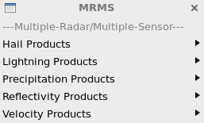
Past Successful Initiatives: MR/MS
What is Multi-Radar/Multi-Sensor?
Single Radar
Exploits areas of overlapping radars to generate 3D cube of reflectivity and shear products and derivatives
2 min. output – 500m-1km resolution
EWP History
Multi-Radar
Evaluated for last 8 years
Multiple iterations of product development
Gained NWS support and trust
System Requirements & Evaluation Committee Top 10 implementation candidate from all NWS regions
Implementation into AWIPS-2 operations this year
AWIPS-2 Menu
Notes:
Another past initiative includes MR/MS which stands for Multiple-Radar/Multiple-Sensor which you’ve heard about a bit already. How this system works is it exploits areas of overlapping radar coverage to generate 3D cubes of reflectivity, velocity, and derivative products every 2 minutes with a variable spatial resolution from 500m for velocity products and 1km for all other products. This initiative went through several iterations in its 8 years in the HWT and during this time began to gain NWS support and trust. Each year the NWS provides a “dream list” and each NWS region votes on products and services they wish to see in operations. MR/MS was rated in the top 10 from every NWS region. This is a rare feat particularly due to the geographic challenges each region faces. We will be hitting an MR/MS milestone this year as the system is implemented into the AWIPS-2 operational baseline.

Slide 8
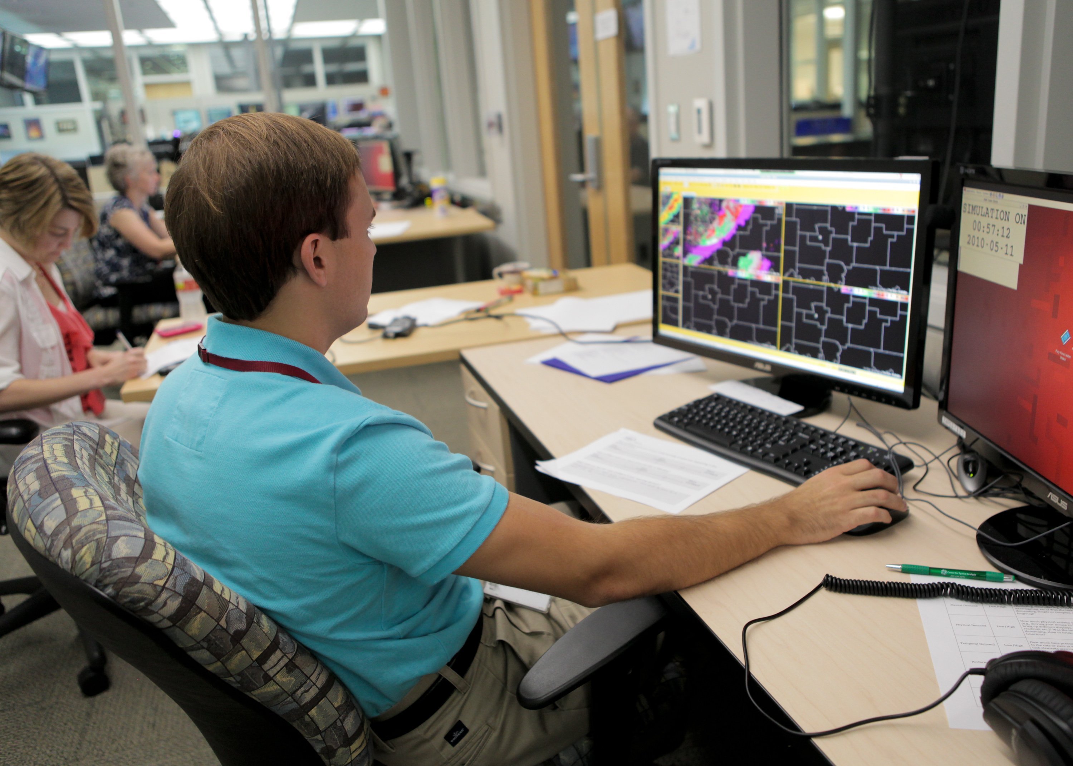
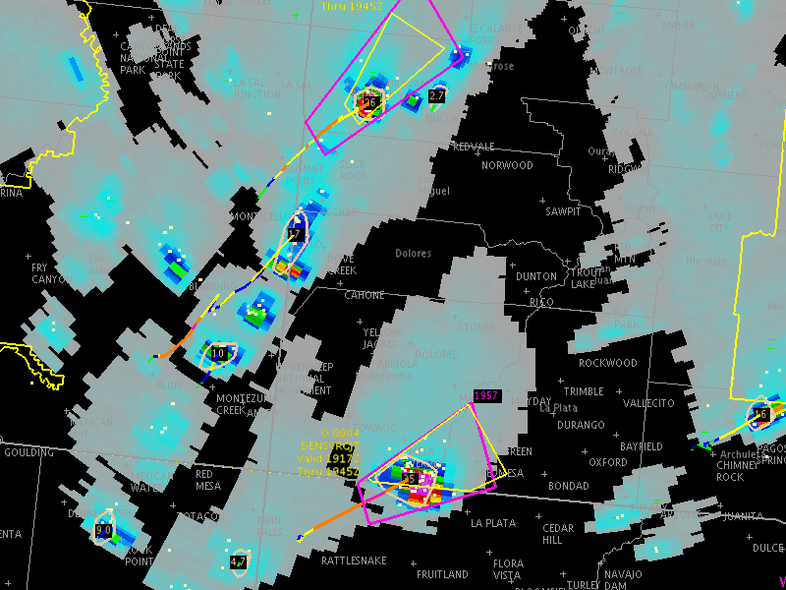
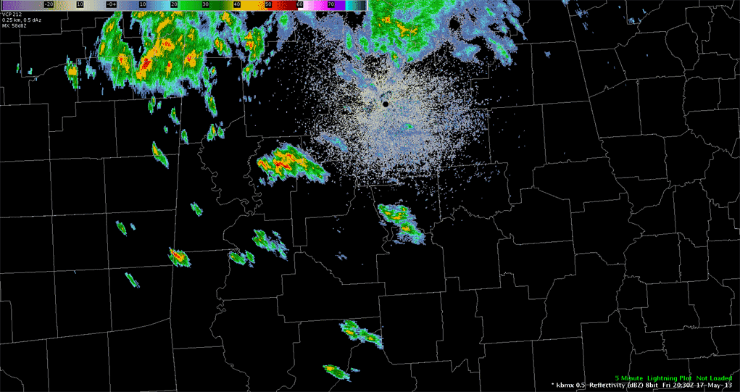
Current Initiative: Earth Networks (ENI) Total Lightning
First EWP public/private sector data evaluation experiment
Single Radar
Objective: Does ENI total lightning and derivative products have value in warning operations?
Experiment Design
A blend of meteorology & social science
+
+
Cloud-Top Cooling
Six two-hour scenarios of varying convective modes
Geostationary
Lightning Mapper
18 NWS
Forecasters
Three tiers of data available for storm interrogation
Notes:
A current initiative the EWP is working on is our first public/private sector data evaluation experiment. We were tasked to evaluate Earth Network’s total lightning and derivative products and determine it’s place in warning operations. To do this, we brought 18 NWS forecasters in and put them through six two-hour scenarios with varying convective modes. Each forecaster had one of three data tiers of information use to make a warning decision and we collected a lot of information about their decisions through observations, warning extraction, and post-event surveys.

Slide 9
ENI Total Lightning: Results & Future Work
NASA Task Load Index
Year 2: Spring 2015
Assess perceived workload of a new task or product
Interpretation
0 = No Stress ; 100 = High Stress
Integration of forecaster feedback into a renewed product set for real-time evaluation
Data Provided | Mean Workload
Radar Only | 55
Radar + Total Lightning | 52
Radar + Total Lightning + Derivatives | 54
Similar workloads observed
Case meteorology plays larger role
Above: ENI total lighting and Dangerous Thunderstorm Alerts
Notes:
Expounding on one output from our experiment was our use of the NASA Task Load Index. This multi-dimensional assessment tool allows us to assess perceived workload of a new task or product. What we found when we applied this to our experiment, was that the mean perceived workload was similar and independent of the data tier utilized. What influenced the perceived workload or forecaster stress more was effectively the meteorology of the case. We are moving forward with this evaluation of these products in real-time as part of spring program this year.

Slide 10
Summary
NOAA’s HWT has a record of success and will continue to provide a mechanism for the evaluation of new products and services to meet the needs of the National Weather Service.
The Path Ahead
Planned Future Initiatives:
Continued work with the Phased Array Radar Innovative Sensing Experiment (PARISE)
Exploring the role of rapid-scan radar data on human factors and forecaster conceptual models
GOES-R Risk Reduction Activities
Evaluate proposed algorithms and tools to support the GOES-R mission
Probabilistic Hazard Information (PHI) into AWIPS-2 Hazard Services
FACETs, decision support services, and human factors experiments
Continued work with Flooded Locations and Simulated Hydrographs (FLASH) Program
Forecaster use and evaluation of a new paradigm for flash flood prediction
Notes:
That is just one of many initiatives the EWP will be a part of moving forward as we provide a platform for the evaluation of new products and services to meet the needs of the National Weather Service. Some of our current and proposed future initiatives include: - Continued work on exploring the role rapid-scan radar has on human factors and forecaster conceptual models for storm dynamics as part of the Phased Array Radar Innovative Sensing Experiment (or PARISE) which you will hear about in the next talk from Dr. Pam Heinselman
Continued risk reduction activities in the development of algorithms and tools to support the GOES-R satellite mission. You’ll hear more about this from Dr. Kristin Calhoun in this session. - Probabilistic Hazard Information (or PHI) development into AWIPS-2 which is one of the pillars of the FACETs frameworks. You’ll hear more about this from Dr. Christopher Karstens and Lans Rothfusz - And finally, evaluation of a new paradigm for flash flood prediction under the Flooded Locations and Simulated Hydrographs (or FLASH) project.

