Slide 1
Hazardous Weather Forecasts and Warnings Overview: Forecast Division
Jack Kain (NSSL)
February 25–27, 2015
National Weather Center
Norman, Oklahoma

Slide 2
NSSL Forecast Research and Development Division
Notes:
This is a picture of everybody in the FRDD at NSSL. I would love to have each of these people come up and tell you about how they contribute to NSSL’s mission. If we had time for that I think you would see that we really span the spectrum of research activities from basic research to development to operational infusion….

Slide 3
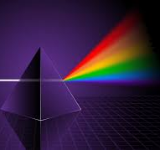
NSSL Forecast Research and Development : Spanning the spectrum from Research to Operations
Quality: Publications, Awards, Technology Transfer, Invited Presentations
Performance: Efficiency, focus - Relationships with SPC, broader NWS allow us to concentrate directly on users’ needs – with constant feedback.
Relevance: From NOAA/OAR Strategic Plan: How can we improve forecasts, warnings, and decision support for high-impact weather events?
Basic Research
Applied Research
Operational Transition
Notes:
But what I hope we can show is that the work of FRDD scientists spans the spectrum from basic research all the way to operation transition of science and technology. What we have done with this session is try to sample different points along the spectrum to give you insight into selected initiatives in the division. In this brief presentation I would like highlight what each speaker and their selected topic bring to the table in terms of Quality, Performance, and Relevance. In a broad sense, measures of quality include tangible things like publications, awards, technology transfers, and so on. In the category of performance, I really want to emphasize our relationship with stakeholders such as the National Weather Service, and how that keeps us focused on their needs and, in turn, the broader needs of society. And this work is clearly relevant to the priorities established by our parent organization, the office of Atmospheric Research.

Slide 4
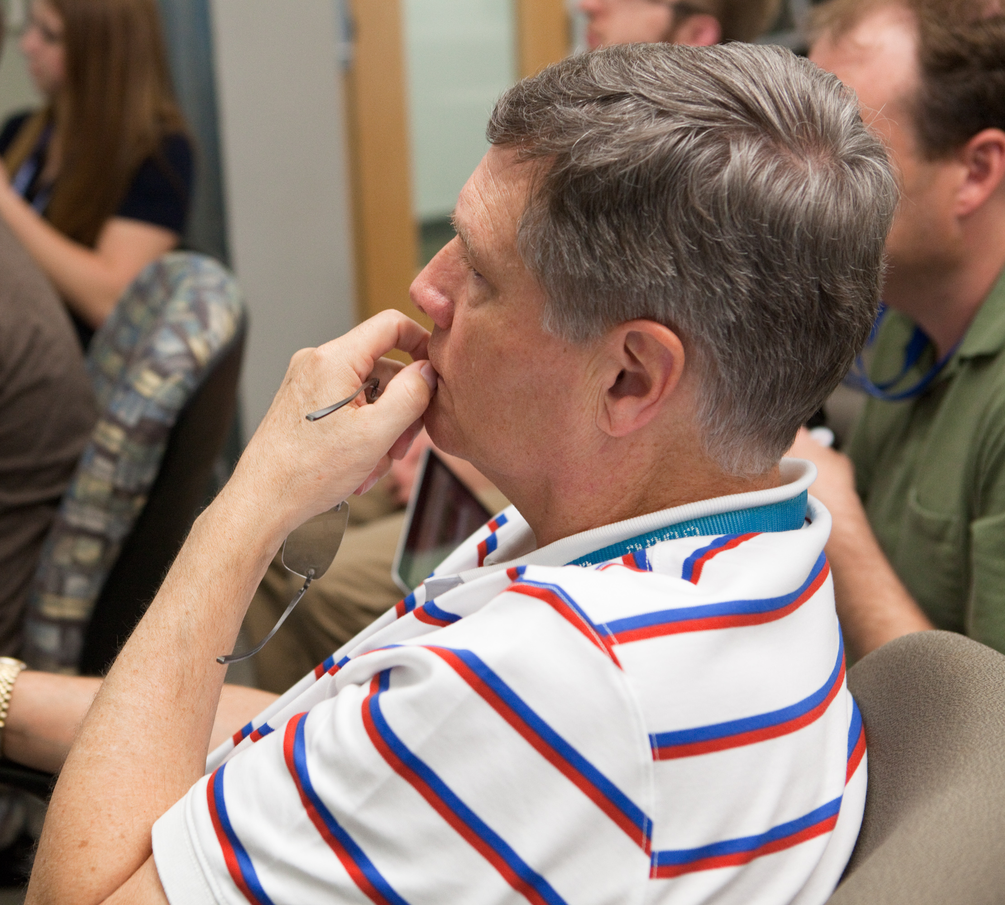
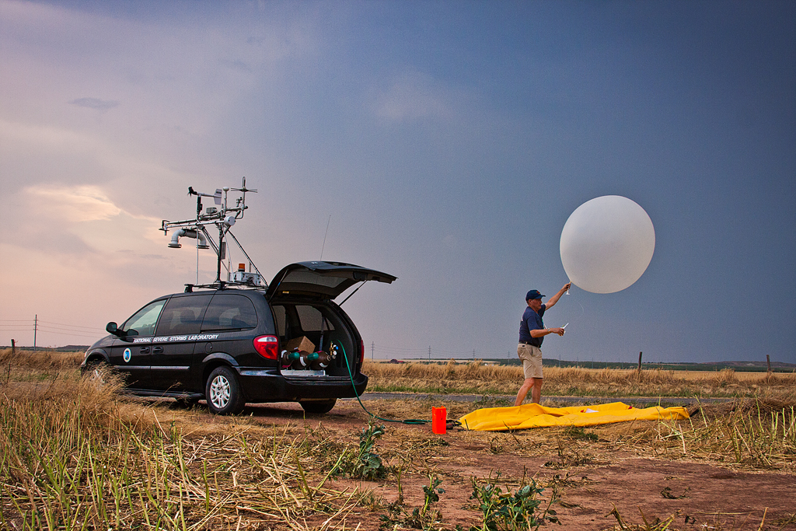
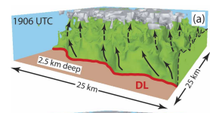
“Process Studies of Convective Storms and their Environments” by Conrad Ziegler: A linchpin of basic research at NSSL for over 20 years
Quality: Ziegler was lead PI on multiple NSF grants that funded major collaborative field programs & innovative analysis projects for collected data
Performance: Annual participation in HWT experiments keeps Ziegler grounded, able to tailor his research to the needs of end users
Relevance: Ziegler’s efforts help fill in the gaps in our understanding of fundamental atmospheric processes, providing a foundation for better forecasts and warnings
(From New Jersey)
Notes:
OK, so what will our first speaker bring to the table? Conrad Ziegler is a long-time leader in basic research at NSSL. He brings quality in many ways, but some of the unique ways for him are his leadership on field programs – and that includes writing the grants to get the programs funded as well as making sure that the collected datasets are fully utilized. Even though he focuses on basic research, Conrad participates in HWT experiments every spring and I think he would be the first one to tell you that he has benefitted tremendously from the interactions with forecasters in HWT activities. By spending time with the end users of our work, Conrad is able to clearly identify the gaps in our fundamental understanding of the atmosphere and tailor his research to fill in those gaps.

Slide 5
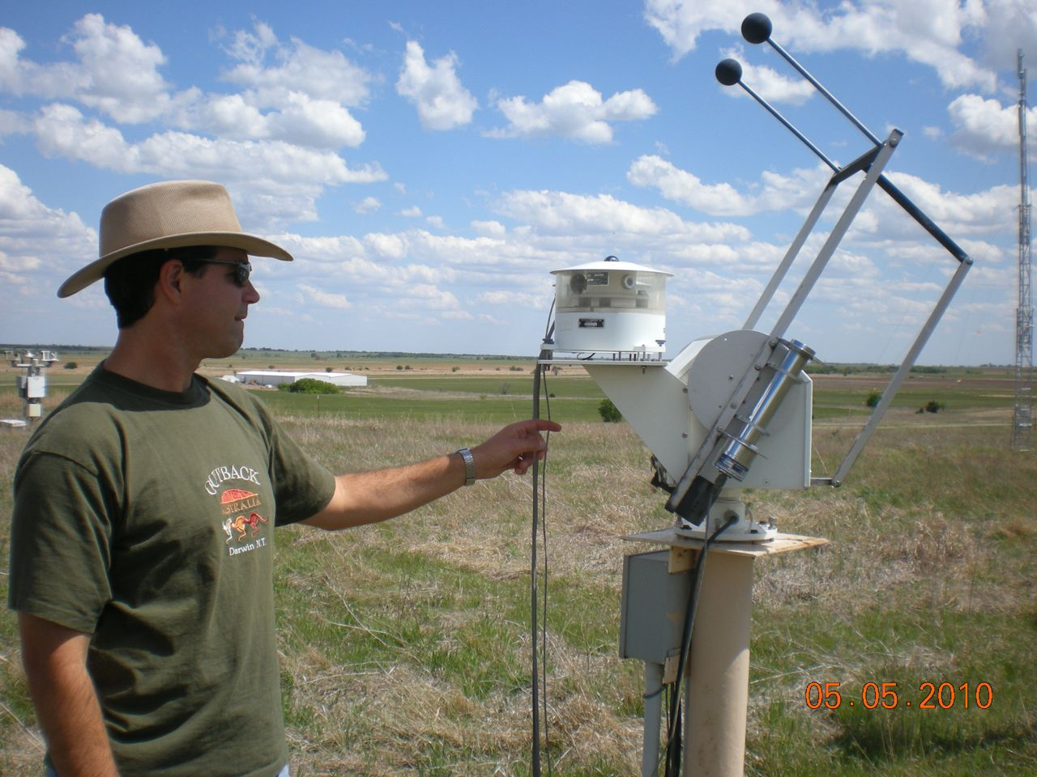
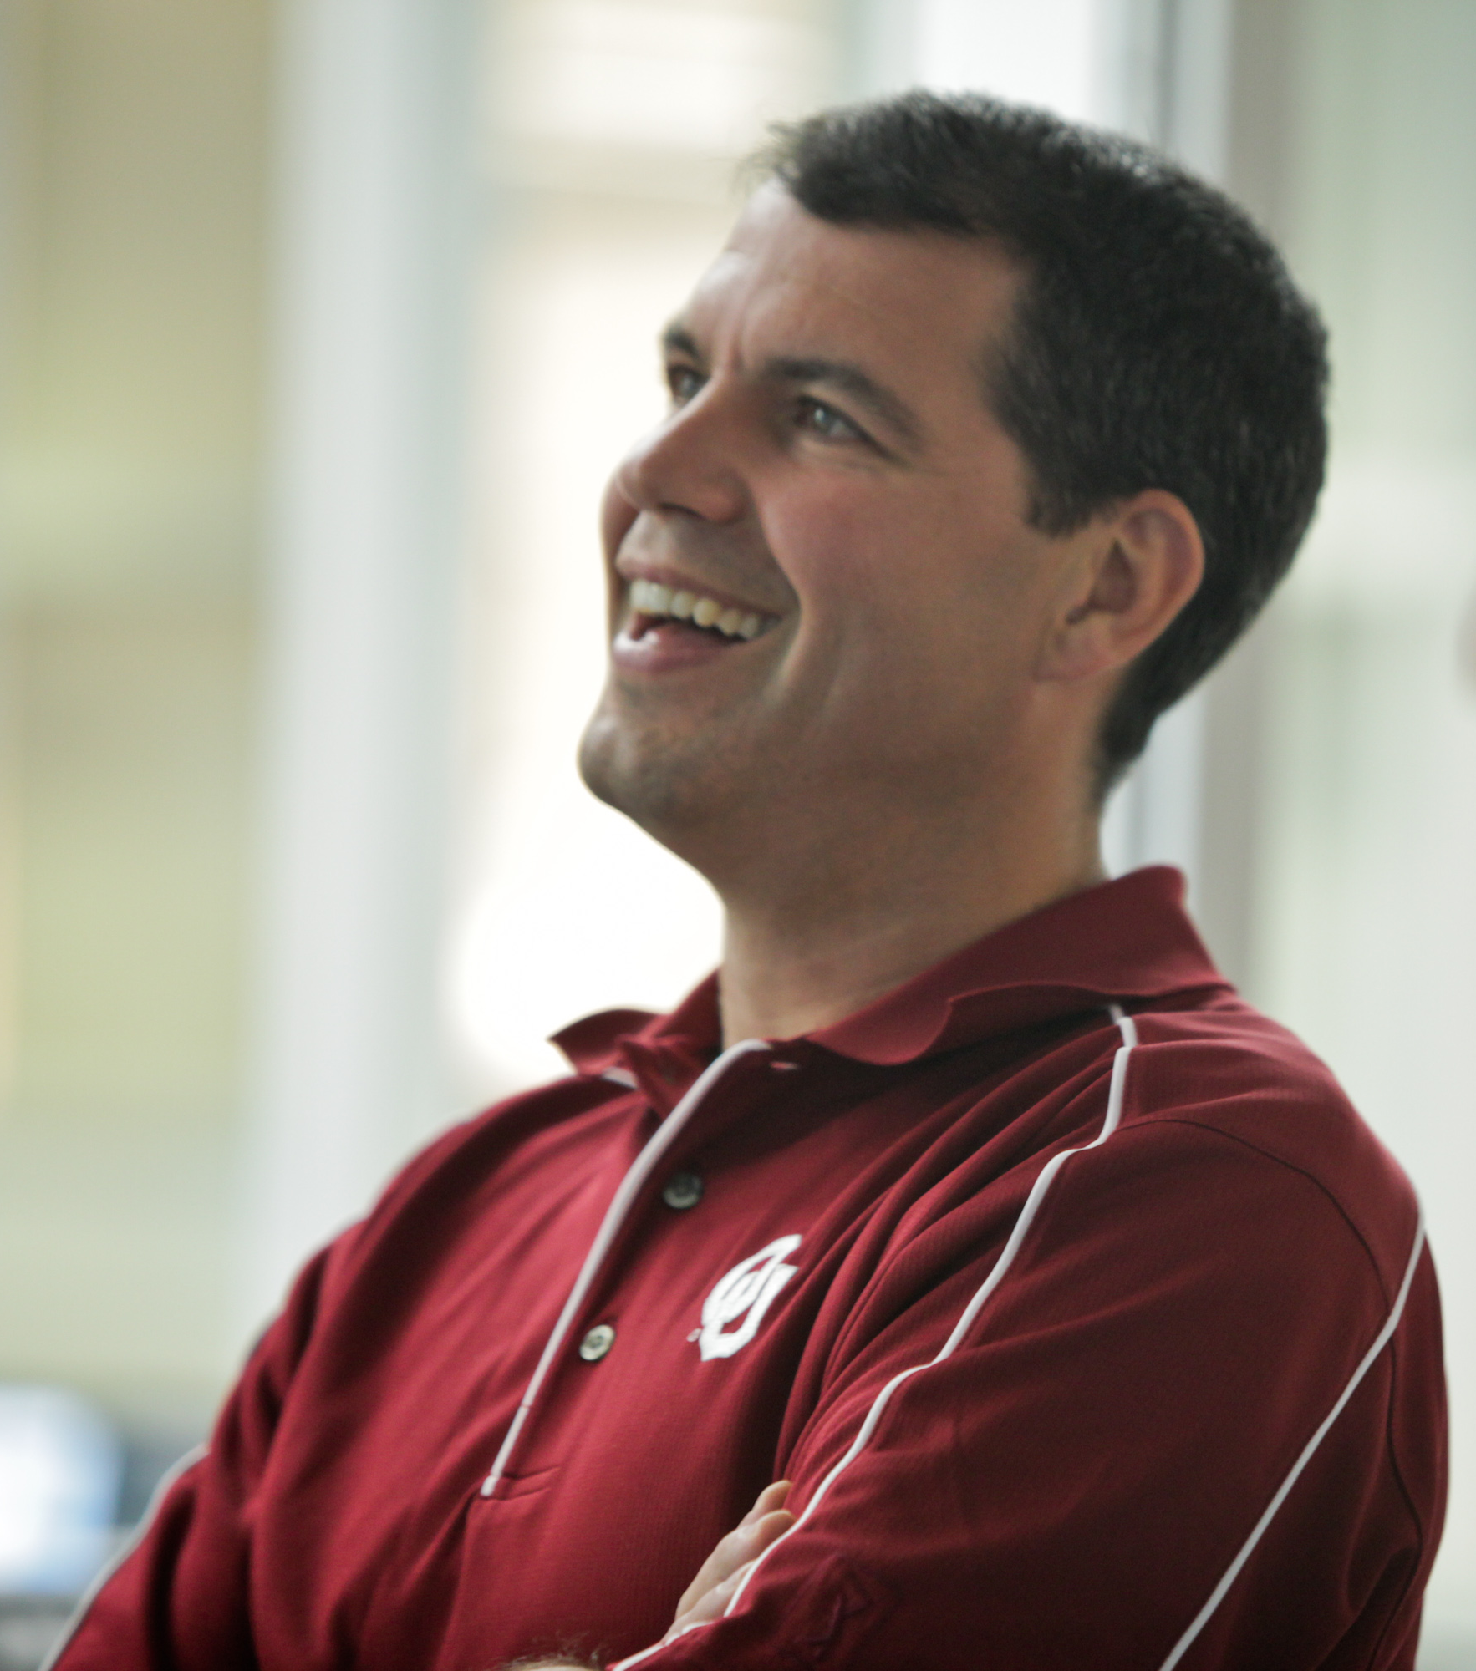
“Ground-Based Instrument Development and Observational Strategies” by Dave Turner
Quality: Turner has more than 100 peer-reviewed publications; 10 invited presentations in last 2 years (4 outside the U.S.)
Performance: Turner consistently maintains >$500K in external funding; funds and mentors large numbers of students; serves on Program Boards and Committees for major scientific funding agencies
Relevance: Goal from NOAA R&D 5-year Plan: Develop the foundational infrastructure for a “Network of Networks” that provides boundary layer profiles of winds, temperature, and moisture
(from Montana)
Notes:
The second presentation will be on the topic of developing and using the next generation of observing systems and strategies. Dave Turner will be the speaker and as you can see his productivity and world-wide recognition are truly exceptional. He is also a very generous contributor, procuring external funds to maintain a large research program, mentoring a team of students, and serving on both internal and external Boards and committees. And his scientific efforts are very relevant to specific goals described in the NOAA 5-yr R&D plan.

Slide 6
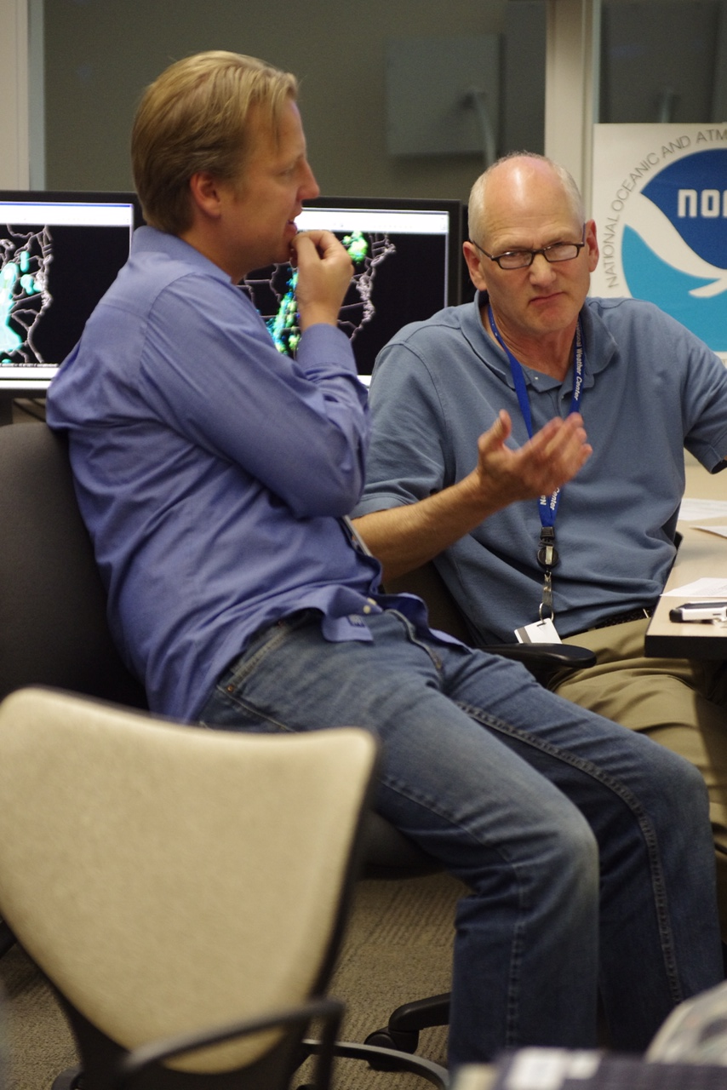
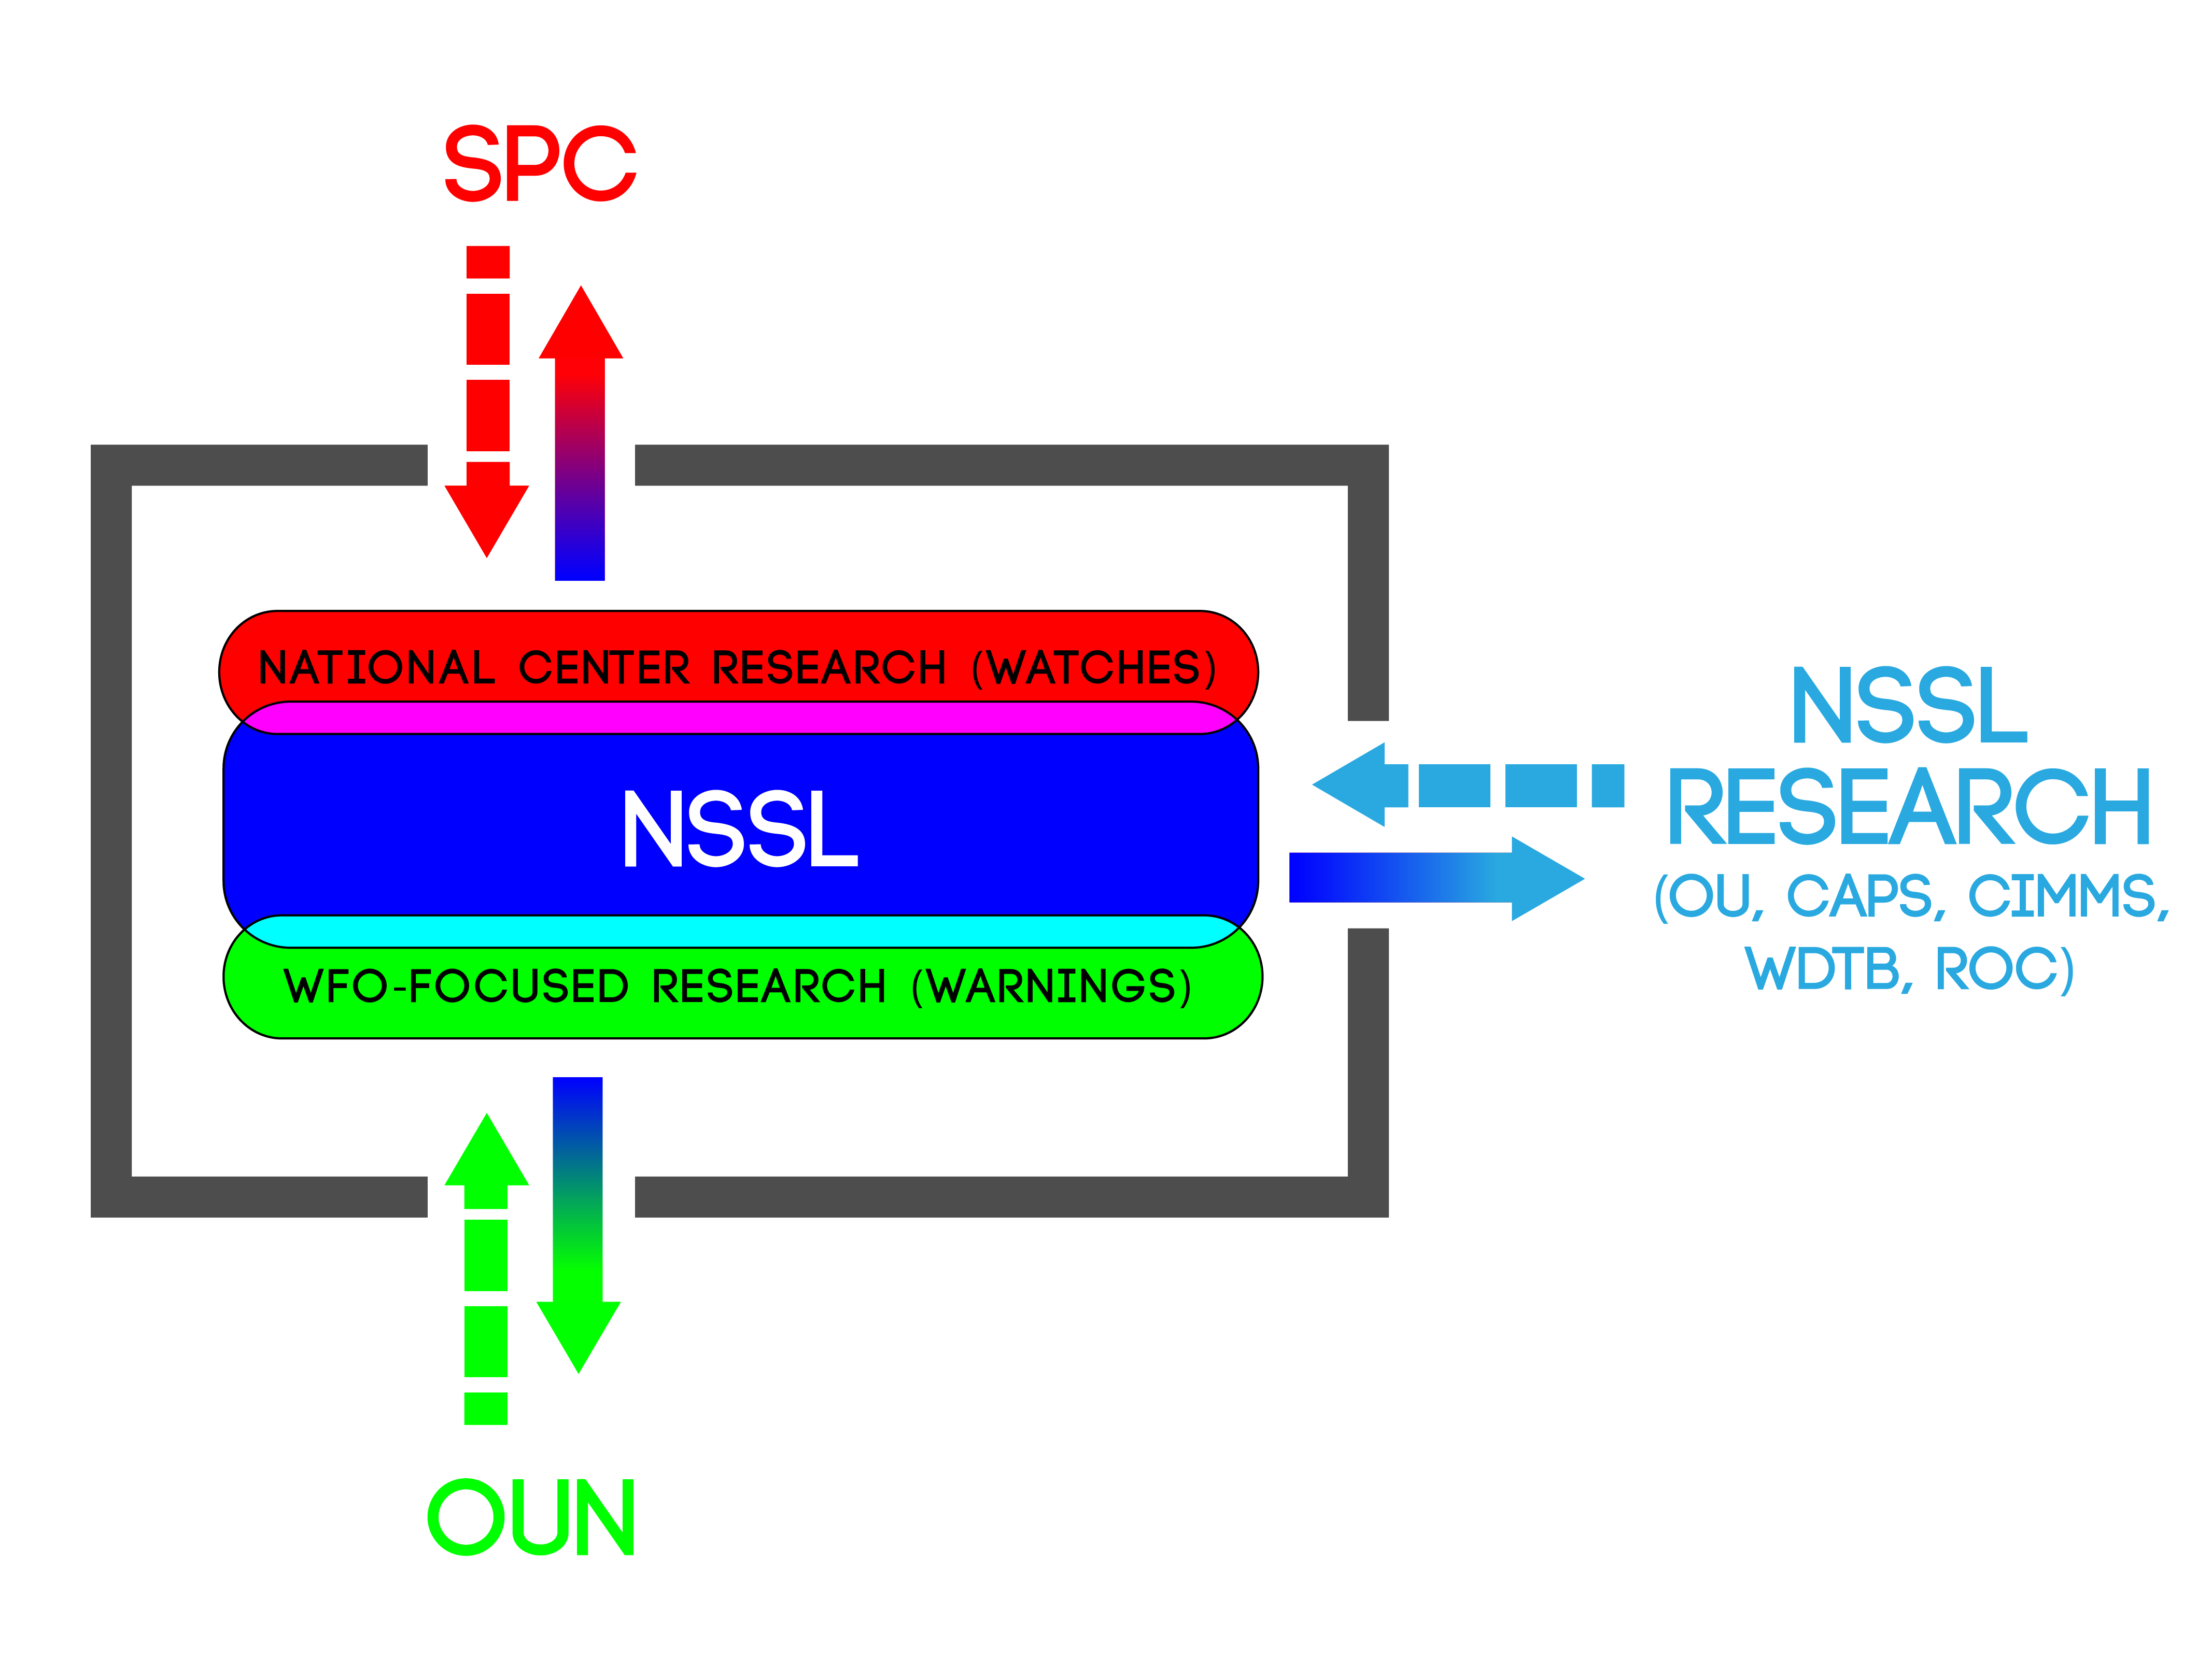
“HWT Spring Forecasting Experiment: History & Success” by Adam Clark
(From Iowa)
Quality: Clark won the 2011 AMS Editor’s Award, 2012 Presidential Early Career Award for Scientists and Engineers (PECASE), the 2013 OU/A&GS Dean’s Award for “excellence in research and scholarship”
Performance: HWT has instituted a funded, peer-reviewed proposal process for choosing and evaluating projects
Relevance: HWT activities engage and promote alignment between researchers, developers, and front-line forecasters.
Notes:
The third talk is about the Spring Forecasting Experiment, which is conducted in the NOAA Hazardous Weather Testbed. The diagram you see here represents the fact that the HWT is sandwiched in between two operational National Weather Service forecast offices – the Storm Prediction Center, with National responsibility for severe thunderstorm and tornado watches on one side, and one of 122 local forecast offices, with local responsibility for warnings on the other side. The speaker for this topic is Adam Clark and the quality of his contributions is clearly reflected by a string of awards that he has won recently, including the prestigious Presidential Early Career Award for Scientists and Engineers in 2012. In terms of performance as an organization, the HWT has become much more organized and efficient since 2009, including the implementation of a peer-reviewed grant-proposal process to determine which activities will be supported in the HWT. And the beauty of the HWT is that it is very effective at improving the alignment of R&D activities all along the spectrum of R2O.

Slide 7
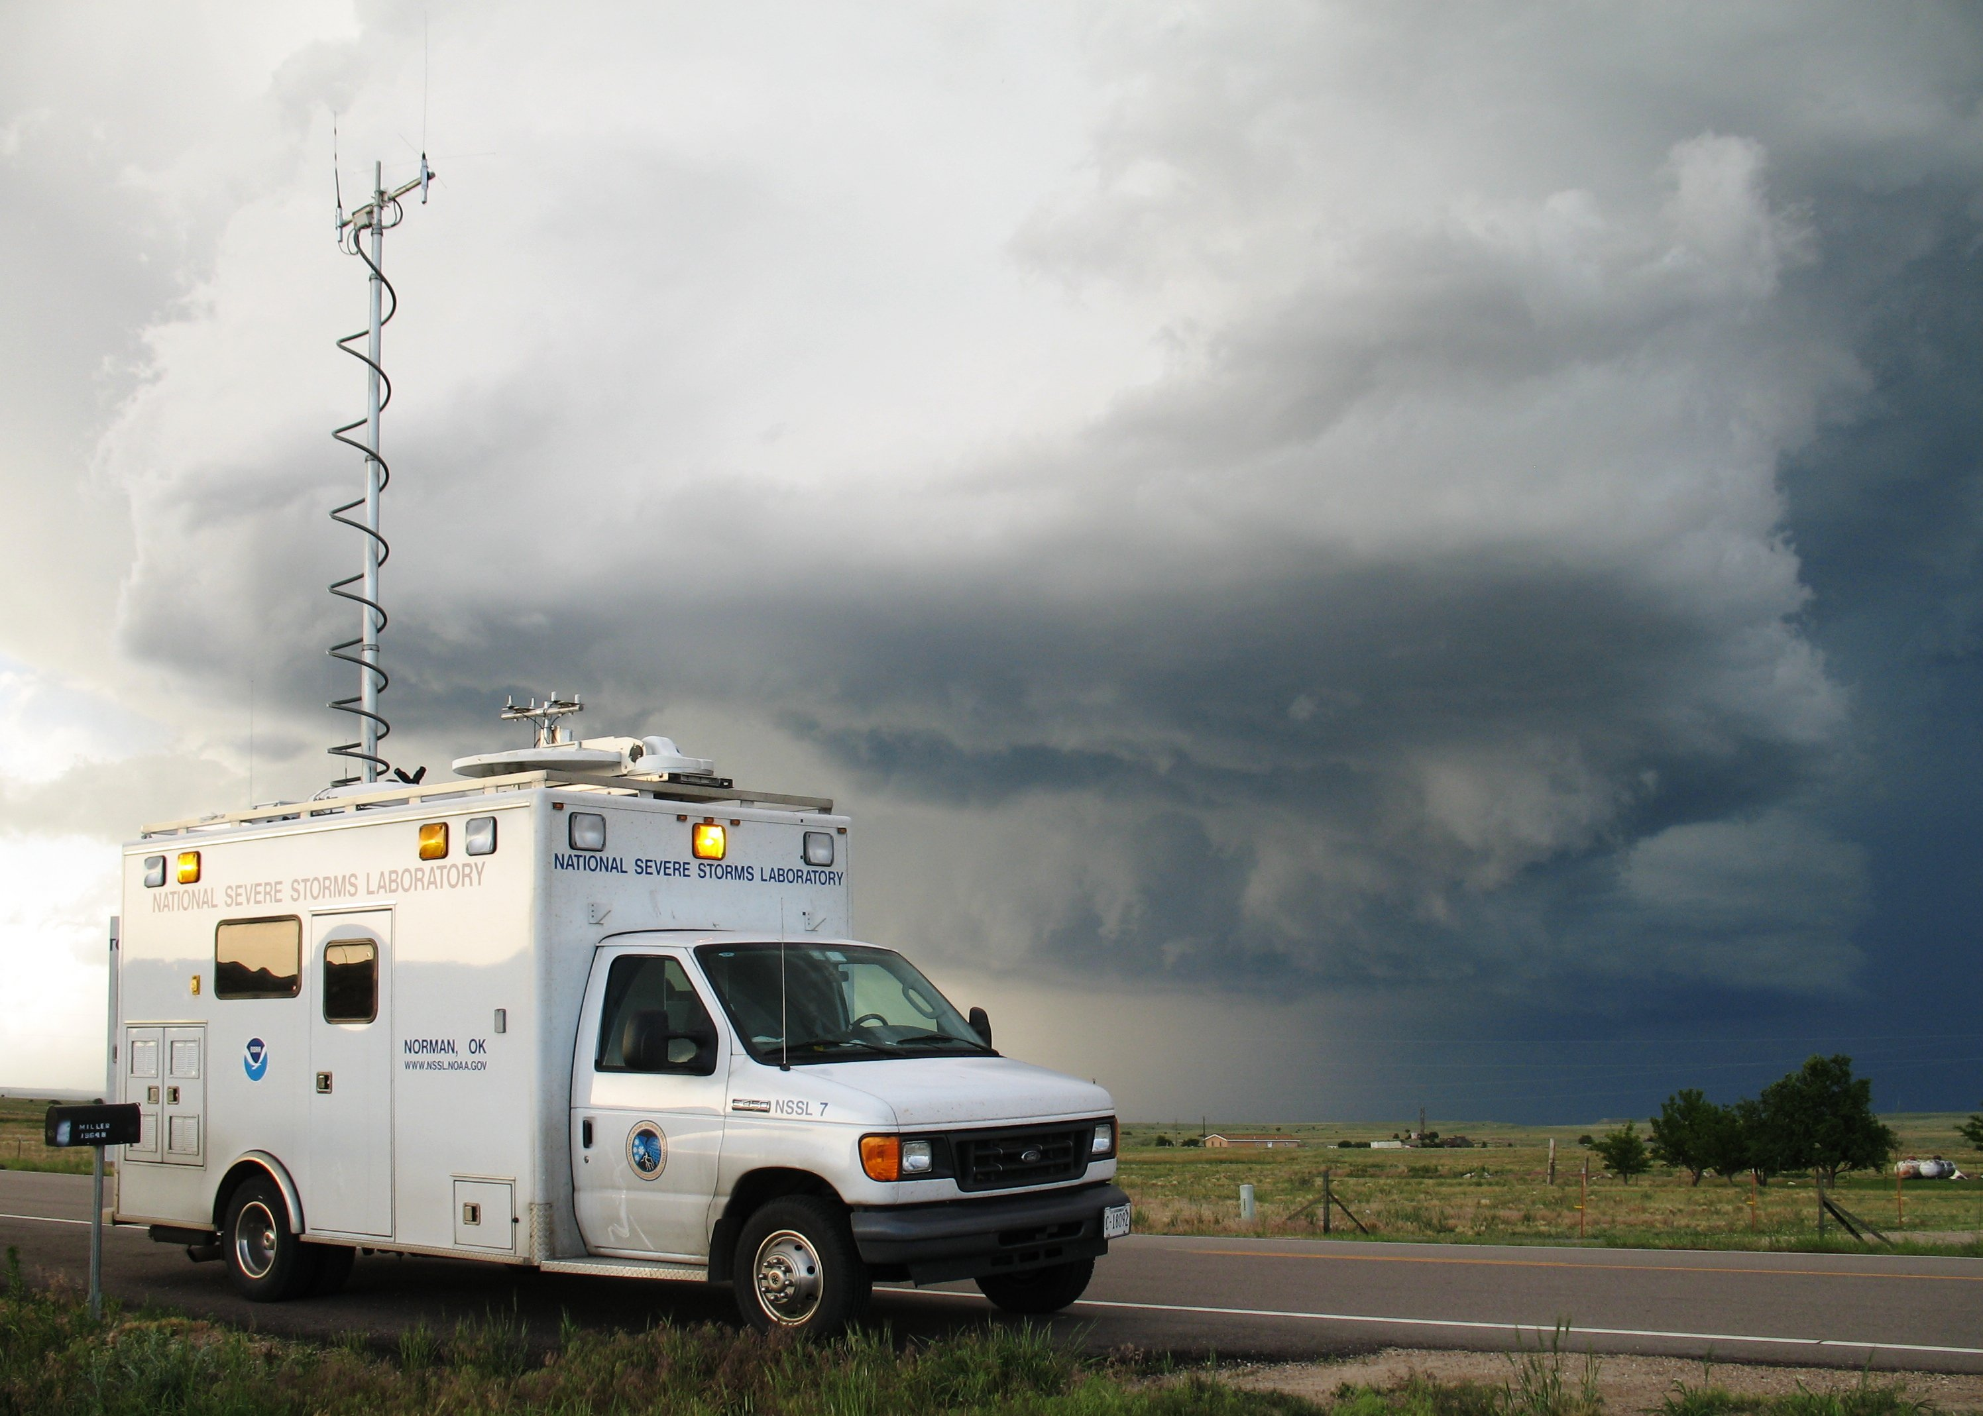
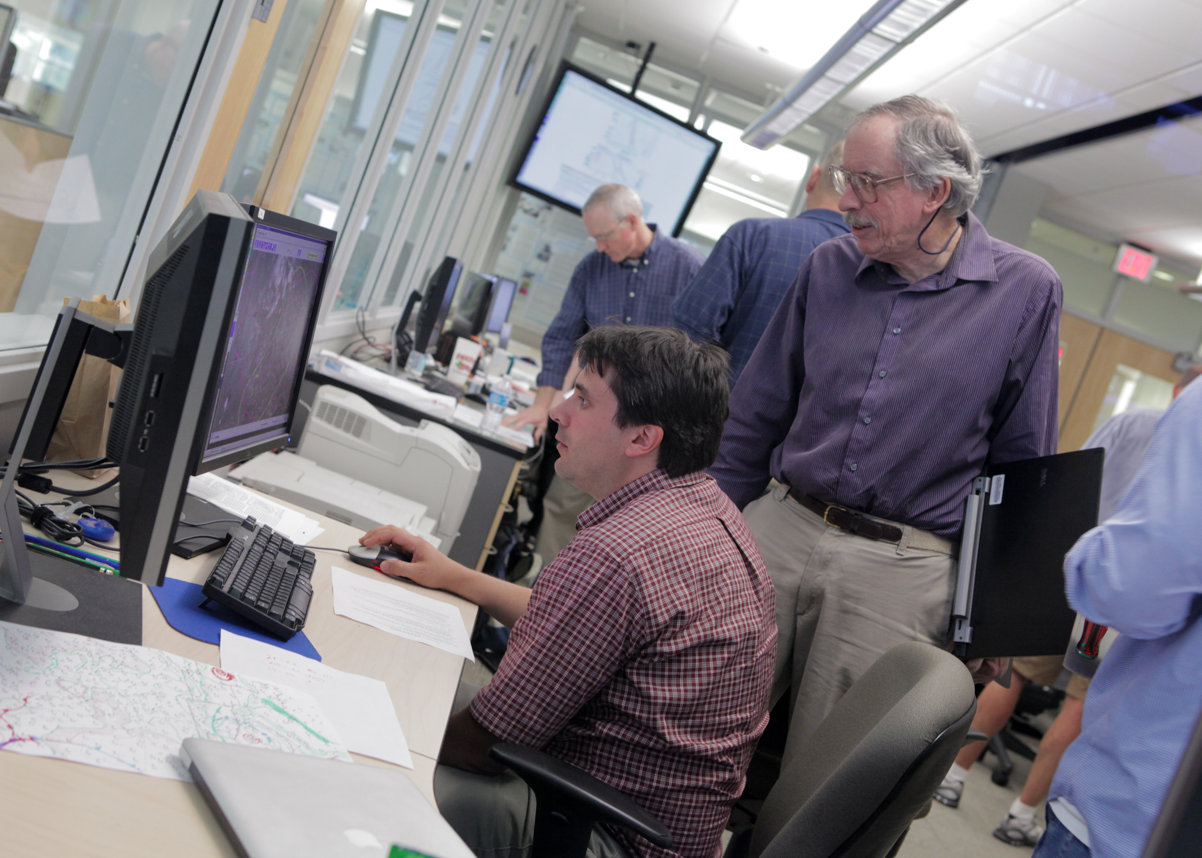
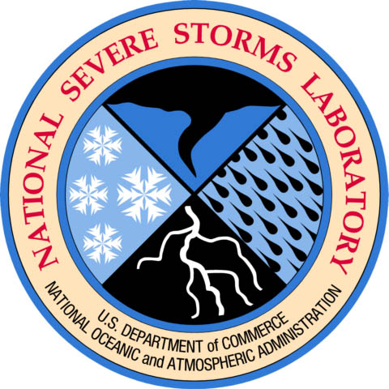
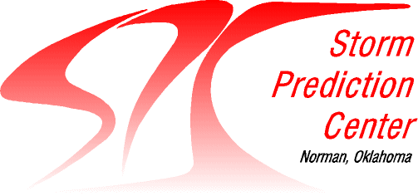
“Bridging Research and Operations: SPC interactions & Field Experiments” by Mike Coniglio
Hometown: Buffalo, NY
Quality: Coniglio won the 2008 PECASE Award, 2009 NSSL Outstanding Scientific Paper Award, and 2012 AMS Kenneth C. Spengler Award
Performance: Coniglio is the first NSSL scientist to work as a forecaster for the SPC, fulfilling a key element of the 1990s NWS re-organization vision
Relevance: Coniglio is a leader in collaborative NSSL-SPC research, infusing scientific knowledge into SPC operations and operational insight into NSSL research activities
Notes:
In the 4th presentation, we would like to highlight the one of the extraordinary assets that we have here in the National Weather Center, specifically the co-location of the National Center for Severe Storms Research and the National Center for Severe Storm Forecasting (SPC). And we would like to talk about how that relationship feeds into our research activities and interactions with other partners. Mike Coniglio will be giving this presentation. Mike is another very promising young scientist with a string of recent awards. And one of the groundbreaking things that Mike has done is become the first NSSL forecaster to become certified and actually issue forecasts for the Storm Prediction Center. We have trying to make this happen since 1997 when the SPC first arrived here in Norman and Mike finally showed us how to cut through the red tape and make it happen. His work is relevant in many ways, but what we would like to emphasize here is the benefit that can come from really working on the front lines of operational forecasters.

Slide 8
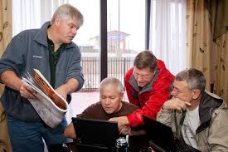
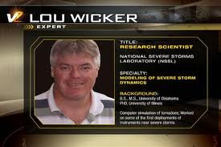
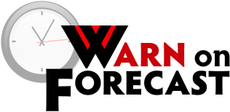
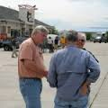
“The Warn on Forecast Program” by Lou Wicker
From:
Rochester, NY
Quality: ~100 peer-reviewed publications last 5 years for WoF Team; significant software contributions (e.g., model improvement, data assimilation) to broader community – R2A
Performance: WoF stakeholders are engaged through frequent communications and annual WoF workshop; Scientific integrity and vision are maintained through collaboration with the WoF Science Advisory Board.
Relevance: Goal from NOAA R&D 5-year Plan: “Establish…technologies needed to produce robust ensemble-based numerical model warnings of severe weather with extended lead times, up to one hour or longer”
Notes:
Lou Wicker, the Program Manager of the Warn-on-Forecast Program, will speak to us on that topic. Lou has a broad range of talents: He is known around the world for his contributions to numerical methods, he played a leadership role in the development of the first mobile Doppler radars and in the VORTEX-2 field program. He was a tenured professor at Texas A&M before coming to NSSL. His presentation will focus on some programmatic aspects of the WoF program, with a few scientific highlights. The WoF team has been very productive under his leadership, with over 100 peer-reviewed publications in the last 5 years and significant software contributions to the research community. He ensures quality and performance within the program through rigorous collaboration with partners and the Science Advisory Board. The scientific goals of WoF are specifically stated in the NOAA 5-year R&D Plan, so you can’t gete more relevant than that.

Slide 9
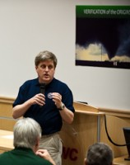
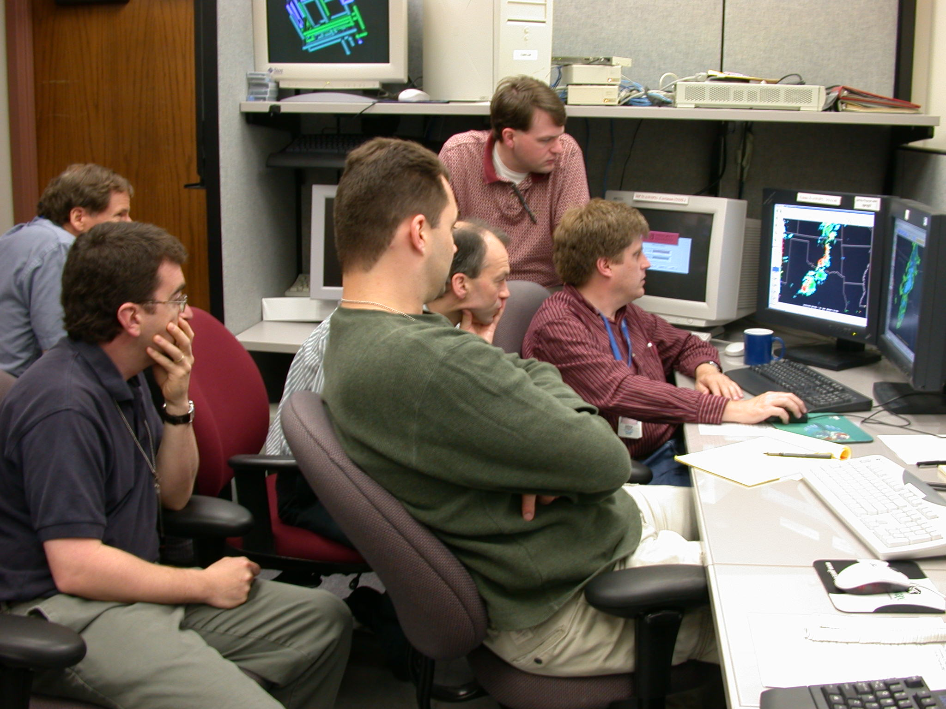
“Severe Weather Climatology and Long-Term Forecasting” by Harold Brooks
Hometown: St. Louis, MO
Quality: Harold won the 2012 NOAA Albritton Award for “outstanding achievement in communicating the meaning and value of NOAA-related science and research to non-scientific audiences”
Performance: Exceptional breadth of contributions, from contributing to the 2006 IPCC team that won Nobel Peace Prize to playing a key role in establishing the European Severe Storms Laboratory to serving on the OKC Mayor’s Storm Safety Task Force
Relevance: Objective from NOAA R&D 5-year Plan: “Apply understanding of weather and climate extremes and the weather-climate linkage to improve preparedness and response”
Notes:
Our last speaker will be Harold Brooks. Harold is widely regarded as an expert in many aspects of Severe Weather and he is an incredibly effective spokesperson for NSSL not only because of his knowledge, but also because of his communication skills. He recently won NOAA’s Albritton Award for his exceptional abilities to communicate to the media and non-scientific audiences. He collaborates with and serves as a consultant for government officials and scientists at all levels, from local cities and towns to major meteorological organizations overseas. And his work is perfectly aligned with NOAA’s plans for R&D.

