Slide 1
Warning Research at NSSL
Dr. David P. Jorgensen (Chief, Warnings R&D Division/NSSL)
February 25–27, 2015
National Weather Center
Norman, Oklahoma

Slide 2
Results from 2009 Review
Worked to improve

Slide 3
Performance
 | 2003-2008 | 2009-2014
Journal Articles | 15 | 45
HWT/EWP Projects -total | 3 | 28¹
Grants for EWP | ~$200k-$300k (2008) | $1.307M (2014)²
¹Does not include HWT-Hydro starting in 2014 in collaboration with WPC
²Grants in 2014 include: NASA/GOES-R risk reduction, OWAQ, Sandy Supplemental, NWS (FACETs), Radar Operations Center

Slide 4
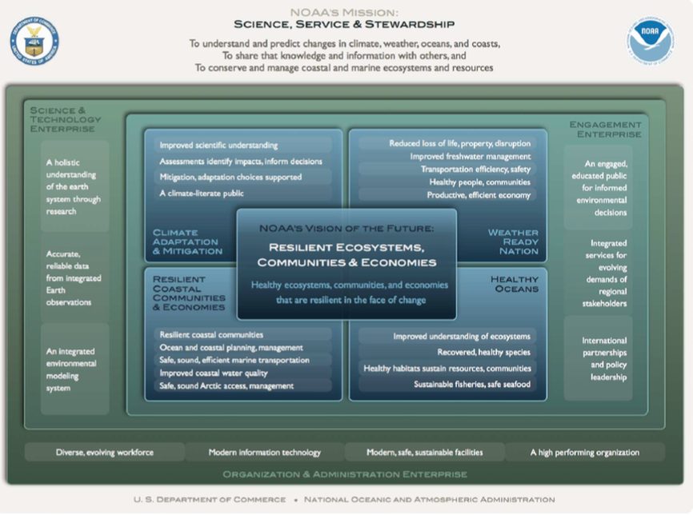
Relevance to Warnings R&D
NOAA Next Generation Strategic Plan
Overarching NOAA Goal: Weather Ready Nation
Objective: Reduced loss of life, property, and disruption from high-impact events
NOAA/OAR 5-year Research Plan (2013-2017)
R&D supporting improved prediction of high-impact events (improved observations, predictive guidance, decision support tools)

Slide 5
Quality
Peer-Reviewed Publications: 45 since 2009
FACETs added to NWS DRAFT Weather Ready Nation Action Plan
WRDD Awards (since 2009)
DOC Gold Medal (2014)
NOAA Bronze Medal (2011)
4 NOAA Outstanding Paper Awards
NWA Operational Achievement Individual Award (2014)
NOAA Technology Transfer Award (2013)
AMS Charles Franklin Brooks Award (2015)

Slide 6
NSSL Grand Scientific Challenges
Warnings R&D Contribution
Probabilistic guidance products Enhanced radar technology Improved flash flood Prediction | Lightning Warnings Observing systems for CI Probabilistic warning uncertainties
GOAL 1: Aim to develop reliable severe convective probabilistic guidance products with a lead-time of 60 min for weather hazards including tornadoes via the Warn-on-Forecast program
FACETS, HWT/EWP
GOAL 4: Attempt to predict useful warnings of lightning activity one hour in advance from the very onset of convection to its demise
EWP (GOES-R), modeling
GOAL 5: Develop and field test innovative atmospheric observing systems needed for reliable nowcasting of convective initiation
LMS, GOES-R
GOAL 6: Provide grid-based probabilistic uncertainty information for high-impact weather to reduce warning false alarms
FACETs

Slide 7
NOAA Priorities
Provide information and services to make communities more resilient
FACETs
Evolve the Weather Service
MRMS-severe, FACETs
Invest in observational infrastructure
Lightning Mapping Array, GOES-R Risk Reduction
Achieve organizational excellence
MRMS transition to operations example

Slide 8
Performance, Quality, Relevance
Experimental Warning Program
HWT Experimental Warning Program History & Successes – Kingfield
Meteorological & Warning Process Studies – Heinselman
GOES-R Research to Operations (R2O) – Calhoun
Forecasting a Continuum of Environmental Threats (FACETs) – Rothfusz
Lightning Research & Forecasting – MacGorman
Warnings R&D Q&A
See also electronic posters

Slide 9
Summary
Successes
MRMS-severe proven technology
Successful MRMS-severe transition to NWS operations
Successful MRMS-severe transition to private enterprise
Muti-Year Reanalysis nearly complete
Remaining Challenges
Prove FACETs and transition to NWS
Integration of FACETs with WoF and flash flood prediction

