Slide 1
Weather Radar Research Overview
Michael Jain (Acting Division Chief, RRDD)
February 25–27, 2015
National Weather Center
Norman, Oklahoma

Slide 2
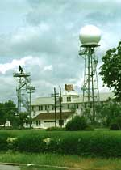
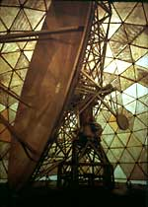
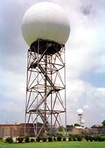
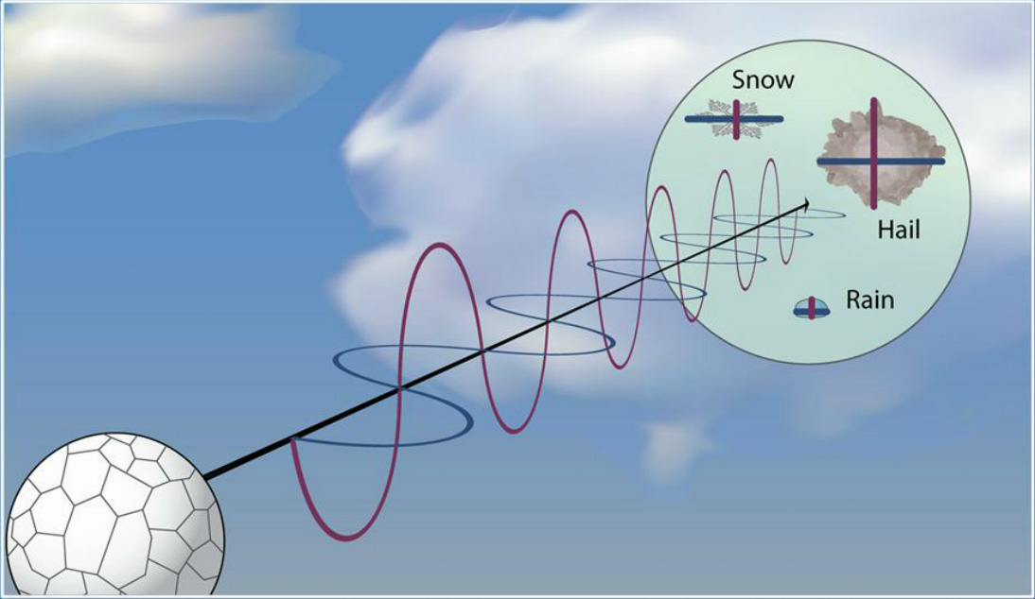
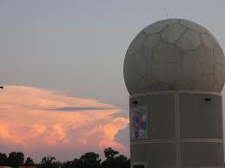
Weather Radar Research & Development
Dual Polarization
Phased Array Weather Radar
WSR-57
Doppler
NEXRAD WSR-88D
NOAA's primary weather radar laboratory with strong scientific and engineering leadership in dual polarization and phased array weather radar
Primary Research to Operations (R2O) Entity for the Operational NEXRAD Radar Network
Co-Technical Lead for the Multifunction Phased Array Radar (MPAR) Program

Slide 3
Quality: Radar Publications
Publication Awards (2009-2014)
1 – International Recognition: WMO Vaisala Award for an Outstanding Research Paper (2010)
2 – NOAA Research Outstanding Scientific Paper (2011, 2008)
(10.5/yr)
(21.8/yr)
Publication Awards (2004-2008)
2 – NOAA Research Outstanding Scientific Paper (2007, 2004)

Slide 4
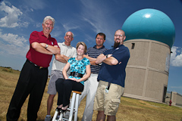
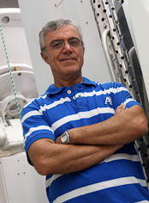
Quality: Radar Researchers
Staff Awards (2009-2014)
NOAA Distinguished Career Award (2014)
NOAA Research Employee of the Year (2010)
NOAA Employee of the Month (2010)
AMS Fellow (2014)
AMS Remote Sensing Prize (2009)
Council of NOAA Fellow (2012)
Staff Awards (2004-2008)
White House Presidential Early Career Award for Scientists and Engineers (2008)
Presidential Rank Award (2004)
NOAA Administrator's Award (2007)
NOAA Team Member of the Month (2008)
AMS Editor’s Award (2007)

Slide 5
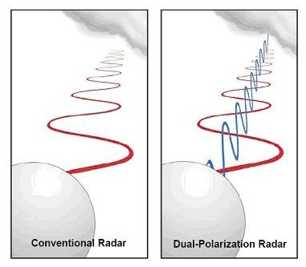
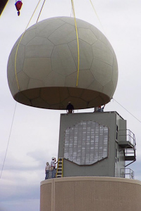
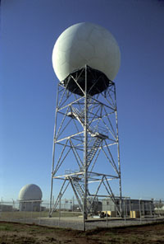
Quality: Radar Technology
Technology Awards (2009-2014)
2 - DOC Gold Medals
2014 – Dual Polarization
2011 – Phased Array Weather Radar
2 - NOAA Technology Transfer Awards (2013, 2010)
Technology Awards (2004-2008)
1 - NOAA Bronze Medal (2008)
2 - NOAA Technology Transfer Awards (2004, 2008)
1 - NOAA High Performance Computing & Communication Tech Award (2004)

Slide 6
Relevance to NOAA Administrator’s Top Priorities
Provide information and services to make communities more resilient
Dual Polarization & Radar Data Quality enhancements to WSR-88D
mPING (Crowdsourcing App – Meteorological Phenomena Identification Near the Ground)
Evolve the Weather Service
Evolving Operational Radar Technologies
Invest in observational infrastructure
MPAR, WSR-88D, Mobile Radars
Achieve organizational excellence
Professional diversity (meteorologists, engineers, software developers, technicians) working closely together to effectively further NOAA Mission

Slide 7
Relevance to OAR Mission
OAR’s Mission …
Conduct research to understand & predict the Earth system
Understanding microphysical processes through polarimetric radar observations & numerical models
Develop technology to improve NOAA science, service and stewardship
Polarimetric-based applications for Hydrometeor Classification, Precipitation Estimation, Data Assimilation
Improved Operational Radar Data Quality
Phased Array Weather Radar Technology
mPING
Transition the results so they are useful to society.
Scientific and Engineering Improvements to the NEXRAD Radar Network
MPAR – next generation of Weather Radar

Slide 8
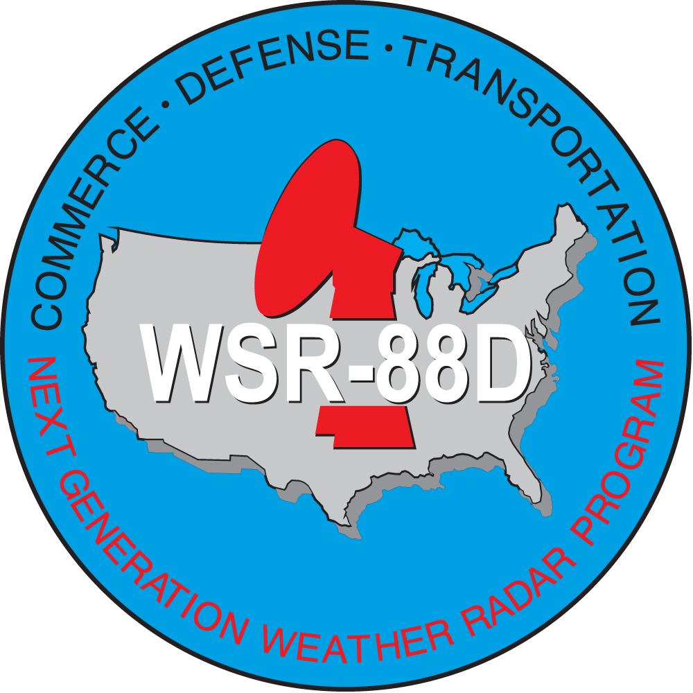
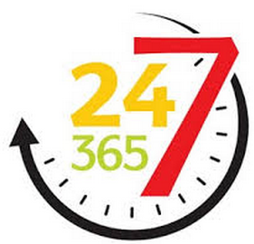
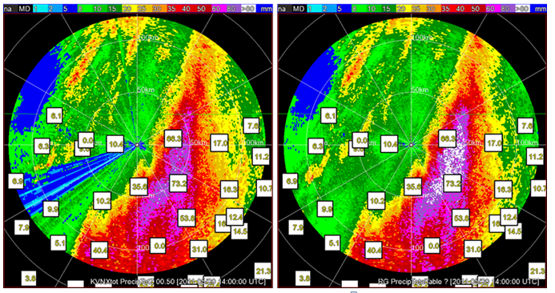
Performance
Technology Transfer (a sampling)
Dual Polarization Upgrade to NEXRAD Network
Addressing Deficiencies Revealed though Operations
Improvements in Data Quality through Signal Processing Techniques
Improvements in Polarimetric Applications
Technical Support to Warning Decision Training Branch (WDTB) for Developing Training Materials

Slide 9
Performance
Engaging Customers & Partners
Coordination with NWS on Planning and Feedback
Long-Standing R2O Agreements
NWS/Office of Science & Technology (OST)
NWS/Radar Operations Center (ROC)
Involve NWS Counterparts in Planning Future Research Elements
Phased Array Radar Innovative Sensing Experiment (PARISE)
Engage NWS Forecasters in Assessment of Rapid Scan Radar Data
NSSL Co-Technical Lead with FAA MPAR Program
Engaged with FAA Counterparts in Planning and Executing MPAR Program

Slide 10
Performance
MPAR Collaborations
Polarimetric, X & C Band Radar Collaborations
Radar Signal Processing Collaborations

Slide 11
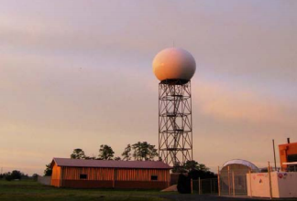
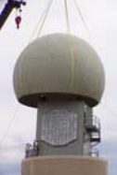
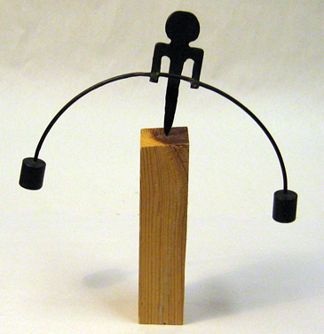
Performance
Major Ongoing Activities
Sustain & Improve Existing Technology
NEXRAD WSR-88D Service Live Extension Program (SLEP)
Working Toward the Future
Multi-Function Phased Array Radar (MPAR)
Challenges
Balancing Resources & Efforts to Support Existing and Future Technologies
Sustaining Funding for Both Technologies

Slide 12
Weather Radar Research (e-posters)
Wednesday 2/25/15
Advantages of Rapid-scan Phased Array Radar Data (Charles Kuster)
Adaptive Scanning on the National Weather Radar Testbed (NWRT) PAR (David Priegnitz)
Increasing the value of NEXRAD's dual-polarization upgrade by improving the quality of correlation coefficient (Igor Ivić)
Thursday 2/26/15
PARISE (Katie Bowden)
PAR to the rescue - Improving clutter mitigation with spatial filtering (Chris Curtis)
Using Bragg Scattering for ZDR (Differential Reflectivity) Calibration (Valery Melnikov)

