Slide 1
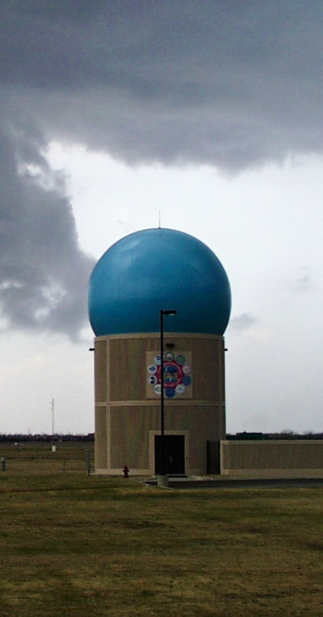
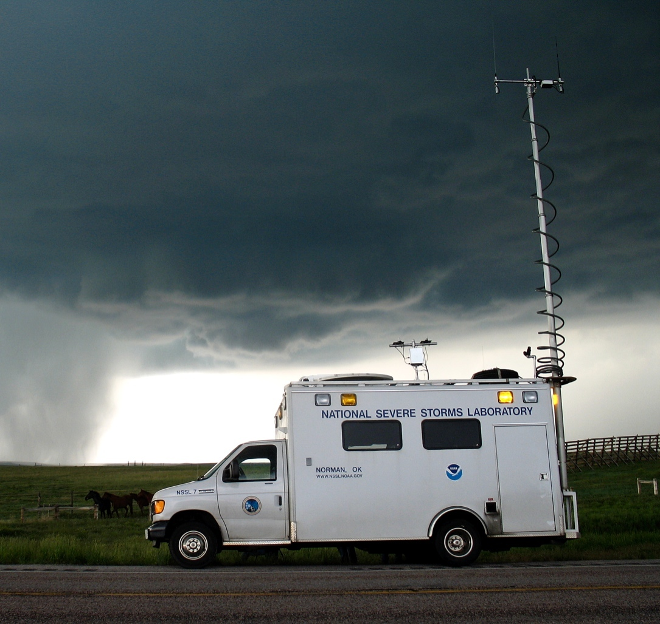

Multi-Radar/Multi-Sensor – Transition to Operations
Kenneth W Howard (NSSL/WRDD/SHMET)
February 25–27, 2015
National Weather Center
Norman, Oklahoma

Slide 2
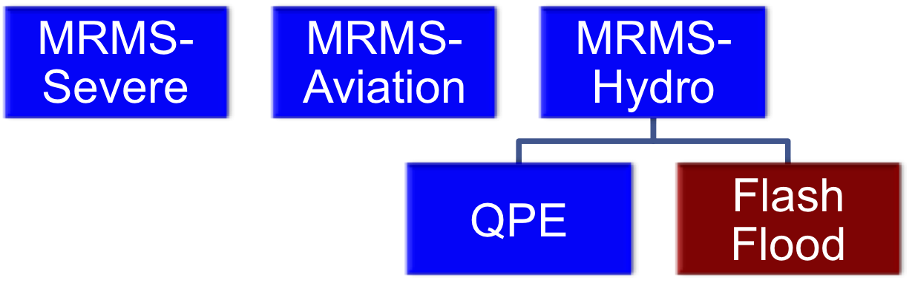
What is Multi-Radar/Multi-Sensor (MRMS)
a research and operational system for the integration and assimilation of multiple sensor observations and numerical analysis/prediction fields for the identification and short term prediction of hazardous weather.
Approaching 500,000 lines of code and scripts
Generates 1,600 CONUS product grids and data sets per day
80% of the MRMS products have never been operationally available

Slide 3

Why MRMS?
2000
2002
2004
2007
2011
The MRMS system was specifically conceived and designed to address the objectives of and to support Weather Ready Nation, NextGen Weather, and Integrated Water Resource Services (IWRS) initiatives.

Slide 4
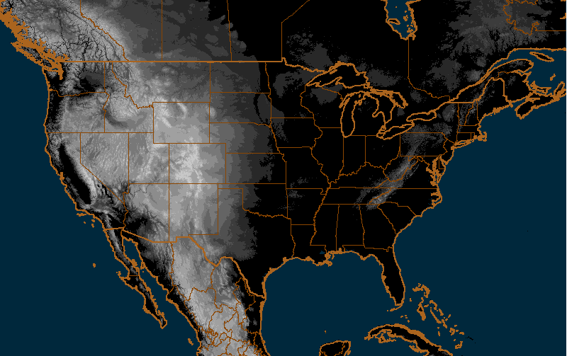
MRMS Domain
~140 WSR-88D 31 Canadian 19 TDWR 1 TV station radar
Notes:
This is the domain map of the NMQ system.
Currently we are ingesting radar data from 140+ WSR-88Ds, 31 Canadian radars, 2 TDWRs, and 1 TV station.
And the software design is modularized and is flexible for ingesting any new radar data such those from CASA.

Slide 5
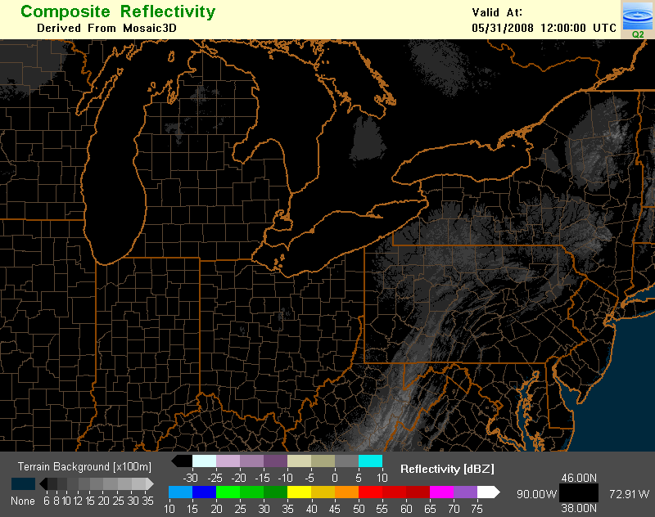
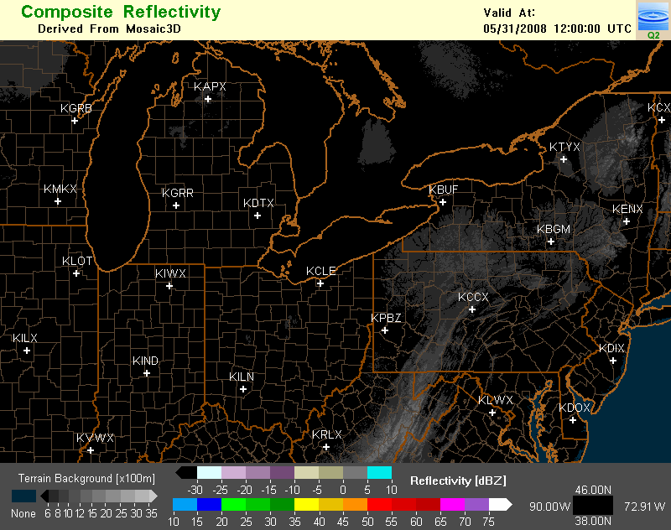
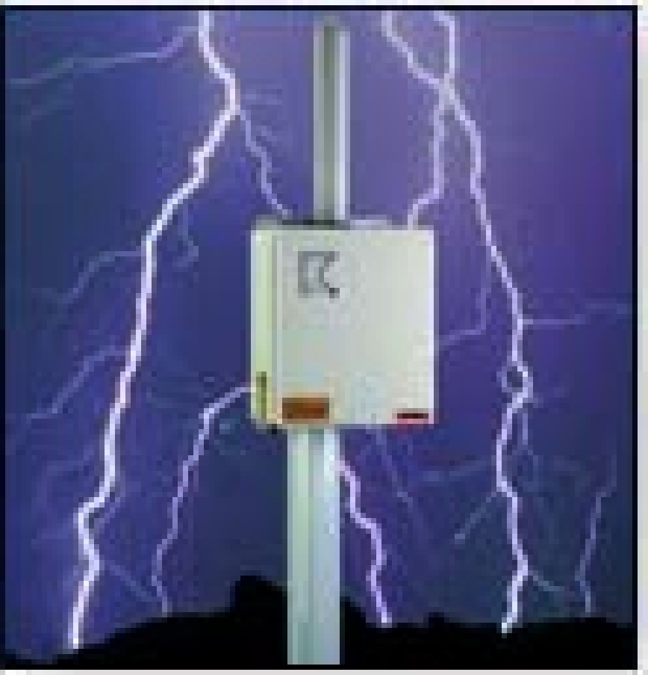
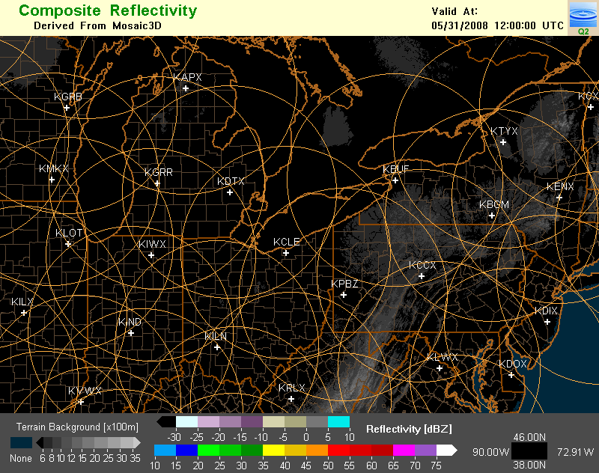


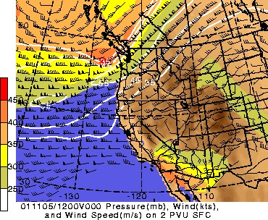
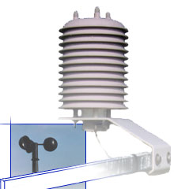
Integrated multiple sensor approach to high resolution
rendering of storms and weather
Lightning
Radar Networks
Upper Air
Satellite
Models
Sfc Obs
5
Notes:
5

Slide 6
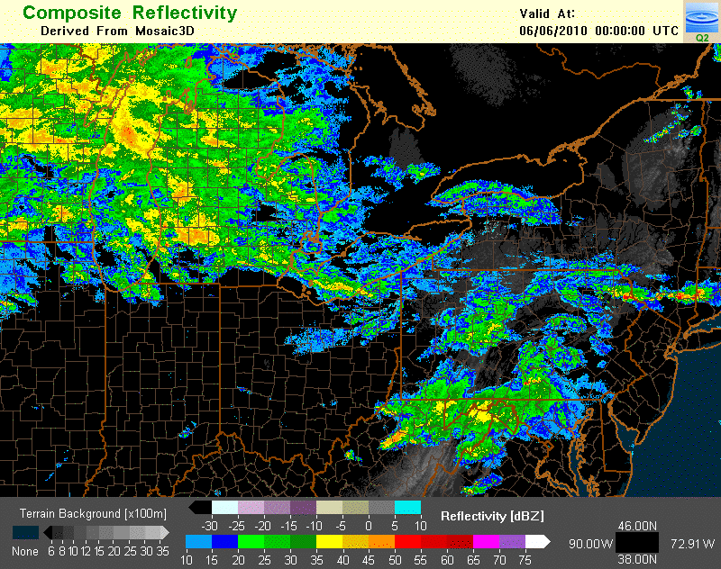
Integrated multiple sensor approach to high resolution
rendering of storms and weather
Lightning
Radar Networks
Upper Air
Insert MRMS_Loop3
Satellite
Models
Sfc Obs
Notes:
6

Slide 7
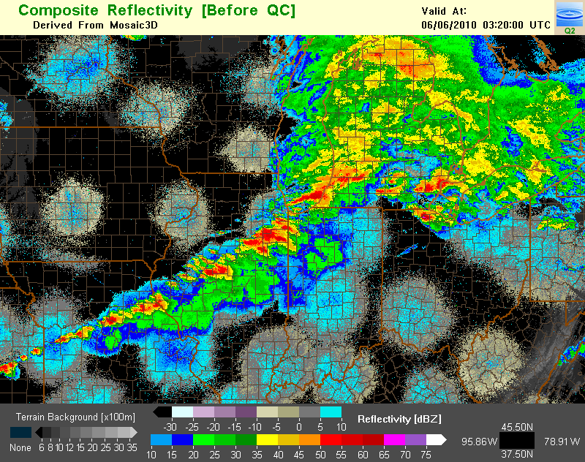
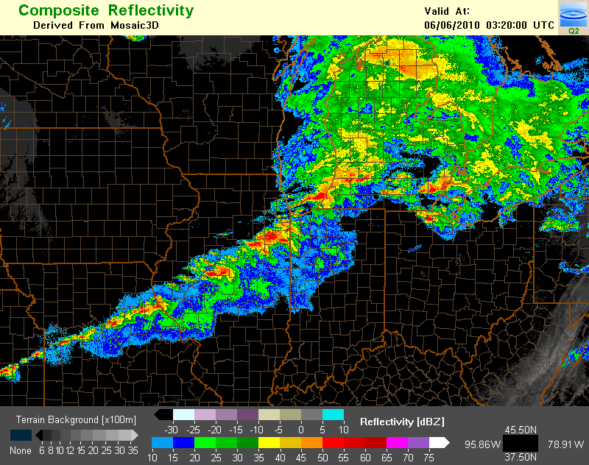
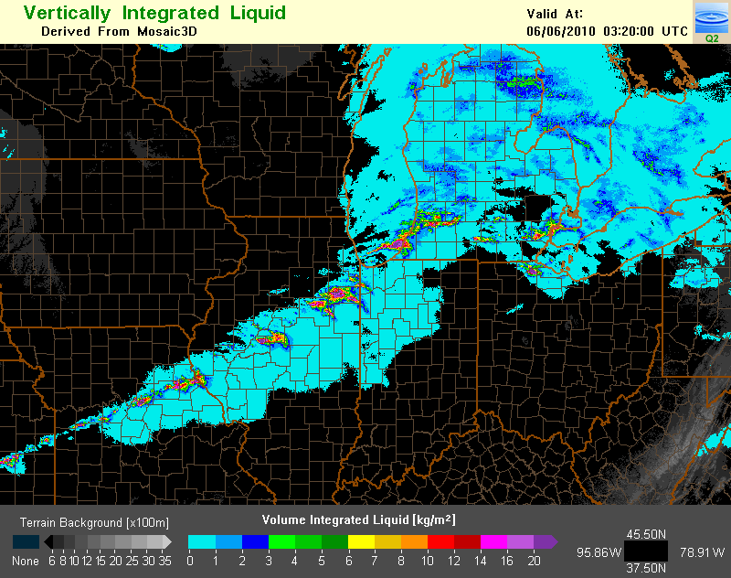
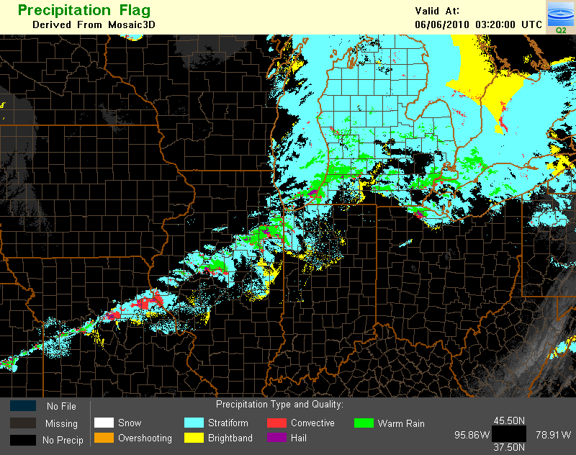
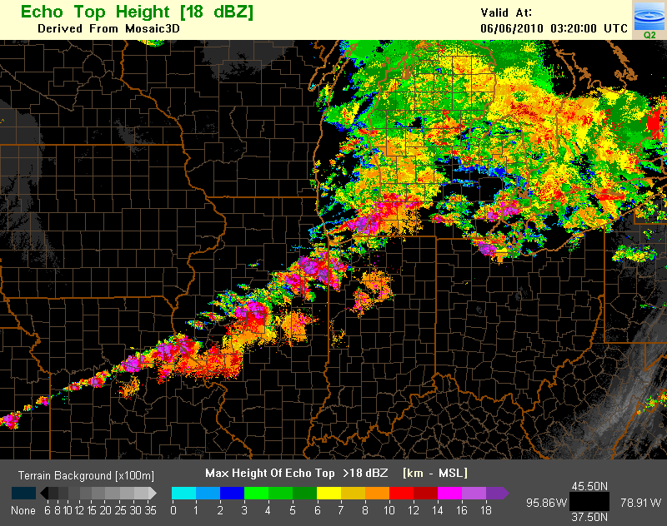
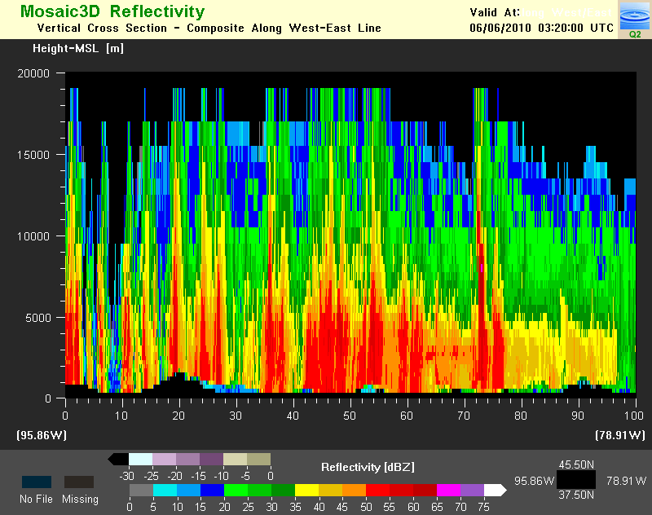
Integrated multiple sensor approach to high resolution
rendering of storms and weather
Lightning
Radar Networks
Upper Air
Satellite
Models
Sfc Obs
Notes:
7

Slide 8
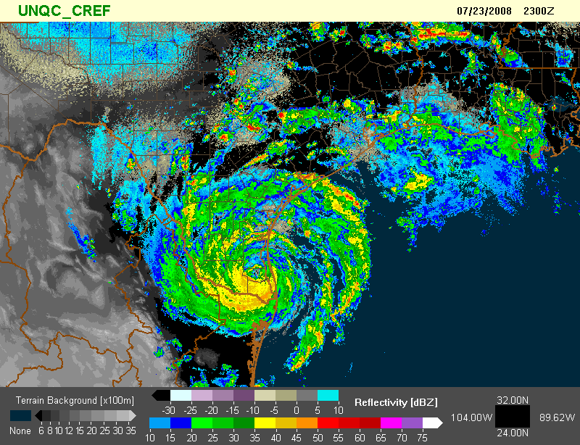
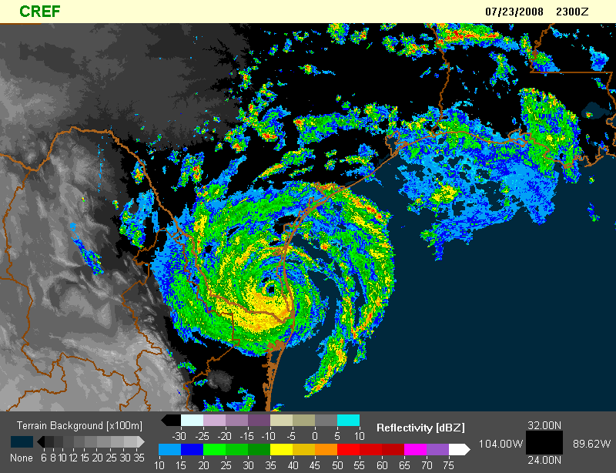
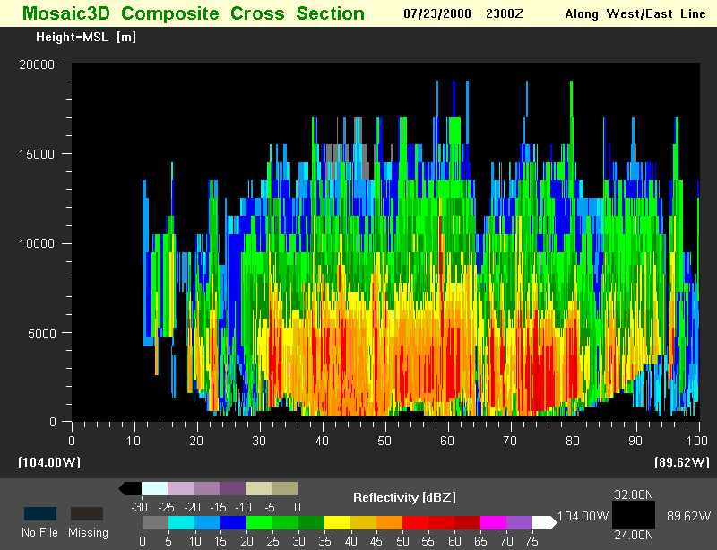
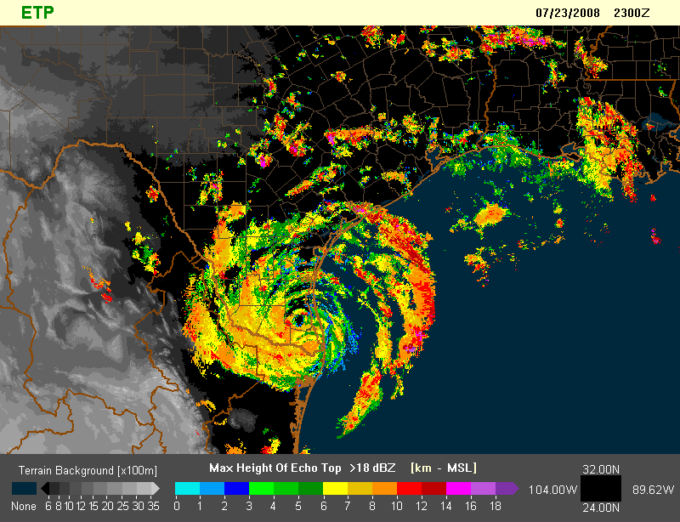
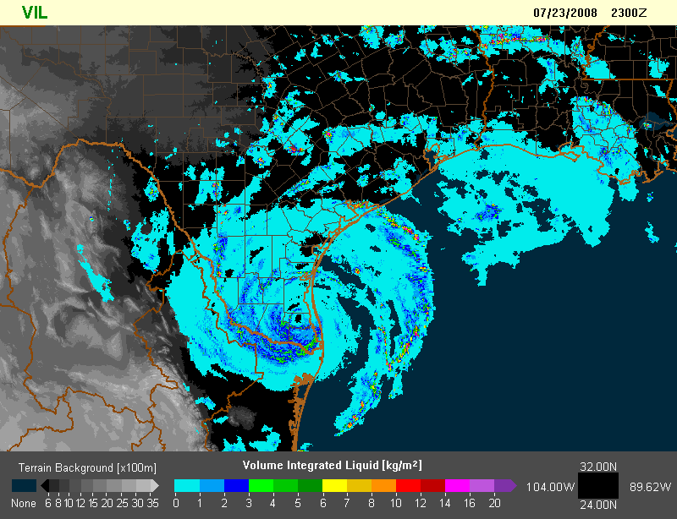
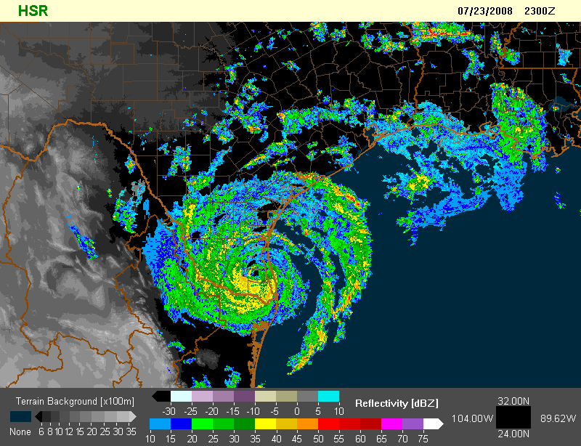
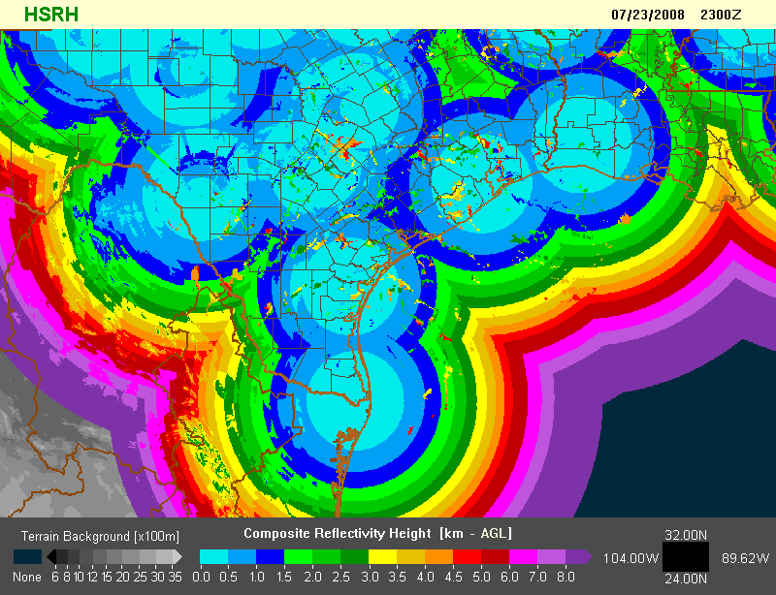
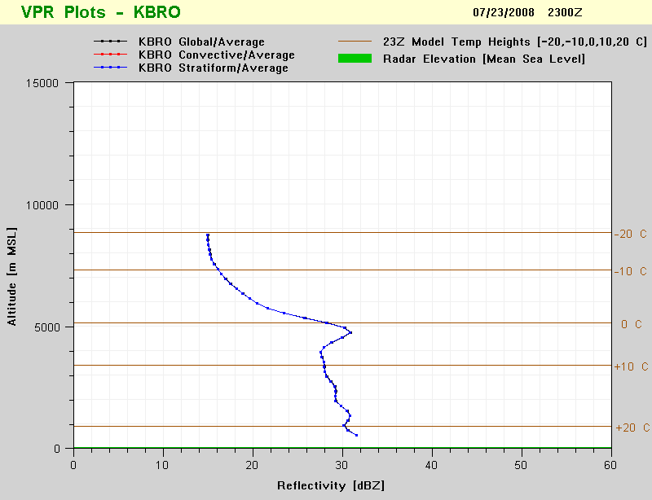
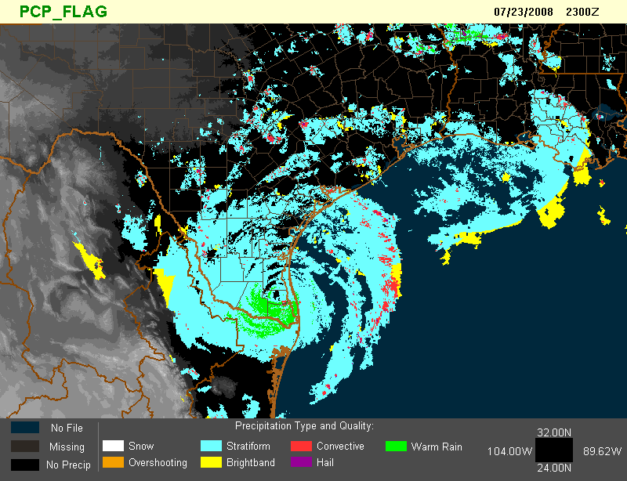
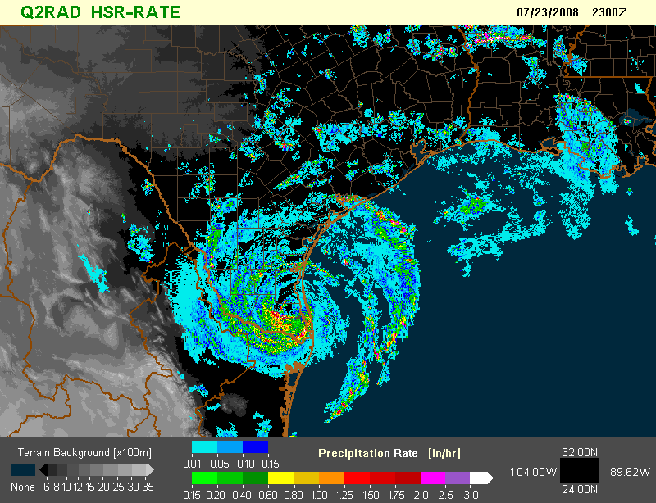
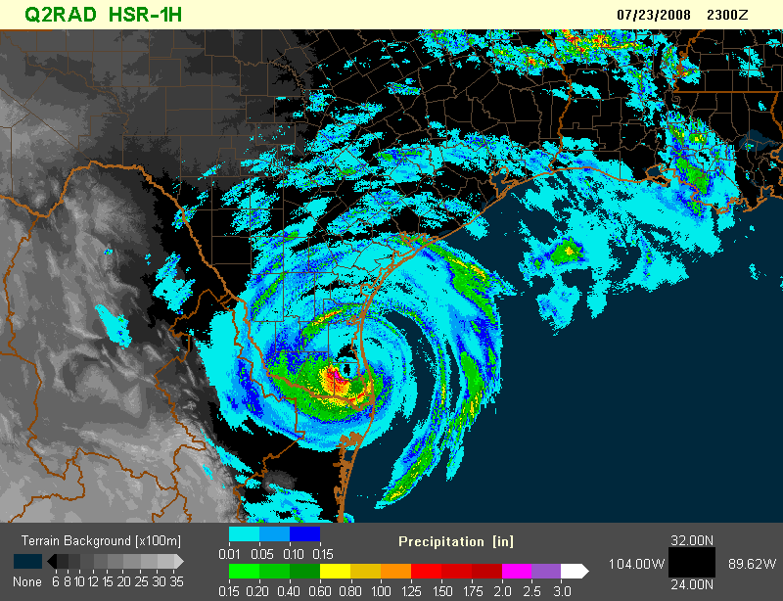
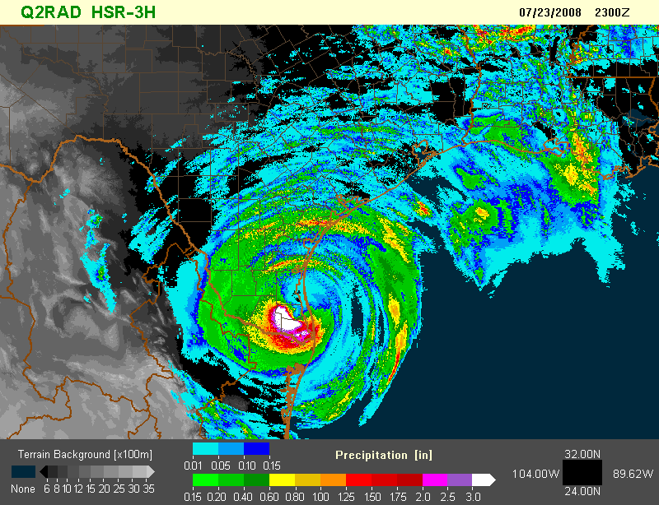
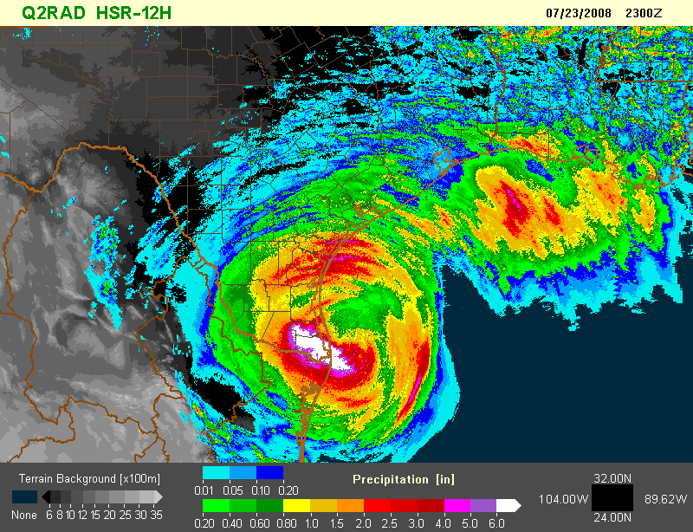
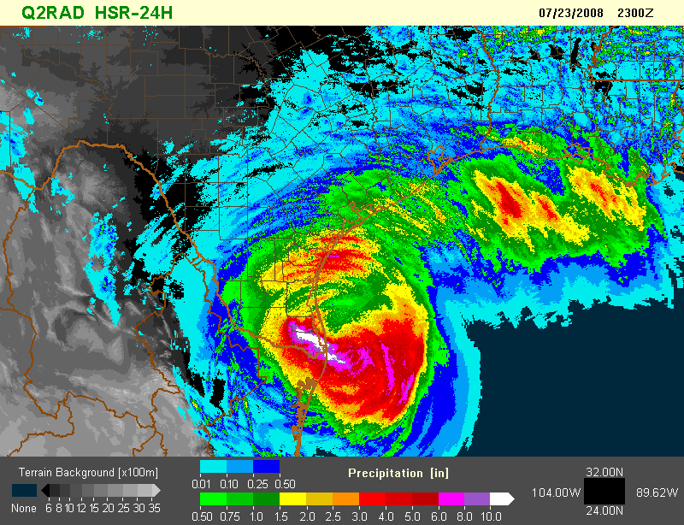
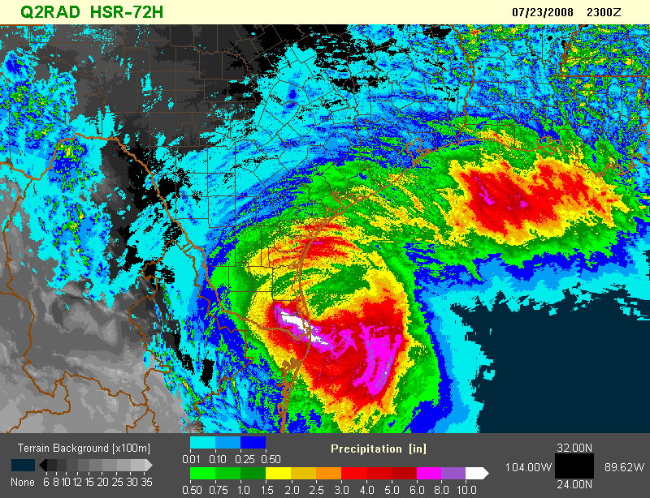
MRMS Reflectivity, Precipitation & Diagnostic Grids
MRMS produces and disseminates a suite of 100+ high resolution product grids over North America (1-km, 2 to 5 minutes) for use in model data assimilation, severe weather, aviation and hydrometeorology (flooding and water resource management).

Slide 9
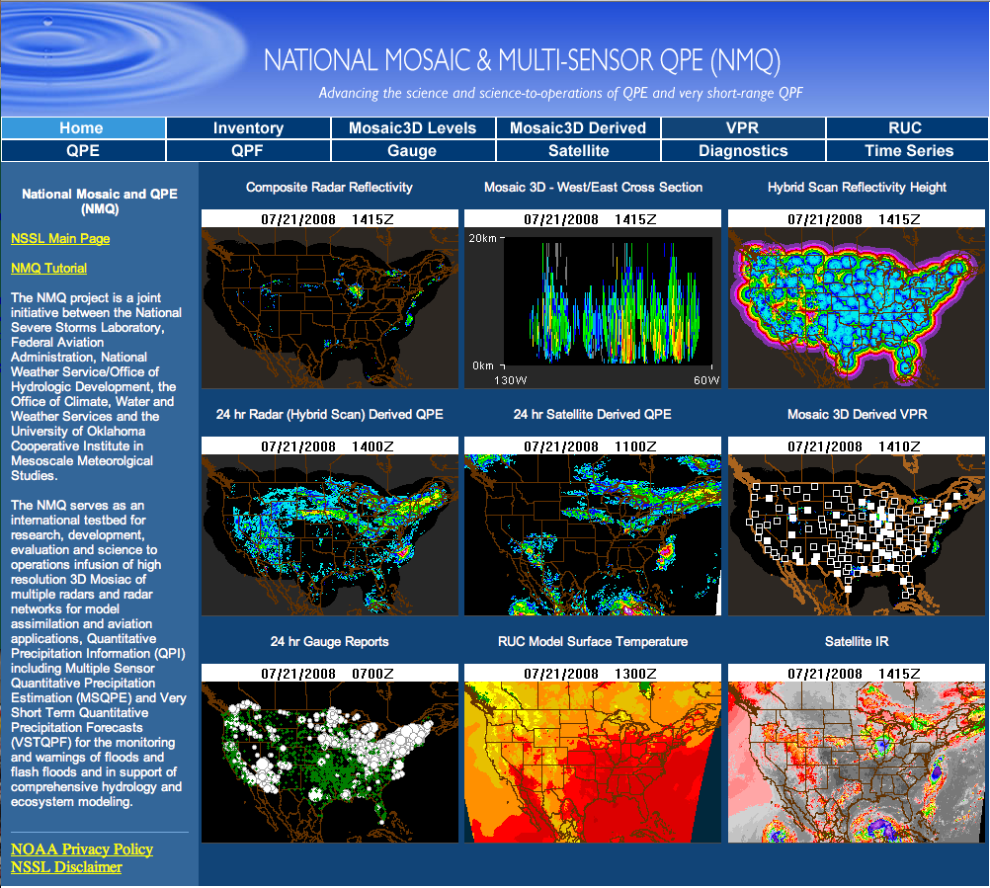
Transparency - MRMS Web Portals
mrms.ou.edu
wdssii.nssl.noaa.gov

Slide 10




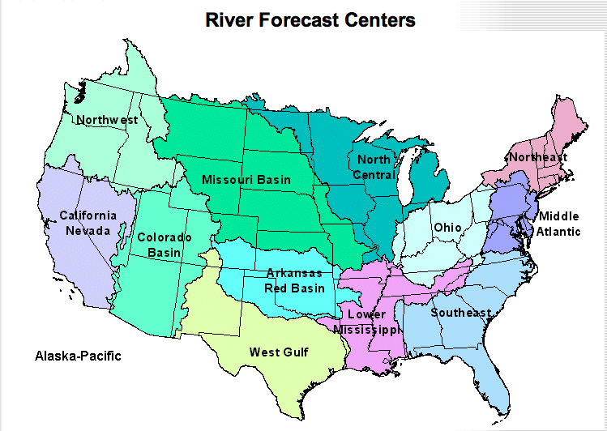







MRMS Collaborators and Product Distribution

Slide 11
MRMS System Expansion
Seamless Integration of Radar Advances, Systems, and Networks
2008 | 2009 | 2010 | 2011 | 2012 | 2013 | 2014 | 2015 | 2016 | 2017 | 2018 | 2019 | 2020 | 2021 | 2022
Canada Network
Commercial Radars
WSR88D High Res
WSR88D DoD L2
TDWR Network
Hawaii WSR88Ds
88D Dual Polarization
Alaska WSR88Ds
Caribbean Network
1km/5min 1km/2.5min 1km/2min 500m/2min 250m/1min
North America Resolution and Refresh Rate
Notes:
_{Find}

Slide 12
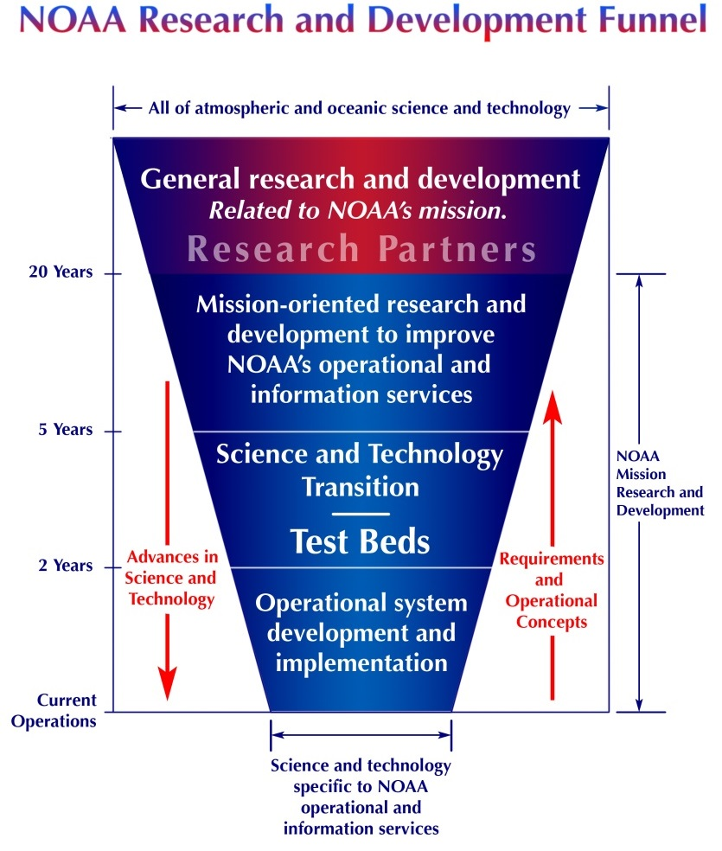
Road to MRMS Implementation
❶ | Pre-06 | General R&D on decision support and quantitative precip estimates using radar
❷ | Oct 06 | MRMS enters NWS transition process
❸ | Nov 10 | MRMS running at FAA Tech Center
❹ | Dec 10 | MRMS approved as an official NOAA Line Office Transition Project
❺ | May 13 | Funding for MRMS transition
❻ | Aug 13 | MRMS Implementation Project charter signed
❼ | Aug 13 – Sep 14 | MRMS enters final development and testing at NCEP
❽ | Sep 14 | MRMS went operational at NCEP
❶
❷
❸
❹
❺
❻
❼
❽

Slide 13
MRMS R2O Success
Having The Right People who know The Right Stuff
  A NSSL team worked directly with NCEP NCO staff on the operational implementation including on site training and interactions
A R&D Environment that functions Operationally
  NSSL built and maintains a real time MRMS system processing environment nearly identical to NCEP in content and data flow to test and evaluate new science and technologies for operational implementation (R2O).
  Seamless Transition

Slide 14
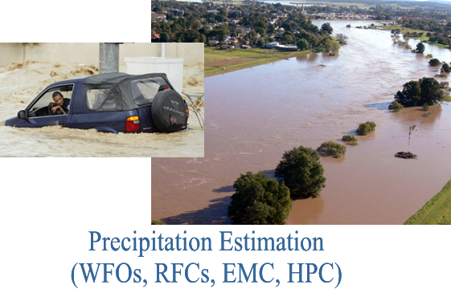
MRMS Benefits Hydrology
Increases effective precipitation estimation coverage in “radar hostile” regions (terrain, bright-band, hail) by up to 35%
Provides measured improvements in data QC removing false precipitation echoes, which improves the RTMA, and reduces inaccurate precipitation estimates and unnecessary flash flood warnings.
Greatly benefits the Western U.S., where there is a combination of major flooding vulnerability and radar coverage gaps.
Integrates lightning sensor data to apply advanced precipitation segregation (convective, stratiform) for more accurate rainfall rates
“MRMS/Q2 provides precipitation estimates from portions of southwest Texas, western New Mexico, south central Colorado and Mexico where few if any other sources of precipitation data exist. This area has now experienced major flooding in two of the past four years due to dissipating tropical systems. The loss of Q2 would, in short, mean the loss of what we have seen to be our most accurate radar-based QPE.”
– Greg Story (West Gulf RFC).
The river stage forecast errors in some basins are reduced by up to 1 meter using MRMS/Q2. This improved accuracy will lead to major savings in flood mitigation efforts (e.g., sandbagging, evacuations).

Slide 15
MRMS Transition into NCEP Operations
MRMS has been installed on the National Weather Service’ (NWS) Integrated Dissemination Program (IDP) Phase II processing farm at NCEP in College Park, MD
Initial MRMS configuration product suite operational in Sept 2014
Major MRMS product updates Sept 2015 and July 2016
MRMS full backup system located on the NWS IDP processing farm in Boulder, CO (to be completed in March 2015)

Slide 16
MRMS activities 2015-2016
MRMS will provide back-end processing for NWS radar mosaic and single radar products for public website (FY15) - MRMS will become a single authoritative source CONUS wide mosaics
Recast portions of MRMS into Gridpoint Statistical Interpolation (GSI) framework at EMC for improved data assimilation
Expand MRMS domain to Alaska, Hawaii, PR, Guam, and western Pacific
3 month update cycle for new products and applications

Slide 17
Summary
MRMS Implementation Project provides a example of good practices to transition R&D as well as lessons learned for future transition projects.
It took the very best of NSSL to implement a world class system to address some of meteorology's most difficult operational challenges.
And we are not done…
“Most unsuccessful programs fail at the beginning.”
Steven R. Meier, “Best Project Management and Systems
Engineering Practices,” Project Management Journal, Vol 8, Issue 1, March 2008

Slide 18
MRMS Web Portals - Transparency
http://nmq.ou.edu/
http://wdssii.nssl.noaa.gov/

