Slide 1
Multi-Function Phased Array Radar (MPAR)
Kurt D. Hondl (NOAA/NSSL)
February 25–27, 2015
National Weather Center
Norman, Oklahoma

Slide 2
Q) Why Phased Array Radar?
To meet NOAA’s evolving requirements
for radar observations.
Faster Volume Updates
Improved Probability of Detection (POD) and False Alarm Ratio (FAR), increased tornado warning lead-times
Data assimilation into numerical weather models (Warn On Forecast)
Electronic Adaptive Scanning
Based on prioritization – Scan when and where needed
These benefits are not possible with the WSR-88D

Slide 3
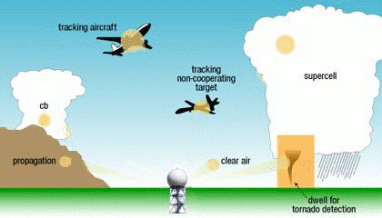
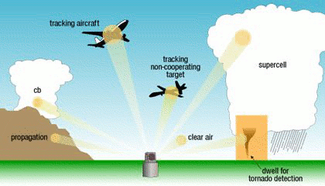
Electronic Scanning
http://wdssii.nssl.noaa.gov/web/wdss2/products/radar/MPAR/par_scan.shtml
Conventional scanning
Sequential scanning only
(including “clear” air)
NEXRAD
Electronic Adaptive scanning
Concentrates radar
only on areas of concern
Phased Array Radar
Notes:
Faster scans by concentrating on areas of interest
Potentially better data (due to non-moving antenna so no smearing)
Faster re-visit times for selected targets (aircraft or tornadoes)
Different scans for aircraft vs weather vs biological targets

Slide 4
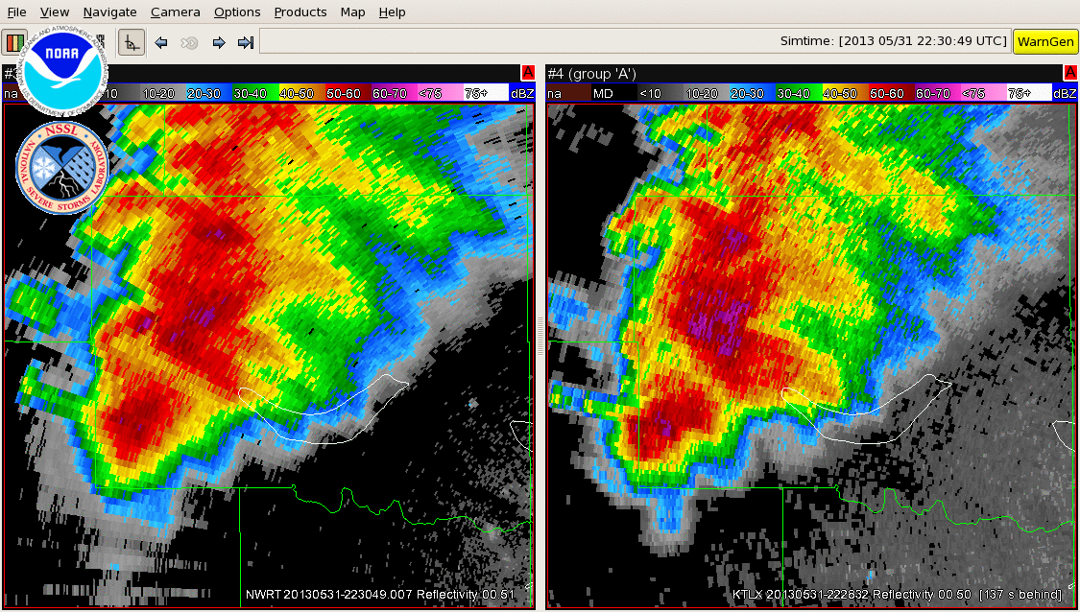
El Reno EF3 Tornado 31 May 2013
http://wdssii.nssl.noaa.gov/web/wdss2/products/radar/MPAR/NWRT/ELReno_NWRTPAR.gif
Transition to tornadic storm seen earlier and more clearly by Phased Array Radar
Direction of tornado path captured better by Phased Array Radar
NWRT/PAR: 1.2-min updates
WSR-88D: 4.2-min updates

Slide 5
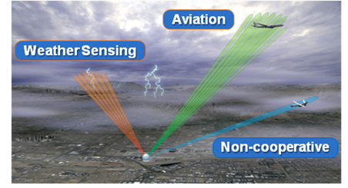
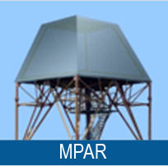
MPAR Concept
ASR-8
ASR-9
ASR-11
TDWR
WSR-88D
CARSR-1/2/3
ARSR-4
FPS
Weather
Radar
Aircraft
Radar
Eight System Types
Single System
Single Mission
Multi-Mission
Legacy Requirements
Legacy & Emerging Requirements
Non-Scalable
Scalable to Mission Needs
Mechanically Rotating
Electronically Steered
Multiple Maintenance, Logistic and Training Programs
Consolidated Maintenance, Logistic and Training Programs

Slide 6
NSWRC and MPAR
Potential savings of $1.8B in acquisition costs by reducing the total number of radars from 554 to ~365
(2006 Office of the Federal Coordinator for Meteorology report)
Federal Enterprise MPAR Deployment
DoD/DHS Participation Accommodated
Adds Replacement of CARSR/ARSR-4/FPS (122 radars)
FAA NOAA Collaboration
Adds NWS WSR-88D replacement (156 radars)
NOAA providing funding and in-kind support
FAA NSWRC
NextGen Surveillance & Weather Radar Capability
Program of Record
Replaces ASRs and TDWR (276 radars)
Engaged in MPAR risk reduction
Other options are being considered

Slide 7
MPAR R&D Focus Areas
Acceptable Cost
Exploit Commercial Technology
Fewer Systems Overall
Economies of Scale
Graceful Degradation
Single Logistics & Maintenance System
Multi-Functionality
Resource Management
One System that Meets Multiple Needs
Data Sharing and Operational Flexibility
Dual Polarization Capability
Unique Weather Requirement of WSR-88D
Improved Clutter Rejection & Aircraft Detection

Slide 8
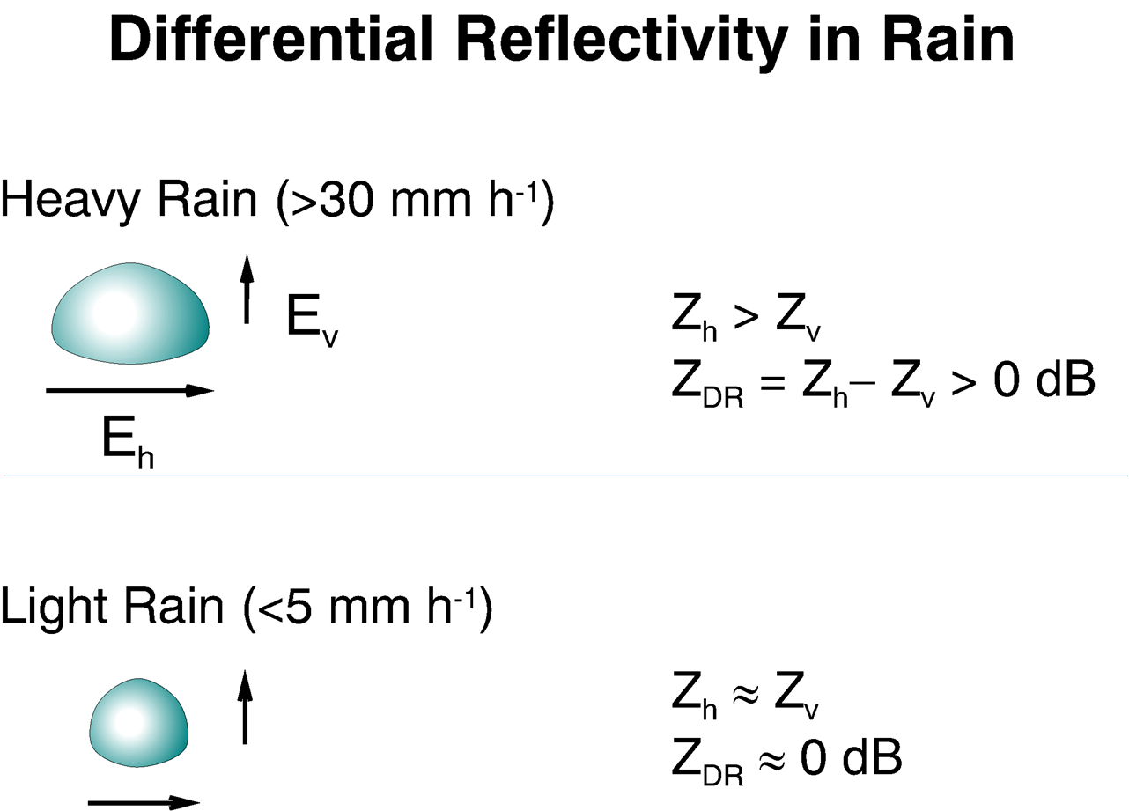
Differential Reflectivity
Larger drops -- Diameter ~ 4.0 mm
Larger rain drops are oblate
Smaller rain drops are more spherical
Smaller drops -- Diameter ~ 0.5 mm
Z_{H} needs to be parallel to the earth at all viewing angles to effectively capture the aspect ratio of the rain drop.
Notes:
WSR-88D recently upgraded to send out horizontal and vertical polarizations.
Use the difference in horizontal and vertical returns signals to provide info on particle size/shape
Need to be able to measure that very small difference

Slide 9
Electronic Scanning
Broadside beam
(beam is perpendicular to the array face)
E_{V} and E_{H} are orthogonal
Off-Broadside beam
(beam is not perpendicular to the array face)
E_{V} and E_{H} are skewed
1.5°
2.1°
E_{V}
E_{V}
E_{H}
E_{H}
Beam is elliptical in shape and H is not parallel to the surface of the earth
Beam is circular in shape and H is parallel to the surface of the earth
Phased Array Antenna
Phased Array Antenna

Slide 10
MPAR Activities
National Weather Radar Testbed / Phased Array Radar (2003-2014)
Meteorological phenomena studies, Adaptive scanning, Warning decision-making process, Multi-function demonstration
MPAR-Sponsored Studies (2010-2014)
Siting study, Spectrum analysis, Preliminary cost study, Microburst / Windshear assessment, Backend analysis
Industry Engagement
Request for Information (2012)
Industry Day (2012)
Sponsored Industry Studies
Phased Array Radar Dual Polarization Engineering Approaches (2012)
Antenna Design and Life Cycle Cost Estimation (2013)
Cylindrical Polarized Phased Array Radar (2011-2105)
OU/ARRC proof of concept demonstrator, CPPAR Design study
10-Panel Dual Polarization Demonstrator Development (2012-2015)
MIT/LL Gen 2+ panel technology, OU transceivers, Final assembly in progress
Advanced Technology Demonstrator (ATD) Design (2014-2015)
Preparing for evaluation prior to FAA/NSWRC Initial Investment Decision (IID)
NOAA/FAA
Activities
Industry Activities
Technology Development Activities

Slide 11
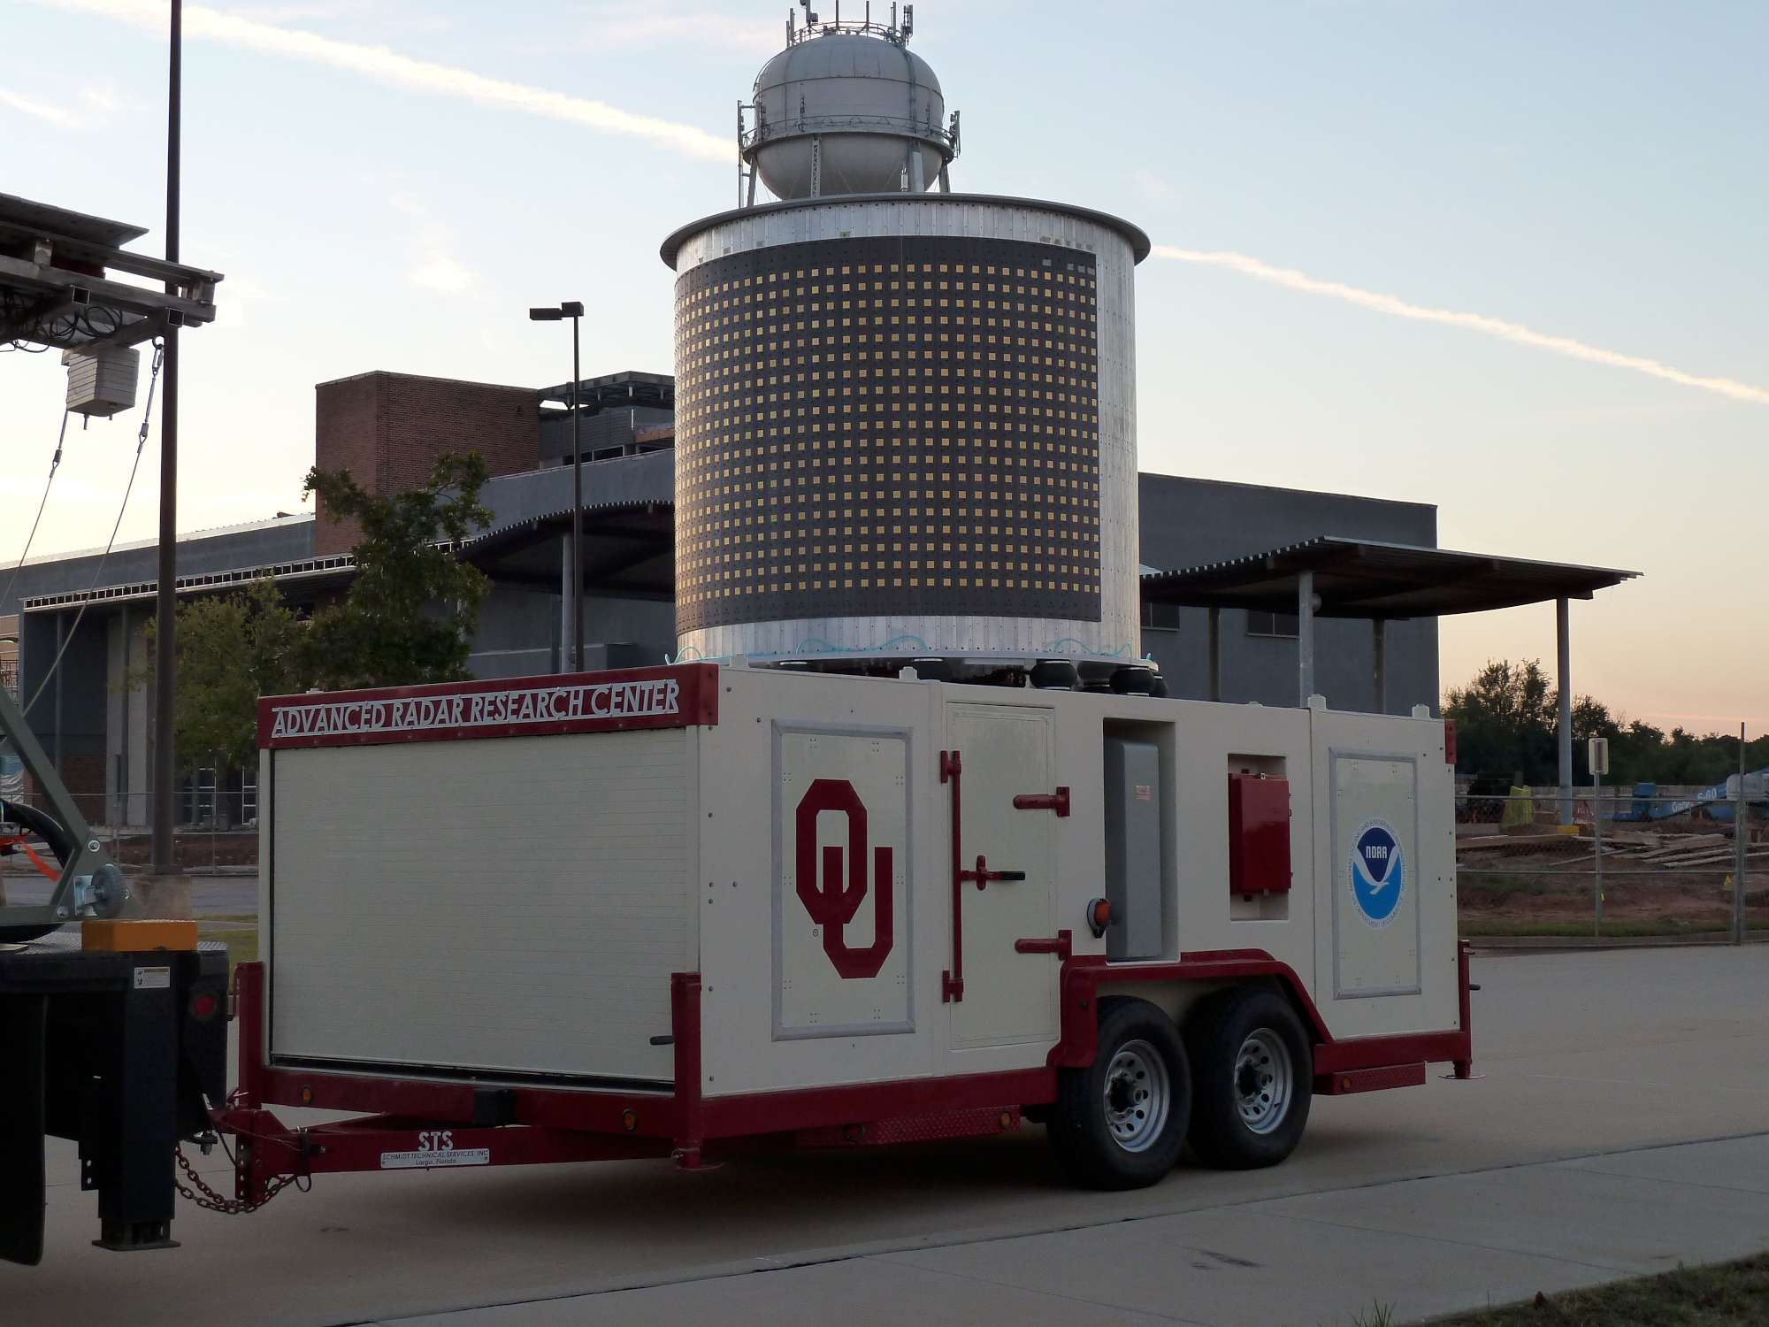
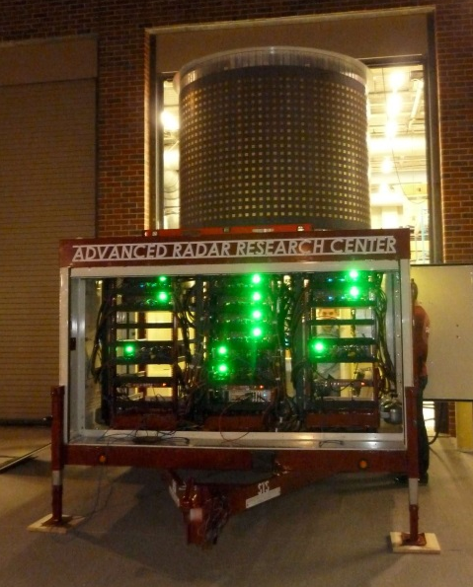
Cylindrical Polarized PAR (CPPAR)
Developed by OU Advanced Radar Research Center (ARRC)
CPPAR Objectives
Demonstrate properties of cylindrical arrays
Scan strategies
Dual polarization performance
Calibration concept
Gain understanding of cylindrical array benefits and limitations
Joint NSSL & ARRC full-scale CPPAR design study 2013-2014
Included all-digital radar architecture
Initiated all-digital array design (fall 2014)

Slide 12
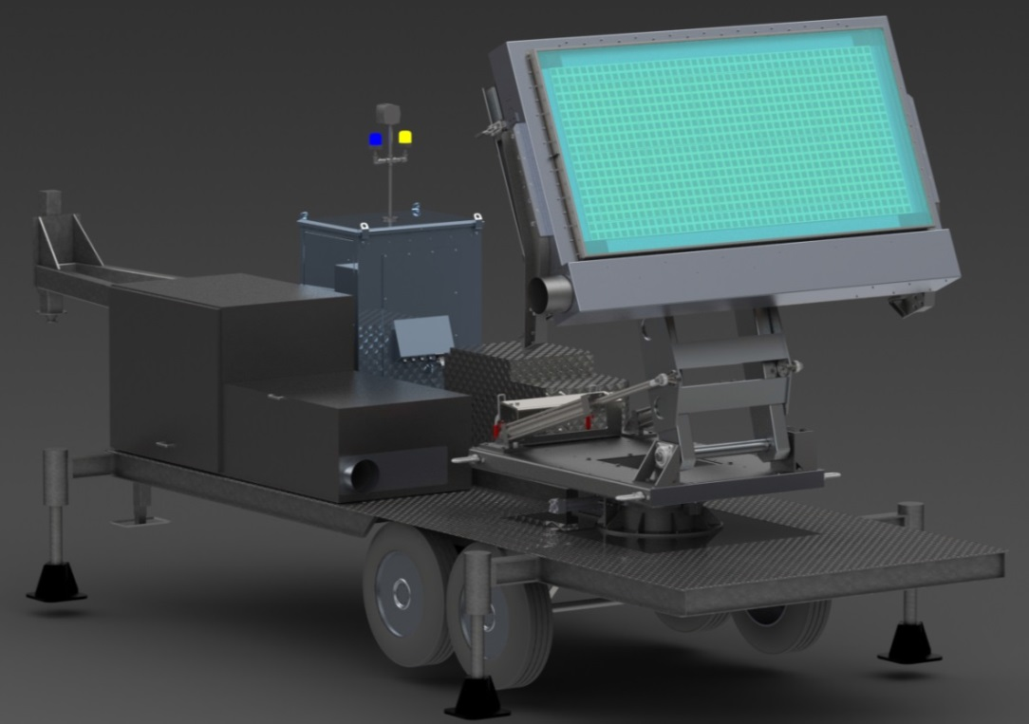
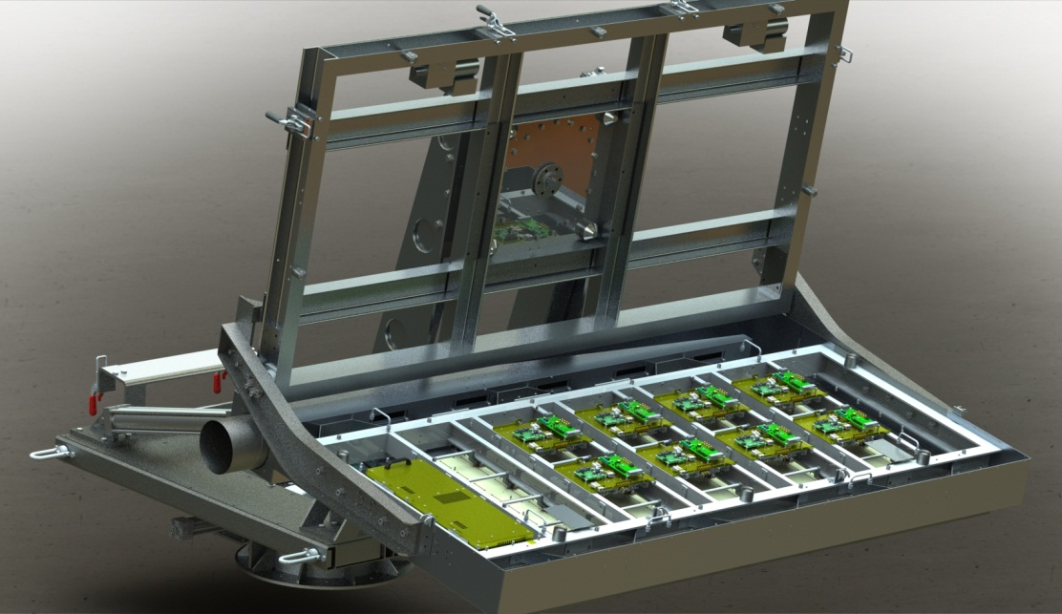
10-Panel Dual Pol Demonstrator
Developed by MIT/Lincoln Laboratory
Dual Polarization Panels
Successive generations of design starting in 2007
Previous funding provided by FAA, and USAF. Demonstrator funded by NOAA.
10-Panel Demonstrator Objectives
Demonstrate sufficient progress towards identified risk areas
Dual polarization performance
Calibration concept
Thermal management
Testing at NSSL during spring 2015
Evaluation for FAA Investment Analysis Readiness Decision (IARD, Dec 2015)
Is the MPAR concept mature enough to be included in the analysis of alternatives?

Slide 13
Dual Polarization Evaluation
Light rain: Zdr at vertical incidence
Radar should see near 0 Zdr values at all pointing angles. Retest after rotation azimuth ±90-deg
Z
X
Vertical Scan

Slide 14
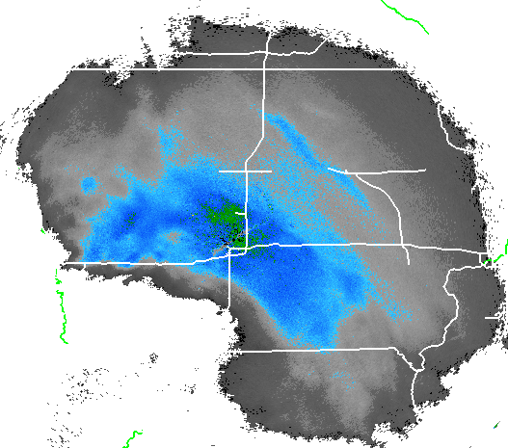
Dual Polarization Evaluation
Y
X
Horizontal Scan
Area sampled by 5 different scanning angles
Self Consistency Check
Successive scans of the same storm at different angles will allow an inter-comparison to validate polarization calibration and correction procedures

Slide 15
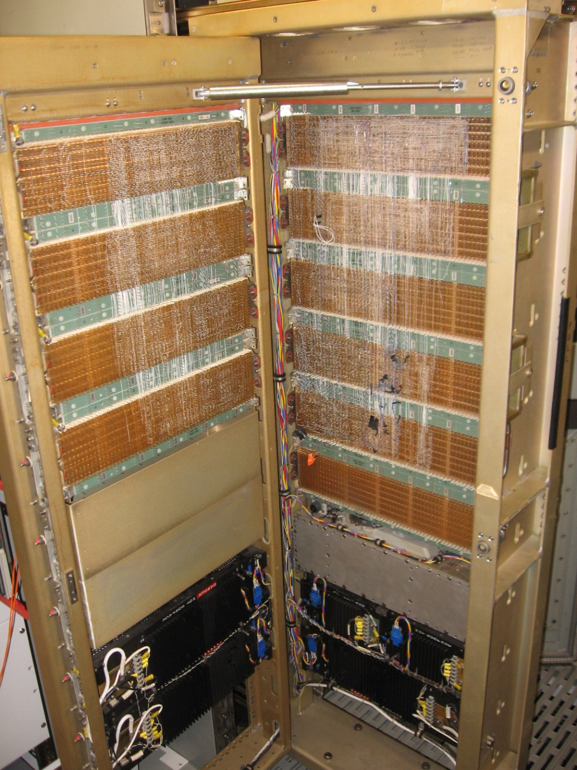
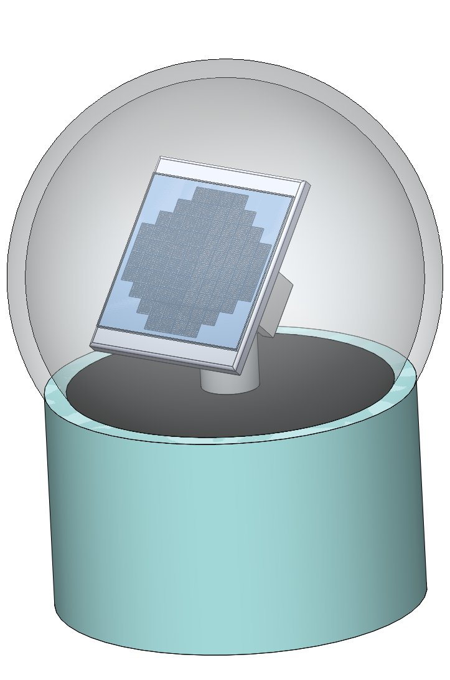
Advanced Technology Demonstrator
NWRT/PAR
NWRT/ATD
Plan to build a new phased array radar with mature, available components
MIT/LL dual polarization panel technology
DOD-developed receivers, exciters, and beamformers
Using a combination of NSSL-developed and DOD-developed software
To demonstrate MPAR-like technology prior to FAA Initial Investment Decision
Will have capabilities that cannot be demonstrated on the NWRT/PAR
Antenna Position Programmer
SPY-1A Antenna
A Modern, Active Array, Dual Polarization, Phased Array Radar
1970’s Technology
NOAA and FAA sharing development costs of ATD

Slide 16
FAA NSWRC Timeline
In-Service Management
IARD FID ISD
MA IA Solution Implementation
2010 2015 2020 2025 2030 2035 2040 2045
CRDR IARD IID FID
Mission Analysis Investment Analysis
Service Gap Analysis Concepts & Req Def Initial IA Final IA
2010 2011 2012 2013 2014 2015 2016 2017 2018 2019
FAA Milestones
CRDR Concepts Requirements Definition
Readiness
IARD Investment Analysis Readiness
Decision
IID Initial Investment Decision
FID Final Investment Decision
ISD In Service Decision
Preliminary Requirements
Analysis of Alternatives
Cost/Benefit Estimate
Update Requirements
Select Preferred Alternative
Define Business Case
Finalize Requirements
Solicit/ Evaluate Offers
Finalize Business Case

Slide 17
FAA NSWRC Timeline
In-Service Management
IARD FID ISD
MA IA Prototype Implementation / Deployment
2010 2015 2020 2025 2030 2035 2040 2045
NOAA Timeline
SLEP = Service Life Extension Program
Must be done to keep WSR-88D viable through 2030
WSR-88D SLEP
IID
Another SLEP?
Option A
2010 2015 2020 2025 2030 2035 2040 2045
MPAR Research
Prototype
MPAR Deployment?
Option B
ATD
Pathfinding
Deploy FAA radars first
Deploy NWS radars
starting ~2030

Slide 18
MPAR Summary
Phased array radar technology may be necessary to meet evolving NWS requirements
Simultaneous multi-function (weather and aircraft) operation only viable via phased array radar
NWRT/PAR has been a very valuable tool for MPAR R&D
The Advanced Technology Demonstrator (ATD) is needed to perform additional MPAR R&D
MPAR R&D partnership with FAA is very strong
Working together to build the ATD
ATD offers an opportunity to initiate closer collaboration with the air surveillance components of DOD and DHS
FAA Initial Investment Decision is rapidly approaching
NOAA will have a decision to make in December 2017

Slide 19
MPAR Collaborators
Mark Benner, Rodger Brown, Richard Doviak, Pam Heinselman, Michael Jain, Michael Shattuck, Arthur Witt, Vincent Wood, Allen Zahrai, Dusan Zrnic
Ric Adams, Katie Bowden, Don Burgess, Chris Curtis, Eddie Forren, Douglas Forsyth, Igor Ivic, Charles Kuster, Valery Melnikov,
Djordje Mirkovic, David Priegnitz, Mike Schmidt, Robin Tanamachi, John Thompson, Sebastian Torres, Daniel Wasielewski

Slide 20
Thank You

