Slide 1
Science & Warning Advancements with Phased Array Radar
Presented by Katie Bowden, PhD Student
Produced by Dr. Pam Heinselman Radar Research and Development Division
Team Leader and Affiliate Assoc. Professor

Slide 2
Relevance
NSSL’s Mission: “To understand the causes of severe weather and explore new ways to use weather information to assist National Weather Service forecasters and federal, university and private sector partners.”

Slide 3
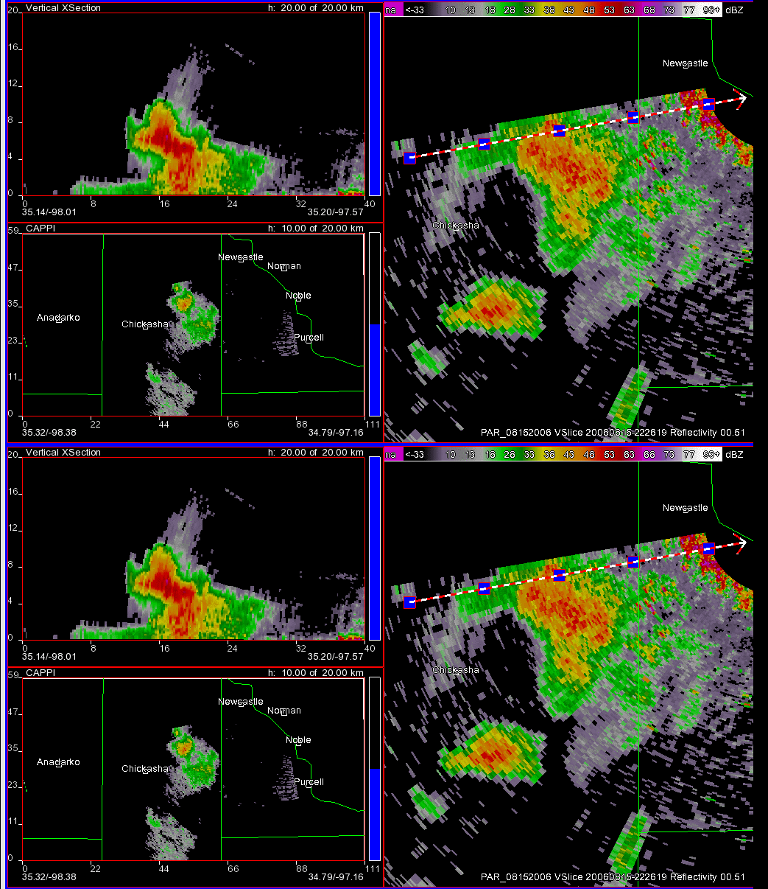
Science: Does Temporal Sampling Matter?
Reflectivity
2220-2240 UTC 15 Aug 06
Heinselman and Torres 2011: High-temporal-resolution capabilities of the National Weather Radar Testbed phased-array radar. J. Appl. Meteor. Climatol., 50, 579–593.
Emersic et al. 2011: Lightning activity in a hail-producing storm observed with phased-array radar. Mon. Wea. Rev., 139, 1809–1825.
Newman and Heinselman 2012: Evolution of a quasi-linear convective system sampled by phased array radar. Mon. Wea. Rev., 140, 3467–3486.
Tanamachi et al. submitted: Impacts of a Storm Merger on the 24 May 2011 El Reno, Oklahoma Tornadic Supercell, Wea. Forecasting.
Vertical Slice
0.5°
NWRT PAR: 26s
10 km
Vertical Slice
0.5°
NWRT PAR: 5 min
10 km

Slide 4
Operations: Does Temporal Sampling Matter?
0014–0158 UTC 19 Aug 2007
LaDue et al. 2010: Strengths and limitations of current radar systems for two stakeholder groups in the Southern Plains. Bull. Amer. Meteor. Soc., 91, 899–910.
Phased Array Radar Innovative Sensing Experiment
2010 PARISE
Heinselman et al. 2012: Exploring impacts of rapid-scan radar data on NWS decisions. Wea. Forecasting, 27, 1031–1044.
2012 PARISE
Heinselman et al. 2015: Tornado warning decisions using phased array radar data. Wea. Forecasting, in press. 2013 PARISE
Bowden et al. 2015: Impacts of phased array radar data on forecaster performance during severe hail and wind events. Wea. Forecasting, in press.
Kuster et al. submitted: 31 May 2013 El Reno Tornadoes: Advantages of rapid-scan phased array
radar data from a warning forecaster's perspective.
43-s Updates
5-min Updates
Electronic Posters

Slide 5
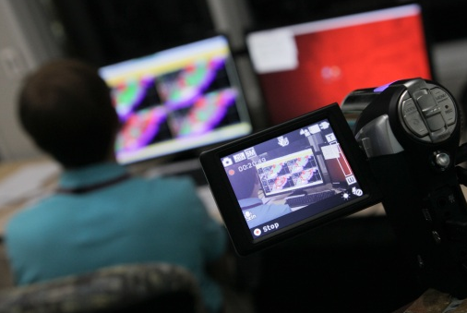
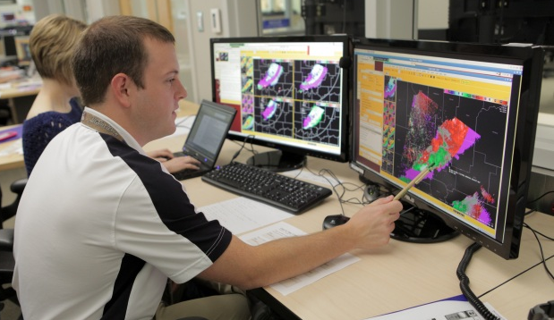
PARISE 2012
Goal: Assess impacts of 1-min updates on forecasters’ performance and warning decision process when working potentially weak tornadic events in displaced real time
1) View weather briefing and work the event using AWIPS 2
2) Produce detailed timeline of decision process (Hoffman 2005)
Sweep 1
Sweep 2
Sweep 3
Stimulated retrospective recall
Review timeline Revise as needed
Deepen the timeline with probing questions

Slide 6
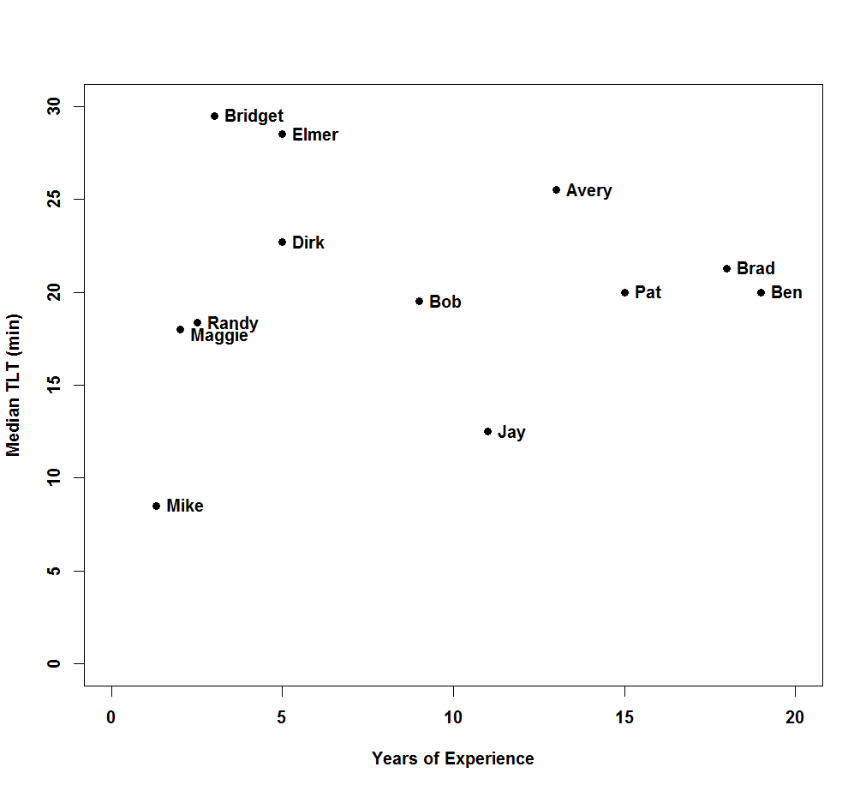
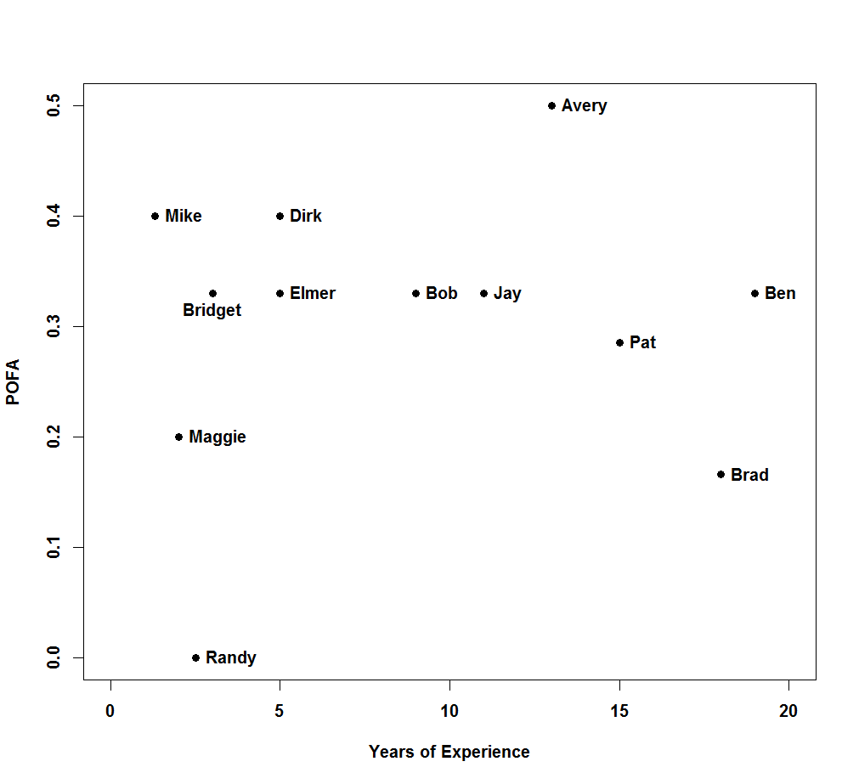
Performance 2 tornadic (EF0/EF1) and 2 non-tornadic events
Median Tornado-Warning Lead Time
Probability of False Alarm
Probability of False Alarm by Chance
PARISE
0
5
10
15
20
25
30
minutes
0
0.1
0.2
0.3
0.4
0.5
Participating Warning Forecast Offices
Central & Southern NWS Regions
0
5
10
15
20
0
5
10
15
20
Years of Experience
Years of Experience

Slide 7
*At lowest elevation scan

Slide 8
Summary
1-min radar updates have:
Improved scientific understanding of storm processes
Aided the warning decision process
Path Forward
PARISE 2015: Increase sample size
Analyze rapid-scan dual-polarization data
Understanding of severe weather processes
Accuracy and timeliness of warnings

