Slide 1
Multi-Radar Multi-Sensor (MRMS) –
Flooded Locations and Simulated Hydrographs (FLASH)
Jonathan J. Gourley
February 25–27, 2015
National Weather Center
Norman, Oklahoma

Slide 2
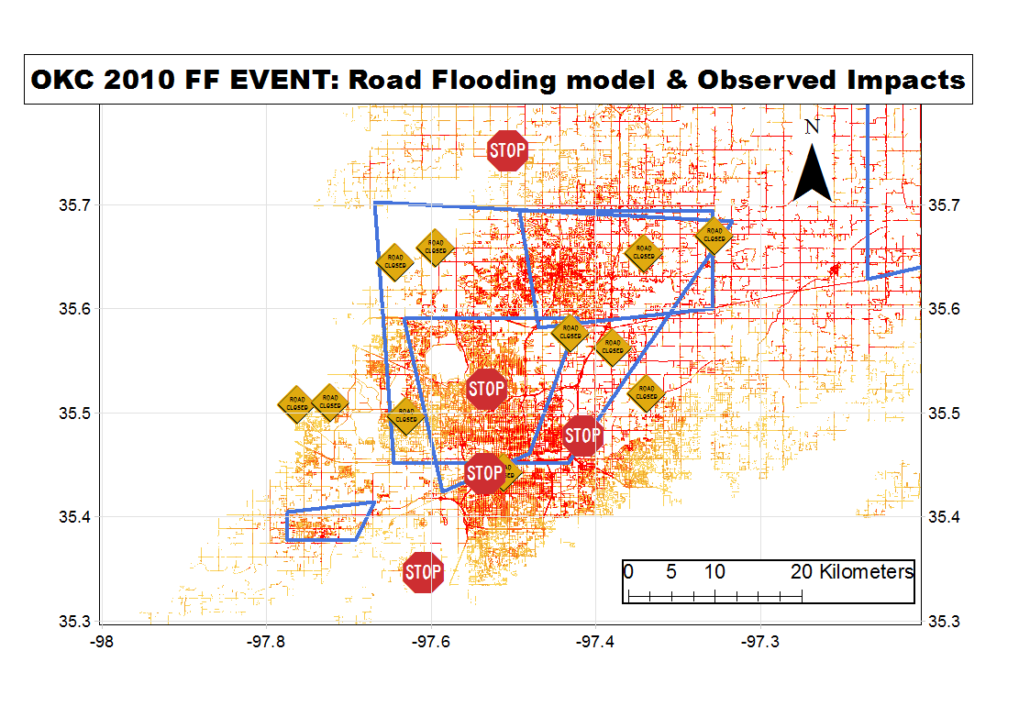
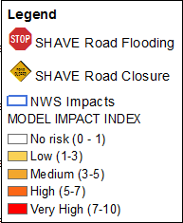
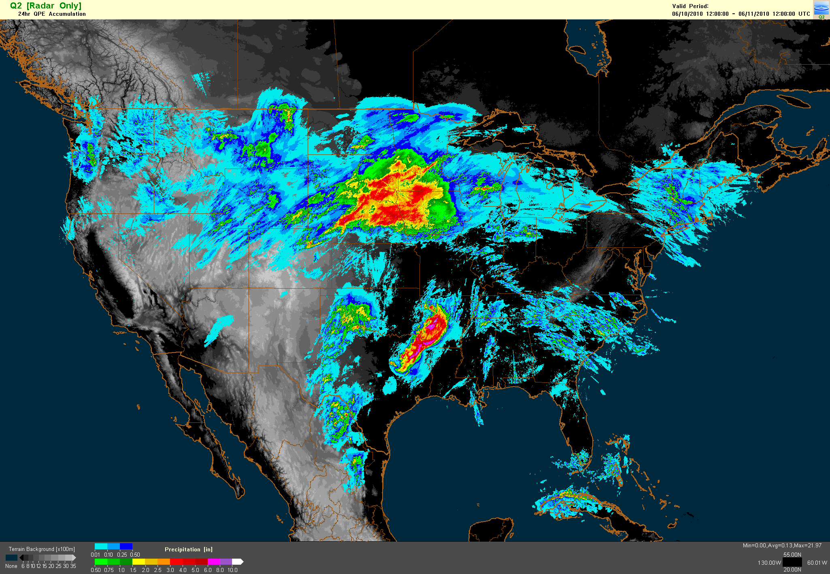
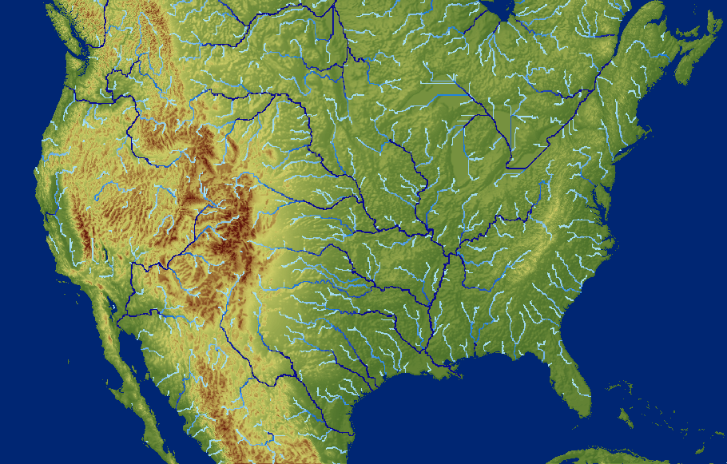
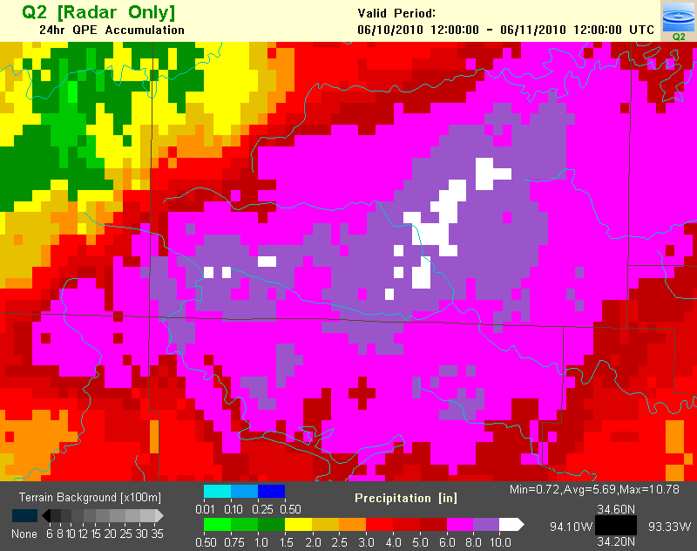
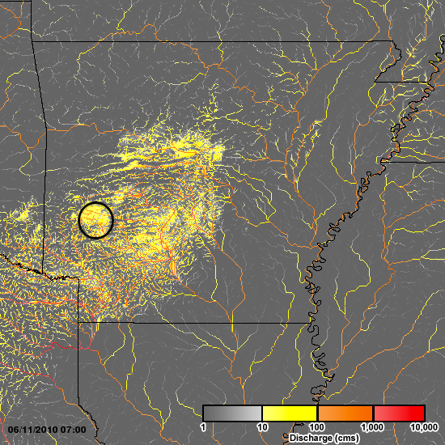
Multi-Radar Multi-Sensor QPE (MRMS)
Flooded Locations And Simulated Hydrographs (FLASH)
- An NWS CONUS-wide flash-flood forecasting system
MRMS/Q3 Rainfall Observations
1km²/2 min
Stormscale Distributed Hydrologic Model Ensemble
-1km²/10 min
Hydro-FACETs
Probabilistic Forecast Products on the Flash Flood Impacts and Magnitudes (70% chance of hazardous road flooding)
Simulated surface water flows and return period
150
Indicator of Relevance
NSSL’s Grand Scientific Challenge #3:
Reliably predict flash flooding for both urban and complex landscapes out to several hours
200
250 mm
20 fatalities
10-11 June 2010, Albert Pike Rec Area, Arkansas

Slide 3

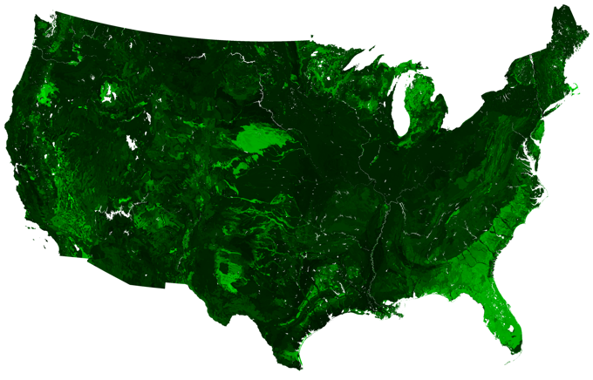
Ensemble Framework for Flash Flood Forecasting
Coupled Routing and Excess Storage (CREST; Wang et al. 2011)
Figure adapted from UC-Irvine
All Parameters from Basin Properties
SAC
K_{Sat}
51 mm/h
Kinematic Wave
Routing
0.01 mm/h
3
Notes:
Wang, J., Y. Hong, L. Li, J. J. Gourley, S. I. Khan, K. K. Yilmaz, R. F. Adler, F. S. Policelli, S. Habib, D. Irwin, A. S. Limaye, T. Korme, and L. Okello, 2011: The coupled routing and excess storage (CREST) distributed hydrological model. Hydrol. Sci. Journal, 56, 84-98, doi: 10.1080/02626667.2010.543087

Slide 4
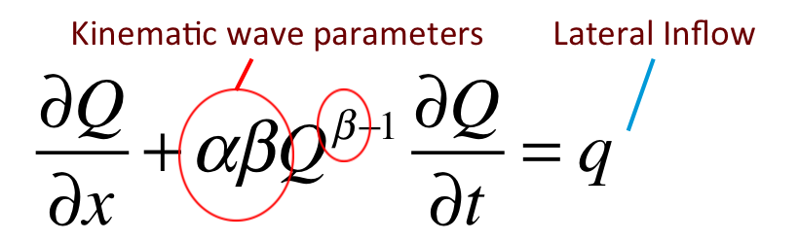
Estimates (via regression) at gauged locations
Channel routing parameters at USGS stream gauges

Slide 5
Extended to all grid points using statistical model (Rigby and Stasinopoulos, 2005)
Significant explanatory variables: 1. Annual Precip, Mean Temp, Relief Ratio, Basin Area
Notes:
*Rigby, R.A. and D.M. Stasinopoulos, 2005: Generalized additive models for location, scale and shape. Appl Stat-J Roy St C, 54, 507–554.

Slide 6
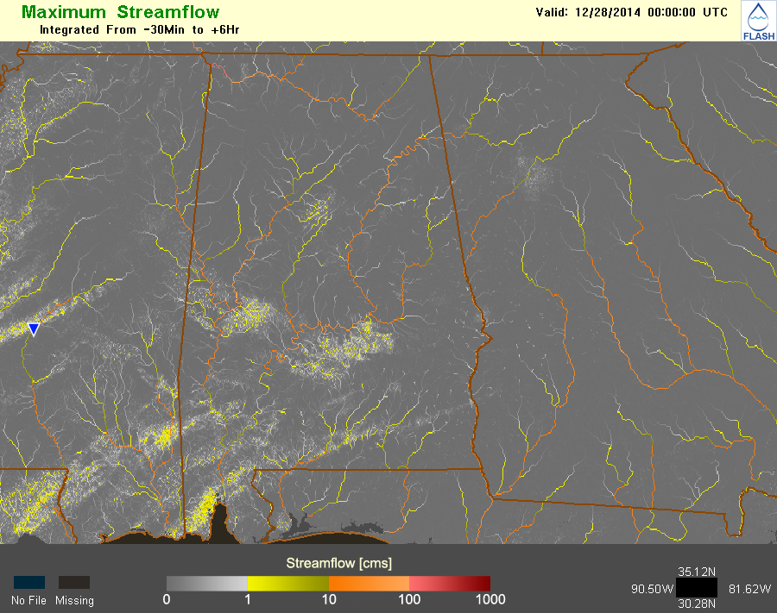
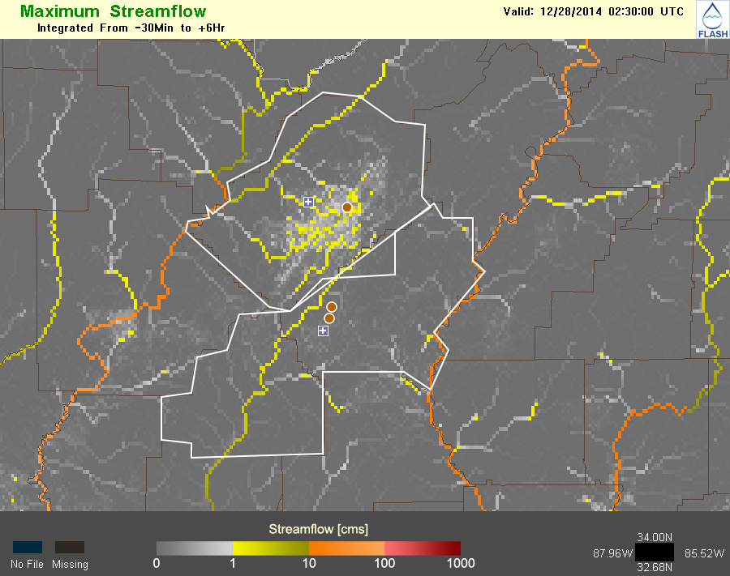
Real-time, direct simulation of flash floods a reality (flash.ou.edu)
0-6 hr streamflow, average recurrence intervals, and soil moisture forecasts…
everywhere
6

Slide 7
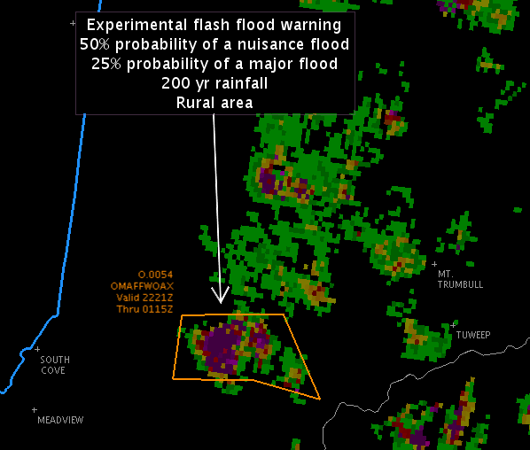
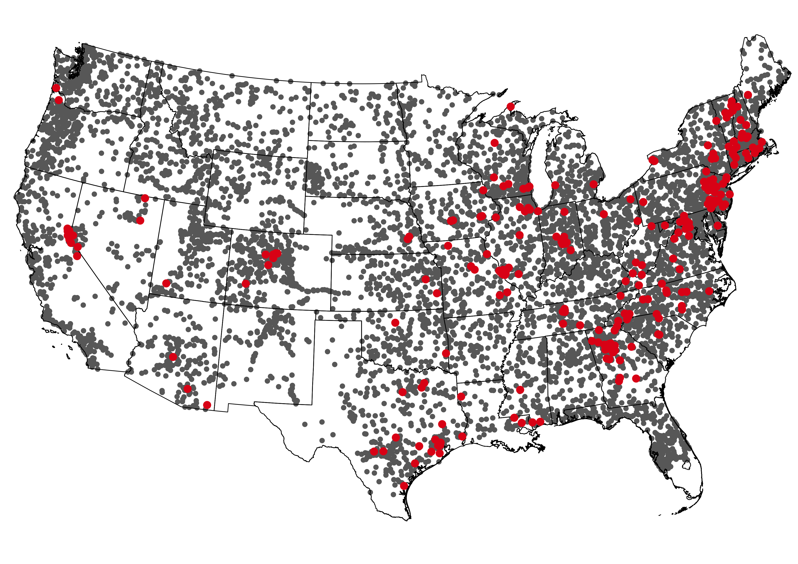
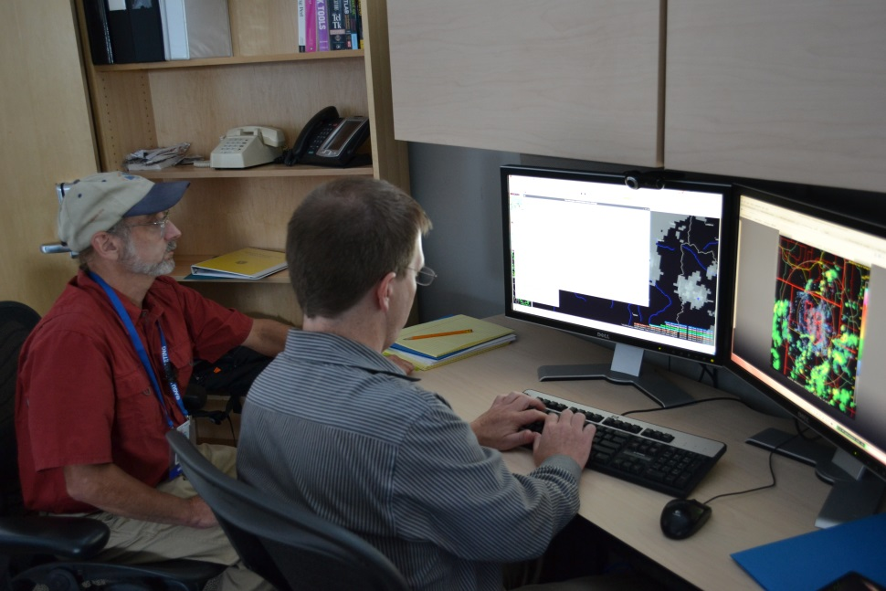
Subjective and Quantitative Evaluations
1. HWT-Hydro Testbed Experiment
2002-2011 using MRMS precip reanalysis (1 km/5min)
CREST model (uncalibrated)
256 gauged basins
Evaluate simulation of event peakflow
2. US Flash flood observation data base (Gourley et al., 2013, BAMS)
All USGS gauges
Catchments < 260 km²
Notes:
Gourley, J. J., Y. Hong, Z. L. Flamig, A. Arthur, R. A. Clark, M. Calianno, I. Ruin, T. Ortel, M. E. Wieczorek, E. Clark, P.-E. Kirstetter, and W. F. Krajewski, 2013: A unified flash flood database across the United States, Bull. Amer. Meteor. Soc., 94, 799-805. doi: http://dx.doi.org/10.1175/BAMS-D-12-00198.1

Slide 8
Event-Based Evaluation (Peakflow)
Quantiles describing observed vs. simulated peakflows using error model (Rigby and Stasinopoulos, 2005)
Future work will extend/regionalize error model to specific hydroclimatic, geomorphologic regimes
q95
q75
q50
q25
N=1932
q5
Notes:
*Rigby, R.A. and D.M. Stasinopoulos, 2005: Generalized additive models for location, scale and shape. Appl Stat-J Roy St C, 54, 507–554.

Slide 9
Multi-radar Multi-sensor (MRMS) Operational Implementation Schedule to NWS/NCEP
MRMS-Severe
QPE
Flash Flood
MRMS-Aviation
MRMS-Hydro
07/15
QPE-to-Flash Flood Guidance (FFG) Ratio
QPE Average Recurrence Interval (ARI*)
10/15
CREST# (Streamflow, ARI, Soil Moisture)
04/16
Sacramento (Streamflow, ARI, Soil Moisture)
Probabilistic QPE⁺
04/17
QPF inputs to FFG, ARI, hydro models
Probability of Flash Flood
Probability of Debris Flow
Impact-Specific Products
#CREST = Coupled Routing and Excess Storage model (Wang et al., 2011)
*Rainfall ARIs computed by comparing real-time MRMS QPE to NOAA Atlas 14 precipitation frequency estimates
⁺PRORATE=Probabilistic QPE using Radar Observations of Rate And Typology Estimates (Kirstetter et al., 2015)
9
Notes:
Wang, J., Y. Hong, L. Li, J. J. Gourley, S. I. Khan, K. K. Yilmaz, R. F. Adler, F. S. Policelli, S. Habib, D. Irwin, A. S. Limaye, T. Korme, and L. Okello, 2011: The coupled routing and excess storage (CREST) distributed hydrological model. Hydrol. Sci. Journal, 56, 84-98, doi: 10.1080/02626667.2010.543087
Kirstetter, P. E., J. J. Gourley, Y. Hong, J. Zhang, S. Moazamigoodarzi, C. Langston, and A. Arthur, 2015: Probabilistic precipitation rate estimates with ground-based radar networks. Wat. Resour. Res. (in press).

Slide 10

Summary
53 peer-reviewed articles on remote sensing of precipitation and flood forecasting in past 5 years
$1.4 million of project funding brought in from NOAA, NASA, and NSF (weighted by SRI%) in past 5 years
Guest editor for J. Hydrol. special issue on Flash floods, hydro-geomorphic response and risk management, 2014-present
AMS J. Hydrometeor. Editor’s Award, 2013
NASA Goddard Space Flight Center Robert H. Goddard Award (Team) for the category of Exceptional Achievement in Science, 2015
Dept. of Commerce Bronze Medal Award, 2012
Member of NASA’s Precipitation Measurement Mission Science Team, 2013-present
Member of AGU’s Precipitation Technical Committee, 2010-present

