Slide 1
Meteorological Phenomena Identification Near the Ground (mPING)
Dr. Kimberly L. Elmore (CIMMS/NSSL)
February 25–27, 2015
National Weather Center
Norman, Oklahoma

Slide 2
A Brief History of mPING
Relevance: Knowing winter surface precipitation type is critical to city and emergency managers, aircraft operations, and quantitative precipitation estimation
Started as an exercise to determine original HCA applicability to surface precipitation type – a misapplication!
  Results showed very limited skill at surface
HCA2 Working Group created through Director’s discretionary funds to create a winter surface precipitation type algorithm
  Success hinges on CONUS-scale verification/development data that includes ice pellets – ASOS does not qualify
  Prior experience demonstrated that Citizen Scientists can properly identify winter precipitation types
“There should be an app for that…”
  mPING app appears in Apple App Store and Google Play on 19 Dec 2012

Slide 3
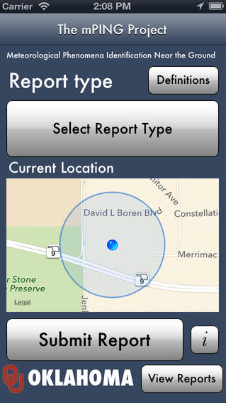
The mPING App
Precipitation
  None
  Drizzle
  Rain
  Freezing Drizzle
  Freezing Rain
  Snow
  Ice Pellets
  Mixed Rain & Snow
  Mixed Rain & Ice Pellets
  Mixed Ice Pellets & Snow
Wind Damage
  5 Levels
Flooding
  4 Levels
Hail
  0-10”, 0.25” steps
Tornado*
Landslide
Blowing Dust
Fog
*Only to NWS
How is mPING doing?
78,000 downloads of the app
720,000 reports submitted via mPING

Slide 4
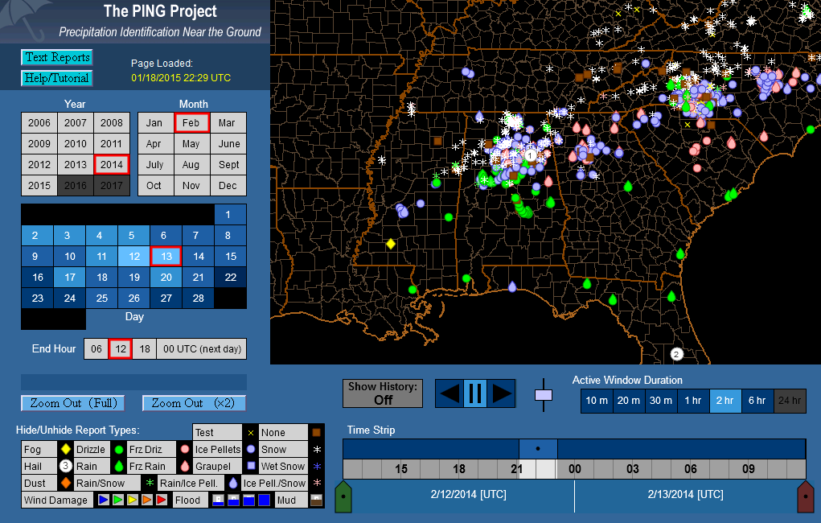
The Public-Facing mPING Display
The busiest 24 h yet recorded by mPING: 9744 reports; approximately 1,600 reports within this 2 h period.

Slide 5
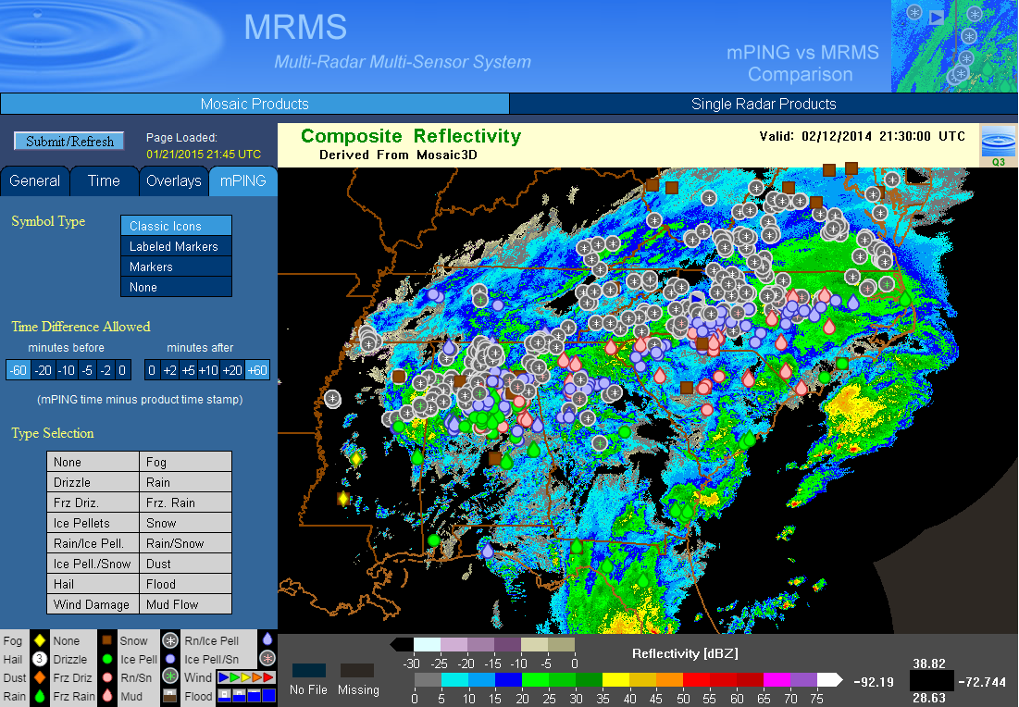
mPING on MRMS
Approximately the same data period shown previously, but now on top of radar reflectivity.

Slide 6
Where do mPING Observations Come From?
Where the people are!

Slide 7
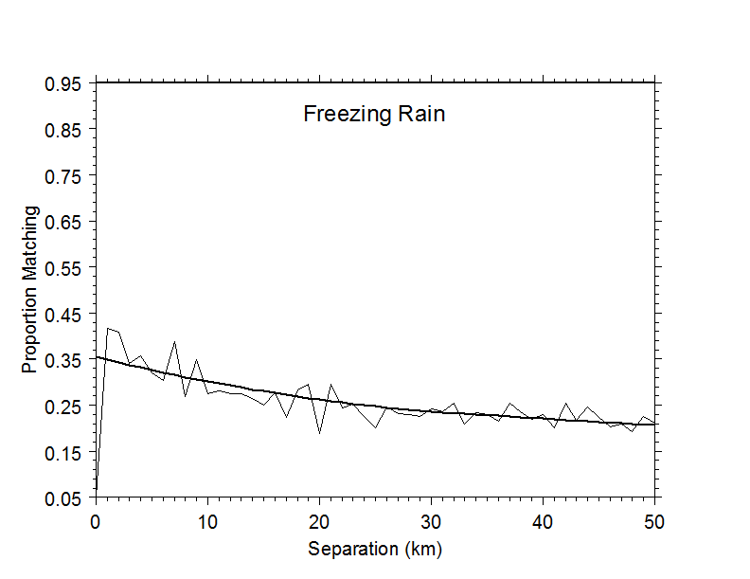
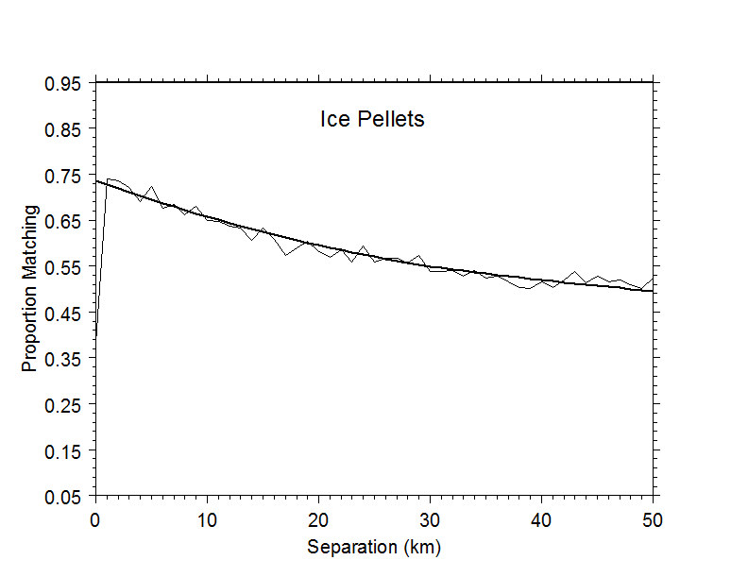
Are mPING Observations Any Good?
Quality: How consistent are mPING observations (do neighbors match)?
!?
Only 17% of disagreeing observations are rain (the most likely error) but 60% are ice pellets
Of disagreeing observations for ice pellets, approximately 66% are snow
Observers are most likely correct: freezing rain is highly variable in time and space
Notes:
If neighboring mPING observations don’t match, people may not be providing reliable data. When neighboring observations do NOT match, what’s the nature of the disagreement? Sometimes, the pattern of how observations disagree may yield information about observer capability. Other times, the pattern of how observations disagree yields insight into physical processes. This result makes physical sense because the environment that supports freezing rain is highly constrained: if the surface-layer temperature increases slightly to above freezing, rain won’t freeze. If the surface-layer temperature decreases slightly, the raindrops will freeze and produce ice pellets.

Slide 8
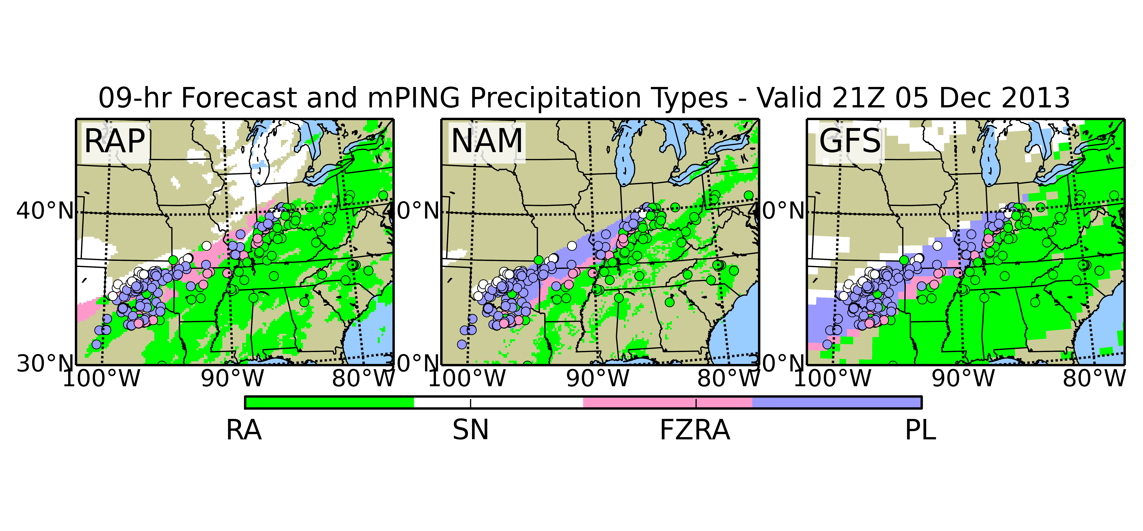
mPING Overlaid on Model Precipitation Type Forecast
Rain Snow Freezing Rain Ice Pellets
Dots are mPING observations within the hour centered on the forecast valid time,
color indicates precip type, shaded areas are model forecast precipitation extent
and type

Slide 9
What About a Better Winter Surface HCA? Use mPING Data to Drive a Statistical Background Classifier
Performance: Use model forecast ptype performance as a benchmark
Drive a Random Forest (RF) statistical classifier using mPING data and HRRR analysis fields for background classification
Evaluate quality using the Peirce Skill Score (PSS), which is equitable
Dashed lines show 95% confidence interval around PSS for each operational models
Colored square indicates RF performance, width shows 95% confidence interval; very significant potential performance improvement!
RF skill using HRRR analysis
valid at analysis time only;
not forecast data
Notes:
The skill depicted for the random forest does not use a forecast, but instead uses the hourly analysis generated by the HRRR. This colored area on the y-axis shows a potential improvement in ptype classification using environmental information.

Slide 10
More Statistical Background Classifier Results
mPING obs revealed a problem in the RAP – effectively no ice pellets
ESRL notified; discovered and fixed an otherwise unknown problem
Relevance: mPING leads directly to RAP improvement
RF is even better: 3X improvement in PSS.
What happened to the RAP?

Slide 11
mPING Directly Helps NWS
Relevance: mPING data used operationally by NWS leading to an updated forecast:
437
FXUS64 KFWD 130157 AAB
AFDFWD
AREA FORECAST DISCUSSION...UPDATED
NATIONAL WEATHER SERVICE FORT WORTH TX
757 PM CST WED NOV 12 2014
.DISCUSSION...
A SHORTWAVE CONTINUES MOVE INTO WEST TEXAS EARLY THIS EVENING. MID
LEVEL MOISTURE AND SOME ENHANCEMENT INDICATING VERTICAL MOTIONS
ALOFT HAVE BEEN NOTED ALONG THE RED RIVER VALLEY WITH A FEW MPING
REPORTS OF SOME VERY LIGHT SLEET. ANALYSIS OF OUR LATEST 00Z FWD
SOUNDING SEEMS TO CONFIRM THAT SLEET WOULD BE THE MAIN PRECIPITATION
TYPE WITH AN ELEVATED ENVIRONMENTAL WARM NOSE OF NEAR 6 DEG C AT
740MB BUT FALLING BELOW FREEZING AROUND 800MB WITH AN INCREASINGLY
DRY LOW LEVEL AIRMASS.
BOTTOM LINE IS YES SOME VERY LIGHT SLEET IS POSSIBLE HERE AND
THERE OVERNIGHT BUT IS NOT LIKELY TO ACCUMULATE OR CAUSE TRAVEL
IMPACTS.

Slide 12
Summary
Successes
  Quality:
    Data from participants are reliable and accurate
    mPING data are without precedent – no equivalent exists anywhere
    Each observation is tagged with GPS location and time
  Relevance:
    Since inception, between 200 and 300 “tweets” about mPING from NWS forecast offices
    Encourage downloading the app
    Solicit mPING report submissions during events
    Comments on forecasts influenced by mPING observations
    mPING data are essential to winter surface HCA development
    Only data available for assessing performance of any Winter Surface HCA algorithms
    Has already directly lead to improvements in operational NWP models
    Required for driving developing any classifiers
    mPING data are global
  Performance:
    mPING data used to drive a RF that can generate very skillful ptype classifications

Slide 13
Summary
Remaining Challenges
  Publicity
    Address through public release of the mPING interface specifications – mPING capability can be integrated into other apps, which leads to more exposure, etc.
  Better spatial coverage: is there a bias based on population density?
    More users won’t eliminate bias, but will allow enough data in otherwise sparse areas to characterize any bias
  Incorporate mPING data into NWS WFOs and NCEP verification

