Slide 1
GOES-R Risk Reduction and
Proving Ground R2O Activities
Kristin M. Calhoun (CIMMS / NSSL WRDD)
February 25–27, 2015
National Weather Center
Norman, Oklahoma

Slide 2
GOES-R Proving Ground Evaluations in the HWT
GOES-R Risk Reduction Projects at NSSL
GOES-R synthetic (simulated) imagery
NearCast Model
Convection Initiation
ProbSevere
Overshooting Tops / Cloud-top Cooling
Super Rapid Scan
pseudo-Geostationary Lightning Mapper Imagery
Total Lightning Tracking Tool
Lightning Jump Algorithm
Sounder RGB Airmass
Applications of concurrent super rapid sampling form GOES-14 SRSOR, radar, and lightning data
Storm Tracking and Lightning Cell Clustering for Data Assimilation and Forecast Applications
Improvements to QPE using GOES Visible ABI and model data
Techniques for Assimilating Geostationary Lightning Mapper Data and Assessment of the Resulting Impact on Forecasts
The GOES-R GLM Lightning Jump Algorithm: A National Field Test for Operational Readiness
Using total lightning data from GLM/GOES-R to improve real-time tropical cyclone genesis and intensity forecasts

Slide 3
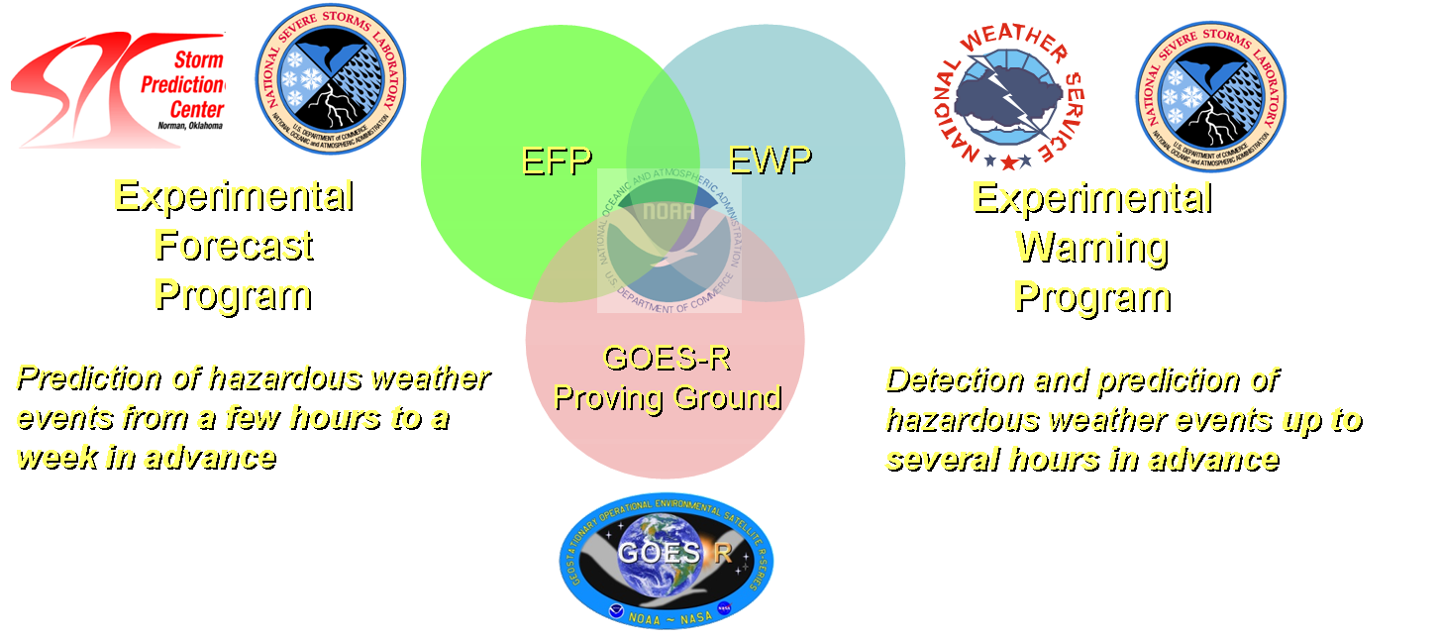
Notes:
The HWT provides a unique opportunity for product developers to interact directly with various forecasters and to observe the baseline and enhanced capability GOES-R algorithms being used alongside standard observational and forecast products in an operational forecast environment (R2O & O2R).
This interaction helps the developer to understand how forecasters use their product, and what improvements might increase the product usability in an operational environment.
Feedback received from participants in the HWT has proven invaluable to the continued development of GOES-R algorithms. The EWP allows for the testing of satellite-based products in the AWIPS-II data visualization system.

Slide 4
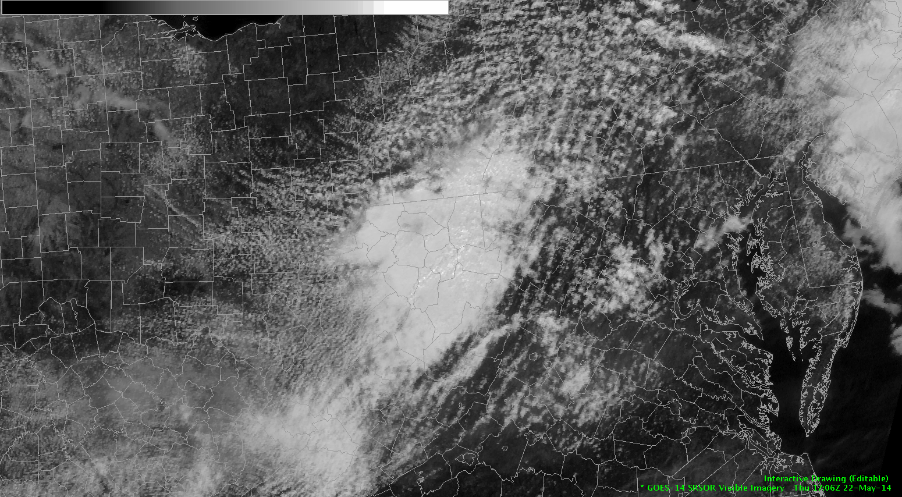
Notes:
GOES-R Proving Ground demonstrations in the HWT provide users with a glimpse into the capabilities, products and algorithms that will be available with the future geostationary satellite series.
HWT activity helps to ensure day-1 readiness for the receipt of GOES-R data

Slide 5
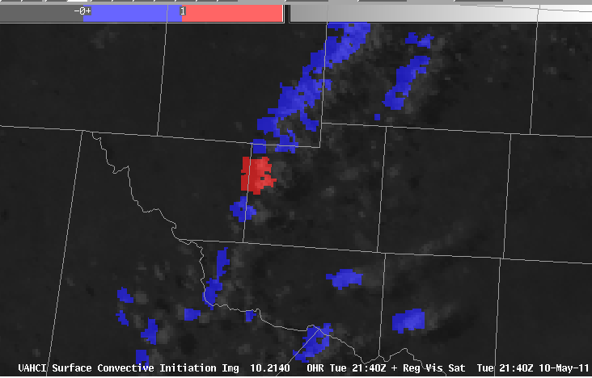
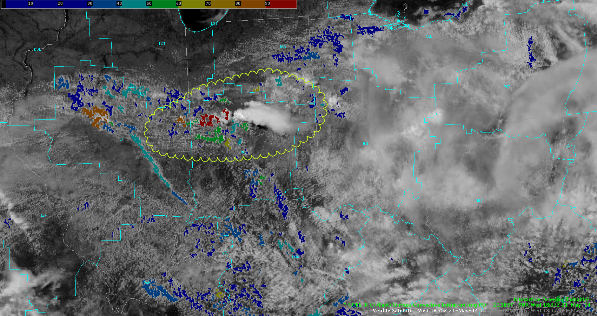
100% of the forecasters responded “yes” in the survey when asked if they preferred a probabilistic approach to a binary yes/no approach.
Applies to R2O in general: provide measures of certainty
Notes:
This fused product (from UAH and NASA) combines various GOES convective cloud properties and Rapid Refresh model environmental fields in a logistic regression framework to produce probabilities of convective initiation.
The output is a 0-100% probability that a given cloud object will achieve a 35 dBz reflectivity echo at the -10C level in the 0-2 hour forecast range.
Continued reliability of this algorithm (particularly at overnight when IR instead of visible) is needed prior to operational implementation.

Slide 6
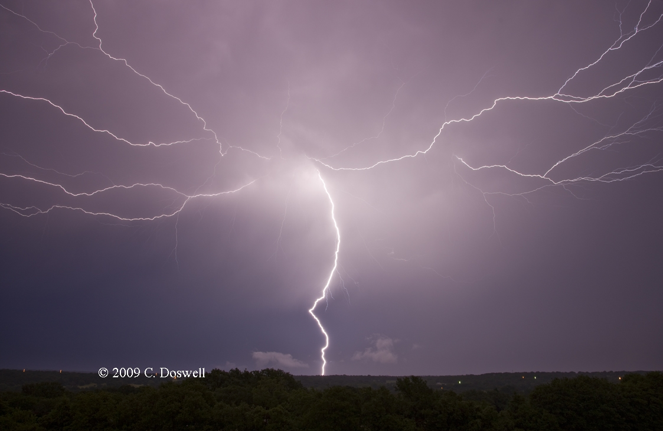
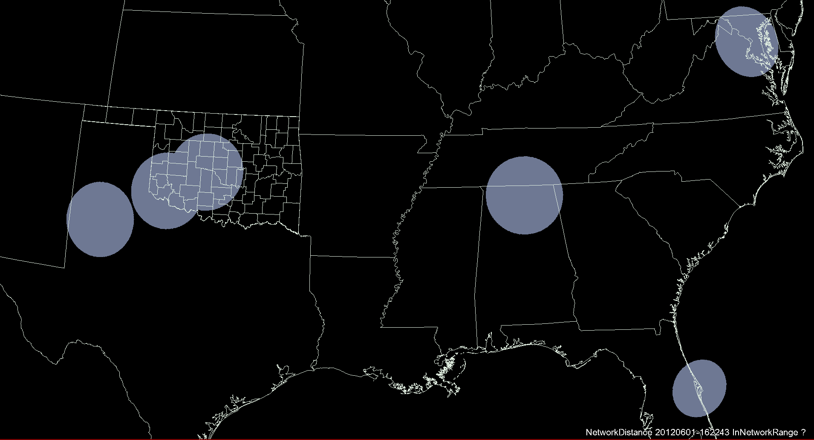
Creation of a Geostationary Lightning Mapper visualization [pGLM]*
Use radiation points detected from ground-based lightning mapping arrays (LMAs)
*Joint effort with NASA – SPoRT

Slide 7
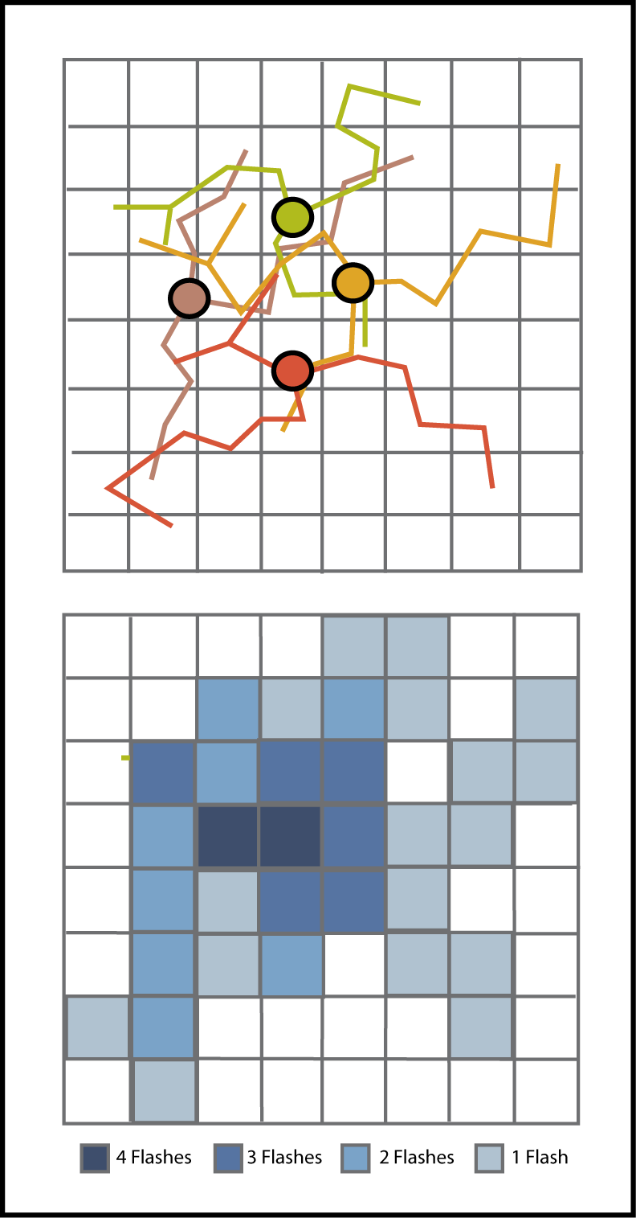
Creation of a Geostationary Lightning Mapper visualization [pGLM]*
Flash Sorting
Flash Extent Density
Flash Extent Density = Flash Footprint
  Produced every min, real-time -> AWIPS2
*Joint effort with NASA – SPoRT

Slide 8
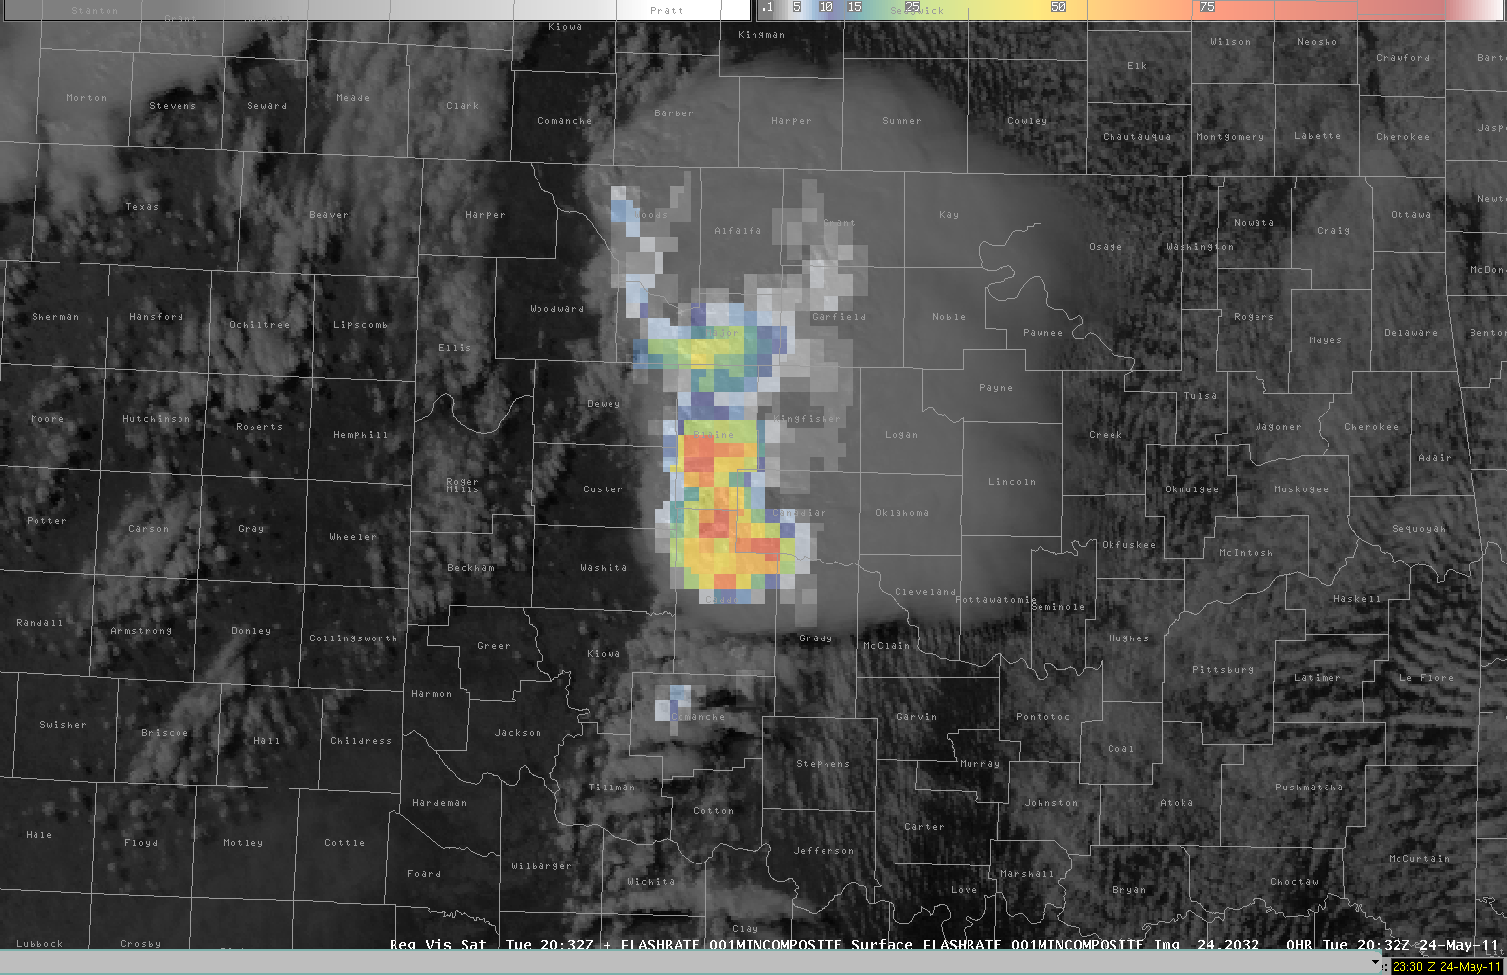

Slide 9
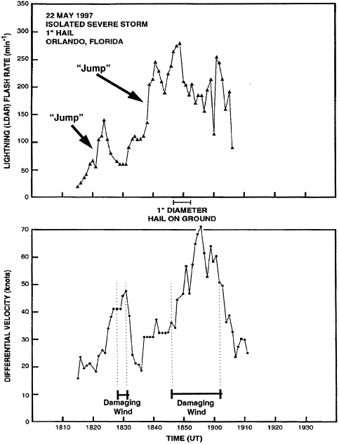
From Williams et al (1999)
Lightning Jump Algorithm
A Lightning Jump =
rapid increase total flash rate
These jumps have been shown to be precursors of severe weather in thunderstorms
Flash Rate per min
This is a typical view of Lightning jump via Time Series.
Should forecaster view this as time series too?
Get the forecaster get an alert?
Hear bells?
See flashing lights?
Differential Velocity (knots)
Goodman et al (1988), MacGorman et al (1989), Williams et al (1999)
More recently Schultz et al (2009, 2011)

Slide 10
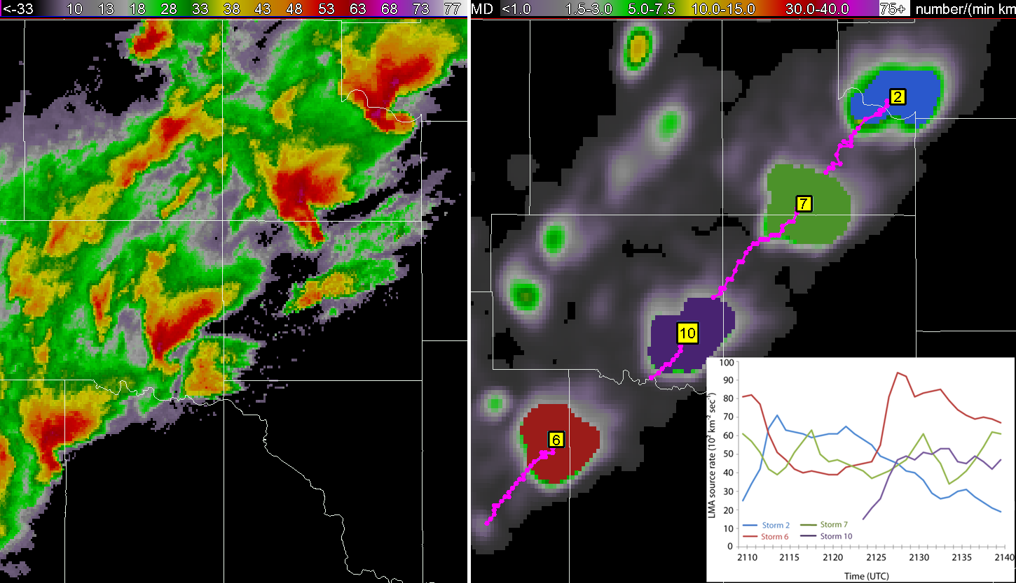

Slide 11
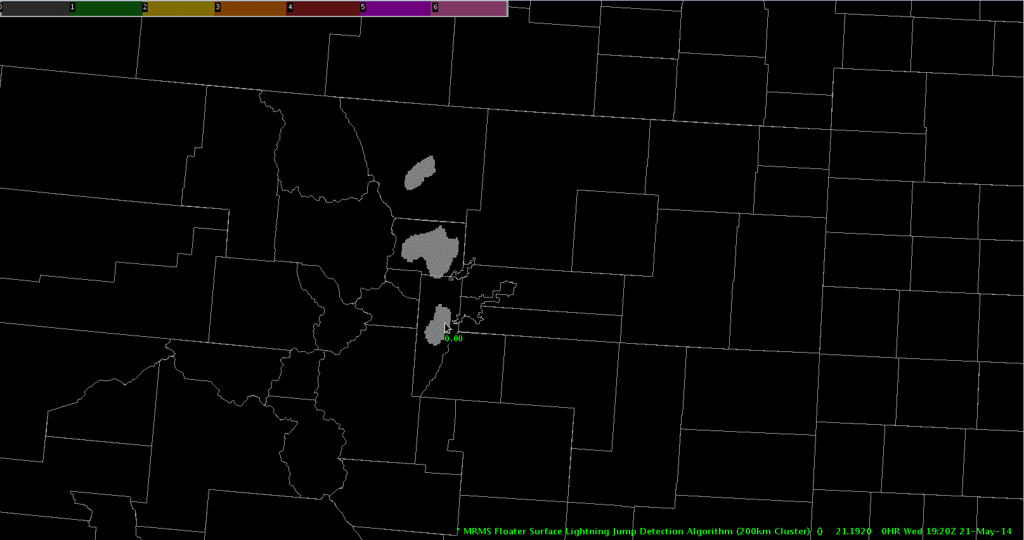
“I really think this could be one of the most valuable tools in WFO operations. Once a jump - or more precisely a series of jumps occurred - there seem to be excellent correlation to an increase in storm intensity.”
-NWS Forecaster, Post Event Survey

Slide 12
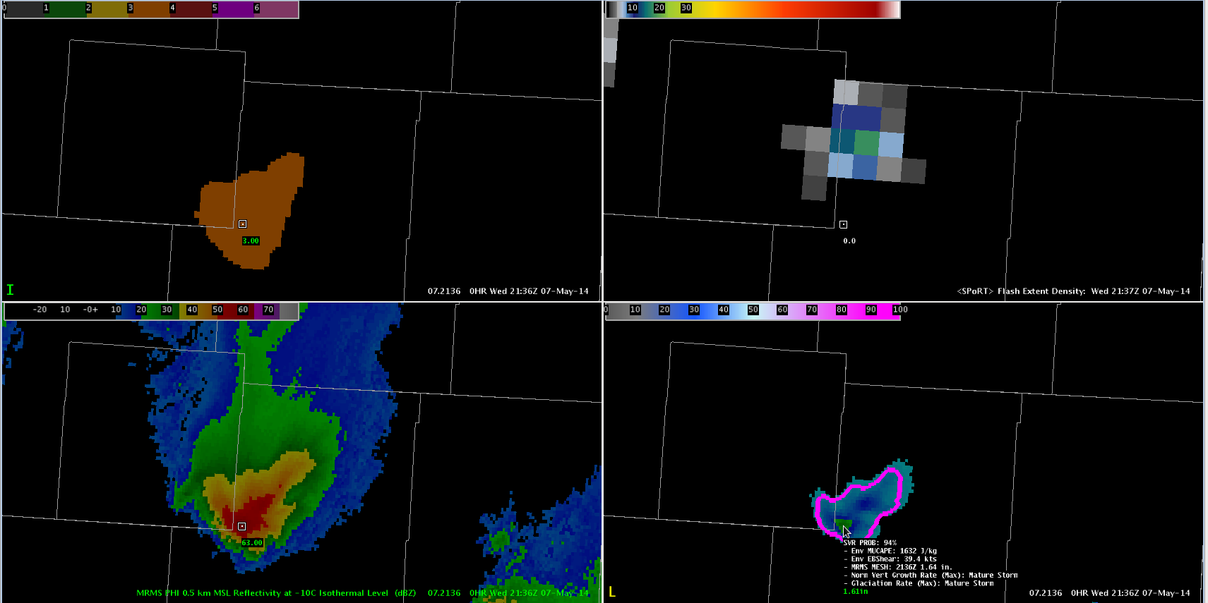
Lightning Data was heavily used in warning operations:
Rapid (1 min) update – filled gap in time (and distance) from radar
Jump provided view of rapid intensification in multiple storm environments
Provided extra confidence in warning decision

Slide 13
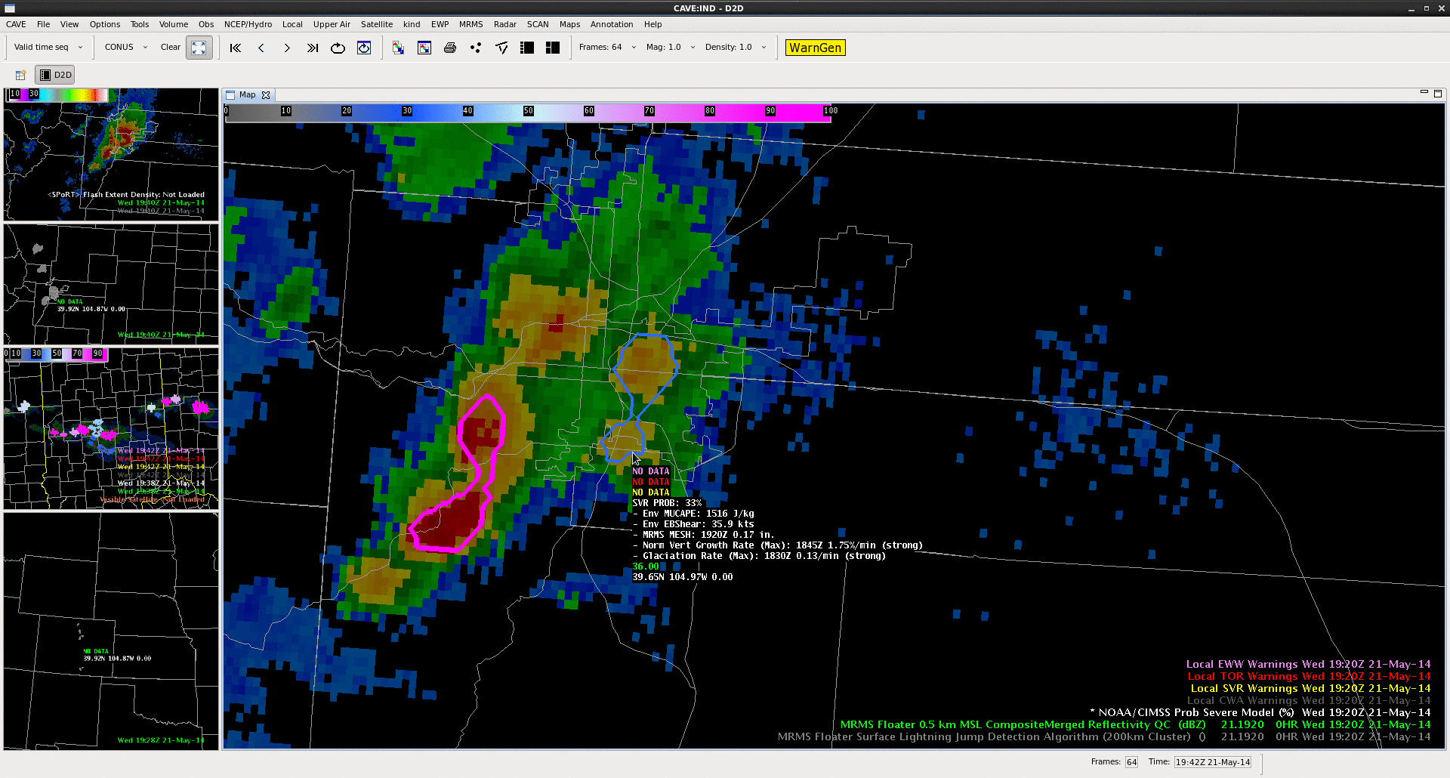
“In this case, ProbSevere and LJDA both displayed the rapid intensification of the updraft, and could be especially useful in identifying the first severe storm of the day, and the maintenance of the ProbSevere and additional lightning jumps continued to highlight the threat of severe weather as the storm continued eastward as the storm propagated eastward.
This information is a high temporal resolution (1-2 minutes) and provides additional data points that can fill gaps between radar volume times.” -NWS Forecasters (HWT blog)
Notes:
“The jump in ProbSevere (46% to 66% from 19:22 to 19:24 UTC) and the 2-sigma and 4-sigma jumps from the LJA (at 19:23 and 19:24 UTC, respectively) may be able to give forecasters enhanced confidence and perhaps more lead time to initial rapid development in the storm, and potential severe hazards…

Slide 14
Predict useful warnings of lightning activity one hour in advance (onset through demise)
Grand Scientific Challenge 4:
GOES-R Collaborators:
NOAA Satellite and Information Service (NESDIS)
Univ. of Alabama – Huntsville
Univ. of Wisconsin – Coop. Inst. for Meteorological Satellite Studies (CIMSS)
NASA – Short-term Prediction Research and Transition Center (SPoRT)
NOAA/ Center for Satellite Applications and Research (STAR)
Colorado State Univ - Coop. Inst. for Research in the Atmosphere (CIRA)
Texas Tech Univ
Meteorological Development Laboratory
Storm Prediction Center
National Weather Service
14

Slide 15
Summary
The HWT provides a vehicle for forecasters to evaluate GOES-R instruments and capabilities PRIOR to launch to ensure use of GOES-R system by the National Weather Service as soon as it is operational.
  Includes: Iterative Product Development (e.g., Operations to Research feedback) as well as development of training / best practices.
HWT also fosters collaboration between organizations leading to new research applications and ideas.

