Slide 1
Severe Weather Climatology and Long-Term Forecasting
Harold Brooks
NSSL Lab Review February 25–27, 2015
National Weather Center
Norman, Oklahoma

Slide 2
NSSL’s Interest
Understanding how severe storms fit into climate
Helping SPC put things in context
Extending forecast horizon
Reports to look at past tornado changes
Using environmental conditions to forecast longer

Slide 3
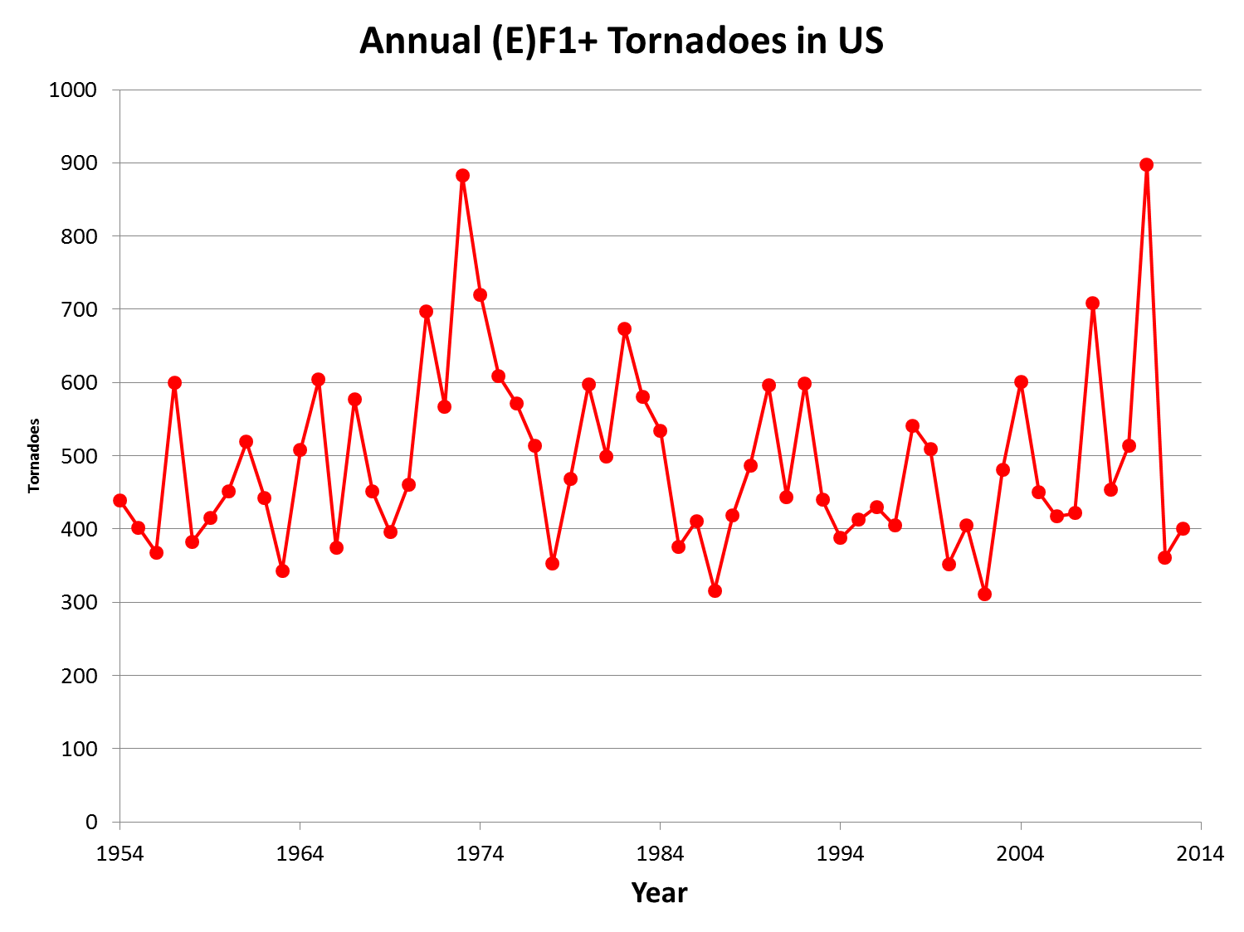

Slide 4
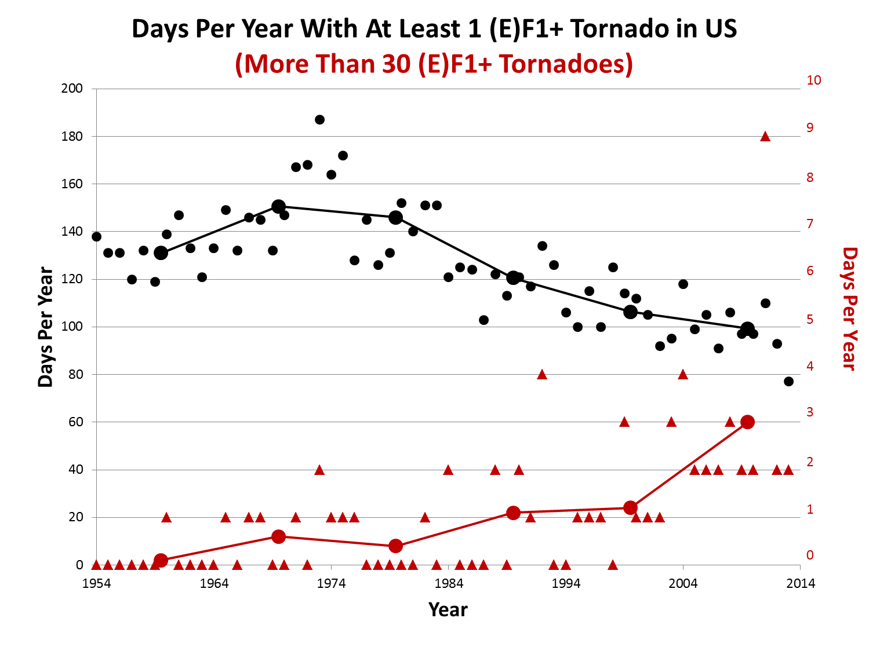
Brooks, Carbin, and Marsh
(Science, 2014)
Brooks, Carbin, and Marsh, 2014 (Science)

Slide 5
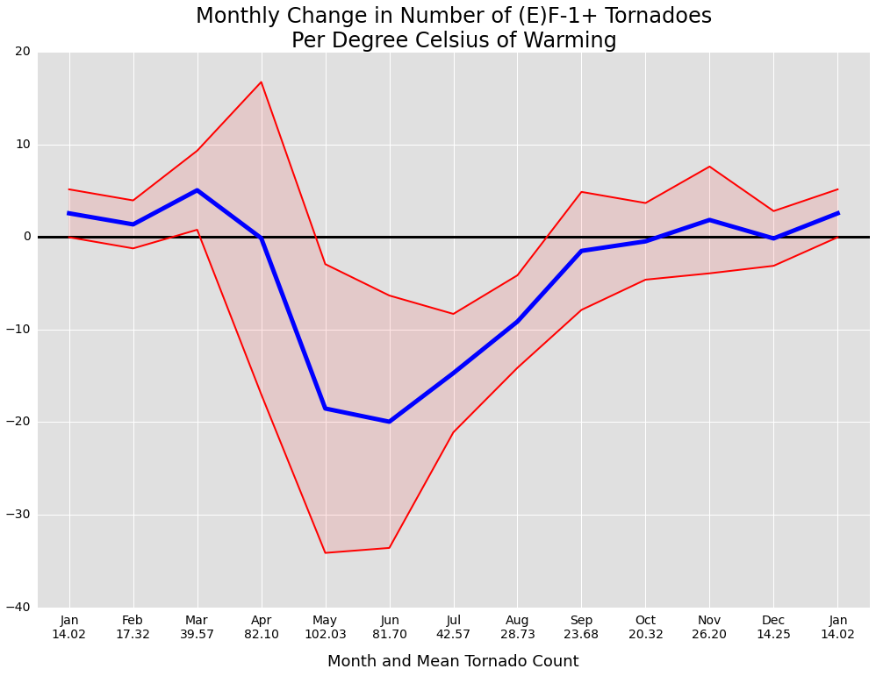
Brooks, Marsh, and Carbin
(Proc. Nat. Acad. Sci., in prep.)
Change in Tornadoes Per Degree Warming
95% Confidence
Warm summers-fewer tornadoes
Warm winters-more tornadoes
Mean Change

Slide 6
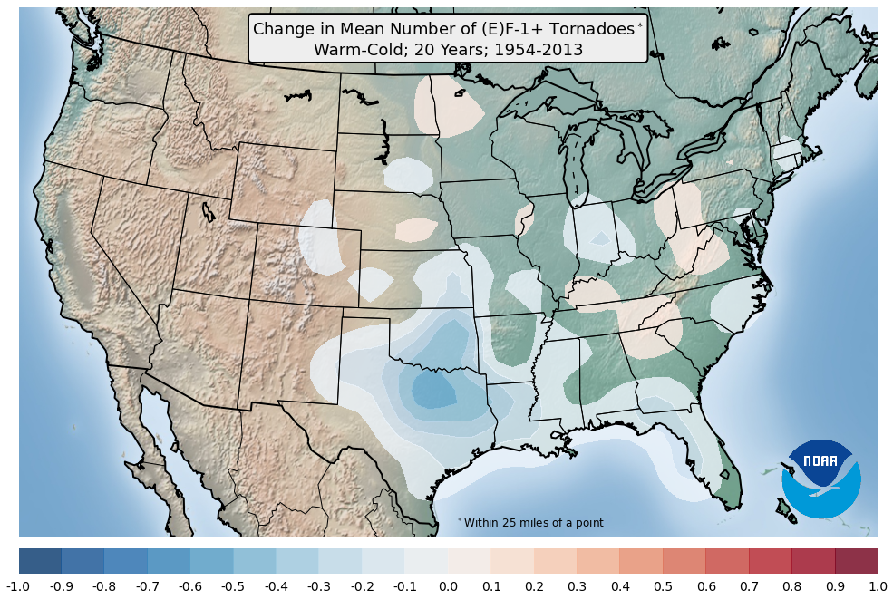
Brooks, Carbin, and Marsh, 2013 (Science)

Slide 7
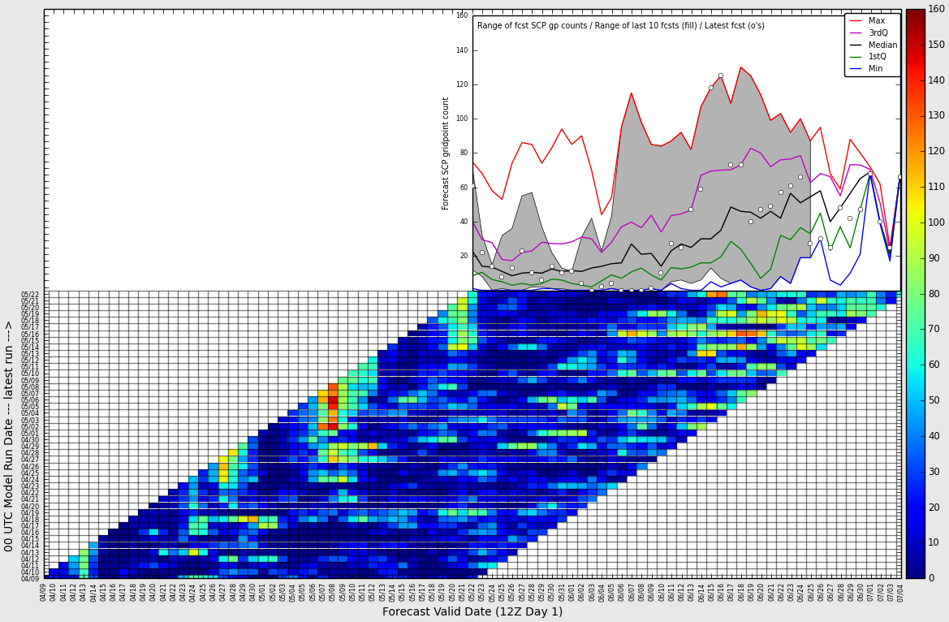
Long-range forecasting with Climate Forecast System
(SPC, Climate Prediction Center, Columbia)
“Why don’t I get seasonal tornado forecasts like I get seasonal hurricane forecasts?”
-B. Obama, 5 March 2012
Current SPC
Forecasts valid same day
Each “chiclet” represents one forecast/valid time pair
Forecasts made same day

Slide 8
Summary and Next
Variability of tornado occurrence has increased
Warm winter (summer)-more (fewer) tornadoes
Have environments changed like tornadoes?
Continue tool, evaluation work for extended range

