Slide 1
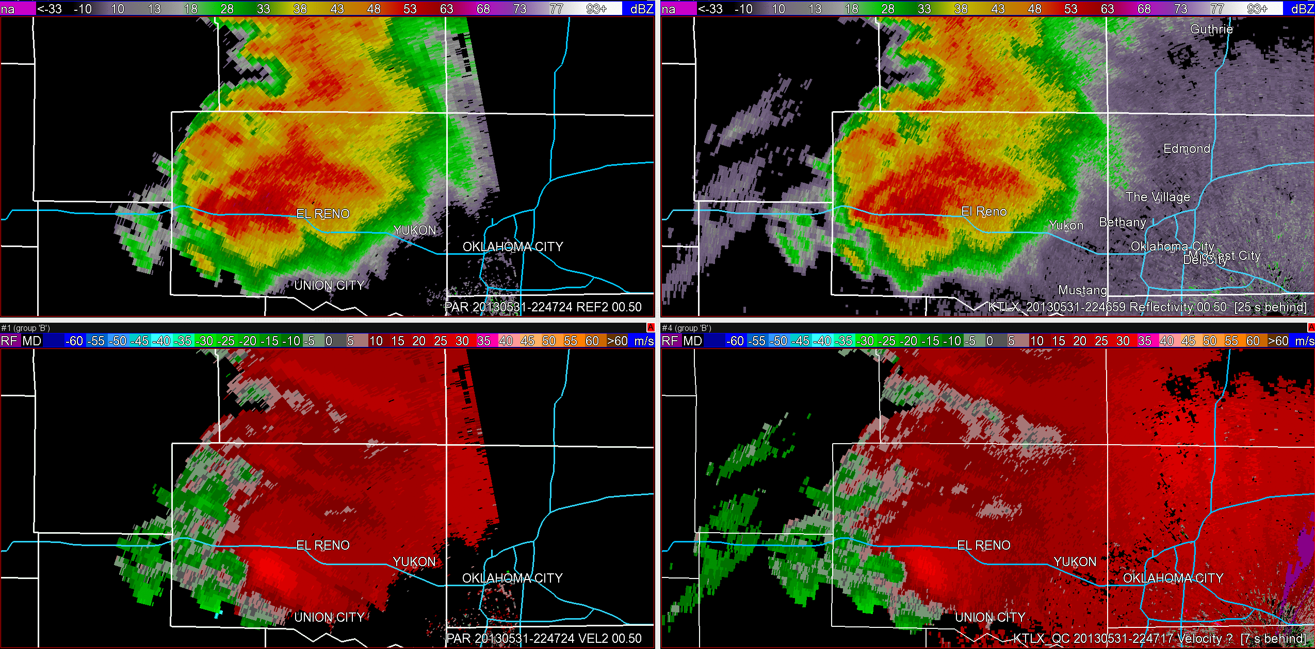
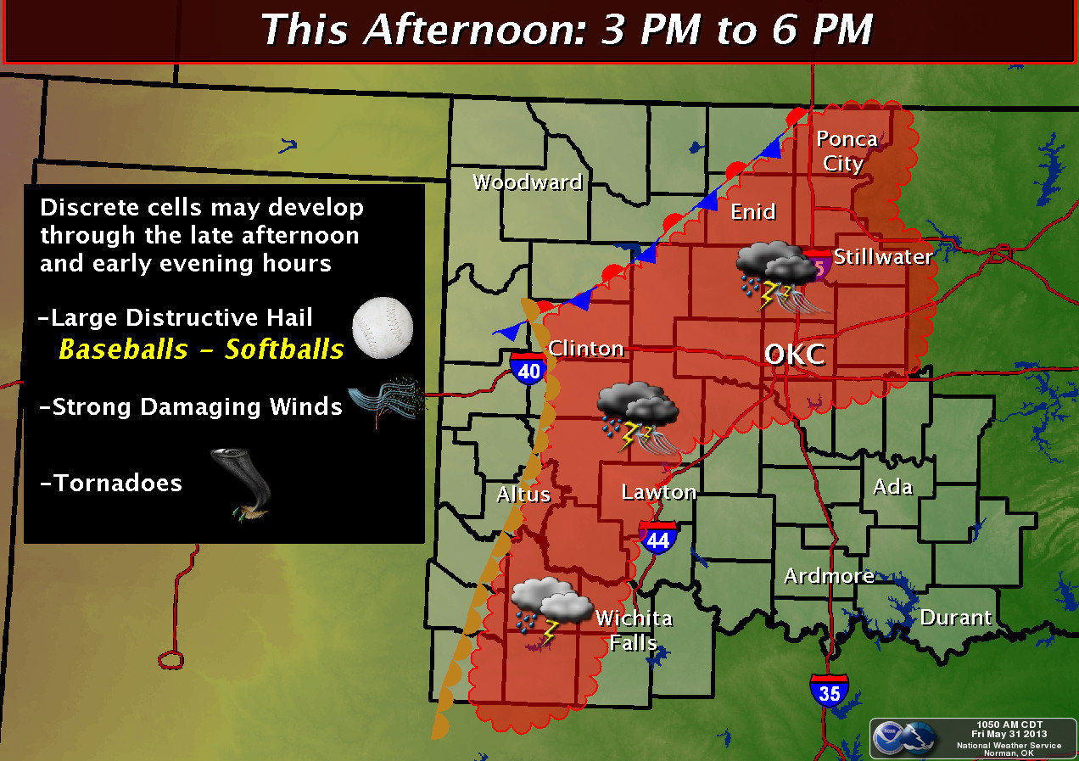
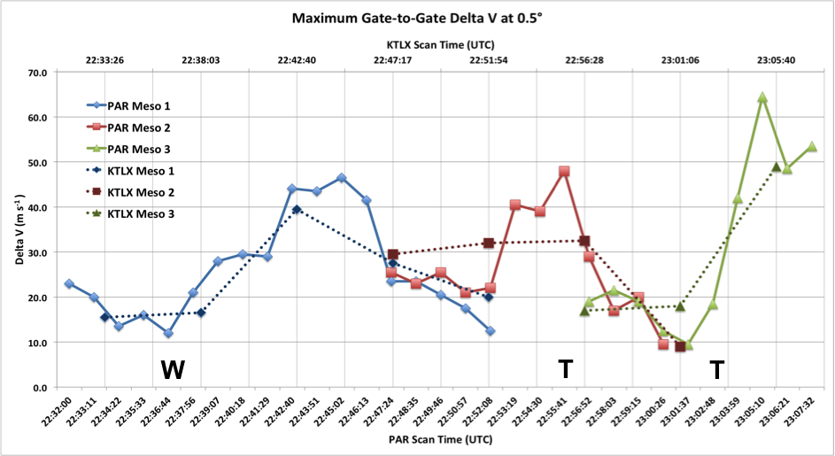
Operational Benefits of Phased Array Radar Data During a Significant Tornado Event: 31 May 2013
Charles M. Kuster (CIMMS), Pamela L. Heinselman (NOAA NSSL), Marcus Austin (NWS Norman)
Warning forecaster examined rapid-update PAR data and conventional WSR-88D data
Compare significant storm-scale features and evolution
Quantitative analysis of important features
Goal: Determine impact of radar update time on warning decisions in an environment clearly favorable for tornadoes
Impact of PAR: Forecaster better able to observe storm organization and tornadogenesis
PAR (0.5°, 2247:24−2306:21 UTC)
KTLX (0.5°, 2246:59−2305:23 UTC)
REF
VEL
Benefits:
Clearer radar-based evidence of brief tornado and strong tornado development, providing validation of ongoing warnings
More confidence in position and motion of tornado for use in warning issuance/updates

Slide 2
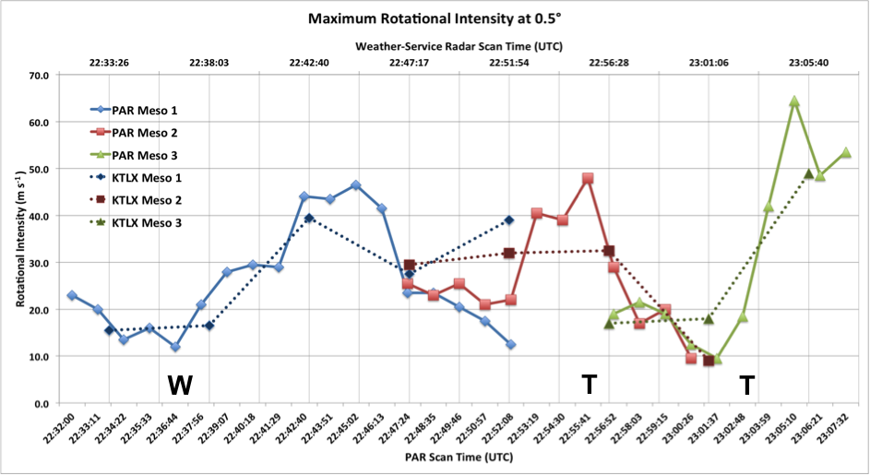
Operational Benefits of Phased Array Radar Data During a Significant Tornado Event: 31 May 2013
Charles M. Kuster (CIMMS), Pamela L. Heinselman (NOAA NSSL), Marcus Austin (NWS Norman)
Warning forecaster examined rapid-update PAR data and conventional WSR-88D data
Compare significant storm-scale features and evolution
Quantitative analysis of important features
Goal: Determine impact of radar update time on warning decisions in an environment clearly favorable for tornadoes
Impact of PAR: Forecaster better able to observe storm organization and tornadogenesis
PAR (0.5°, 2247:24−2306:21 UTC)
Conventional (0.5°, 2246:59−2305:23 UTC)
REF
VEL
Benefits:
Clearer radar-based evidence of brief tornado and strong tornado development, providing validation of ongoing warnings
More confidence in position and motion of tornado for use in warning issuance/updates
Radar velocities:
PAR

Slide 3
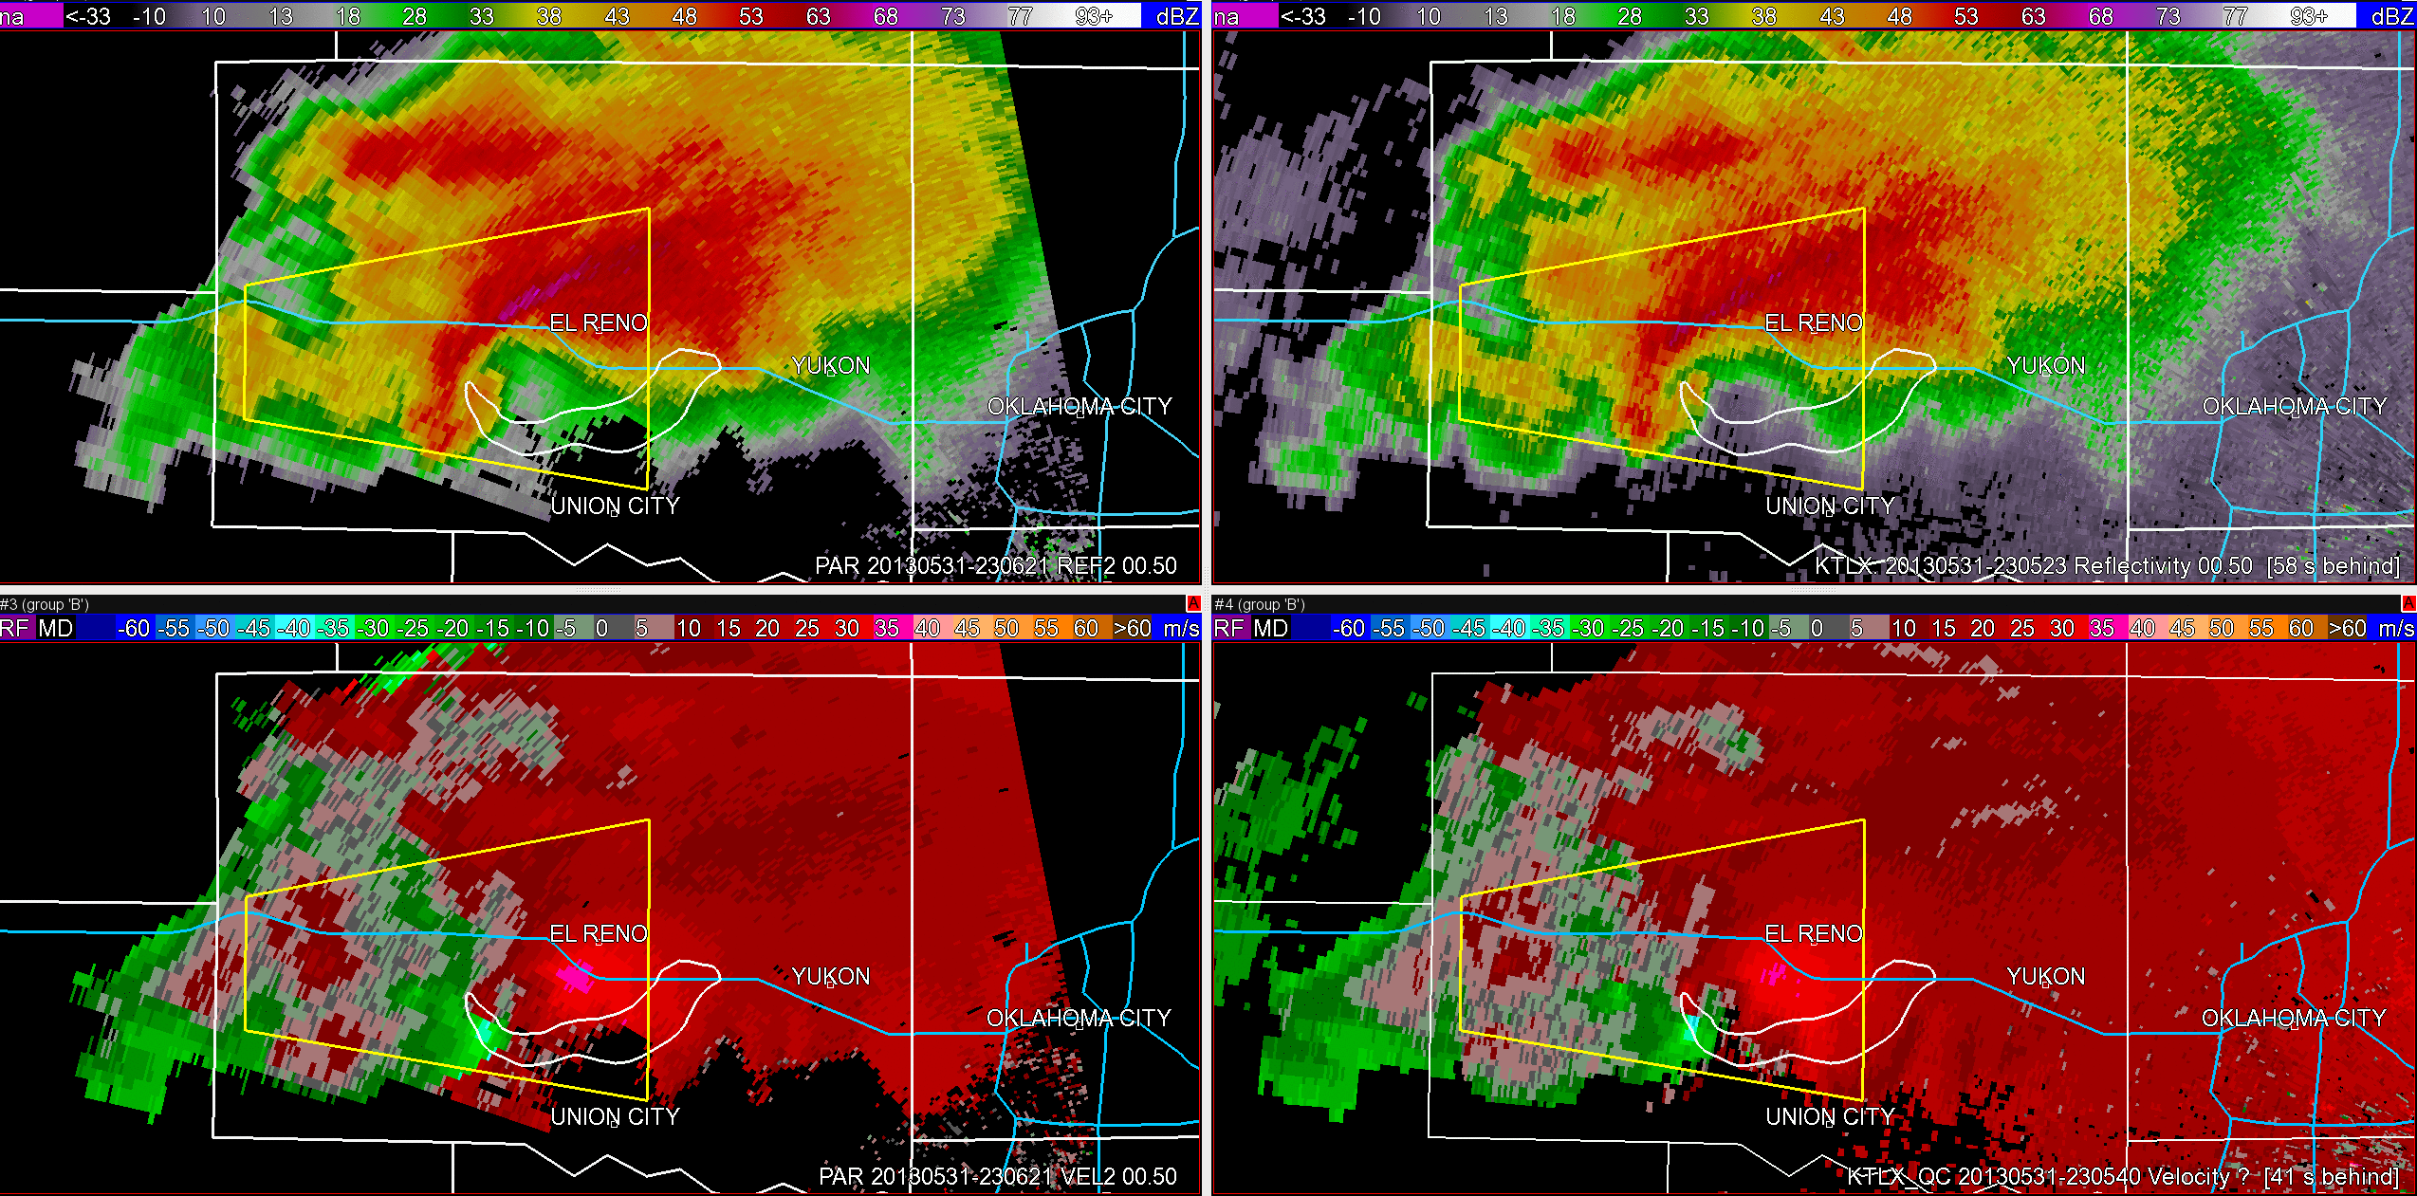
Operational Benefits of Phased Array Radar Data During a Significant Tornado Event: 31 May 2013
Charles M. Kuster (CIMMS), Pamela L. Heinselman (NOAA NSSL), Marcus Austin (NWS Norman)
Warning forecaster examined rapid-update PAR data and conventional WSR-88D data
Compare significant storm-scale features and evolution
Quantitative analysis of important features
Goal: Determine impact of radar update time on warning decisions in an environment clearly favorable for tornadoes
Impact of PAR: Forecaster better able to observe rapid changes in tornado motion
PAR (0.5°, 2306:21−2333:35 UTC)
Conventional (0.5°, 2305:23−2332:59 UTC)
REF
VEL
Radar velocities:
Benefits:
Clearer radar-based evidence of brief tornado and strong tornado development, providing validation of ongoing warnings
More confidence in position and motion of tornado for use in warning issuance/updates
PAR

Slide 4
Operational Benefits of Phased Array Radar Data During a Significant Tornado Event: 31 May 2013
Charles M. Kuster (CIMMS), Pamela L. Heinselman (NOAA NSSL), Marcus Austin (NWS Norman)
Warning forecaster examined rapid-update PAR data and conventional WSR-88D data
Compare significant storm-scale features and evolution
Quantitative analysis of important features
Goal: Determine impact of radar update time on warning decisions in an environment clearly favorable for tornadoes
Impact of PAR: Forecaster better able to observe storm organization and tornadogenesis
PAR (0.5°, 2247:24−2306:21 UTC)
KTLX (0.5°, 2246:59−2305:23 UTC)
REF
Missed with weather-service radar
Strong rotation seen two min earlier
VEL
Benefits:
Clearer radar-based evidence of brief tornado and strong tornado development, providing validation of ongoing warnings
More confidence in position and motion of tornado for use in warning issuance/updates
Radar velocities:
PAR

