Slide 1
MRMS & Hydro-Meteorological Research
Dr. David P. Jorgensen (Chief, Warnings R&D Division/NSSL)
February 25–27, 2015
National Weather Center
Norman, Oklahoma

Slide 2
Results from 2009 Review
Worked to improve

Slide 3
Performance
 | 2003-2008 | 2009-2014
Journal Articles | 18 | 77
NWS/FLASH 2014 watch skill¹ | 0.2 | 0.23/0.31
External Users of MRMS-Hydro | ~20 | >70²
Grants | ~$1M | $2.173M (2014)
Gap filling radar deployments³ | 5 | 6
¹Critical Success Index (CSI) watch skill score (higher CSI scores show a combined higher probability of detection and reduced number of false alarms). See Clark, R. A., J. J. Gourley, Z. L. Flamig, Y. Hong, and E. Clark, 2014: CONUS-wide evaluation of national weather service flash flood guidance products. Wea. Forecasting, 29, 377–392.
²Users of MRMS products include the HRRR model, many River Forecast Centers, the Great Lakes Environmental Research Laboratory, a few Weather Service Forecast Offices, Air Force Weather Center, & NOAA's Weather and Climate Operational Supercomputing System.
³Gap filing radar experiments: Salt River Project (2012-2014), HMT (2005-2006), Debris Flow (2006-2010), Colorado River Water (2014), IPHEX (2014)
CI-FLOW has achieved its goal of demonstrating the usefulness of coupling streamflow forecasts with storm surge forecasts in producing skillful inundation estimates.

Slide 4
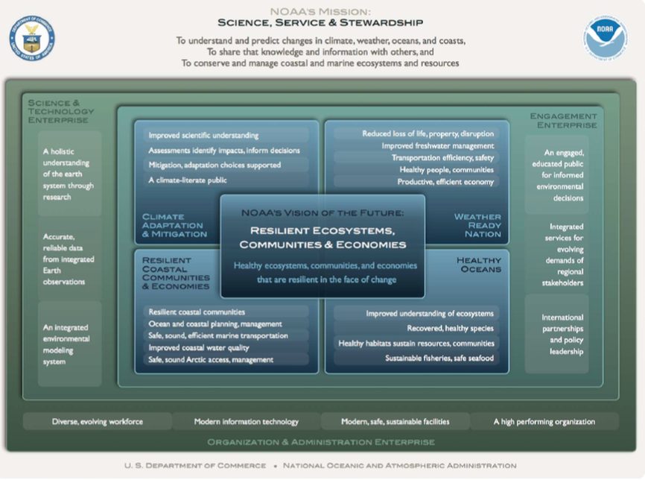
Relevance (HydroMet & MRMS)
NOAA Next Generation Strategic Plan
Overarching NOAA Goal: Weather Ready Nation
Objective: Reduced loss of life, property, and disruption from high-impact events.
Objective: Improved freshwater resource management
NOAA/OAR 5-year Research Plan (2013-2017)
R&D supporting improved prediction of high-impact events (improved observations, predictive guidance, decision support tools)
Increased hydrologic forecast skill

Slide 5
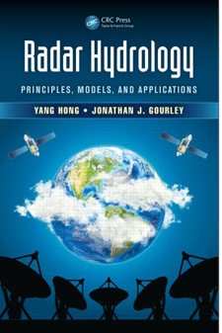
Quality
Publications (77 + book since 2009)
Awards (since 2009)
NOAA Bronze Medal (2011)
AMS Editor’s Award (2013)
Dept. of Interior Cooperative Conservation Award (2009)
NASA Robert H. Goddard Award for Exceptional Achievement in Science (2014)

Slide 6
NSSL Grand Scientific Challenges
Hydro Warnings R&D Contribution
Probabilistic guidance products Enhanced radar technology Improved flash flood prediction | Lightning warnings Observing systems for CI Probabilistic warning uncertainties
GOAL 3: Intend to achieve the proven capability to reliably predict flash flooding for both urban and complex landscapes several hours in advance
MRMS, FLASH, HWT-hydro (testing), CI-FLOW
GOAL 6: Provide grid-based probabilistic uncertainty information for high-impact weather to reduce warning false alarms
FLASH through FACETS

Slide 7
NOAA Priorities
Provide information and services to make communities more resilient
MRMS, CI-FLOW, FLASH, PARISE
Evolve the Weather Service
MRMS, FLASH
Invest in observational infrastructure
Gap filling radar studies
Achieve organizational excellence
MRMS transition to operations example

Slide 8
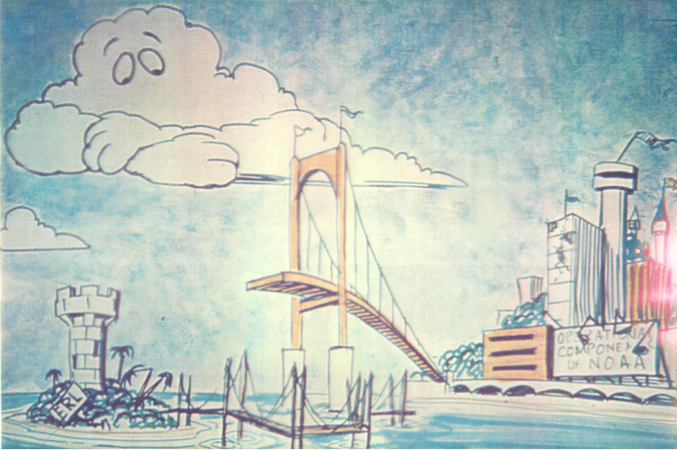
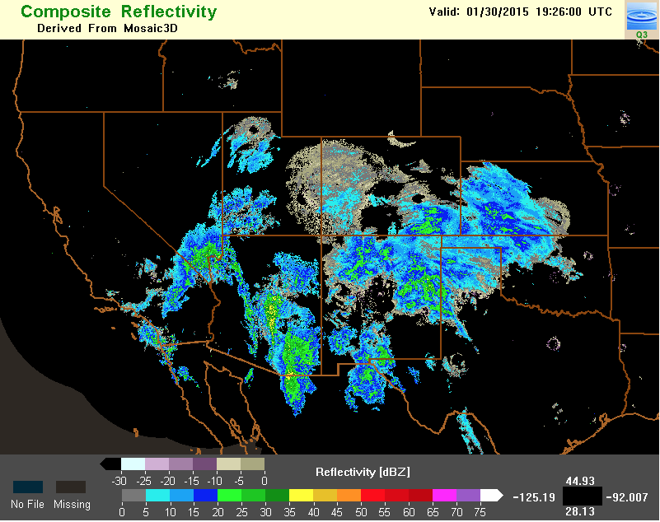
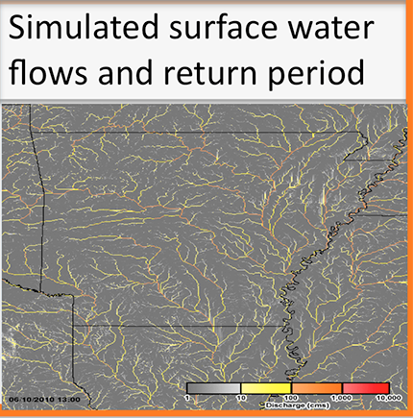
Performance, Quality, Relevance
The R2O Process: MRMS Transition – Howard
MRMS-Hydro – Zhang
Flooded Locations And Simulated Hydrographs Project (FLASH) – Gourley
MRMS-Severe – Smith
MRMS & Hydro-meteorological Research Q&A
See also electronic posters

Slide 9
Summary
Successes
MRMS & FLASH proven technologies for hydroMet
Successful MRMS transition to NWS operations
Gap filling radar technology useful in the west
Remaining Challenges
Dual-Pol application to winter/snow amounts
Continue to improve QPE nationally in all seasons

