Slide 1
CONTEXT FOR THE REVIEW
Steven Fine, Ph.D.
Deputy Assistant Administrator for Laboratories & Cooperative Institutes
Office of Oceanic & Atmospheric Research
February 25, 2015
Notes:
Thank you, Steve Koch. I appreciate the opportunity to talk with you today.
Segue: This will be a tag team affair. I’d like to set the stage by talking a bit about OAR’s role at NOAA, some efforts we have undertaken to look at how we manage NOAA’s research and development portfolio, the fiscal environment in which we are operating, and where I see OAR heading in the future.
Steve will then follow with more details regarding the State of PMEL today.

Slide 2
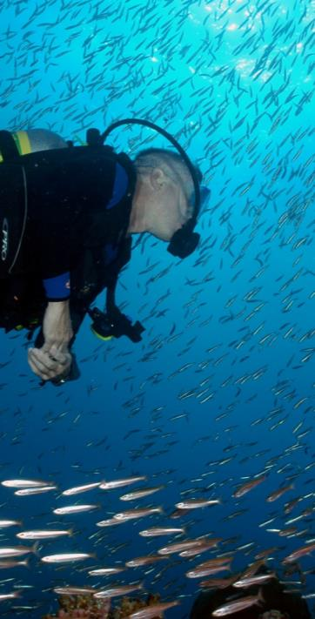
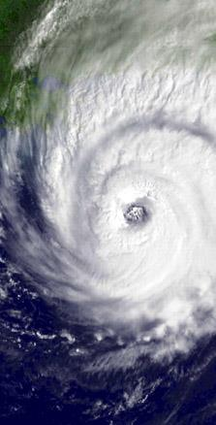
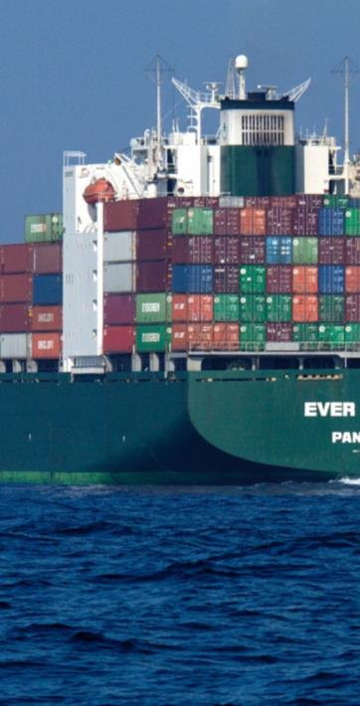
NOAA’S NEXT GENERATION STRATEGIC PLAN GOALS
Healthy Oceans
Weather Ready Nation
Climate Adaptation & Mitigation
Resilient Coastal Communities & Economies
SCIENCE & TECHNOLOGY
Notes:
NOAA’s mission is to understand and predict changes in the Earth’s environment, to conserve and manage coastal and marine ecosystems and resources, and to share that knowledge and information with others to meet our Nation’s economic, social, and environmental needs. NOAA Research is at the heart of NOAA’s research and development enterprise and is the innovation engine for achieving NOAA’s strategic vision and long-term goals.
NOAA’s Long-Term Mission Goals:
Healthy Oceans
Marine fisheries, habitats, and biodiversity that are sustained within healthy and productive ocean ecosystems
Weather Ready Nation
A society that is prepared for and responds to weather-related events
Climate Adaptation & Mitigation
An informed society anticipating and responding to climate and its impacts
Resilient Coastal Communities and Economies
Coastal and Great Lakes communities are environmentally and economically sustainable
In addition to the four thematic mission goals, NOAA also recognizes the inherent need for support. This is captured in the NOAA Enterprise Objectives: Science and Technology, Engagement, and Organization and Administration. Underpinning the S&T Enterprise are a holistic understanding of the Earth system through research, accurate and reliable data from integrated earth observations, and an integrated environmental modeling system.
NOAA is essentially America’s Environmental Intelligence Agency with global activities on land and sea, in the air and in space. NOAA relies on science partnerships to achieve our mission. NOAA partnerships span academic and industry sectors as well as other government agencies. These critical relationships improve relations with our customers, build reliable interconnected data sources, and support NOAA’s mission.

Slide 3
America’s Environmental Intelligence Agency: 2014 - 2018 Priorities
MONITORING
MODELING
OBSERVATIONS
ASSESSMENT
FORECAST &
PRODUCTS
Provide information and services to make communities more resilient
Evolve the Weather Service
Invest in observational infrastructure
Achieve organizational excellence
Notes:
The scientists at NOAA Research are among the most innovative in the world. We contribute to the American people daily by providing outstanding science innovation and products, enabling NOAA to be a leading provider of environmental intelligence in the atmosphere, weather, oceans, and climate. Dr. Sullivan sees "environmental intelligence" at the core of our mission, and as you should be aware, has outlined NOAA’s four high level priorities:
Provide information and services to make communities more resilient
Evolve the Weather Service
Invest in observational infrastructure
Achieve organizational excellence
Images:
Observations: GOES-R satellite
Monitoring: DART Buoy
Assessment: NOAA Diver collecting data on corals.
Modeling: GFDL model on sea surface temperature
Forecast & Products: NWS forecast alerts of severe storms and flooding.

Slide 4
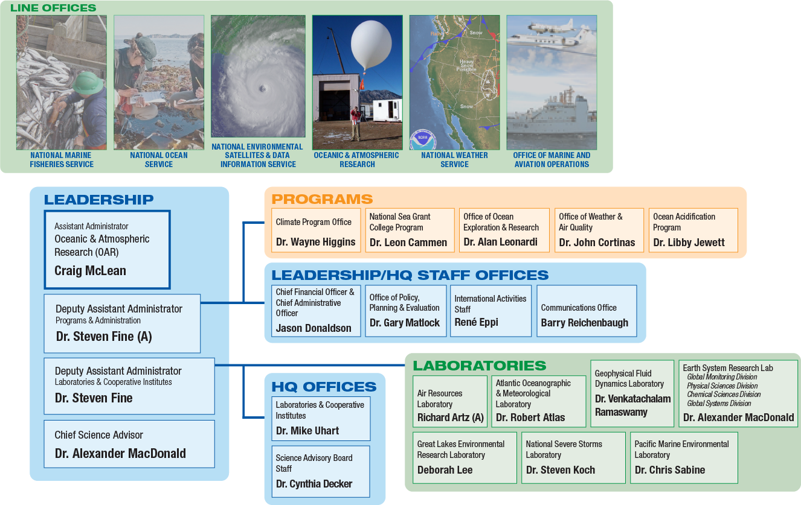
NOAA’S ORGANIZATION

Slide 5
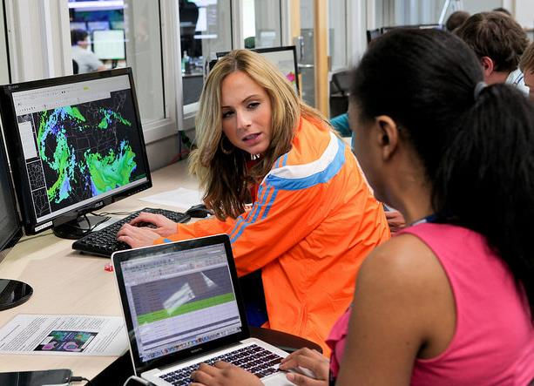
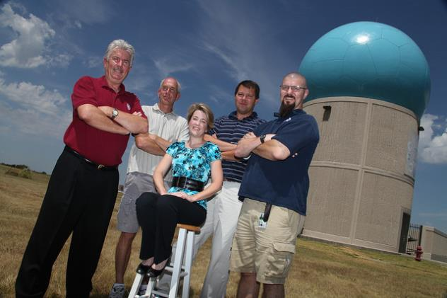
OAR’S VISION & MISSION
To be a trusted world leader in observing, modeling, understanding and predicting the Earth system.
To conduct research to understand and predict the Earth system; develop technology to improve NOAA science, service and stewardship; and transition the results so they are useful to society.
VISION
MISSION
Notes:
Main Message: Preeminent research is at the center of all NOAA Services.
OAR Vision: Be a trusted world leader in observing, modeling,
understanding and predicting the Earth system. (per OAR ???? 2014 Strategic Plan)
OAR Mission: Conduct research to understand and predict the
Earth system; develop technology to improve
NOAA science, service and stewardship; and
transition the results so they are useful to society. (per OAR ???? 2014 Strategic Plan)
OAR specializes in improving operational capabilities, and improving our understanding of the Earth system across NOAA’s mission areas. OAR conducts R&D that increases our knowledge of climate, weather, oceans and coasts, and it increases the effectiveness of NOAA’s service lines, as well as a great range of partners in the public, private, and academic sectors.
The science and technology that OAR produces and transfers to partners
(in NOAA’s service lines and beyond) is instrumental to preventing the loss of human life, managing natural resources, and maintaining a strong economy.
Vision Image: A forecast for the tsunami caused by a magnitude-8.9 earthquake that struck off the coast of Japan on March 11, 2011. Heat-map colors show maximum tsunami height within the first 24 hours.
Mission Image: 4th generation monitoring system DART-ETD (Easy to Deploy) buoy. An improved pressure sensor on this model will be able to detect and measure a tsunami closer to the earthquake source providing valuable information to warning centers even faster.

Slide 6
POWER OF PARTNERSHIPS
Labs
Programs
Partners
Key OAR Partners: Cooperative Institutes and Sea Grant Programs
Notes:
Main Message: OAR is unique within NOAA and compared to many other Federal science agencies in that it supports research: (1) at “in-house” laboratories; (2) through programs; and (3) through partners with funding through our Cooperative Institutes, Sea Grant College Program, RISAs, and Competitive Grants.
In all cases they are supporting goal-oriented research aimed at improving NOAA’s ability to meet its mission requirements.
Why have labs?
• to maintain highly specialized, unique expertise in key areas over many years (e.g. weather radars)
• to translate research results into applications and operations to address NOAA’s mission requirements (e.g. products such as HWRF or HRR for the NWS; DART buoys)\)
• to conduct long term monitoring of ocean and atmosphere and contribute to regional and national assessments (e.g. GOOS, GMD, IPCC)
Why have programs?
• to foster collaboration across NOAA, with other Federal agencies and with the University community (e.g. Sea Grant, CPO)
• to provide a focus on specific topics and emerging areas of research (e.g. OA)
• to execute programs specifically authorized by Congress (e.g. OER, OWAQ)
Why have partners?
• to provide OAR access to expertise and technical capabilities it doesn’t have in-house (e.g. social sciences)
• to provide flexibility to rapidly shift priorities and increase or decrease staffing levels
• to provide access to students, post-docs and early career scientists that continually bring new blood and fresh ideas to OAR

Slide 7
COOPERATIVE INSTITUTES
Are NOAA supported, non‐federal organizations located at degree-granting institutions whose research reinforces NOAA’s mission and priorities
Are often colocated and collaborate directly with NOAA’s diverse research communities, programs and labs
Have portfolios ranging from satellite climatology and fisheries biology to atmospheric chemistry and coastal ecology
Provide complementary scientific expertise
Widen pool of young scientists in topics of interest to NOAA

Slide 8
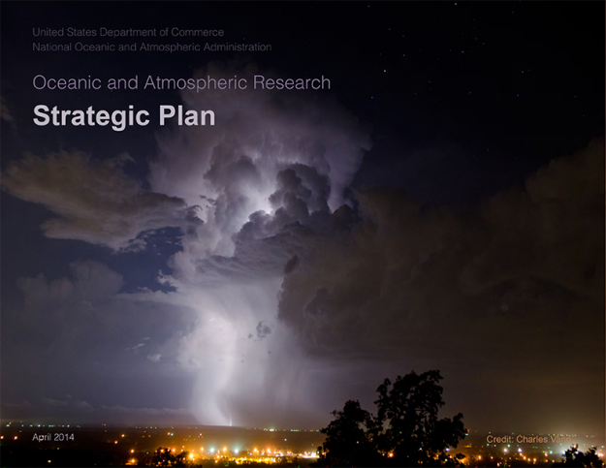
NSSL RESEARCH DRIVERS
LEGISLATIVE DRIVERS
National Weather Service Organic Act (15 U.S.C. §313)
United States Weather Research Program (USWRP), (15 U.S.C. § 313c)
Windstorm Impact Reduction, (42 U.S.C. § 15701-15707)
Meteorological Services to Support Aviation (49 U.S.C. 44720)
Weather Impact Reduction, 42 U.S.C. § 15701-15707)
POLICY DRIVERS
Weather Bureau Technical Note 2-NSSL23 (1964)
National Research Council - Completing the Forecast: Characterizing and
Communicating Uncertainty for Better Decisions Using Weather and Climate Forecasts (2006)
NOAA Next Generation Strategic Plan (2010)
NWS Strategic Plan (2011)
National Research Council Report: Weather Services for the Nation: Becoming Second to None (2012)
National Academy of Public Administration (for the U.S. Congress): Forecast for the Future: Assuring the Capacity of the National Weather Service (2013)
OAR Strategic Plan (2014)
Annual Report of the UCAR Community Advisory Committee for NCEP (2013)
Memorandum of agreement for scientific collaboration between the UK Met Office (Met Office) and the U.S. NOAA/OAR/National Severe Storms Laboratory (2014)
Notes:
Main Message: NSSL is responsive to a variety and number of external policy and legislative drivers.

Slide 9
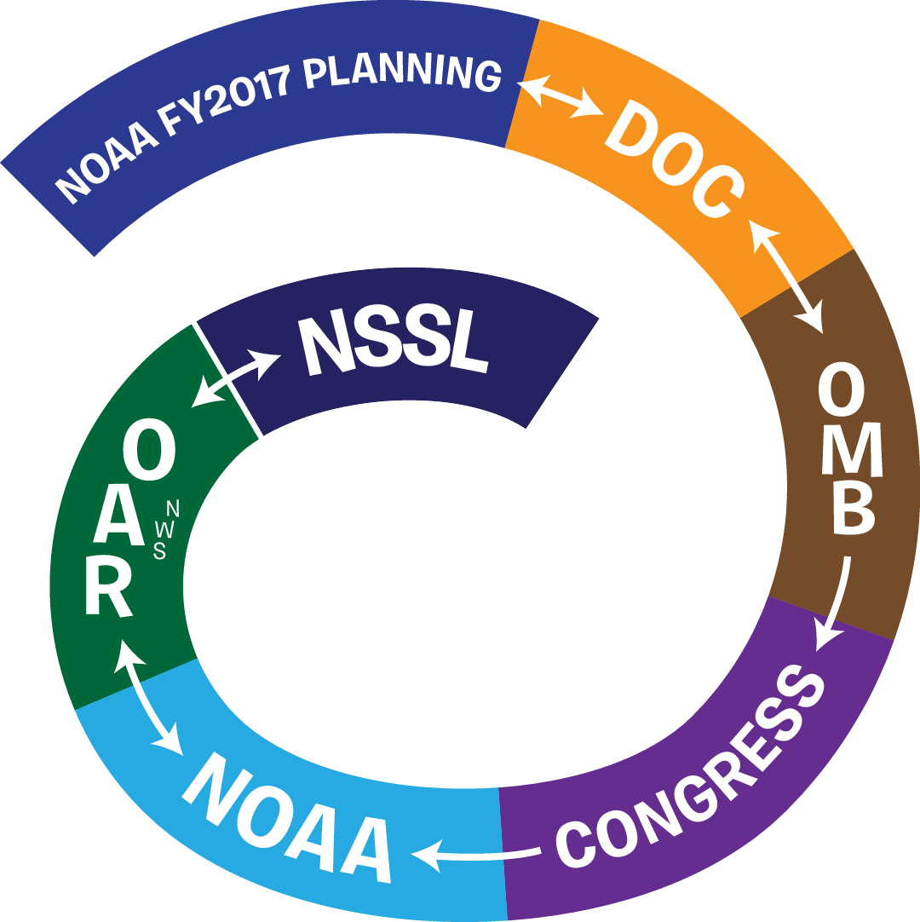
NOAA’S FUNDING PROCESS
Notes:
OAR Budget Documents:
Budget documents prepared 1-1.5 years in advance
Describe activities that will be performed
Include performance measures and milestones
E.g., “Number of tools, technologies, and information systems developed to enhance NOAA’s observing, forecasting or management responsibilities. ”
“Continuation of the unique 14-year characterization of ecosystems and physical , chemical, and biological ocean environment processes that impact them within the NOAA NeMO Seafloor Observatory at Axial Volcano. ” and “Build and deploy the first ever device for collecting the gas discharge from an actively erupting submarine volcano (West Mata). ”
OR
E.g., “Number of tools and technologies developed and transitioned to increase tsunami forecast accuracy and timeliness. (Cumulative) “
“Complete & Integrate Tsunami Forecast Models into the Tsunami Forecast System developed for NOAA/NWS Tsunami Warning Centers.”

Slide 10
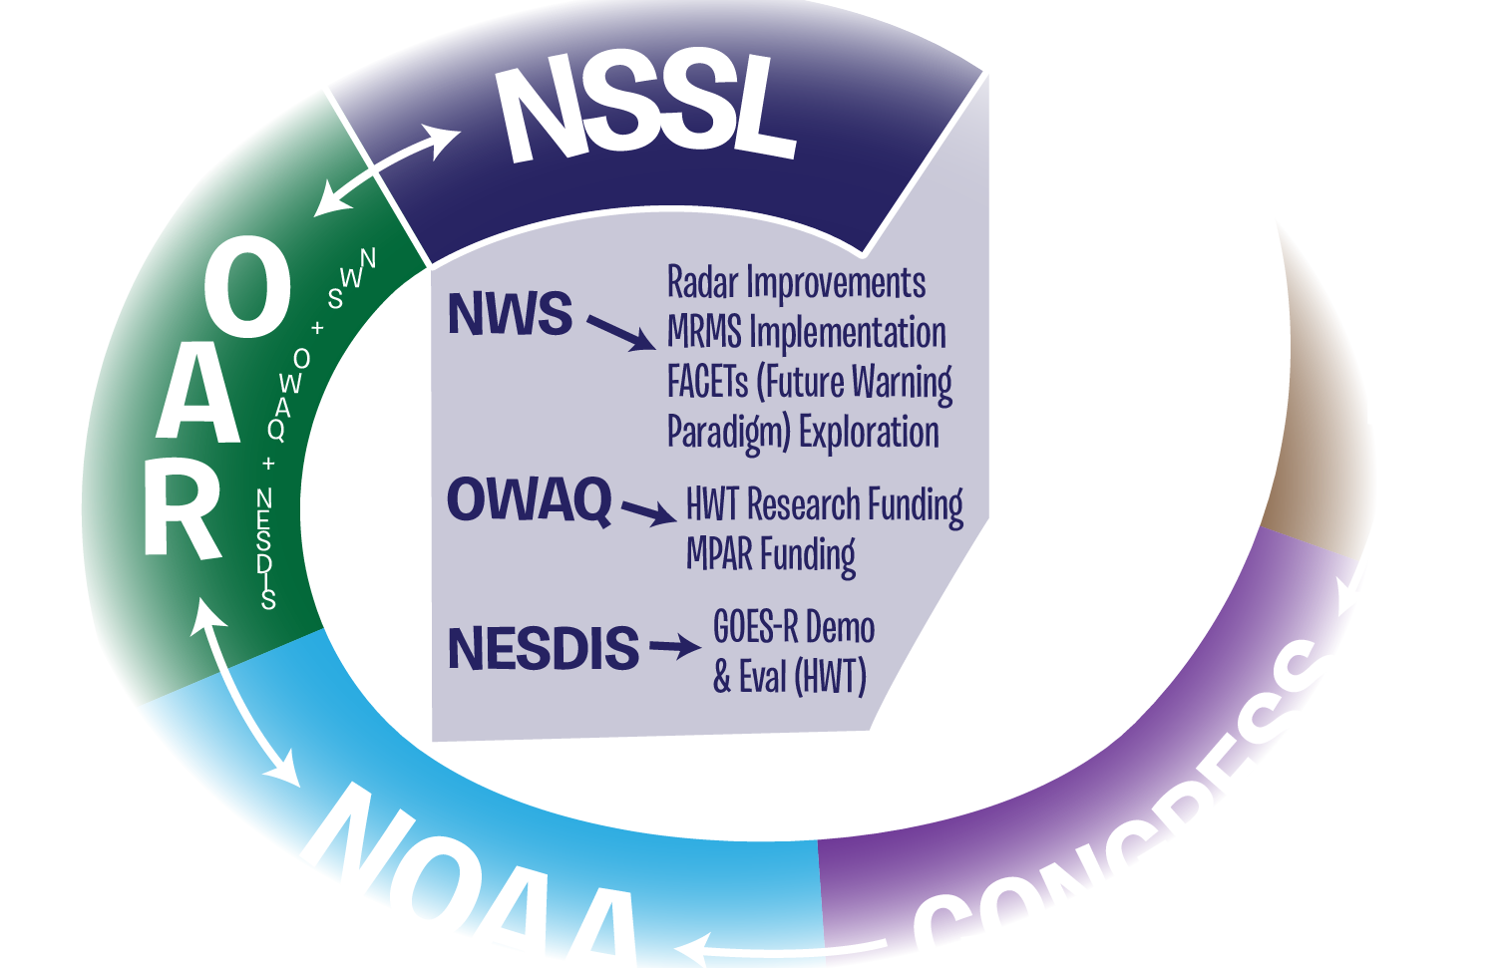
NOAA’S FUNDING PROCESS
Notes:
NWS
-> Radar Improvements
-> MRMS Implementation
-> FACETs (Future Warning Paradigm) Exploration
Office of Weather & Air Quality (OWAQ)
-> HWT Research Funding
-> MPAR Funding
NESDIS
-> GOES-R Demo & Evaluation (HWT)

Slide 11
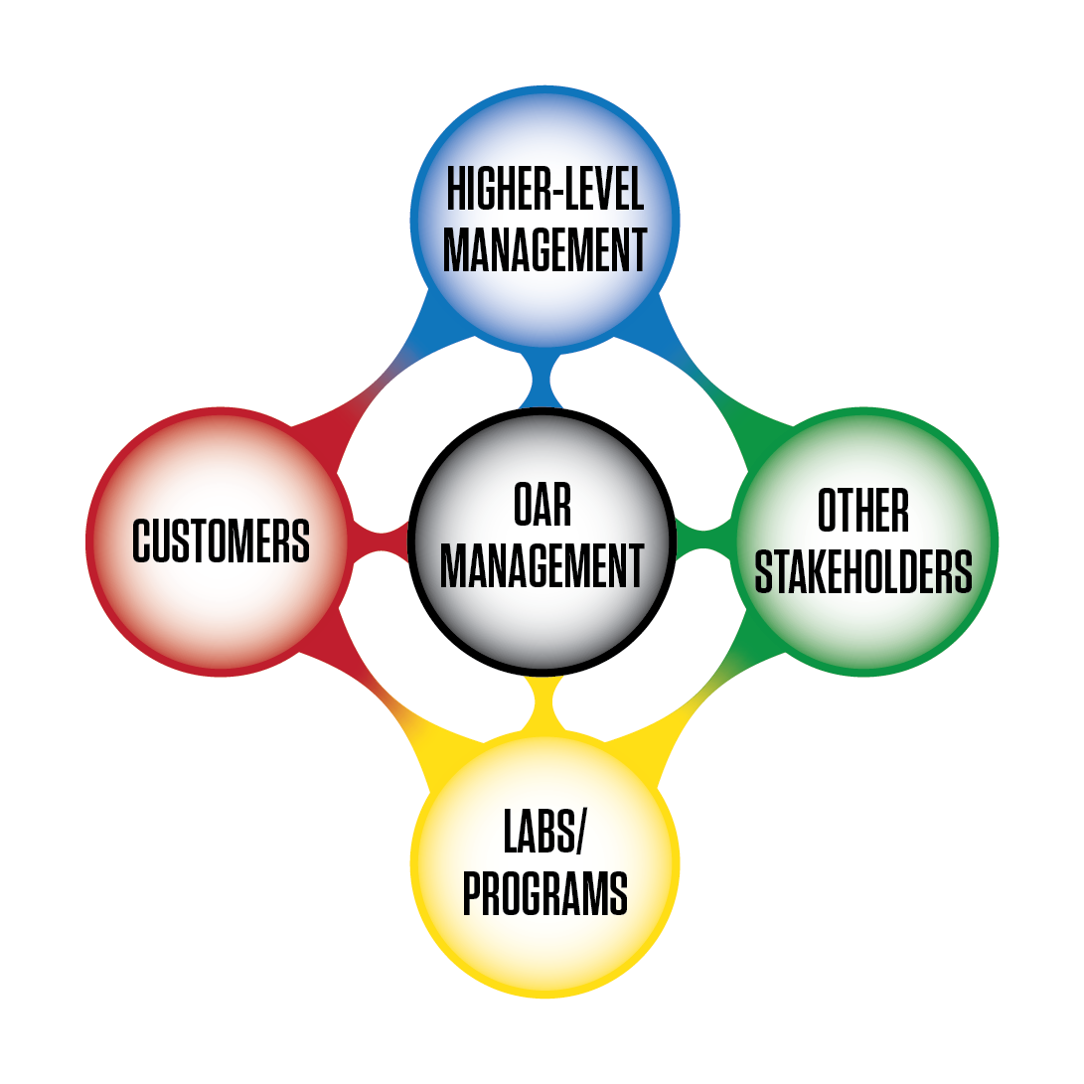
NOTIONAL APPROACH TO PLANNING R&D
Various balances of
input from top and bottom
Notes:
Strategic Documents:
- DOC Strategic Plan
- NOAA Next Generation Strategic Plan
Includes evidence of progress
E.g., “Improved basis for confidence in understanding key oceanic, atmospheric, hydrologic, biogeochemical, and socioeconomic components of the climate system and impacts”
- NOAA Five-Year Research Plan 2013-2017
Includes 5-year targets
E.g., “Assess the climate influences of ocean basin properties
on interannual and decadal predictability”
- OAR Strategic Plan
- Laboratory Strategic Plan
Annual Plans and other guidance:
NOAA Annual Guidance Memorandum
Annual Operating Plans with -
Performance Measures
E.g., “Cumulative number of data collection platforms deployed by PMEL in support of the Global Ocean Observing System (GOOS)” or “Number of tools and technologies developed and transitioned to increase tsunami forecast accuracy and timeliness.”
Milestones
E.g., “Deploy 40 Argo floats” or “Implement next version of tsunami forecast software at NOAA Tsunami Warning Centers”
Individual Performance Plans
Short-term funding opportunities
Guidance for Changes in Funding Levels
E.g., Maintain long-term observations, intermural-extramural balance
Other guidance—e.g., accelerate/enhance transition of research to applications, ecosystem forecasting

Slide 12
CHARGE TO REVIEWERS
QUALITY: Assess quality of lab’s R&D
RELEVANCE: Assess lab’s R&D relevance to NOAA’s mission & value to Nation
PERFORMANCE: Assess overall effectiveness of lab’s plans & R&D in meeting NOAA’s Strategic Plan objectives & Nation’s needs
Notes:
Quality Image: Employee during HWT 2013
Relevance Image: Mobile lab positioned safely ahead of forming tornado
Performance Image: Pam Heinselman and Dave Priegnitz scan tornadic storms with the phased array radar not far from NSSL

